Slide 1
The Fermi Gamma-ray Space Telescope
Liz Hays
NASA GSFC

Slide 2
Lecture Plan
The Fermi Observatory
Science Motivation
Instruments
Detecting gamma rays with the Large Area Telescope
Instrument Subsystems
Angular resolution
Energy resolution
Science Highlights
Outlook

Slide 3
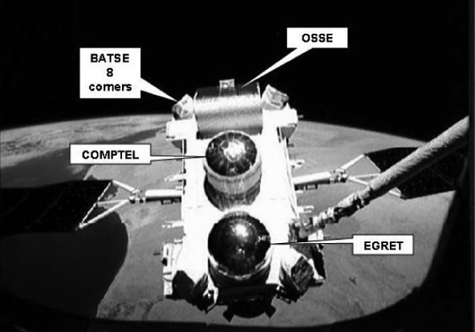
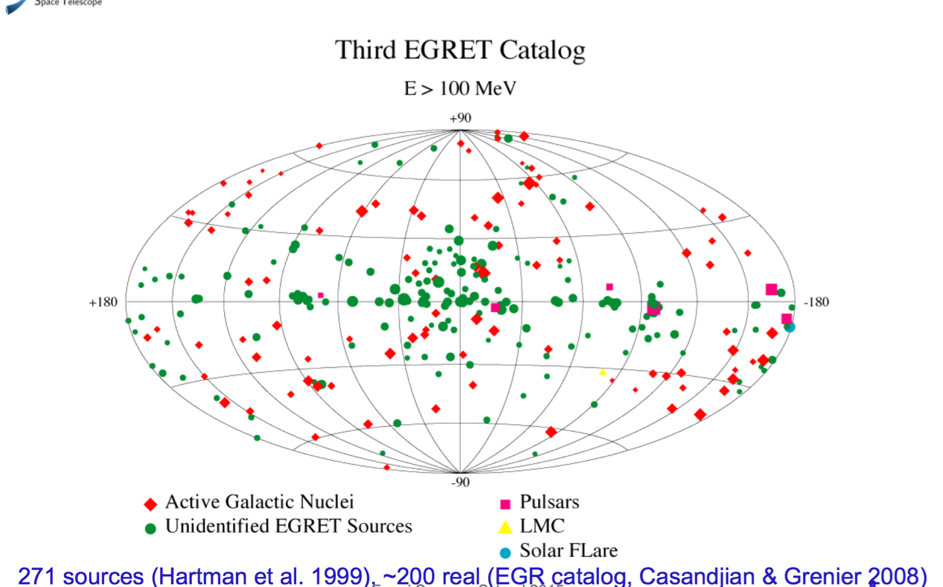
Science Motivation: EGRET Legacy
Strongly variable active galactic nuclei (blazars)
Pulsars
Galactic and Extragalactic diffuse emission
Large Magellanic Cloud
Many TBD…

Slide 4
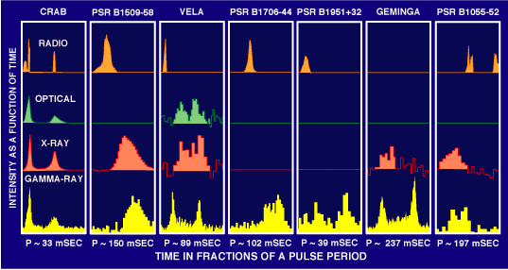
Science Motivation: Gamma-ray pulsars

Slide 5
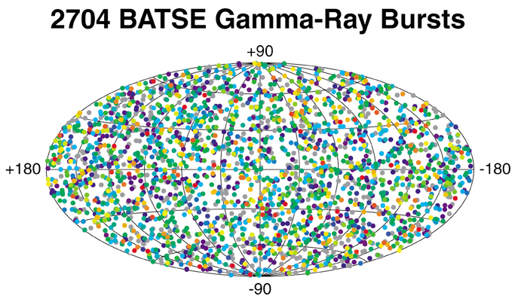
Science Motivation: Gamma-ray Bursts

Slide 6
Fermi Science Objectives
Explore the most extreme environments in the Universe, where nature harnesses energies far beyond anything possible on Earth.
Search for signs of new laws of physics and what composes the mysterious Dark Matter.
Explain how black holes accelerate immense jets of material to nearly light speed.
Help crack the mysteries of the stupendously powerful explosions known as gamma-ray bursts.
Answer long-standing questions across a broad range of topics, including solar flares, pulsars and the origin of cosmic rays.

Slide 7
Lessons from the 90s for Fermi
The high-energy sky is dynamic. Need sensitive monitoring to know where and when to look for flares and gamma-ray bursts.
Increased angular resolution is critical for interpreting the gamma-ray sky.
Many questions require emission above 1 GeV, where EGRET’s sensitivity dropped.
More, possibly many more, gamma-ray pulsars expected and some may be gamma-ray only, some may be millisecond pulsar – timing precision necessary.
Multiwavelength studies are critical to extracting science!

Slide 8
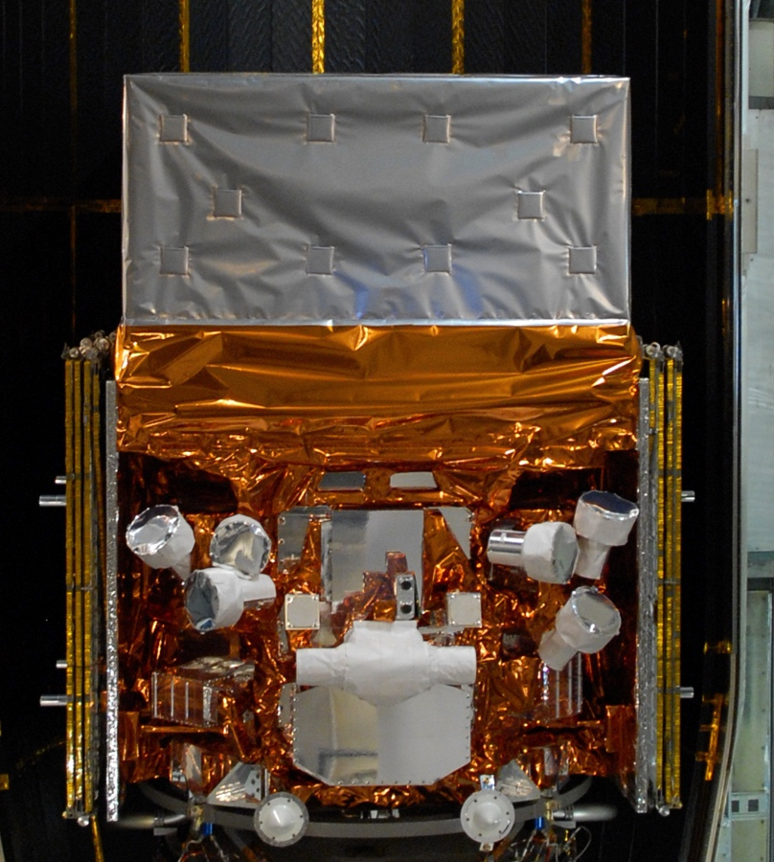
The Fermi Observatory
Large Area Telescope (LAT)
Large field of view (>2.4 sr)
Entire sky every 3 hrs (every 2 orbits)
Broad energy range
(20 MeV - >300 GeV)
Gamma-ray Burst Monitor (GBM)
Views entire unocculted sky
NaI: 8 keV - 1 MeV
BGO: 150 keV - 40 MeV

Slide 9
Gamma-ray Telescopes: basic considerations
So, it’s a box?
Non-focusing counting experiments
Materials
Radiation physics guides the gamma-ray interaction and can play a role in sensing interaction products.
Sensors and electronic read out
Determine limits for signal sensitivity, spatial and timing information.
Configuration
Size, spacing, and relative placement of materials and sensors tune performance.
Backgrounds are large; details depend on energy range.
Observe from space! (Up to energies that can invoke the atmosphere itself as a detector medium.)
A box filled with special stuff!
A box filled with special stuff mixed with tiny, hot things.
A box of obsessively arranged special stuff mixed with tiny, hot things.
Oh, and there’s a bunch of junk that you didn’t order whizzing around in your box.
Notes:
Gamma-ray astronomy is the art of putting something destructive in the way of the gamma-ray signal and then getting creative about interpreting what happens back into position, energy, time, and potentially polarization information. Coded-mask, occultation/shadowed counters, Compton trackers, pair conversion trackers. Even the ground-based techniques.

Slide 10
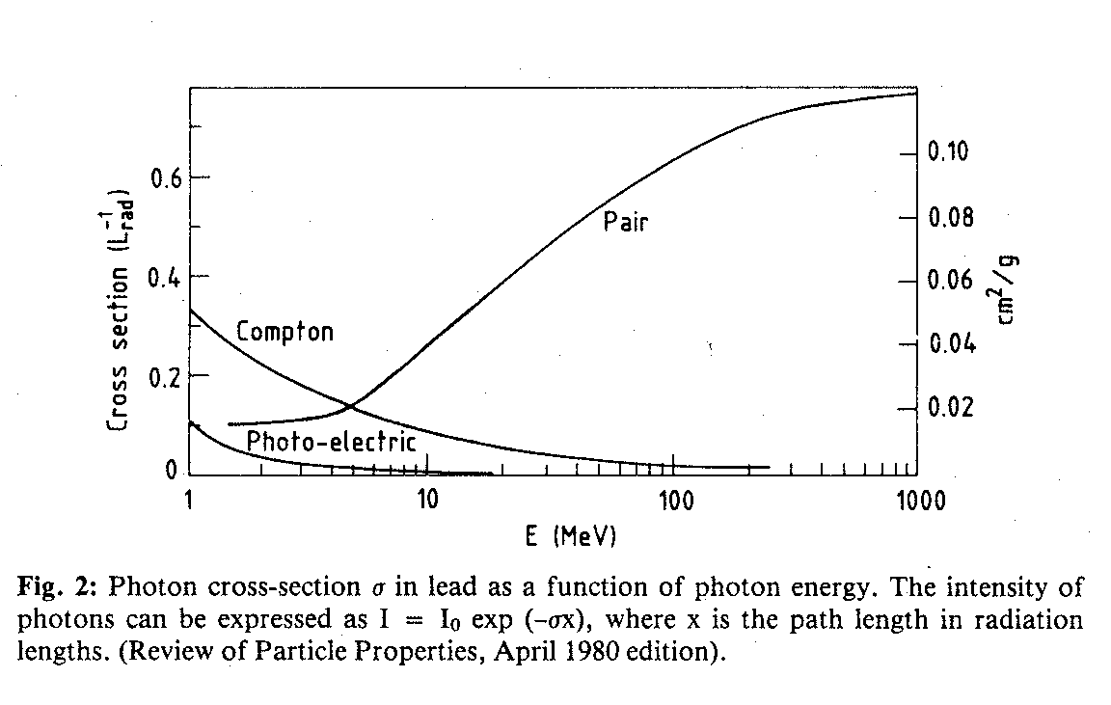
Gamma-ray Energy Loss Mechanisms
For photons with energy > ~10 MeV pair conversion is the dominant energy loss mechanism in matter.
Pair Cross-Section
saturates at E_{γ} > 1 GeV

Slide 11
Pair Conversion Telescope Basics
γ
Gamma ray converts to
an e⁺ e⁻ pair in a high density foil layer.
An anti-coincidence shield vetos
incoming charged particles.
The tracks of charged
particles in the instrument are recorded by sensors.
e⁺
e–
The photon energy is determined from measured energy deposited in the calorimeter.
The tracks are used to determine the direction of the gamma-ray source.

Slide 12
Pair Conversion Components
Tracker: Must have sufficient position resolution and conversion efficiency to produce and then track the electron and positron pair to determine gamma-ray direction.
Must balance competing, energy-dependent effects
conversion efficiency => Thick conversion foils, or many foils
multiple scattering (at low energies) => thin conversion foils
position resolution (at high energies) => fine pitch detectors
Calorimeter: Must be deep enough (have sufficient radiation lengths, X₀) to absorb most of the shower energy.
Anti-coincidence detector: Must have very high efficiency for rejecting charged particles, but not reject gamma rays

Slide 13
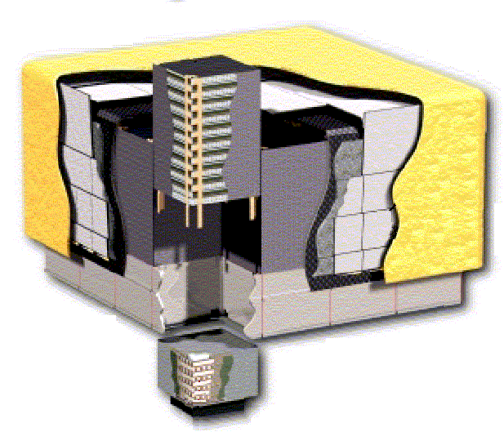
The Fermi Large Area Telescope
A box of boxes!
Overall LAT Design:
4x4 array of identical towers. Size: 1.8 m × 1.8 m × 1.0 m.
Mass: ~3000 kg Power: ~650 W
γ
Tracker
Precision Si-strip Tracker (TKR)
18 XY tracking planes. 228 μm pitch.
Good position resolution => good ang. resolution at high energy
12 layers Tungsten 0.03 X₀ (front) => reduce multiple scattering.
4 layers Tungsten 0.18 X₀ (back) => increase sensitivity >1GeV
CsI Calorimeter(CAL)
Array of 1536 CsI(Tl) crystals in 8 layers.
Hodoscopic => Cosmic-ray rejection, shower leakage correction.
Depth of 8.5 X₀ => Shower max contained <100 GeV
Anticoincidence Detector (ACD)
Shell of 89 plastic scintillator tiles => minimize self veto
e⁺
e–
Calorimeter
Anti-coincidence Detector
Systems work together to identify and measure the flux of cosmic gamma rays with energy 20 MeV - >300 GeV.

Slide 14
LAT Instrument Subsystems
γ
Tracker
Tracker (TKR)
Convert gamma ray into electron positron pair
Measure direction
Provide trigger input
Calorimeter (CAL)
Convert pair into EM shower
Measure energy
Provide trigger input
Anticoincidence Detector (ACD)
Reject charged particle background
Provide trigger input
Onboard trigger and filter system acts as an additional subsystem, combining outputs to use subsystems together in flight.
e⁺
e–
Calorimeter
Anti-coincidence Detector

Slide 15
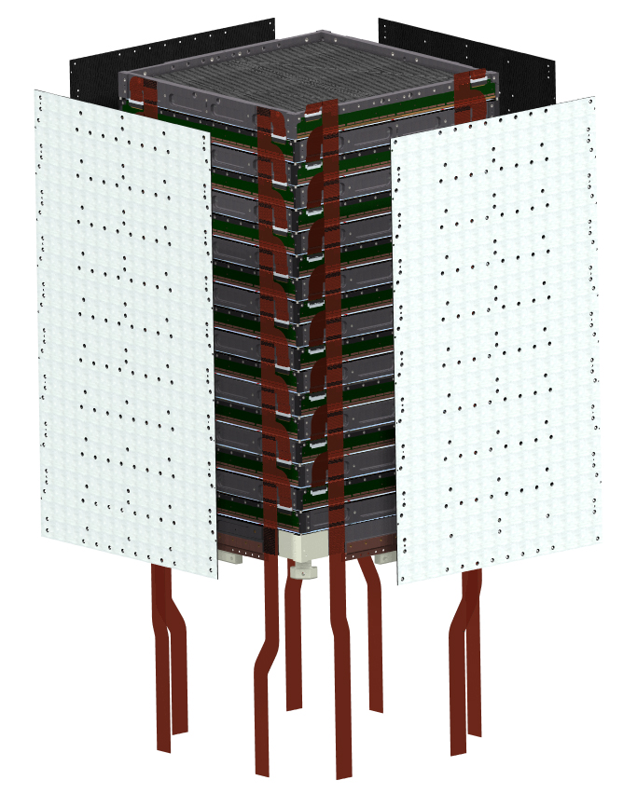
Silicon Tracker Design
Single Tracker Module
1 of 16 total
Job: Convert gamma-ray. Provide input for the gamma-ray trigger. Measure direction.
How: Silicon strip detectors (SSDs) record X-Y position of charge deposited by converted electron and positron pair.
Considerations
18 bi-layers (x,y planes) with SSDs of thickness 400 μm and pitch of 228 μm.
Tracker layers are distinguished by thickness of associated Tungsten conversion foils.
Front: 12 thin layers (0.03 X₀)
Back: 4 thick layers (0.12 X₀)
Last 2 layers without conversion foil.

Slide 16
Tracker Configuration and Angular Resolution
Αssume γ converts ½ way through the Tungsten layer
Tungsten Convertor Foil
Minimize separation to reduce multiple scattering (elastic Coulomb scattering on nuclei) effects at lower energy.
Minimize SSD strip pitch to enhance angular resolution at higher energy
Si Strip Detector plane (X and Y)
d
Trim convertor foil to
match active SSD area.
Plane-to-plane spacing d and SSD strip pitch set the measurement precision limit.
Close spacing of convertors
to SSDs to minimize multiple
scattering effects.
Position resolution σ_{ssd} = strip pitch/√12
θ_{det} = √2 σ_{ssd}/d = 228 μm/(32.9 mm x √6) = 2.8 mrad = 0.16°
Notes:
Fix this one

Slide 17
Optimizing the Tracker Design
Tracker design determines the field of view, angular resolution, and effective area of the instrument
Thick convertors provide better effective area but worse angular resolution
Larger spacing between tracker planes improves angular resolution but decreases the field of view
Thin front and thick back convertor sections provide a balance between good effective area and good angular resolution
Ideal tracker? Both conversion and high-resolution position measurement can be done by a gas-based time projection chamber, but this has some practical limitations.

Slide 18
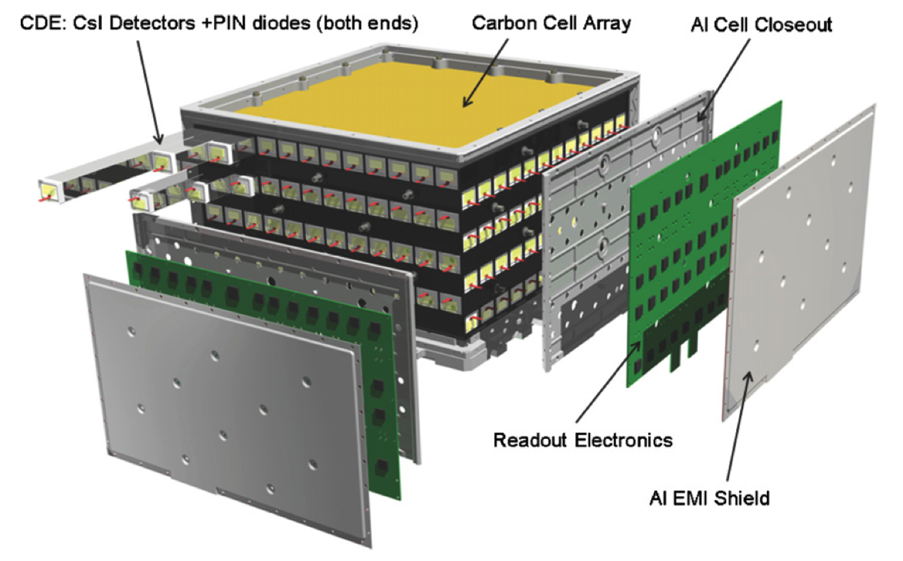
Calorimeter Design
Job: Measure energy. Provide trigger input.
How: Relativistic charged particles produce scintillation light in CsI(Tl) crystals. Light is collected by PIN diodes placed at each end of a crystal log.
Considerations
Depth in radiation lengths of 8.6 X₀ on-axis (compared to 1.5 X₀ for tracker)
Induce and contain an electromagnetic shower
Not all energy is contained with increasing losses with increasing energy
Modules are segmented in layers and rows to measure the size and development of the shower
Single Calorimeter Module
1 of 16 total
Notes:
Check David’s thesis for profile graph

Slide 19
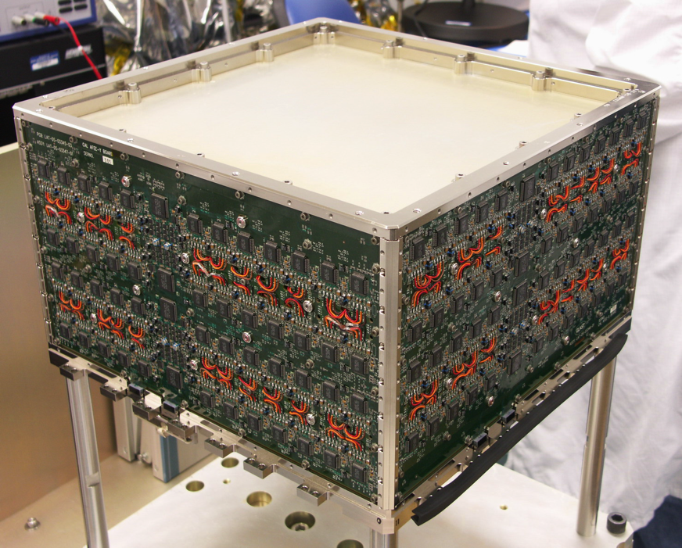
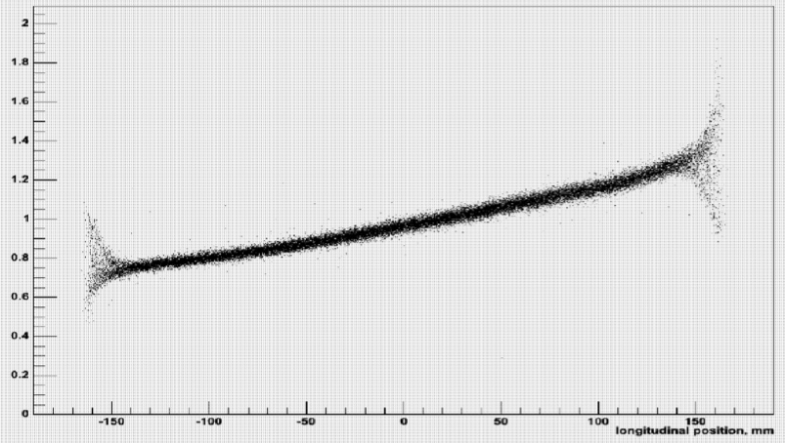
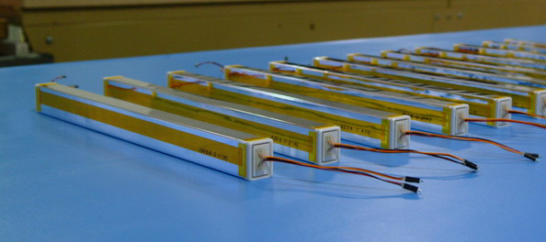
The Calorimeter
Each module (16 total, 1 per tower) contains 8 orthogonally alternating layers of 12 crystal logs
Total light output measures energy deposited in each crystal log.
Ratio of light measured at ends gives position along length of the crystal for 3D imaging of the shower.
Radiation damage gradually reduces light output but calibration is adjusted annually to compensate.
End-to-End Light Ratio

Slide 20
Imaging the Deposited Energy
In addition to measuring shower energy the LAT Calorimeter also images the shower
Asymmetry of light collected at crystal ends can be used to reconstruct a 3-D coordinate for the energy deposit – can be used to build a 3-D image of the shower
Imaging aids reconstruction of the initial gamma ray and distinction from cosmic-ray events
Major axis of CAL shower provides an initial direction for track reconstruction in the TKR
Helps in evaluation of leakage correction for energy reconstruction
Consistency between TKR and CAL directions used for background rejection
Shower Topology – another useful background rejection parameter; electromagnetic showers from gamma rays are generally smoother and more confined along the particle trajectory than hadronic showers from protons and nuclei.

Slide 21
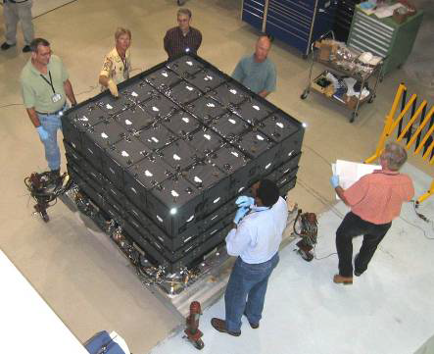
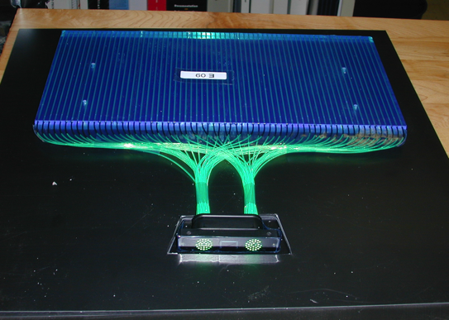
Anticoincidence Detector
Job: reject charged particle background .
How: Shell detects time and coarse direction of cosmic-ray particles and nuclei entering the tracker from above and sides. Photomultiplier tubes collect light produced in 89 plastic scintillator tiles.
Considerations
>99.97% efficient.
Scintillating fiber covers gaps between rows.
Segments reduce unwanted vetos caused by scattered charged particles produced in higher energy gamma-ray showers.

Slide 22
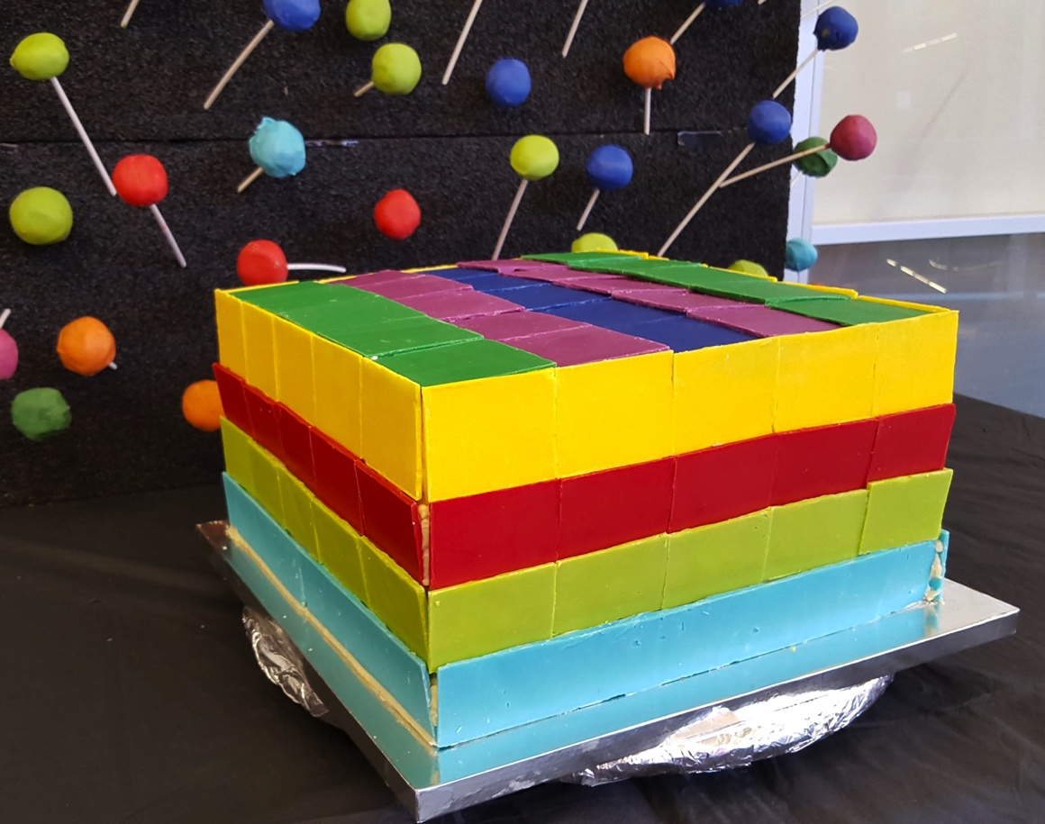
The edible ACD
This did not pass requirements, but it tasted great!
Notes:
Hermeticity is hard…

Slide 23
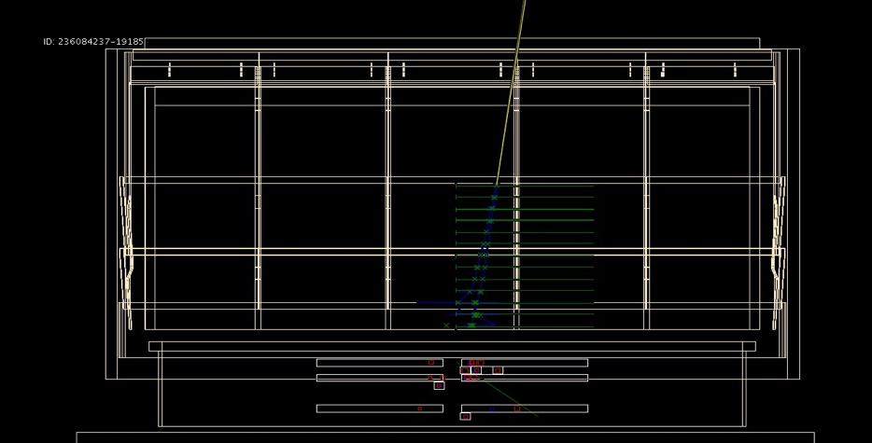
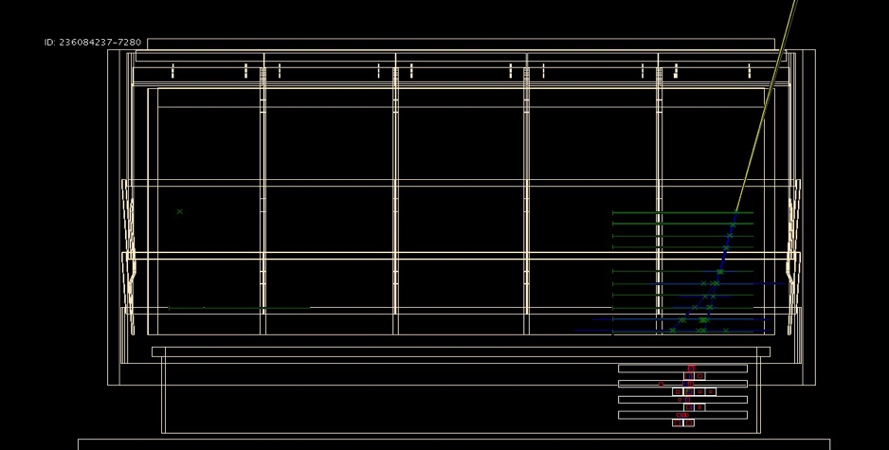
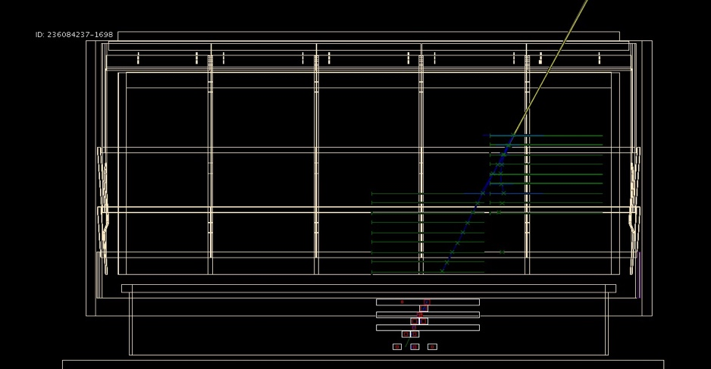
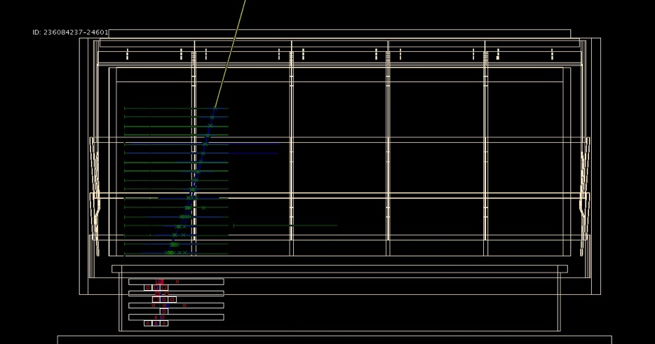
Candidate Gamma-ray Events
Green crosses --> detected positions of the charged particles Blue lines --> reconstructed track trajectories
Red crosses --> detected energy depositions in the cal. Yellow line --> estimated direction of candidate gamma ray

Slide 24
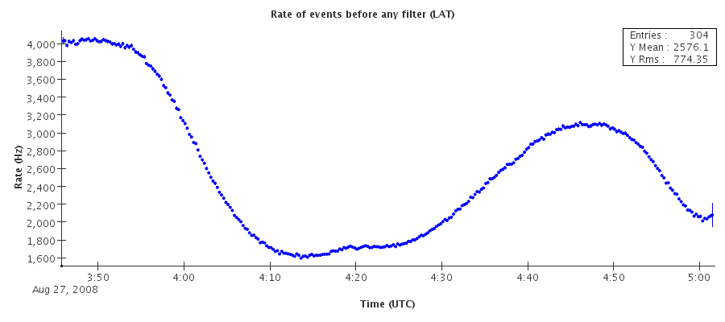
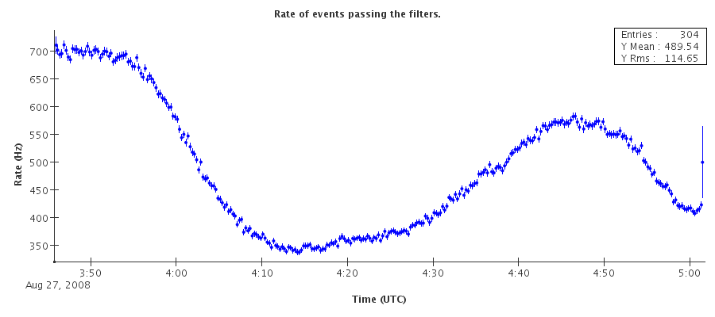
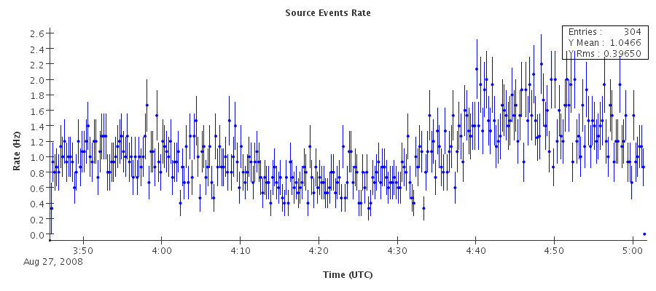
On-orbit Event Rates
Triggered event rate
Trigger rate: ~few kHz
Huge variation in backgrounds over orbit
Downlinked rate: ~400-500 Hz
~90% from gamma filter
~20-30 Hz from diagnostic filter
~5 Hz from heavy ion filter
Photon-selected rate: ~1 Hz
Passes least restrictive background rejection and quality selection cuts
Downlinked event rate
Photon rate
75 min

Slide 25
LAT Performance
Effective Area, Acceptance, and Sensitivity
Angular Resolution
Energy Resolution

Slide 26
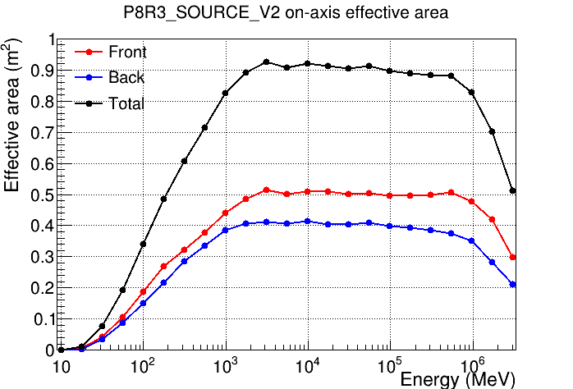
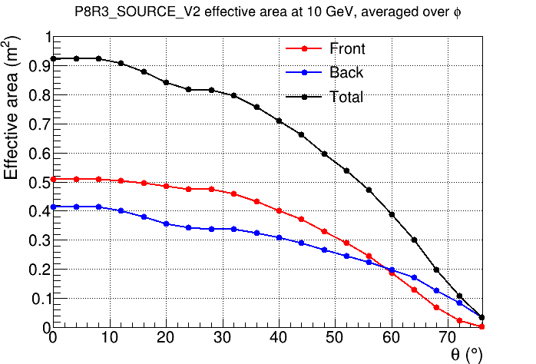
Effective Area
# detected gammas = Source flux * effective area
Effective area = physical area * detection efficiency
EGRET
Inclination angle
Effective area increases rapidly up to 1 GeV.
Photons detected out to 65-70 deg from the LAT boresight.

Slide 27
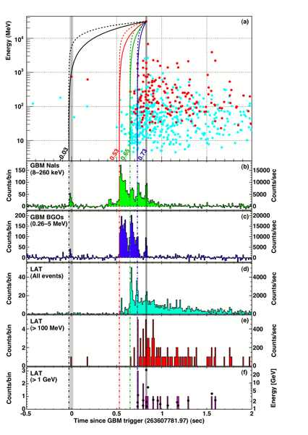
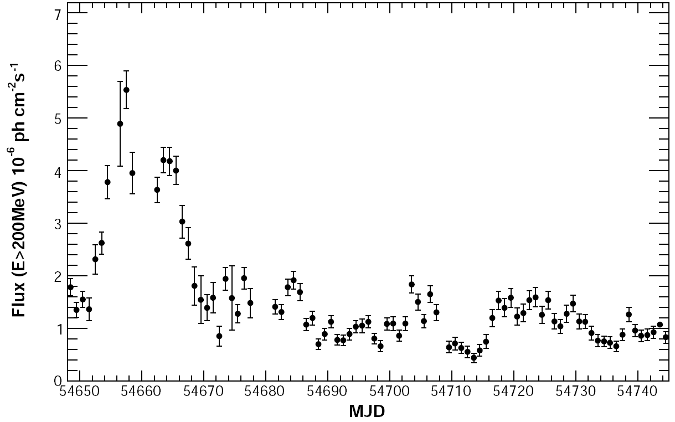
Effective area
Larger effective area means more gamma-rays are detected at a given source brightness in a given interval.
Important for variability measurements
A typical minimum integration for bright source is a day, but can be shorter for the brightest sources. Minutes for brightest flares (3C 279); Seconds for GRBs
Blazar 3C 454.3

Slide 28
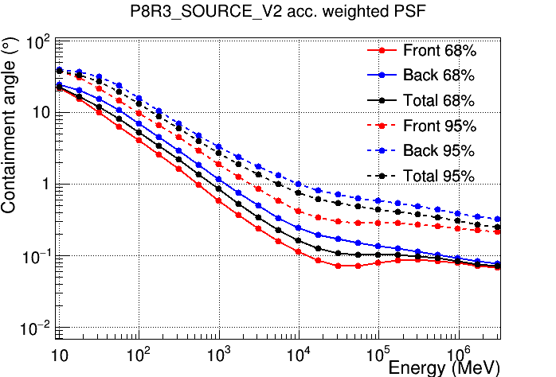
Angular Resolution
Definition: angular radius containing 68% or 95% of the gamma-rays from a point source.
The Point Spread Function describes the angular distribution of measured photons from a point source.
Angular resolution improves dramatically with increasing energy.
Notes:
Note plateau where detector resolution limit is reached at high energy.

Slide 29
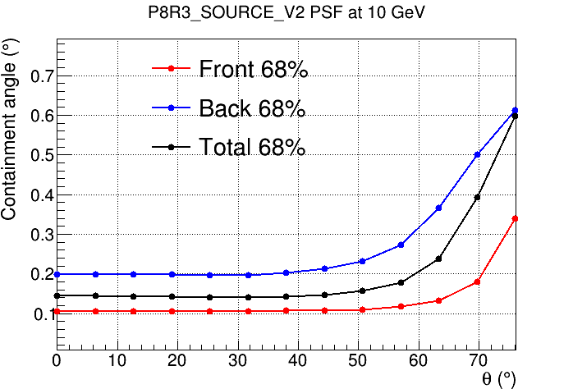
Angular Resolution
Definition: angular radius containing 68% or 95% of the gamma-rays from a point source.
The Point Spread Function describes the angular distribution of measured photons from a point source.
Inclination angle
Uniform out to large incidence angles, where 2D sensor geometry becomes important.
Notes:
Note effect of 2D detector geometry – resolution degrades at high incidence angle where the tracks do not cross many layers.

Slide 30
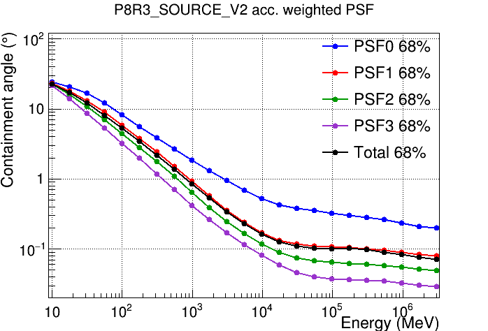
Data types act as independent instruments
Analysis and not only hardware can configure the instrument and adjust its performance.
Divide into quantiles in angular resolution to gain finer control of background rejection and spatial studies.
A more accurate representation of the instrument in terms of angular resolution.

Slide 31
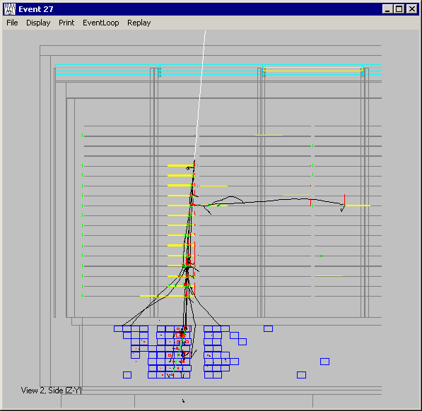
Energy Measurement
Event Reconstruction accounts for effects like energy deposits in tracker, leakage of energy out of the instrument, and gaps in sensors.
The relative importance changes over the energy range of the instrument.
1 GeV gamma ray
Gap Between
Tracker Towers
Thin Convertors
Thick Convertors
Gap Between
Calorimeter Towers
No Convertors
Calorimeter
Crystals
Energy leakage out of calorimeter
Notes:
Low Energies - Energy deposited in Tracker is critical
High Energies - Leakage of shower is critical. Gaps where sensors are not active become important. Reconstruction must be compensate for both.

Slide 32
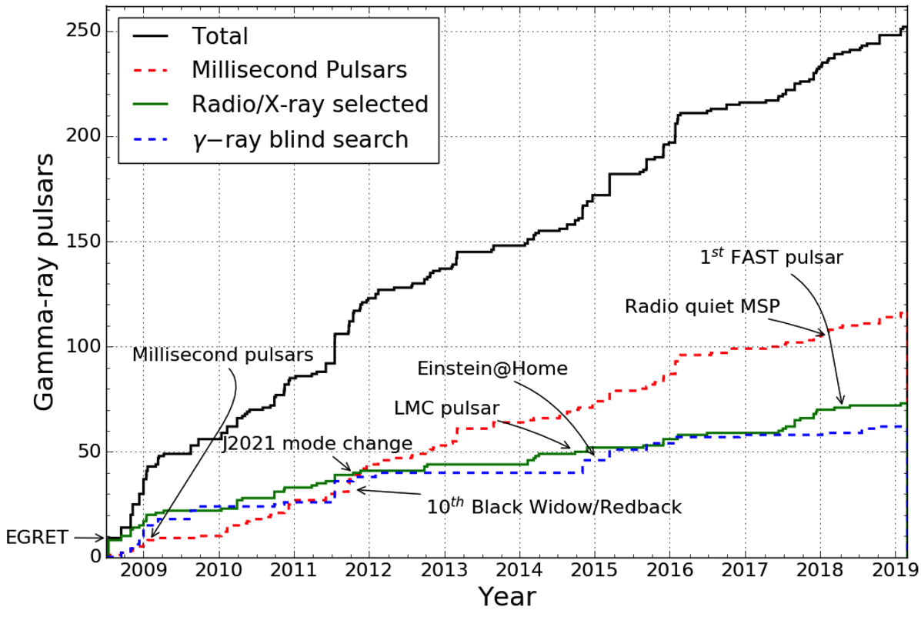
Gamma-ray pulsars are found using different approaches
Fermi searches of known radio/x-ray pulsar locations
Fermi searches of unidentified gamma-ray sources
Others search Fermi unidentified gamma-ray source locations that can then be detected in Fermi data.
Notes:
http://tinyurl.com/fermipulsars

Slide 33
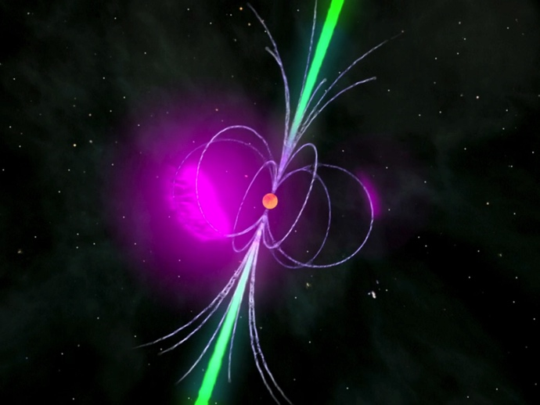
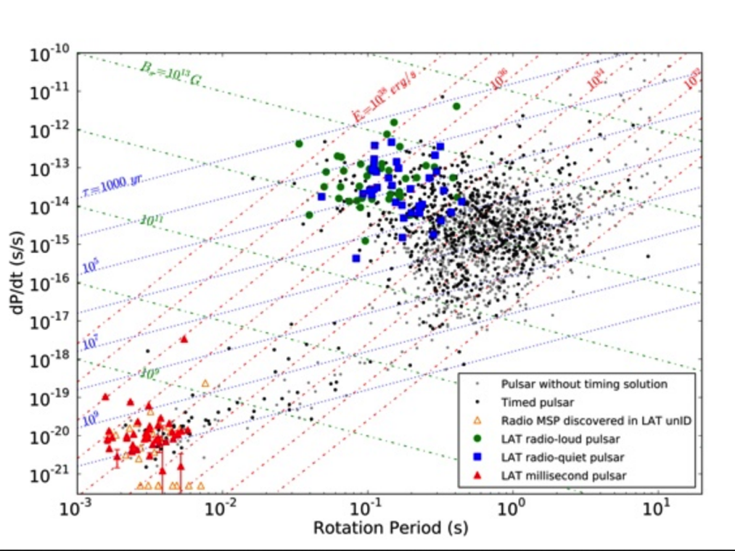
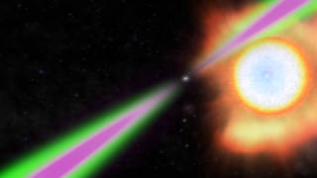
Gamma-ray pulsars
Black Widow and Redback Binaries have been primarily found using Fermi
Notes:
Lines of constant rotational energy in red. Line of constant polar B in green.
Fermi-directed searches have found 1/3 of the 348 known field millisecond pulsars (10 discovered in gamma rays). ~2 dozen of those added to pulsar timing arrays.

Slide 34
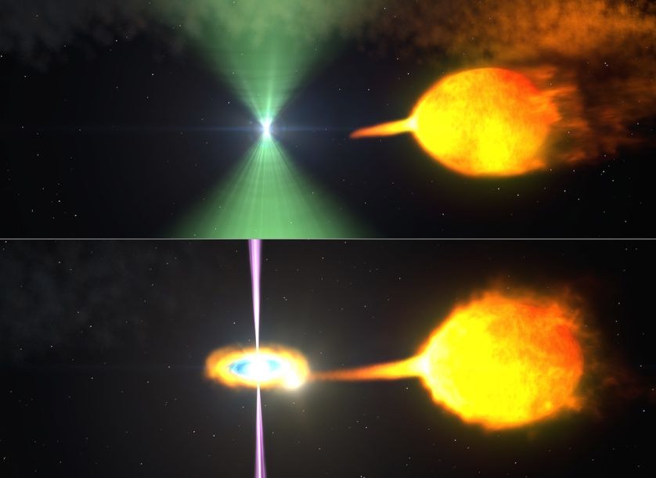
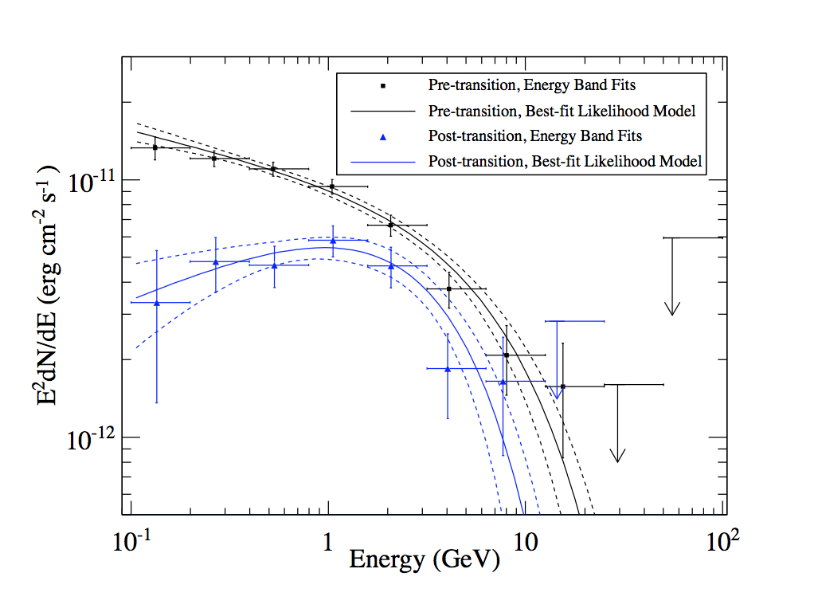
Transitional Millisecond Pulsars
Gamma-ray spectral modes for PSR J1227-4853
Millisecond pulsar (redback system) in the process of ablating low mass companion (~0.2 Msol, orbital period <1 day)
Johnson et al. 2015
Notes:
3 of these known so far. Initially in LMXB phase. Transitions to rotation-powered pulsar in late 2012 over a day or few. Gamma ray pulsations detected in rotation-pow phase. Transition rates estimated at ~27 yrs based on LAT obs. Nine redback systems known = very close MSP binary. Redbacks have larger low mass companions than BW and show radio eclipses.
In LMXB state, the disk penetrates the pulsar megnetosphere quenching the rotation-powered pulsar emission mechanism. The observed X- and gamma-ray emission is the result of synchrotron and synchrotron self-Compton scattering from electrons accelerated at the interface between the disk and the pulsar magnetosphere.

Slide 35
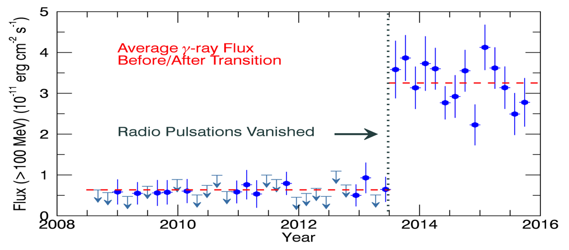
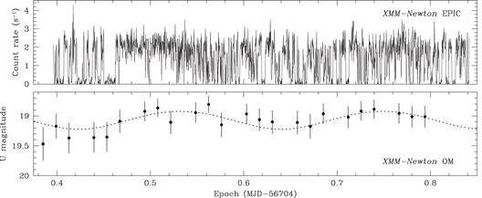
Transitional Millisecond Pulsars
Gamma-ray Transition of PSR J1023+0038
~40% of MSPs discovered in searches of LAT sources are interacting binaries (`black widows’ and `redbacks’)
Prior to Fermi only 1 redback and ~6 black widows were known outside of globular clusters (now several dozen)
LAT also detected transitions between accreting and radio MSP states
γ-ray brightening in the accreting state intriguing because accreting sources are not typical γ-ray emitters.
Optical searches of LAT sources important for revealing new candidates.
X-ray and U Band Light Curves of 3FGL J1544.6-1125
Bogdanov et al. 2015
Notes:
The bottom figure is from Bogdanov & Halpern 2015, "Identification of the High-energy Gamma-Ray Source 3FGL J1544.6-1125 as a Transitional Millisecond Pulsar Binary in an Accreting State", ApJl, 803, L27
Searches of LAT unassociated source error regions that turn up variable optical and X-ray sources are finding transitional MSPs in either their MSP or accreting states.

Slide 36
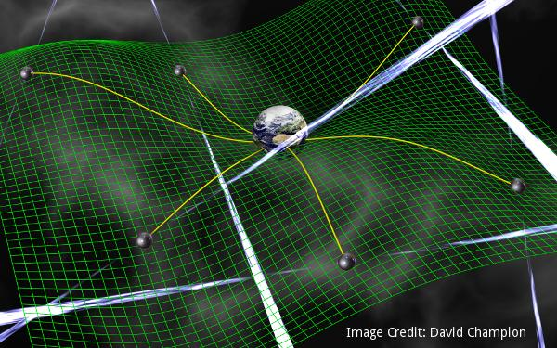
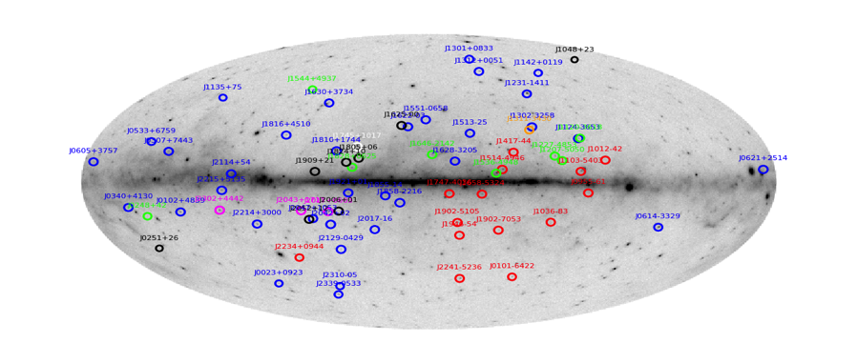
Fermi and Pulsar Timing Arrays
Pulsar Timing Array (PTA) projects, like NANOGrav, will explore gravitational waves from 5–500 nHz (lower frequency than LIGO or LISA).
The Fermi Pulsar Search Consortium has discovered ~100 MSPs in searches of LAT unassociated sources (40% of the MSP discoveries since 2008 and about ⅓ of all known Galactic MSPs)
Two dozen new MSPs have been added to PTA projects so far.
Sky map of some MSPs discovered by targeting LAT sources

Slide 37
A note on Timing Precision
Have to know where the spacecraft is (<20 m)
Need accuracy of the clock and timing chain
Pre-launch calibrations measured timestamp accuracy (GPS) at 300 ns rms.
Flight calibration uses pulsars
Can check for drift of the clock using high rotational rate pulsars, millisecond pulsars
Check absolute timing using the Crab pulsar – high braking index allows higher accumulate rate of error per rotation
Comparisons to radio data constrain the annual timing variance of clock to ~1 usec (limited by photon statistics). Exceeds 10 usec goal.

Slide 38
Probing the gamma-ray burst mechanism with gamma rays

Slide 39
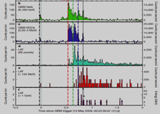
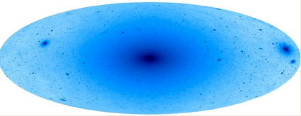
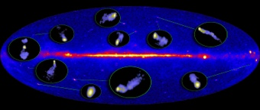
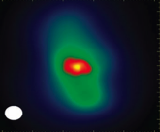
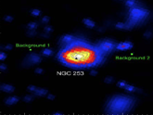
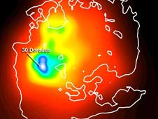
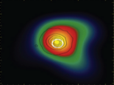
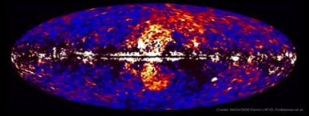
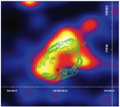
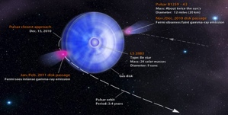
Fermi Highlights and Discoveries
Dark Matter searches
GRBs
Blazars
Extragalactic
Radio Galaxies
Starburst Galaxies
LMC & SMC
Globular Clusters
Fermi Bubbles
SNRs & PWN
Galactic
γ-ray Binaries
Novae
Pulsars: isolated, binaries, & MSPs
Sun: flares & CR interactions
Terrestrial γ-ray Flashes
Unidentified Sources
e⁺e⁻ spectrum

Slide 40
Conclusions and Outlook
Fermi-LAT provides the deepest survey of the high-energy gamma-ray sky and incredibly stable, high-cadence, decade-long lightcurves – enables a huge range of energetic astrophysics.
More than 5000 catalogued sources and increasing steadily
Discoveries of variable and transient phenomena keep coming.
Fermi-GBM is the most prolific detector of short gamma-ray bursts. High impact studies include accreting pulsars, magnetars, the Crab nebula, and terrestrial gamma-ray flashes.
At 12 years of operation both LAT and GBM significantly exceed performance at the time of launch with no degradation in science capabilities.

Slide 41
Thank You!

Slide 42
Extra Stuff

Slide 43
About me
Physics Major, Cornell U.
Discovered astrophysics and a love for experiments through senior level classes and internships
Ph. D. in Physics from Univ. Maryland, College Park
Searched for variability in the very-high-energy gamma-ray sky using Milagro, a water Cherenkov telescope
Post Doc U. Chicago/Argonne
Integrated data acquisition for VERITAS imaging atmospheric Cherenkov telescope array and hunted cosmic-ray signatures in Cherenkov light
NASA Goddard Research Astrophysicist
Flight performance and simulation studies, variability and spatial analysis studies using Fermi LAT data
Project Scientist/former deputy for Fermi Gamma-ray Space Telescope; Chief, Astroparticle Physics Laboratory

Slide 44
Science Motivation: EGRET Legacy
Active Galactic Nuclei: Blazars
Pulsars
Galactic and
Extragalactic Diffuse
Large Magellanic Cloud

Slide 45
LAT Measurement Characteristics
Notes:
https://fermi.gsfc.nasa.gov/ssc/data/analysis/documentation/Cicerone/Cicerone_Introduction/LAT_overview.html

Slide 46
Measurement Goals
Detect photons
with energies from ~100 MeV to >100 GeV
from as much of the sky as possible
on shortest possible intervals (<day for blazars, <sec for gamma-ray bursts)
and distribute promptly to public
Measure direction and energy
Resolve sources from background and each other
Know photon arrival time sufficiently well for pulsar timing
Know gamma-ray burst locations onboard sufficiently well to rapidly repoint the high energy instrument

Slide 47
Instrument Goals
Maximize detection efficiency
Minimize background
Minimize angular resolution
Maximize field of view
Minimize energy resolution

Slide 48
Tracker – Multiple Scattering
The electron and positron passing through matter undergo repeated elastic Coulomb scattering with nuclei
nuclei have mass greater than the incoming electron. The energy transfer is negligible but each scattering center adds a small deviation from the incoming particle’s trajectory. Even if the deflection is small, the sum of many adds a random component to the particle’s path.
We can approximate multiple scattering dependencies by θ_{MS} proportional to1/E

Slide 49
What Makes an Ideal Tracker?
Converters: Infinitesimally thin. Avoid loss of information in scattering
Sensors: Infinitesimally small. Minimize physical resolution scale
Depth: Infinite for 100% conversion. Infinite number of layers.
Perfect! But unbuildable.

Slide 50
What Makes an Ideal Calorimeter?
Infinite depth – no energy leakage
No gaps – fully active calorimeter would reduce uncertainties in energy measurement
Infinite position and timing resolution – provide perfect reconstruction of the shower image without energy deposits unrelated to the gamma ray

Slide 51
Anti Coincidence Detector
Primary subsystem for rejection of charged particle backgrounds
Triggers can be rejected (vetoed) in the instrument
Triggered events can be filtered to reduce data passed to the ground
Improves reconstruction of data in the ground processing
ACD information also used in offline reconstruction to identify CR events
Cosmic-ray shield around the four sides and top of the LAT
89 plastic scintillating tiles
Plastic scintillator is a low Z material, so long radiation length -> minimize absorption of gamma-rays
8 ribbons to cover remaining gaps
Segmented design minimizes rejection of good gamma rays that produce particles in the calorimeter that pass through the lower part of the shield, i.e. self-veto effect
Very high detection efficiency for charged particles (~99.97%)
Notes:
Add color fig of shell

Slide 52
The Ideal Anticoincidence Detector
Perfect coverage without gaps – reduce charged particle background sneaking through holes and cracks.
Infinite segmentation or position resolution knowledge - allow imaging of charged particle impacts to avoid rejecting gamma ray events.
Timing information about particle entry and exit of the instrument to reduce Earth-generated charged particle backgrounds.

Slide 53
LAT 8 Year Source Catalog
>5000 sources
50 MeV – 1 TeV

