Slide 1
Comparing Reliability
At Concept Design Period

Slide 2
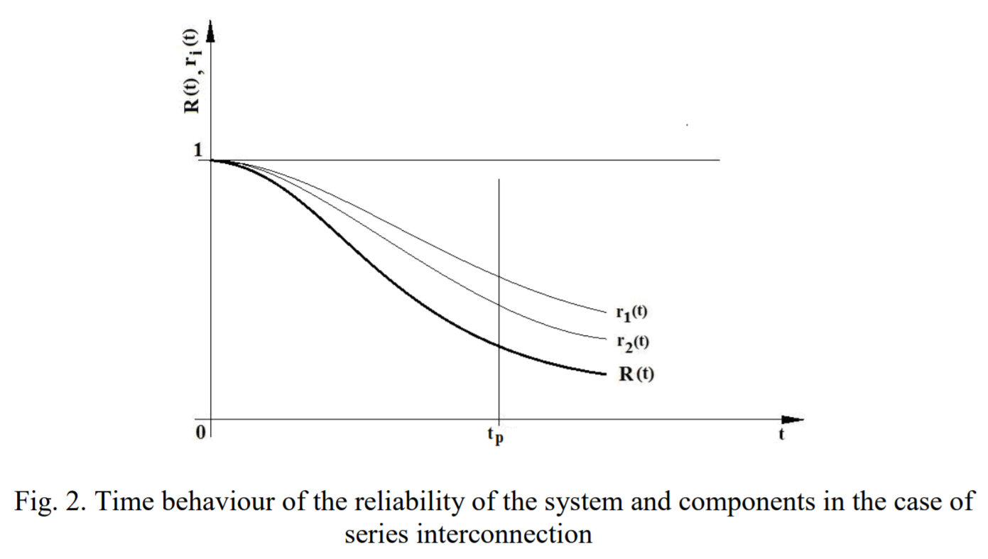
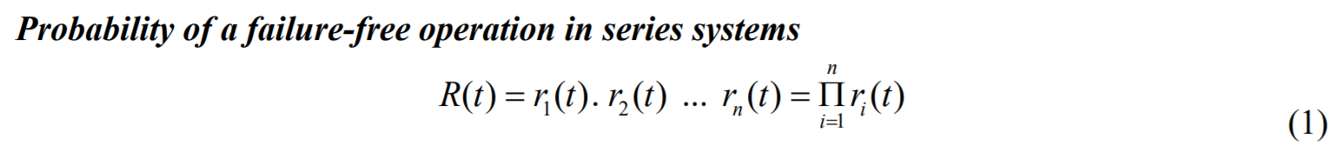
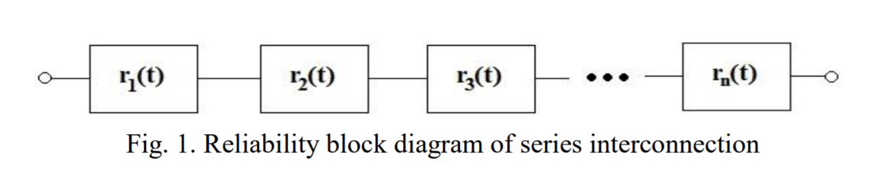
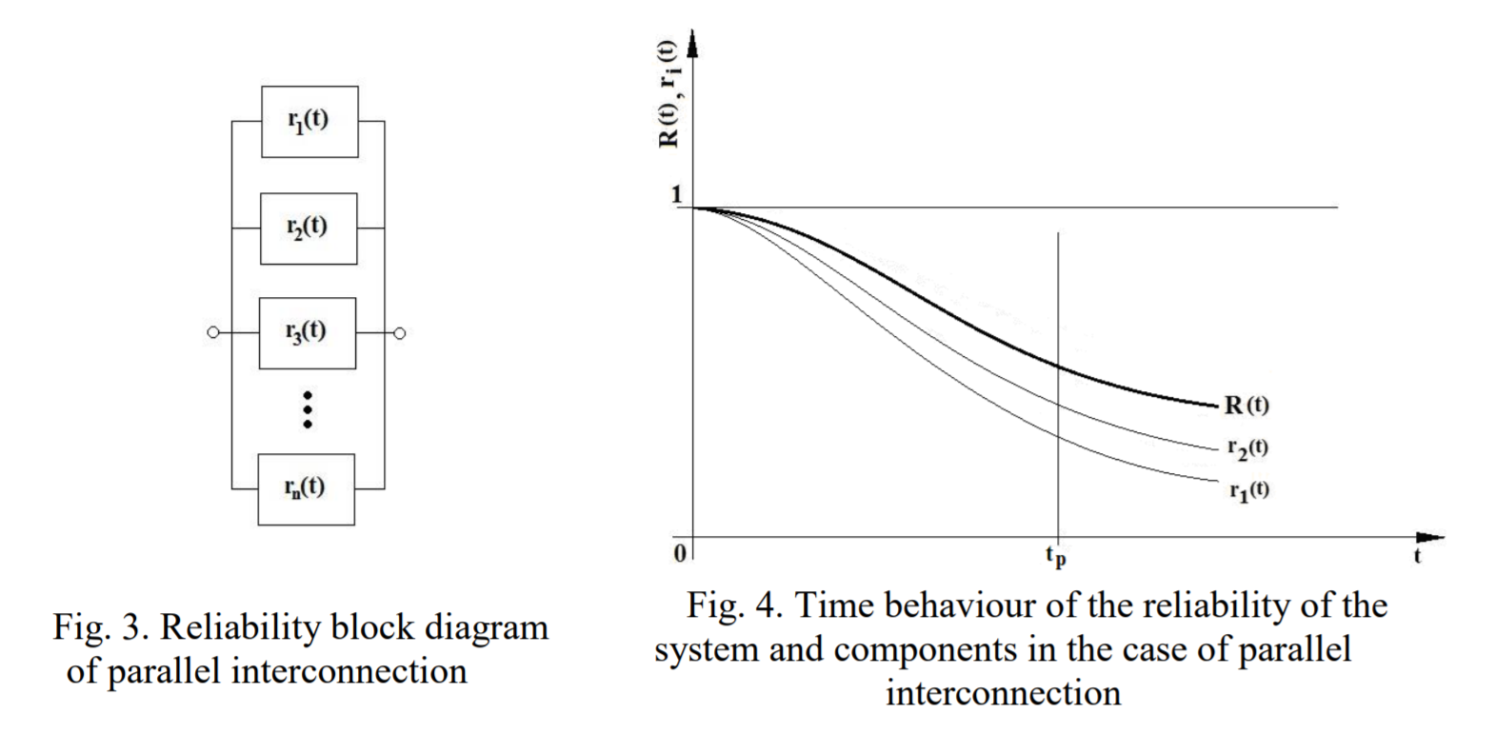
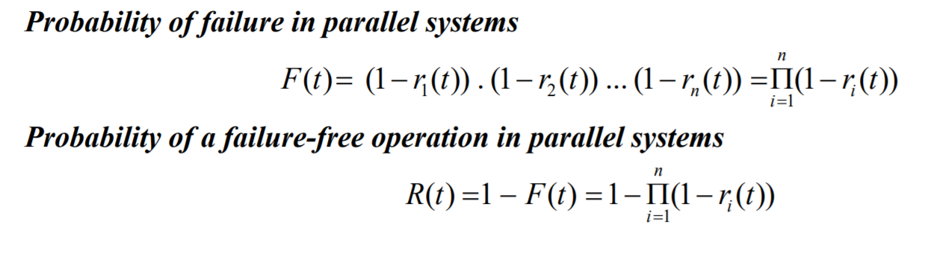
Reliability in Series/Parallel Systems
Eva FALTINOVA. Martin MANTIC, et. al.. Reliability Analysis of Crane Lifting Mechanism.
Scientific Journal of Silesian University of Technology. Series Transport. 2018, 98, 15-26.
ISSN: 0209-3324. DOI: https://doi.org/10.20858/sjsutst.2018.98.2.

Slide 3
Safety Evaluation
Different function fail causes different damage, So it has different weight:
Define w_{i} as the importance of the function and suppose:
Then:
  Safety of Series system:
    S(t)=r₁(t)w₁r₂(t)w₂…r_{n}(t)w_{n}
  Safety of Parallel system:
    S(t)=1-(1-r₁(t)w₁)(1-r₂(t)w₂)…(1-r_{n}(t)w_{n})
When fail | Such As | w_{i}
Deadly damage |  | 0
Big damage | Hit telescope | 0.25
Middle damage | Get wet by rain | 0.5
Small damage |  | 0.75
No matter |  | 1

Slide 4
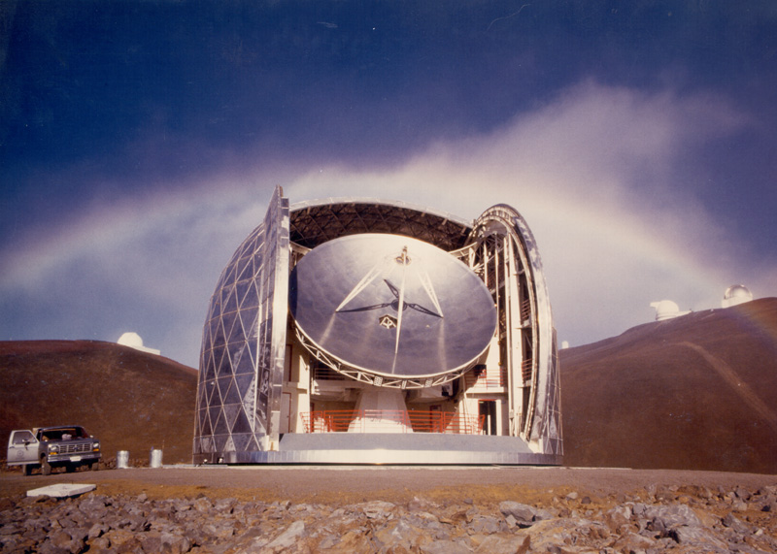
Traditional Round Dome
No. | Functions | Reliability | Safty Weight
1 | Rotate | 0.9 | 1
2 | Window | 0.9 | 0.5
1
2
R=0.9*0.9=0.81
S=0.9*1*0.9*0.5=0.41

Slide 5
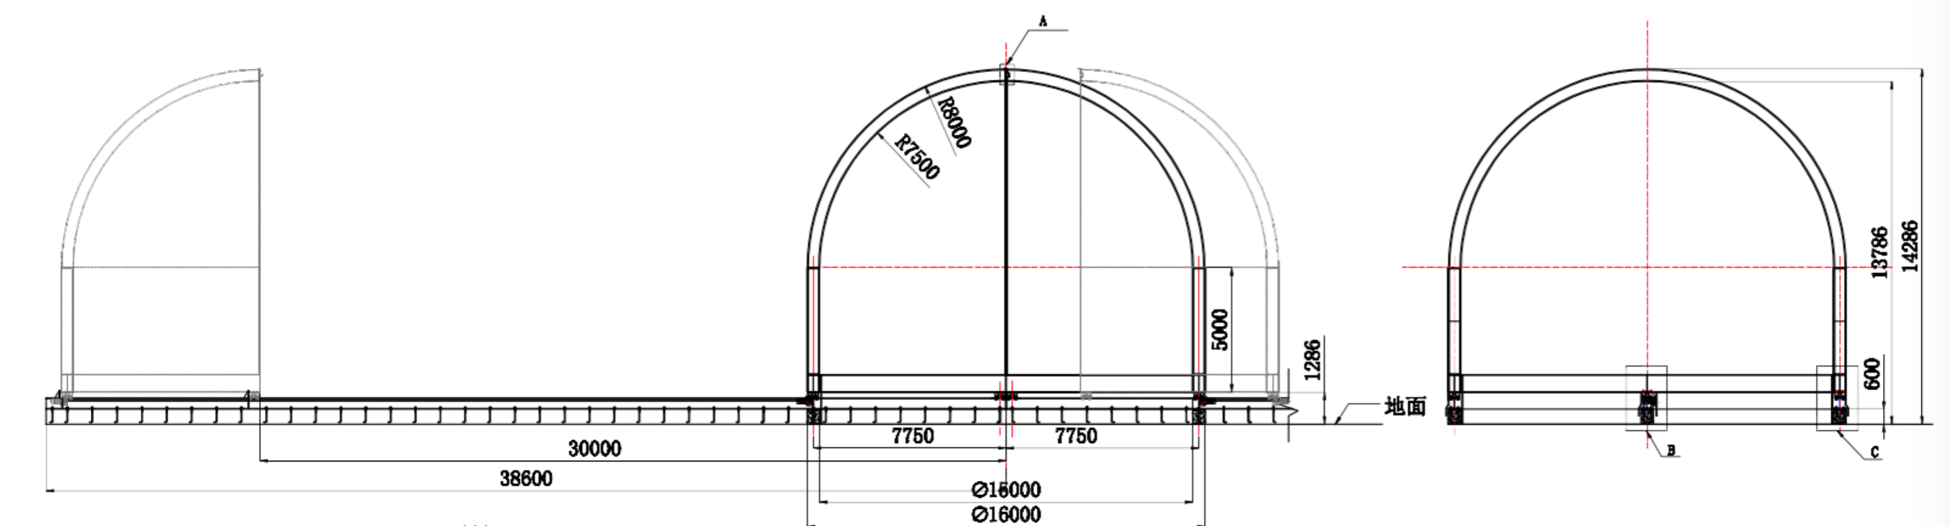
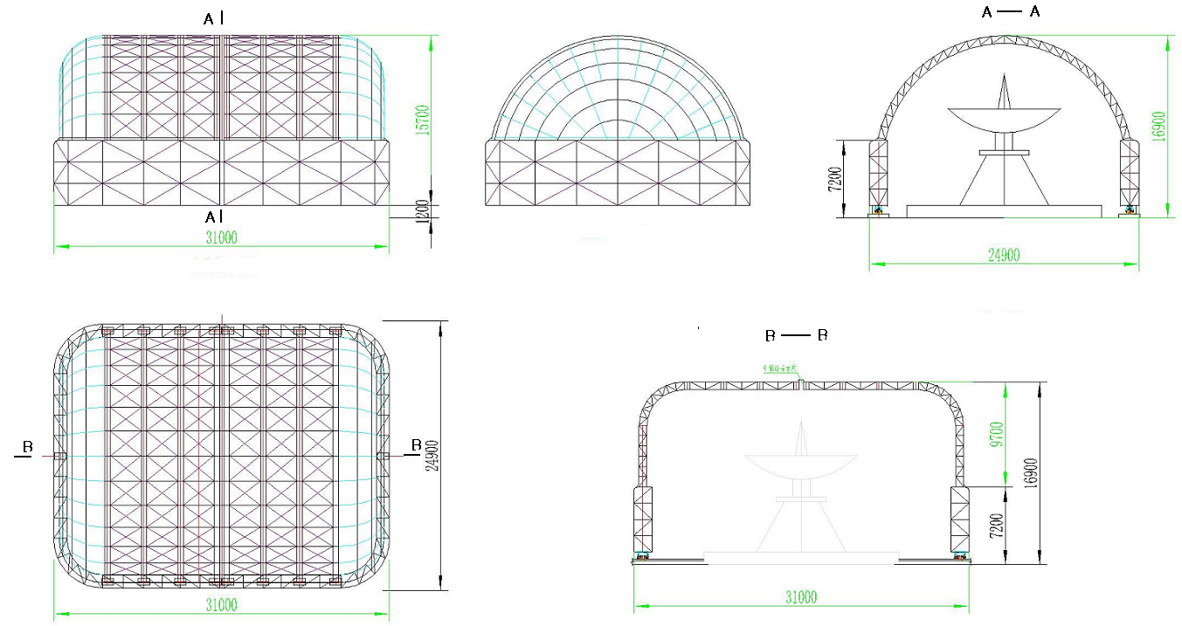
Two sliding Halves
No. | Functions | Reliability | Safty Weight
1 | Sliding 1 | 0.9 | 0.5
2 | Sliding 2 | 0.9 | 0.5
1
2
R=0.9*0.9=0.81
S=0.9*0.5*0.9*0.5=0.20
Three companies have bids.

Slide 6
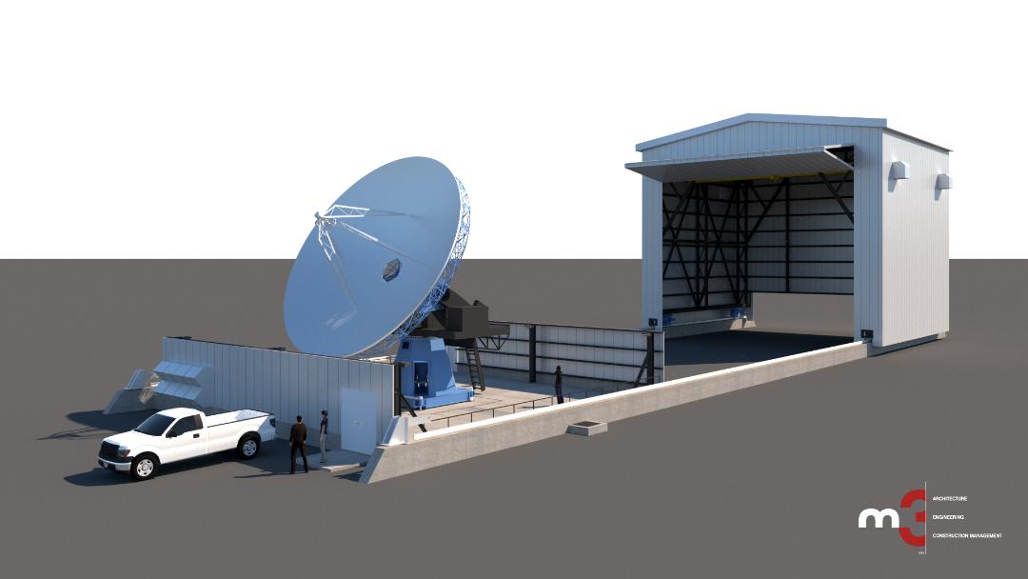
Sliding with one gate
No. | Functions | Reliability | Safty Weight
1 | Sliding 1 | 0.9 | 0.5
2 | gate | 0.9 | 0.25
1
2
R=0.9*0.9=0.81
S=0.9*0.5*0.9*0.25=0.10

Slide 7
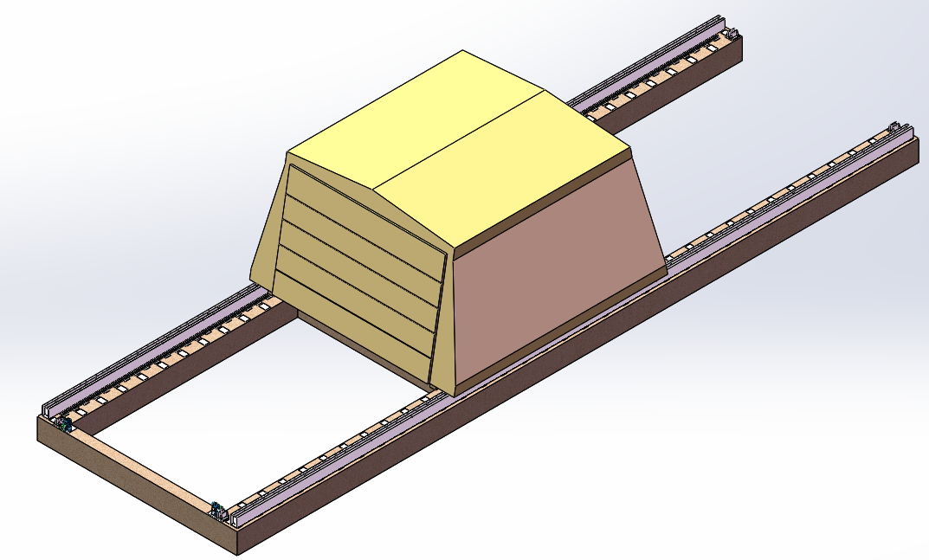
Sliding with two gates
No. | Functions | Reliability | Safty Weight
1 | Sliding 1 | 0.9 | 0.5
2 | Gate 1 | 0.9 | 0.25
3 | Gate 2 | 0.9 | 0.25
1
2
3
R=0.9*0.9*0.9=0.73
S=0.9*0.5*0.9*0.25*0.9*0.25=0.022

Slide 8
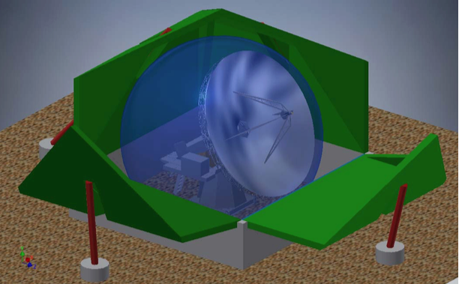
Lotus with 4 petals
No. | Functions | Reliability | Safty Weight
1 | Wall 1 | 0.9 | 0.5
2 | Wall 2 | 0.9 | 0.5
3 | Wall 3 | 0.9 | 0.5
4 | Wall 4 | 0.9 | 0.5
1
2
3
4
R=0.9*0.9*0.9*0.9=0.66
S=0.9*0.5*0.9*0.5*0.9*0.5*0.9*0.5=0.041

Slide 9
Lotus with Hydraulic rams
No. | Functions | Reliability | Safty Weight
1 | Wall 1 | 0.95 | 0.5
2 | Wall 2 | 0.95 | 0.5
3 | Wall 3 | 0.95 | 0.5
4 | Wall 4 | 0.95 | 0.5
1
2
3
4
R=0.95*0.95*0.95*0.95=0.81
S=0.95*0.5*0.95*0.5*0.95*0.5*0.95*0.5=0.051

Slide 10
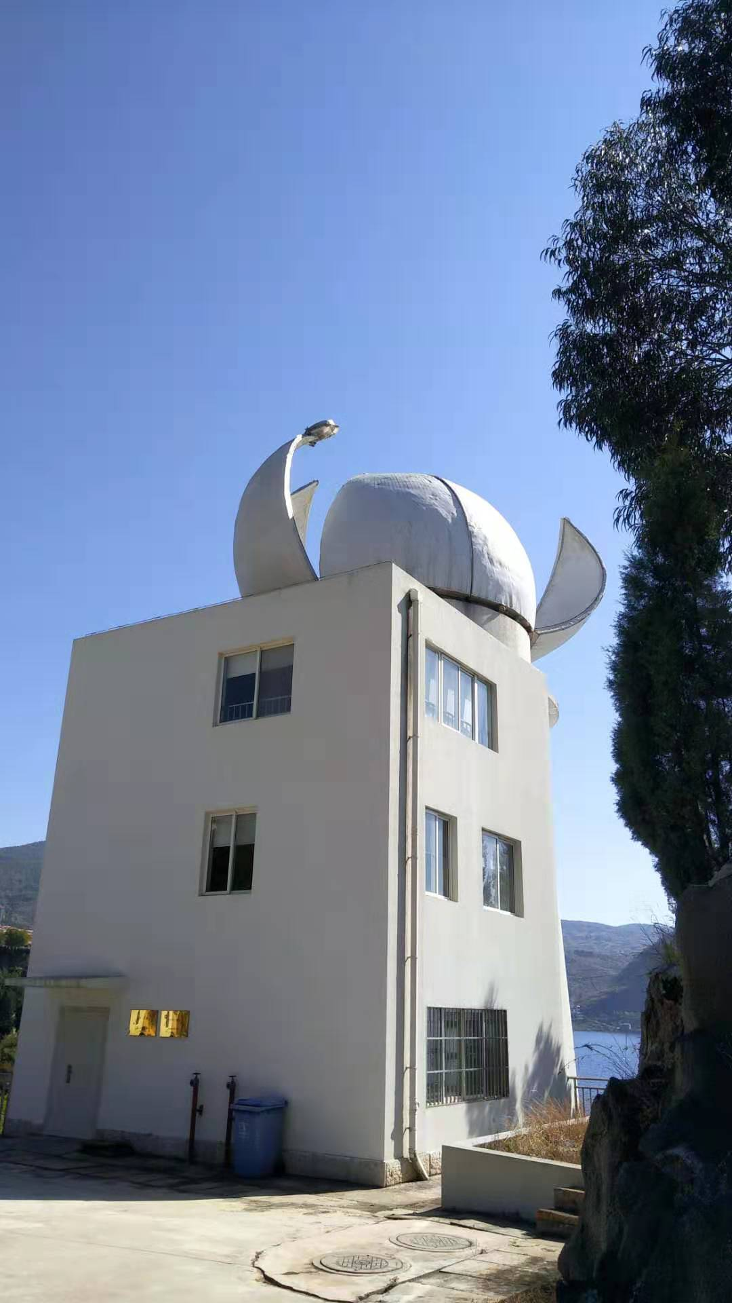
Lotus with 6 petals
No. | Functions | Reliability | Safty Weight
1 | Wall 1 | 0.9 | 0.5
2 | Wall 2 | 0.9 | 0.5
3 | Wall 3 | 0.9 | 0.5
4 | Wall 4 | 0.9 | 0.5
5 | Wall 4 | 0.9 | 0.5
6 | Wall 4 | 0.9 | 0.5
1
2
3
4
5
6
R=0.9*0.9*0.9*0.9*0.9*0.9=0.53
S=0.9*0.5*0.9*0.5*0.9*0.5*0.9*0.5*0.9*0.5*0.9*0.5=0.0083

Slide 11
Summary
 | Traditional round dome | Two sliding halves | One gates | Two gates | Four petals | Enhance reliability of each petal | Six petals
Reliability | 0.81 | 0.81 | 0.81 | 0.73 | 0.66 | 0.81 | 0.53
Safety | 0.41 | 0.20 | 0.10 | 0.022 | 0.041 | 0.051 | 0.0083

Slide 12
Summary：Reliability + Cost
 |  | Traditional round dome | Two sliding halves | One gates | Two gates | Four petals | Enhance reliability of each petal | Six petals
Reliability |  | 0.81 | 0.81 | 0.81 | 0.73 | 0.66 | 0.81 | 0.53
Safety |  | 0.41 | 0.20 | 0.10 | 0.022 | 0.041 | 0.051 | 0.0083
Cost | base | 1 | 1+6 | 1+3 | 1+2 | 1 | 1 | 1
 | Structure & material | 1- | 1 | 1 | 1 | 1+ | 1+ | 1+
 | motions | 2+hoist | 2+hoist | 2+hoist | 3+hoist | 4+Crane | 4+Crane | 6+Crane
 | Trans& onsite Assemble | 1+ | 1 normal | 1 normal | 1 normal | 1 particular | 1 particular | 1 particular

