Slide 1
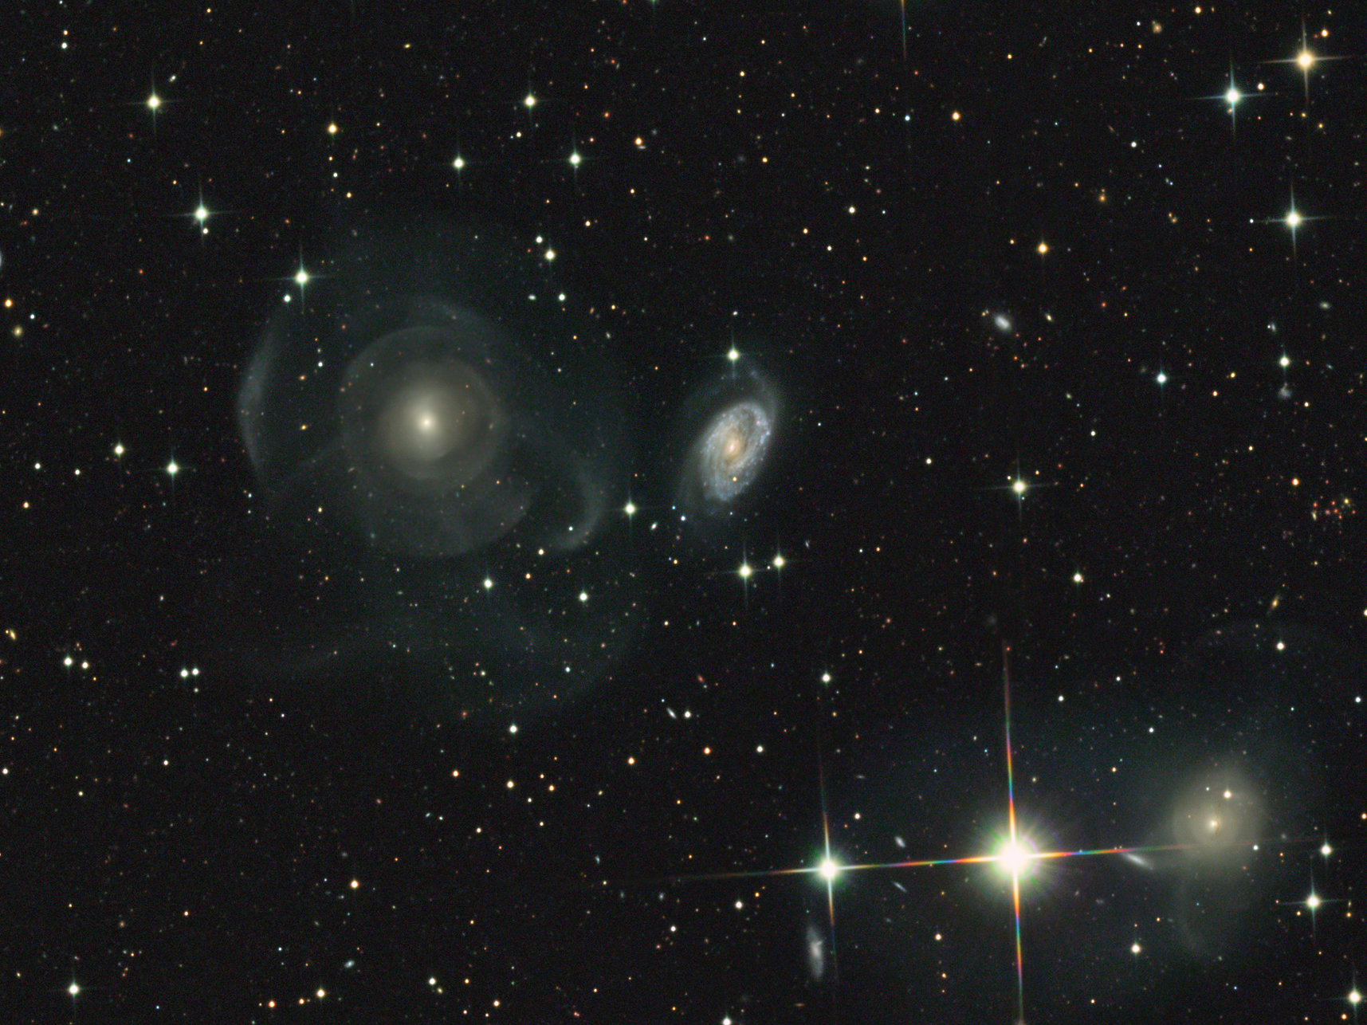
Ay 124 Structure and Dynamics of Galaxies
S. G. Djorgovski & A. Benson
Winter 2009

Slide 2
Class Logistics
All info, lecture notes, useful links, homeworks, exams, announcements, etc., will be on the class webpage:
http://www.astro.caltech.edu/~george/ay124/
Textbook:
Binney & Merrifield, “Galactic Astronomy” (BM)
With some chapters from Binney & Tremaine, “Galactic Dynamics” (BT)
Please read ahead, and ask questions during the class!
Today’s lecture:
Some history (BT 1)
Common units, coordinates, astrometry (BT 2.1)
Measuring distances to stars and clusters (BT 2.2)

Slide 3
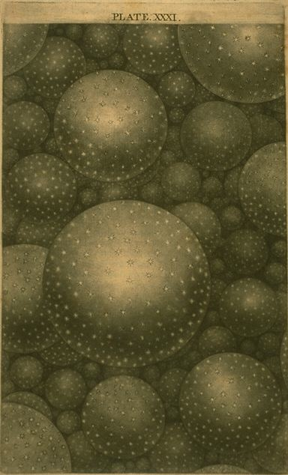
The Discovery of Galaxies
18th Century:
The first catalogs of “nebulae”: Charles Messier, William Herschel
The pioneers of “island universes”: Thomas Wright, Immanuel Kant
Herschel’s sketch of the Galaxy, from his star counts
Lord Rosse’s sketch of M51
19th and Early 20th Centuries:
More catalogs, first spectra, but no physical understanding

Slide 4
Expanding the Scale of the Galaxy
Discovery of the interstellar extinction circa ~ 1920’s (Trumpler, Shapley) greatly expanded the scale of the Milky Way, and displaced the Sun from its center

Slide 5
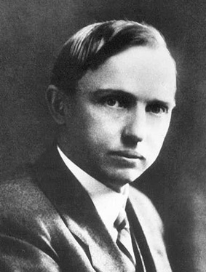
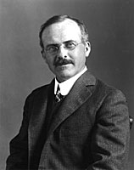
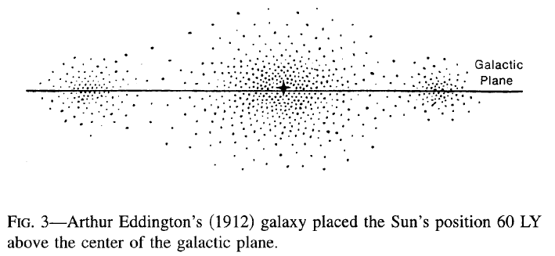
The Shapley-Curtis Debate on the nature of faint nebulae (= galaxies)
At the meeting of the National Academy of Sciences in Washington on 26 April 1920, Harlow Shapley of Mount Wilson and Heber D. Curtis of Lick Observatory gave talks under the title "The Scale of the Universe"
Shapley argued that the nebulae are parts of our own Galaxy, the only one
Curtis 
thought that these are other galaxies, just like ours

Slide 6
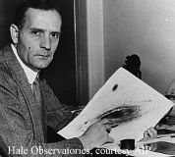
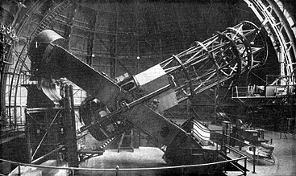
The Resolution: Nebulae are Extragalactic
In 1923 Hubble resolved Cepheids in M31 (Andromeda)
A profound shift in the understanding of the scale of the universe
The Mt. Wilson 100-inch
Edwin Hubble

Slide 7
Mapping the Milky Way and Its Kinematics
The development of radio astronomy after the WW2, and the discovery of the 21 cm line of H I, enabled the mapping of the Milky Way independent of the optical extinction.
At the same time, that opened the possibility of the measurements of the global kinematics (e.g., rotation) of the Milky Way (Oort et al. 1958).
Until then, only the ~ local kinematic of stars could be measured.

Slide 8
The Milky Way in Visible Light

Slide 9
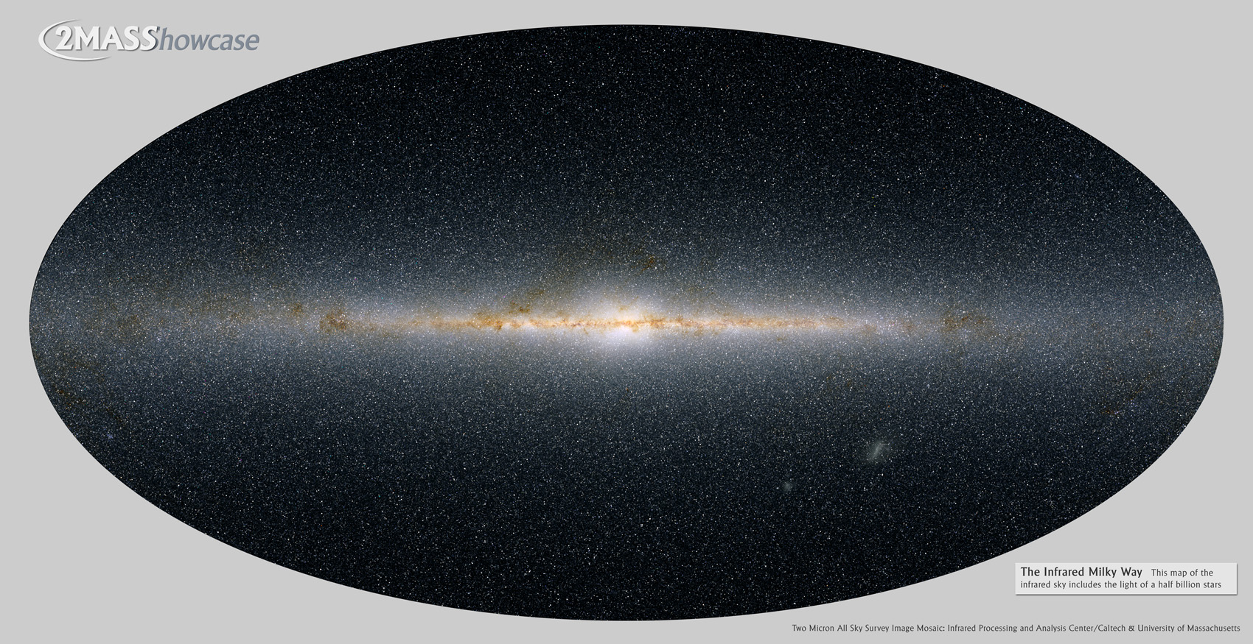
The Milky Way from 2MASS
And it is a barred galaxy!

Slide 10
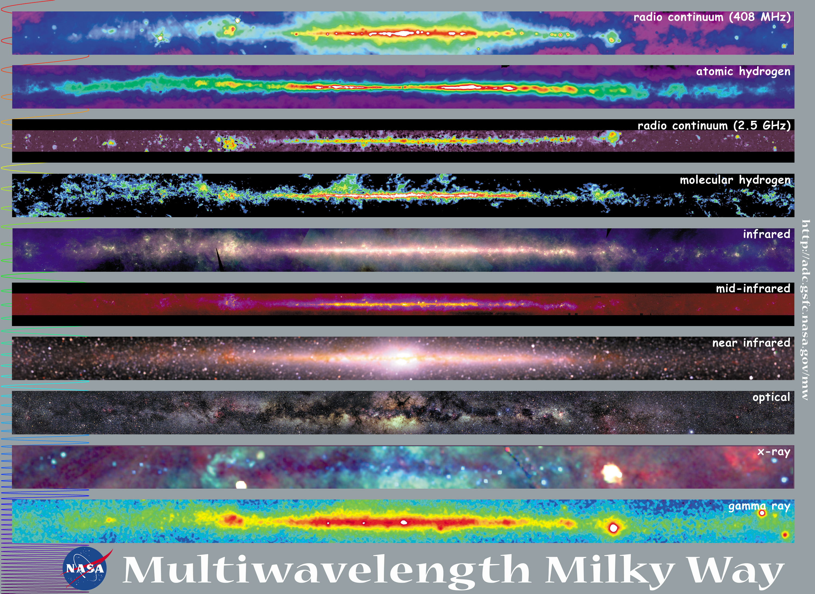

Slide 11
The Fundamental Goals and Methods
Understand the physics and the origins of galaxies and their subsystems (structural, dynamical, compositional), as well as other types of stellar systems (e.g., star clusters)
Stellar dynamics is an essential tool
Consider galaxies in the 6-dimensional phase space of positions and velocities
For stars, measure the 2 positions on the sky, plus distances from parallaxes and other methods (XYZ)
Get the velocity components from proper motions + distances (v_{ϑ},v_{φ}), and radial velocities (v_{r})
For gas, measure the sky positions and radial velocities directly, but infer the other components using a global Galaxy rotation model
Spectroscopy also provides chemical abundances, ages for the stars, physical state of the ISM
Use stars or gas as test particles to probe the gravitational potential

Slide 12
Some Commonly Used Units
Distance:
Astronomical unit: the distance from the Earth to the Sun, 1 au = 1.49610¹³ cm
Light year: c 1 yr, 1 ly = 9.463 10¹⁷ cm
Parsec: the distance from which 1 au subtends an angle of 1 arcsec, 1 pc = 3.086 10¹⁸ cm = 3.26 ly = 206,264.8 au
Angle:
Usually in “hex”, e.g., 12º 34´ 56.78˝, or 12.5824389 deg, except for RA, which is usually given in time units, e.g., 12^{h} 34^{m} 56.789^{s}. Note that Δα [deg] = Δα [h]  15 cos δ
Mass and Luminosity:
Solar mass: 1 M = 1.989 10³³ g
Solar luminosity: 1 L = 3.82610³³ erg/s

Slide 13
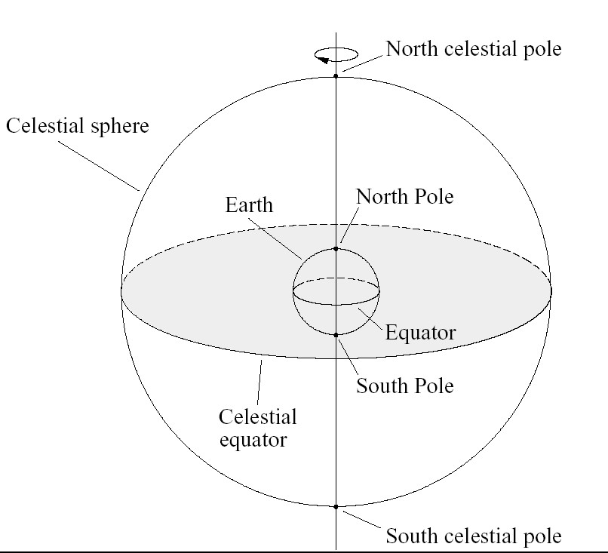
The Celestial Sphere
Think of it as an outward projection of the terrestrial long-lat coordinate system onto the sky
 the Equatorial System

Slide 14
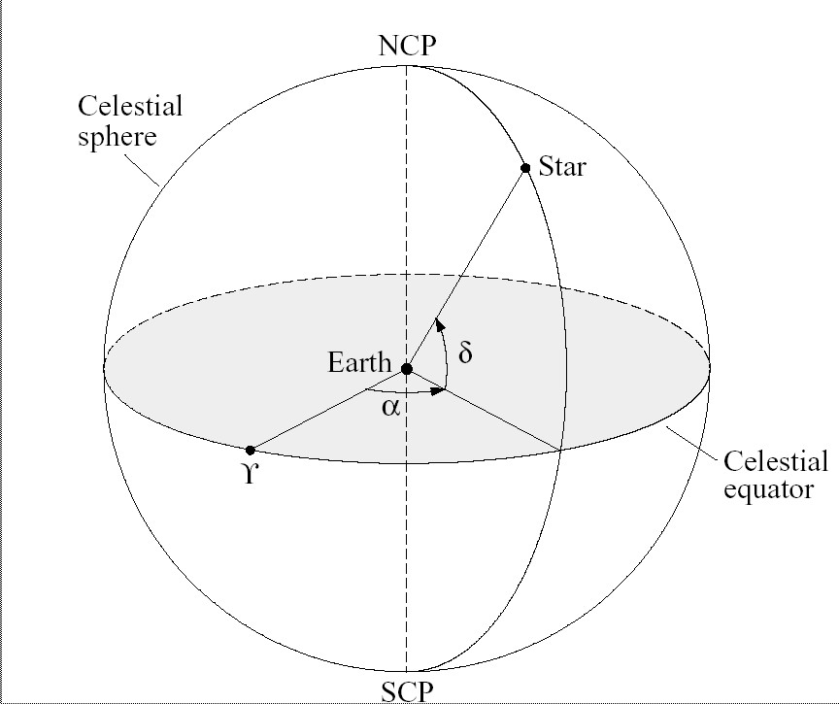
The Equatorial System
The coordinates are Right Ascension (RA, or α) and Declination (Dec, or δ), equivalent to the georgaphic longitude and latitude
RA = 0 defined by the Solar position at the Vernal Equinox

Slide 15
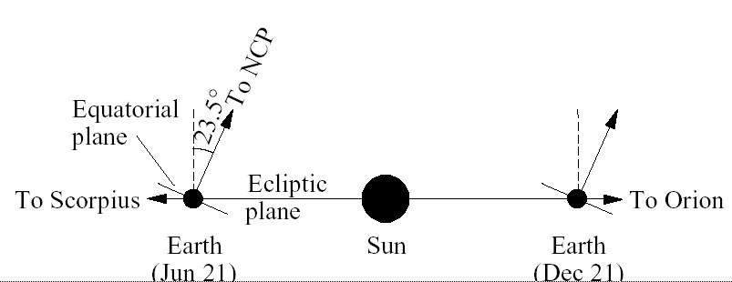
Other Common Celestial Coordinate Systems
Ecliptic: projection of the Earth’s orbit plane defines the Ecliptic Equator.
Sun defines the longitude = 0.
Galactic: Projection of the mean Galactic plane is close to the agreed-upon (!) Galactic Equator; longitude = 0 is close, but not quite at the Galactic center. (α,δ) → (l,b)

Slide 16
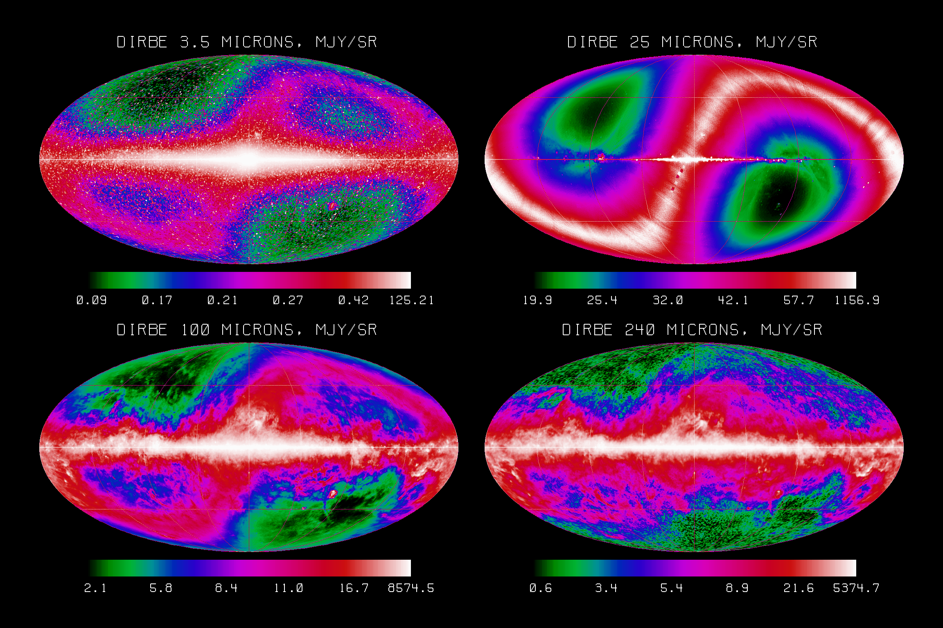
COBE DIRBE Galactic Sky

Slide 17
Astrometry
Deals with (precise) positions, angular proper motions, and parallaxes of celestial sources
Could be wide-angle (e.g., for reference systems) or narrow-angle (e.g., precision parallaxes, stellar wobbles, etc.)
Reference coordinate systems (typically equatorial) are defined by a grid of stellar positions; the basic one is the International Celestial Reference System (ICRS), as embodied by the Fifth Fundamental Catalogue (FK5)
USNO is a handy place to get catalogs and other info:
http://ad.usno.navy.mil/star/
See also the Hipparcos mission website:
http://www.rssd.esa.int/HIPPARCOS

Slide 18
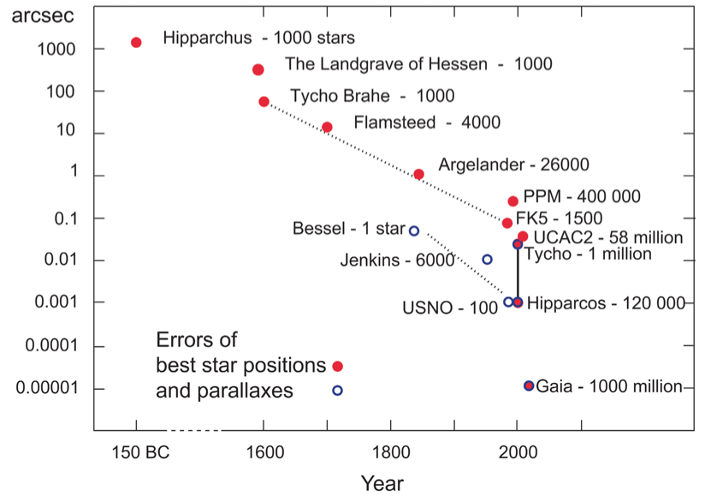
The Evolution of Astrometric Accuracy

Slide 19
Some Astrometric Catalogs
Name
Date
Nstars
σ(p)(mas)
σ pm(mas/yr)
SAO
1966
260 000
1000
10
ACRS
1991
320 000
200
5
PPM
1991
469 000
200
4
HIPPARCOS
1997
120 000
0.8
0.9
Tycho1
1997
1 060 000
40
40
ACT
1997
989 000
40
~ 2.5
TYCHO-2
1999
2 500 000
25
~ 2.5
UCAC-2
2003
48 330 000
22~70
1~6

Slide 20
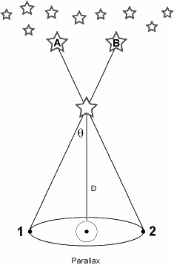
Distances and Parallaxes
Distances are necessary in order to convert apparent, measured quantities into absolute, physical ones (e.g., luminosity, size, mass…)
Stellar parallax is the only direct way of measuring distances in astronomy! Nearly everything else provides relative distances and requires a basic calibration
Small-angle formula applies:
D [pc] = 1 / π [arcsec]
Limited by the available astrometric accuracy (~ 1 mas, i.e., D < 1 kpc or so, now)
π

Slide 21
How Far Can We Measure Parallaxes?
Since nearest stars are > 1 pc away, and ground-based
telescopes have a resolution of ~1 arcsec, might seem impossible to measure π (and thus D) to any useful precision. Actually, it can be done :
1838: Bessel measured π = 0.316 arcsec for star 61 Cyg
(modern value π = 0.29 arcsec)
Current ground-based: best errors of ~ 0.001 arcsec
Hipparcos satellite: measured ~10⁵ bright stars with
errors also of ~0.001 arcsec
GAIA satellite: will measure positions of ~10⁹ stars with
an accuracy of micro-arcsecs - this is a reasonable
fraction of all the stars in the Milky Way!
Currently: measure D accurately to ~ a few 100 pc

Slide 22
Parallax Programs
Catalog | Date | #stars | σ(mas) | Comments
YPC | 1995 | 8112 | ±15 mas | Cat. of all π through 1995
USNO pg | To 1992 | ~1000 | ±2.5 mas | Photographic parallaxes
USNO ccd | From ‘92 | ~150 | ±0.5 mas | CCD parallaxes
Nstars & GB | Current | 100? | ± 2 mas | Southern π programs
Hipparcos | 1997 | 10⁵ | ±1 mas | First modern survey
HST FGS | 1995-2010? | 100? | ±0.5 mas | A few important stars
SIM | 2016? | 10³ | ±4 µas | Critical targets & exoplanets
Gaia | 2016? | 10⁹ | ±10µas | “Ultimate” modern survey

Slide 23
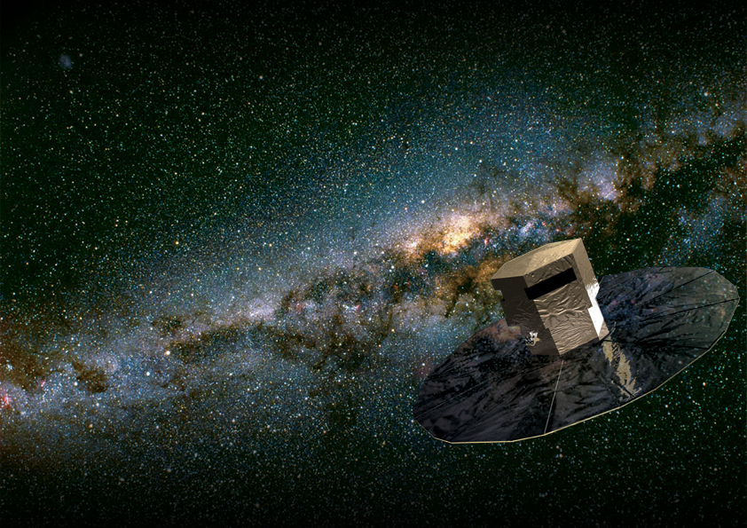
GAIA concept
See http://gaia.esa.int/

Slide 24
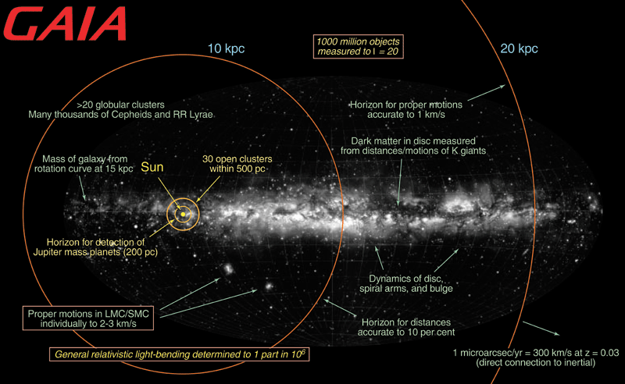
Scientific Goals of the GAIA Mission

Slide 25
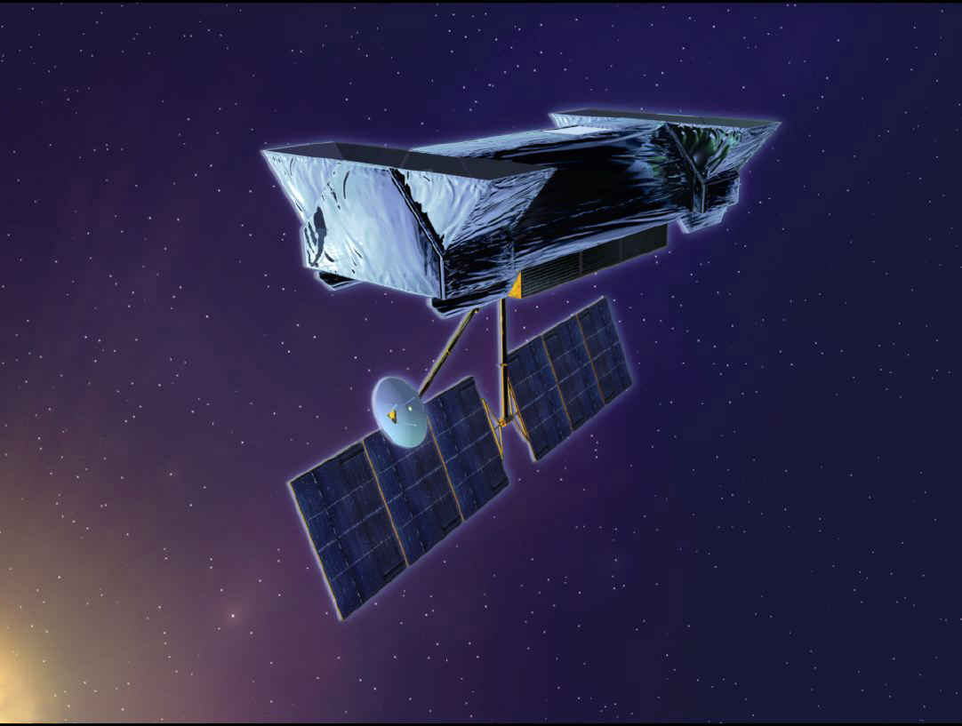
SIM concept
http://planetquest.jpl.nasa.gov/SIM/

Slide 27
Astrometry in Practice
Typically telescopes do not point better than to a few arcsec; so one points to a nearby star with precisely known coordinates, zeroes the telescope system, and does a small, “blind” offset to a target
For imaging observations, one often uses positions of the stars in the frame, which have known positions (usually to a ~ 0.2 arcsec accuracy, e.g., from the USNO-B catalog), measures their XY positions in the image, and solves for the XY  RA,Dec transformation
These transformation can be encoded in the image headers using the World Coordinate System (WCS) standard

Slide 28
Moving Cluster Method
A geometrical method, with some assumptions
Nearby clusters of appreciable angular extent (e.g., Hyades) have stellar proper motions which converge to a point in the sky parallel to cluster’s mean motion relative to the sun
This gives the angle between our line of sight and the cluster’s motion – what fraction of the motion is tangential (proper motion) and what fraction is radial
Allows us to calibrate the magnitudes of the stars in the cluster; this calibrates the H-R diagram main sequence
Can get distances out to the Hyades & Pleiades, young open star clusters, nearly Solar metallicity
D(Hyades) = 46 ± 2 pc, and from Hipparcos parallaxes D = 46.3 ± 0.3 pc

Slide 29
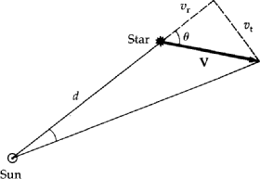
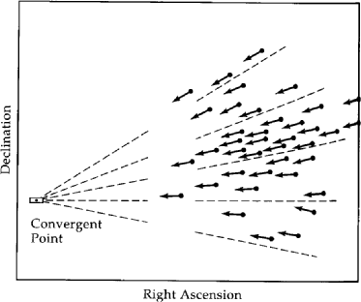
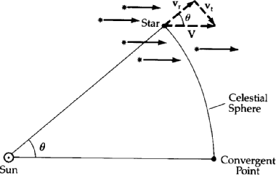
The Moving
Cluster
Method
Proper motion μ = v_{t}/d
v_{t} = v_{r} tanθ = d sinμ ~ dμ
v_{t} = 4.74 μ d = (4.74 μ) / p (km/s)
where p is parallax in arcsec
and μ is proper motion in arcsec/yr
Thus,
d = (<v_{r}> tan θ) / (4.74 <μ>)
p = (4.74 <μ>) / (<v_{r}> tan θ)

Slide 30
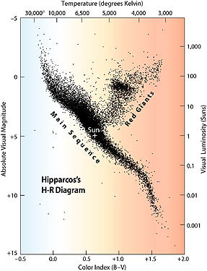
Main Sequence Fitting for Star Clusters
Luminosity (distance dependent) vs.
Temp. or color (distance independent)
Can measure distance to star clusters (open or globular) by fitting their main sequence of a cluster with a known distance (e.g., Hyades)
The apparent magnitudes difference gives the ratio of distances, as long as we know reddening!
There are no parallaxes to GCs (no nearby globulars) so we use parallaxes to nearby subdwarfs (metal-poor main sequence stars)
Hipparcos H-R diagram

Slide 31
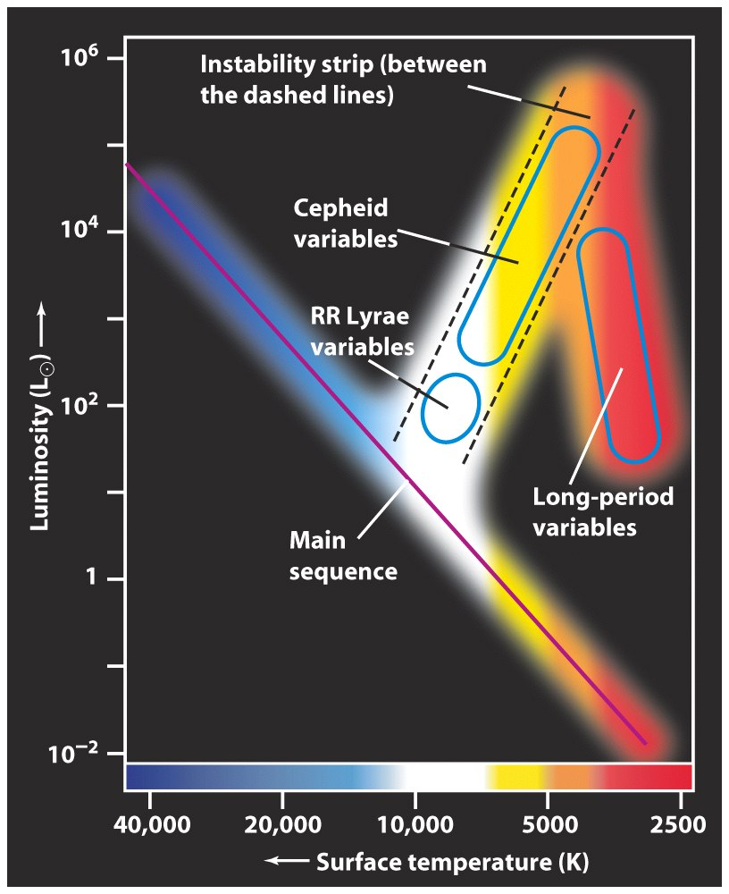
Pulsating Variables
Cepheids are high-mass, Pop. I stars
RR Lyrae are low-mass, metal-poor stars, often found in globulars
Long-period variables (e.g., Miras) pulsate in a fashion that is less well understood
All obey empirical period-luminosity rel’s which can be calibrated to yield distances

Slide 32
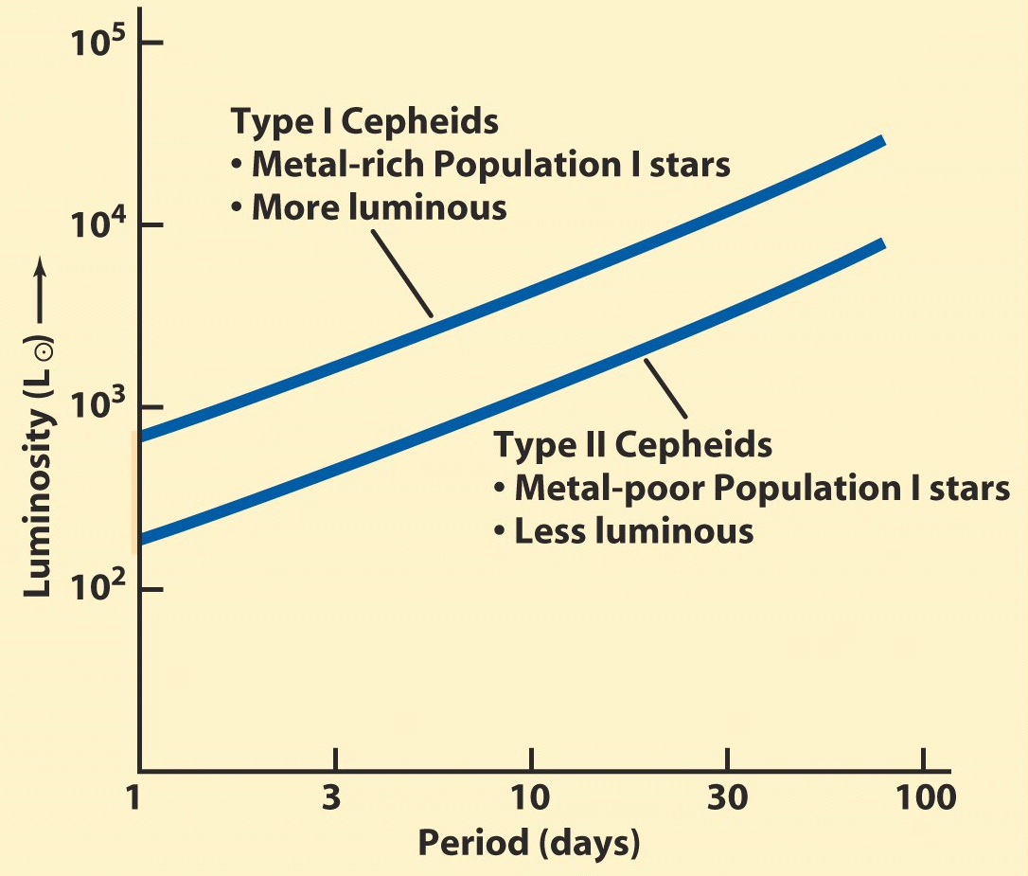
Population I vs. Population II
The first major revision in the distance scale was Walter Baade’s realization that there are different stellar population - and their most common pulsating
variables (classical Cepheids vs. RR Lyrae stars) have vastly different luminosities at the same pulsation periods

Slide 33
Cepheids
Luminous (M ~ -4 to -7 mag), pulsating variables, evolved high-mass stars on the instability strip in the H-R diagram
Shown by Henrietta Leavitt in 1912 to obey a period-luminosity relation (P-L) from her sample of Cepheids in the SMC: brighter Cepheids have longer periods than fainter ones
Advantages: Cepheids are bright, so are easily seen in other galaxies, the physics of stellar pulsation is well understood
Disadvantages: They are relatively rare, their period depends (how much is still controversial) on their metallicity or color (P-L-Z or P-L-C) relation; multiple epoch observations are required; found in spirals (Pop I), so extinction corrections are necessary
P-L relation usually calibrated using the distance to the LMC and now using Hipparcos parallaxes. This is the biggest uncertainty now remaining in deriving the H₀!
With HST we can observe to distances out to ~25 Mpc

Slide 34
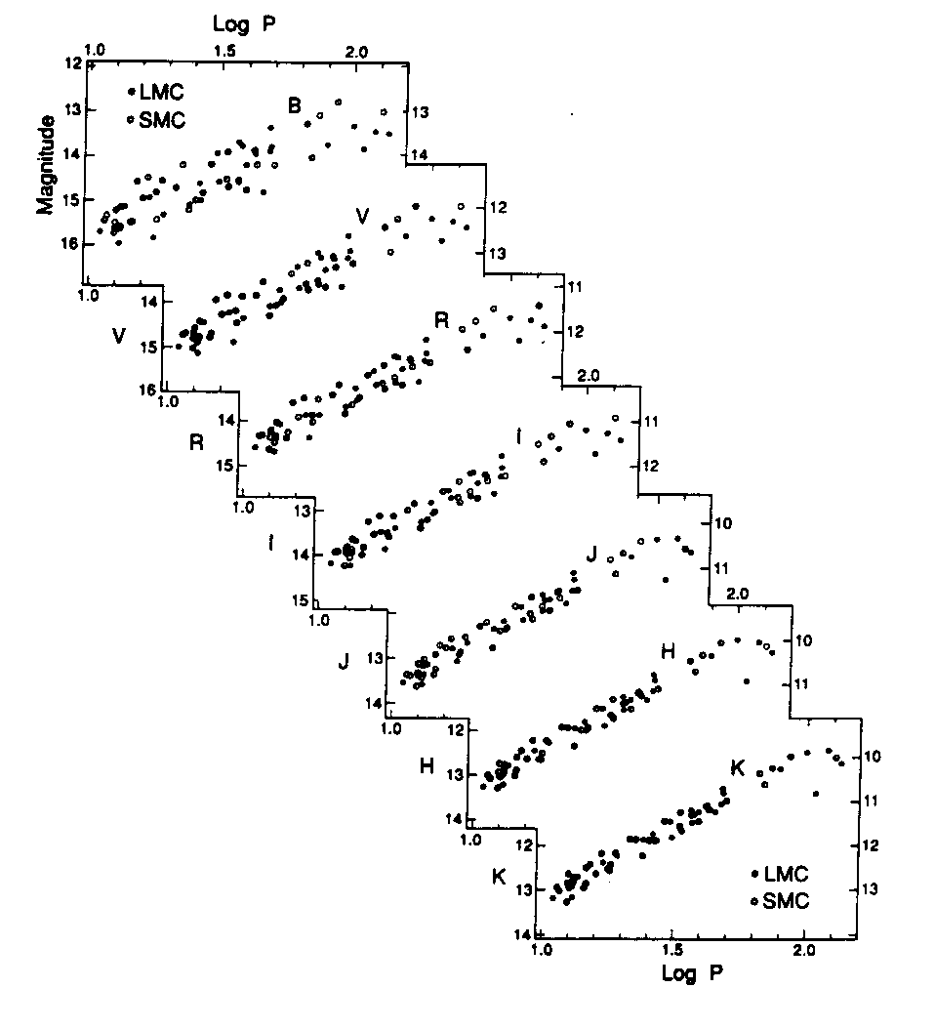
Cepheid P-L Relation in different photometric bandpasses
(Madore & Freedman 1998)
Amplitudes are larger in bluer bands, but extinction and metallicity corrections are also larger; redder bands
may be better overall

Slide 35
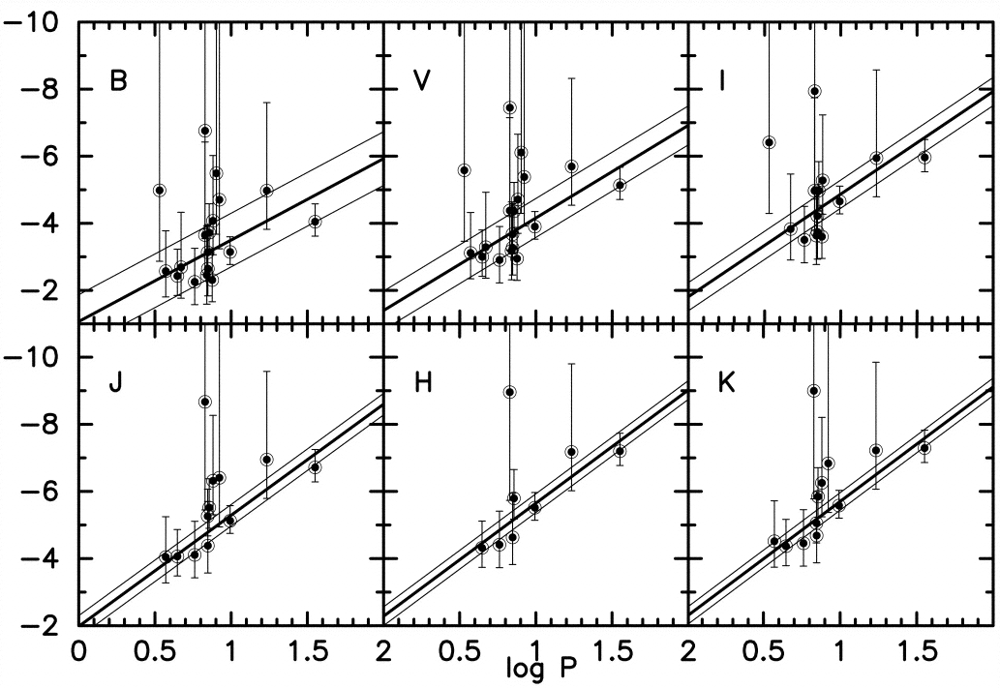
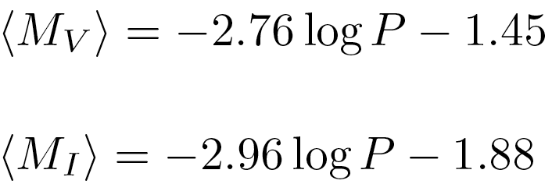
Hipparcos Calibration of the Cepheid Period-Luminosity Relation
P-L relations for Cepheids with measured parallaxes, in different photometric bands
(from Freedman & Madore)
Typical fits give:
… with the estimated errors in the range of ~ 5% - 20%

Slide 36
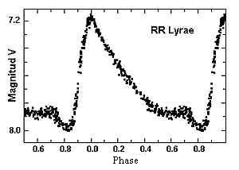
RR Lyrae Stars
Pulsating variables, evolved old, low mass, low metallicity stars
Pop II indicator, found in globular clusters, galactic halos
Lower luminosity than Cepheids, M_{V} ~ 0.75 +/- 0.1
There may be a metallicity dependence
Have periods of 0.4 – 0.6 days, so don’t require as much observing to find or monitor
Advantages: less dust, easy to find
Disadvantages: fainter (2 mag fainter than Cepheids). Used for Local Group galaxies only. The calibration is still uncertain (uses globular cluster distances from
their main sequence fitting; or from Magellanic Clouds clusters, assuming that we know their distances)

Slide 37
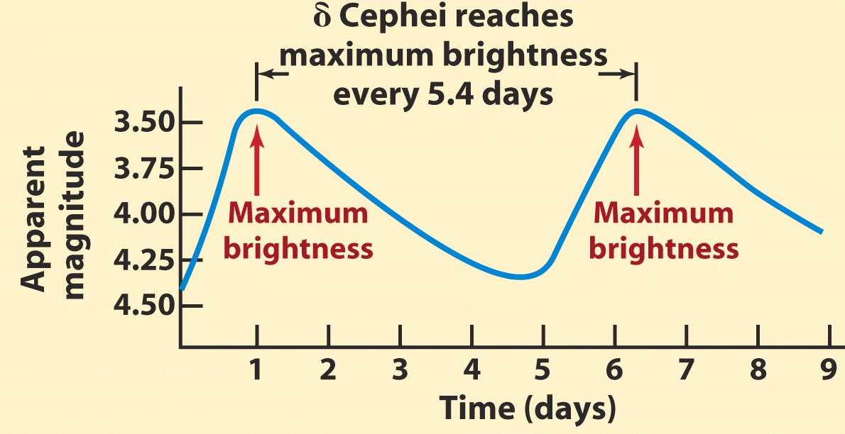
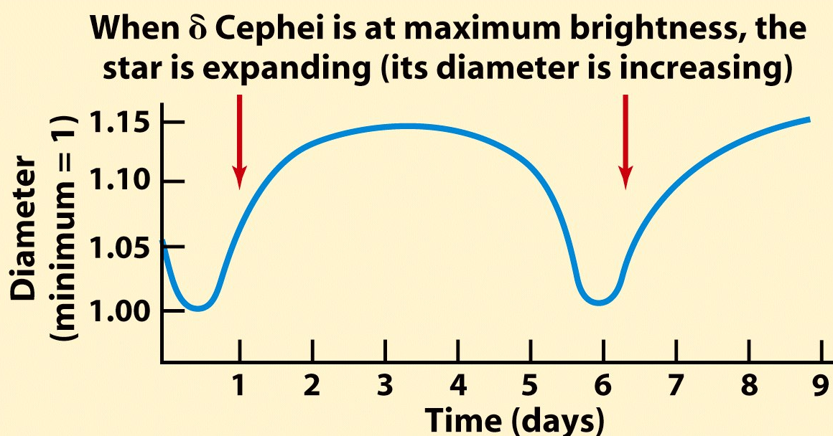
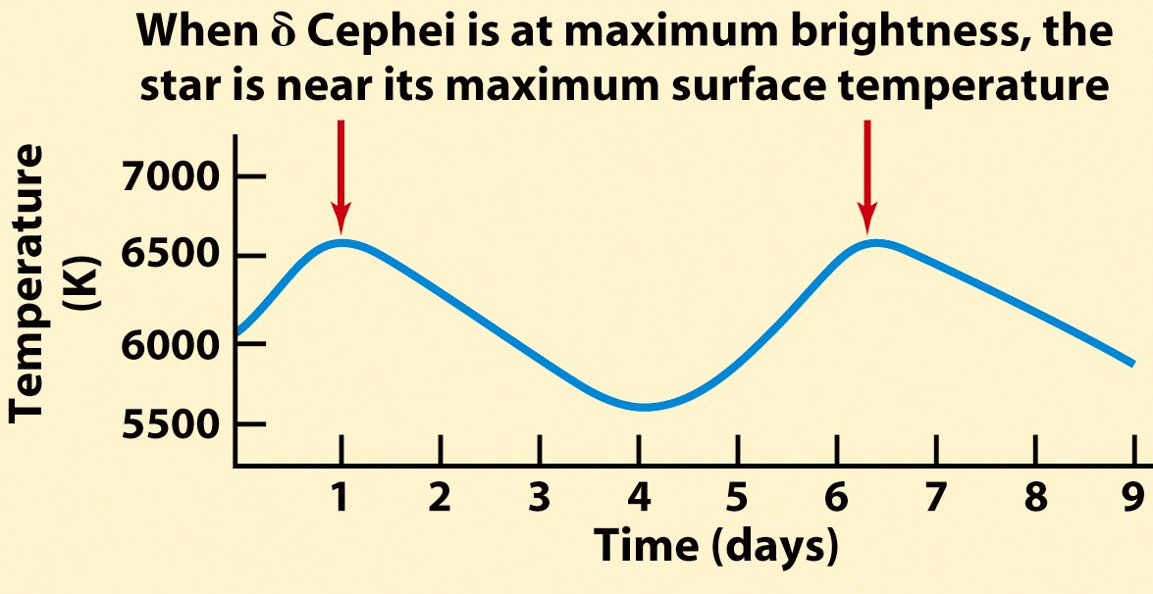
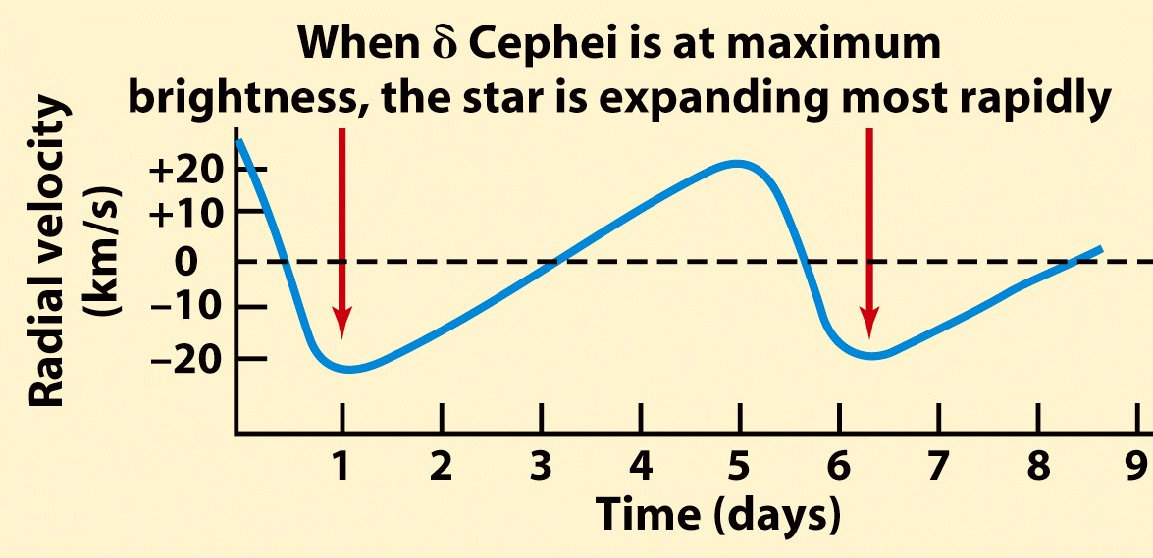
Physical Parameters of Pulsating Variables
Star’s diameter, temperature (and thus luminosity) pulsate, and obviously the velocity of the photosphere must also change

Slide 38
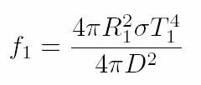
Baade-Wesselink Method
Consider a pulsating star at minimum, with a measured temperature T₁ and observed flux f₁ with radius R₁, then:
Similarly at maximum, with a measured temperature T₂ and observed flux f₂ with radius R₂:
Note: T₁ , T₂ , f₁ , f₂ are directly observable! Just need the radius…
So, from spectroscopic observations we can get the photospheric velocity v(t), from this
we can determine the
change in radius, ΔR:
 3 equations, 3 unknowns, solve for R₁, R₂, and D!
Difficulties lie in modeling the effects of the stellar atmospheres, and deriving the true radial velocity from what we observe.

Slide 39
Summary of the Key Ideas
This is a field with a venerable history – and it remains one of the most vibrant areas of modern astrophysics
We map the structure and kinematics of Galaxian subsystems using a combination of positional and spectroscopic measurements, and interpret them using stellar dynamics
Astrometry provides some of the most fundamental data we need; GAIA is the key forthcoming mission
Parallaxes are the only direct, model-independent way of measuring distances; everything else is statistical, model-dependent, or empirical, requiring basic calibrations
Other popular methods for determining distances to stars and clusters include: pulsating variables (e.g., Cepheids, RR Lyrae), main sequence fitting, the moving cluster method

