Slide 1
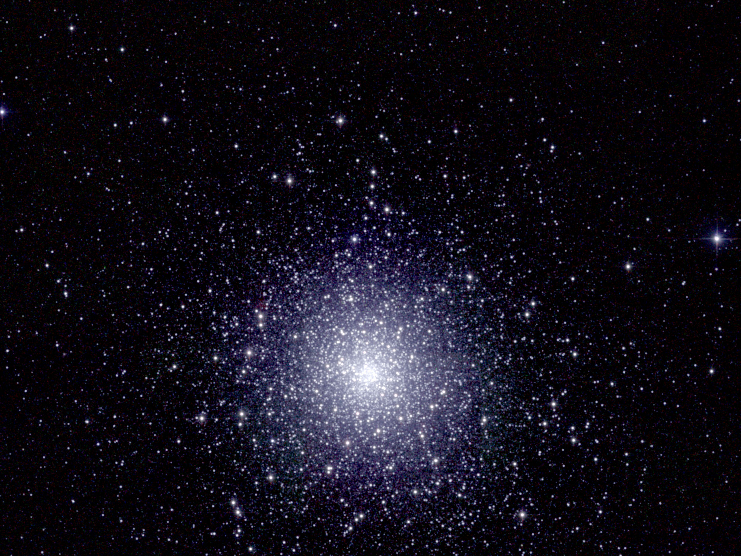
Ay 124 – Lecture 2 Photometry, Color-Magnitude Diagrams, Interstellar Extinction

Slide 2
Measuring Flux = Energy/(unit time)/(unit area)
Real detectors are sensitive over a finite range of λ (or ν).
Fluxes are always measured over some finite bandpass.
Total energy flux:
Integral of f_{ν} over all frequencies
Units: erg s⁻¹ cm⁻² Hz⁻¹
A standard unit for specific flux (initially in radio, but now more common):
f_{ν} is often called the flux density - to get the power, one
integrates it over the bandwith, and multiplies by the area
(From P. Armitage)

Slide 3
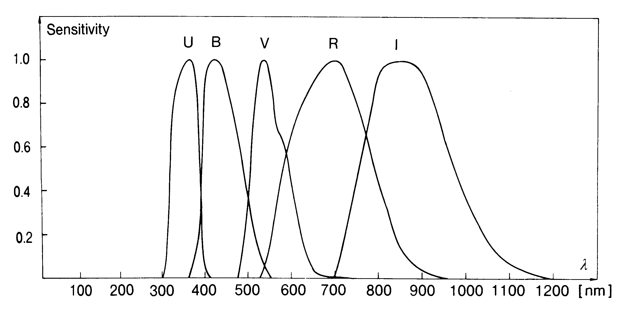
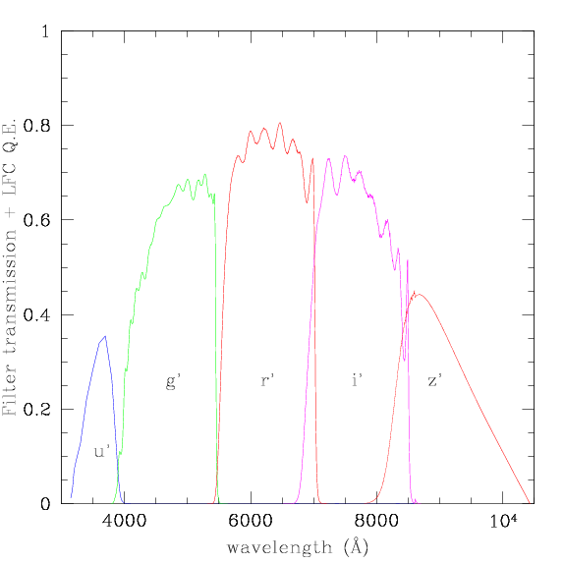
Some Common Photometric Systems (in the visible)
Johnson 
Gunn/SDSS
↓

Slide 4
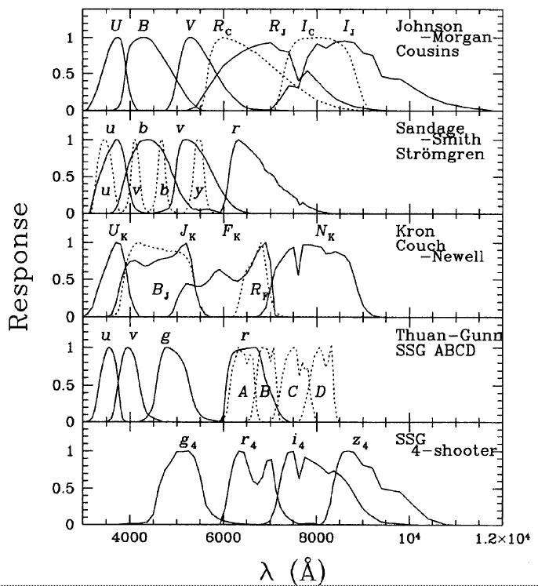
There are way, way too many photometric systems out there …
(Bandpass curves from Fukugita et al. 1995, PASP, 107, 945)

Slide 5
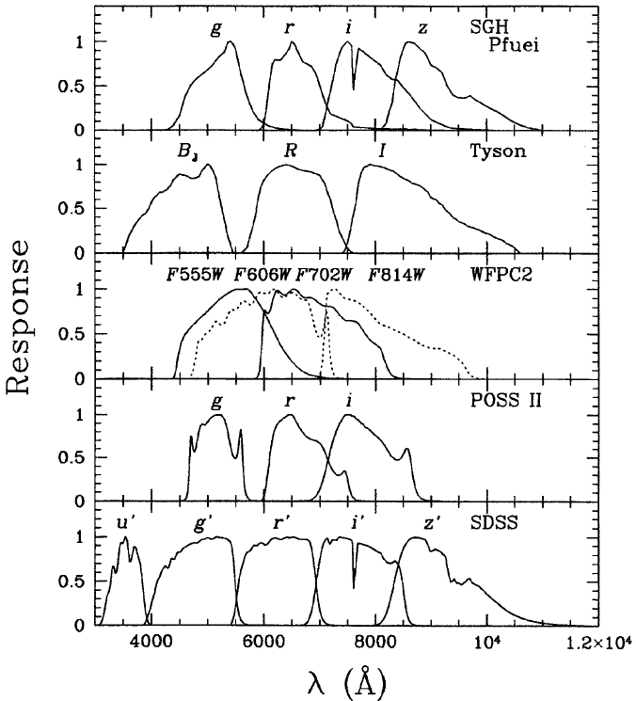
… and more …
… and more …
… and more …

Slide 6
Fluxes and Magnitudes
For historical reasons, fluxes in the optical and IR are
measured in magnitudes:
If F is the total flux, then m is the bolometric magnitude. Usually instead consider a finite bandpass, e.g., V band.
e.g. in the V band (λ ~ 550 nm):
f_{λ}
flux integrated over the range
of wavelengths for this band
λ
(From P. Armitage)

Slide 7
Using Magnitudes
Consider two stars, one of which is a hundred times fainter than the other in some waveband (say V).
Source that is 100 times fainter in flux is five magnitudes
fainter (larger number).
Faintest objects detectable with HST have magnitudes of
~ 28 in R/I bands. The sun has m_{V} = -26.75 mag
(From P. Armitage)

Slide 8
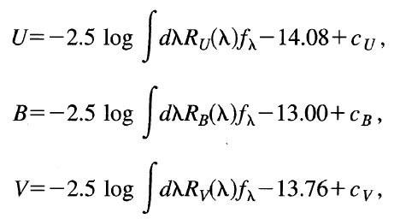
Magnitudes, A Formal Definition
e.g.,
Because Vega (= α Lyrae) is declared to be the zero-point! (at least for the UBV… system)

Slide 9
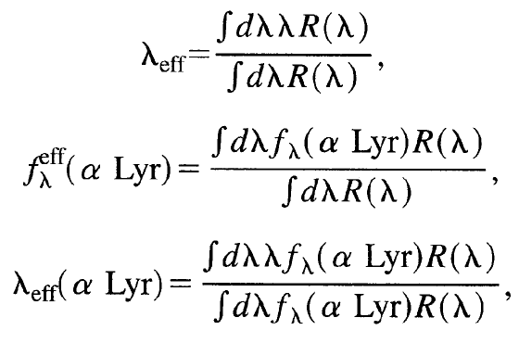
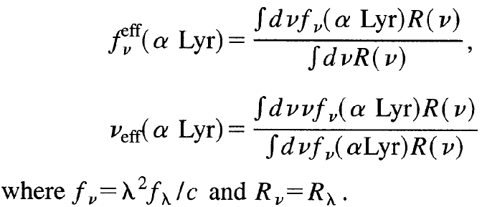
Defining
effective
wavelengths
(and the
corresponding
bandpass
averaged
fluxes)

Slide 10
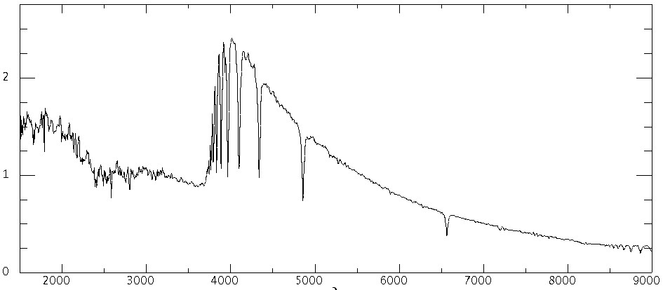
Magnitude Zero Points
f_{λ}
Vega = α Lyrae
Alas, for the standard UBVRIJKL…
system (and many others) the
magnitude zero-point in any band
is determined by the spectrum
of Vega ≠ const!
U
B
V
R
I
λ
Vega calibration (m = 0): at λ = 5556:
f_{λ} = 3.39 10 ⁻⁹ erg/cm²/s/Å
f_{ν} = 3.50 10 ⁻²⁰ erg/cm²/s/Hz
N_{λ} = 948 photons/cm²/s/Å
A more logical system is AB_{ν}
magnitudes:
AB_{ν} = -2.5 log f_{ν} [cgs] - 48.60

Slide 11
Photometric Zero-Points (Visible)
(From Fukugita et al. 1995)

Slide 12
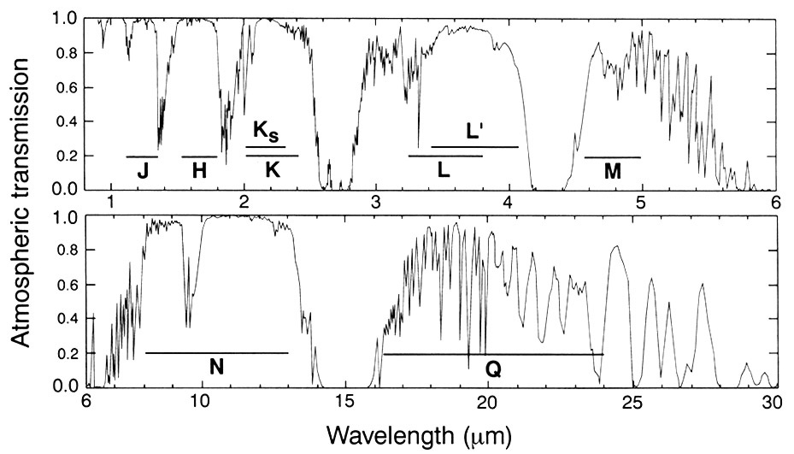
The Infrared Photometric Bands
… where the atmospheric transmission windows are

Slide 13
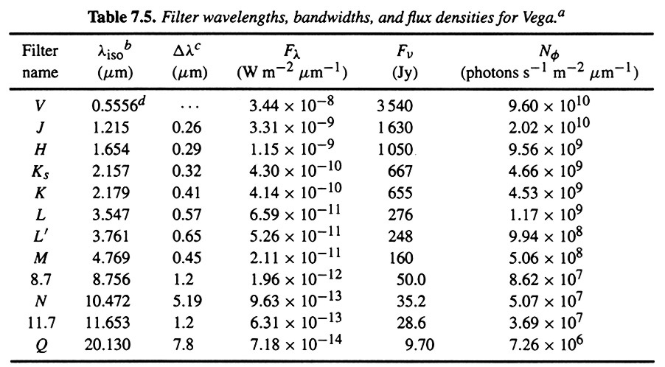
Infrared Bandpasses

Slide 14
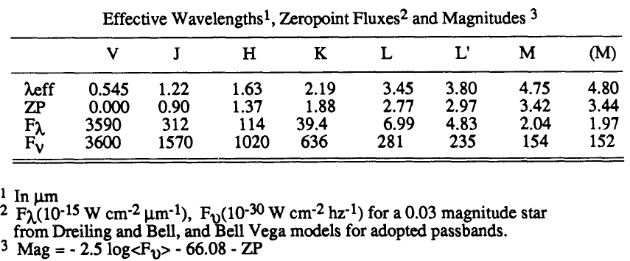
Infrared Bandpasses

Slide 15
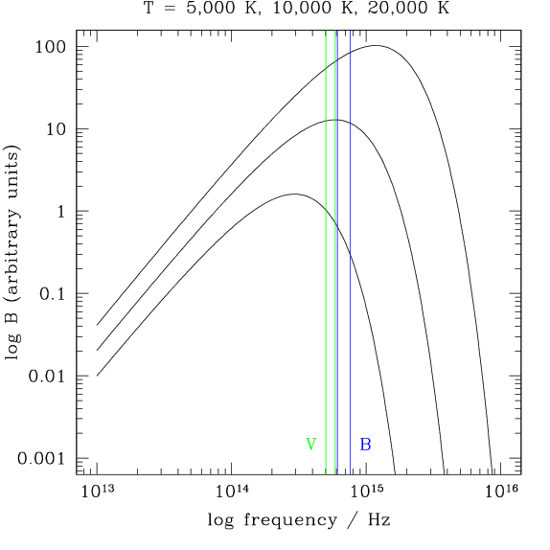
Colors From Magnitudes
The color of an object is defined as the difference in the magnitude in each of two bandpasses: e.g. the (B-V) color is: B-V = m_{B}-m_{V}
Stars radiate roughly as
blackbodies, so the color
reflects surface temperature.
Vega has T = 9500 K, by
definition color is zero.
(From P. Armitage)

Slide 16
Apparent vs. Absolute Magnitudes
The absolute magnitude is defined as the apparent mag.
a source would have if it were at a distance of 10 pc:
M = m + 5 - 5 log d/pc
It is a measure of the luminosity in some waveband.
For Sun: M_{B} = 5.47, M_{V} = 4.82, M_{bol} = 4.74
Difference between the apparent magnitude m and the absolute magnitude M (any band) is a measure of the distance to the source
Distance modulus
(From P. Armitage)

Slide 17
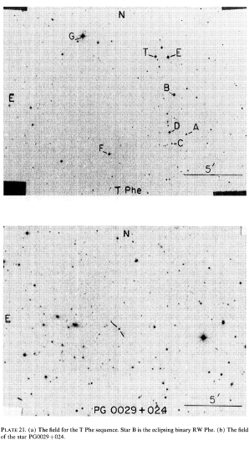
Photometric Calibration: Standard Stars
Magnitudes of Vega (or other systems primary flux standards) are transferred to many other, secondary standards. They are observed along with your main science targets, and processed in the same way.

Slide 18
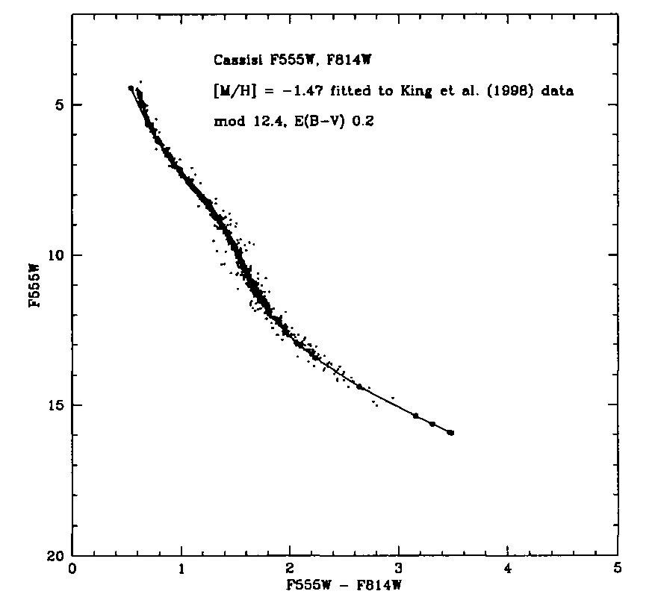
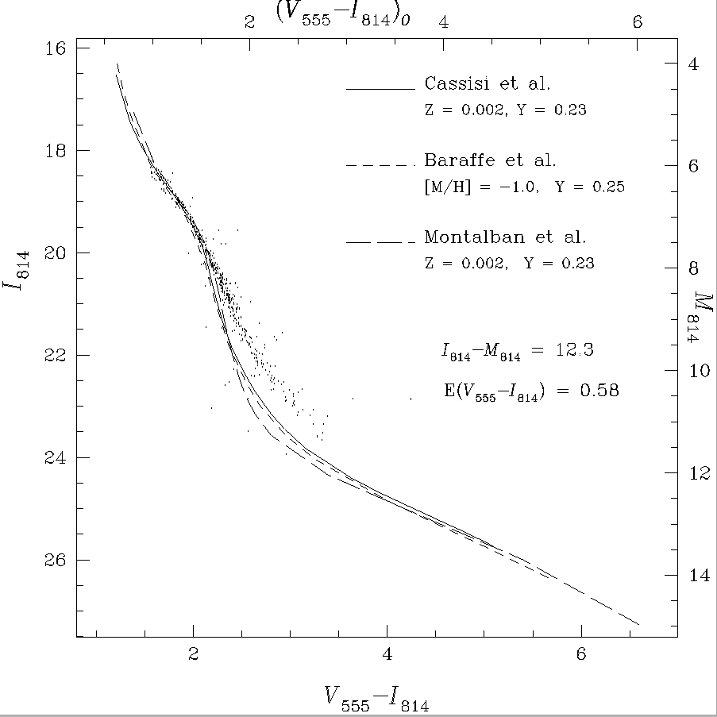
We often need to compare
observations with models,
on the same photometric
system
Low
metallicity
NGC 6397
(King, Anderson,
Cool, Piotto, 1999)
Always, always transform models to observational system, e.g., by integrating model spectra through your bandpasses
Intermediate
metallicity
M4
(Bedin, Anderson,
King, Piotto, 2001)

Slide 19
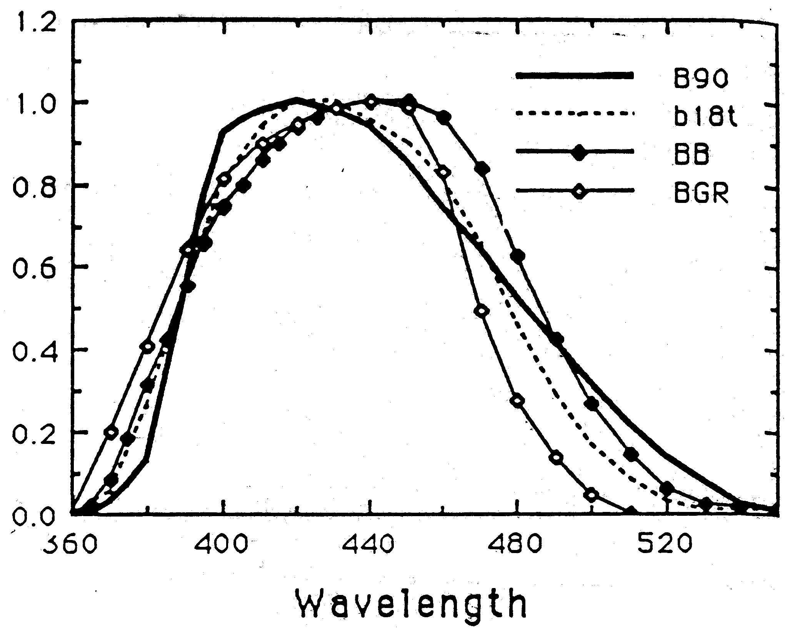
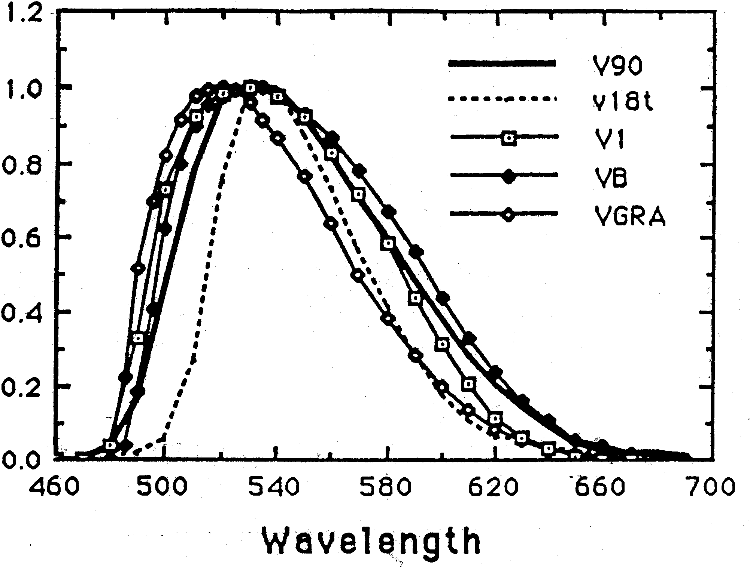
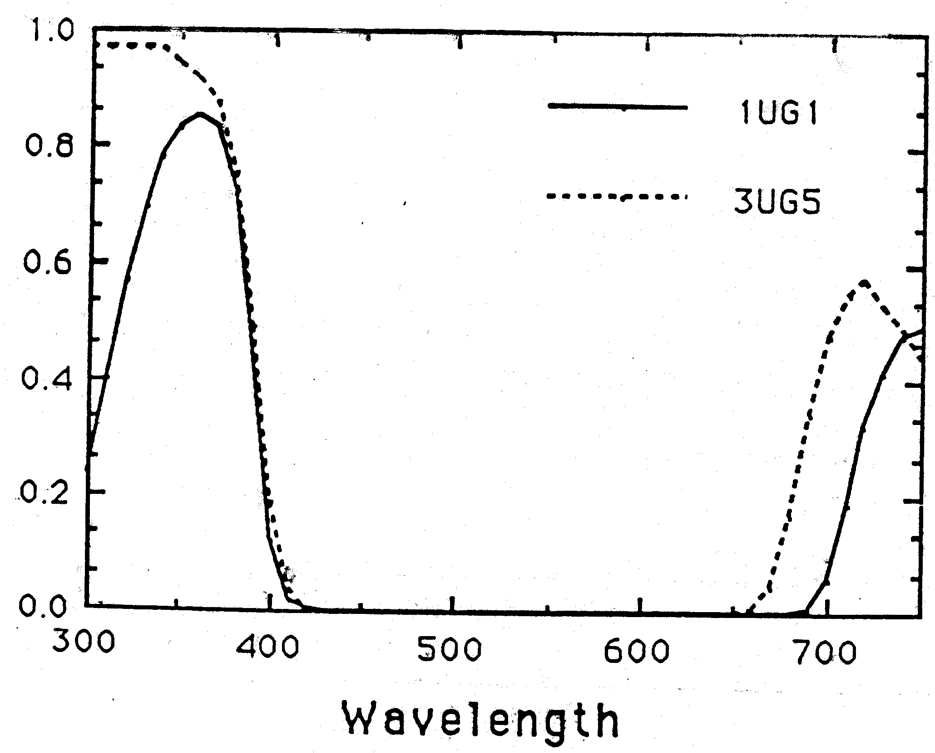
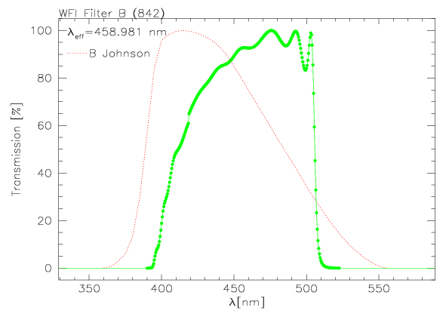
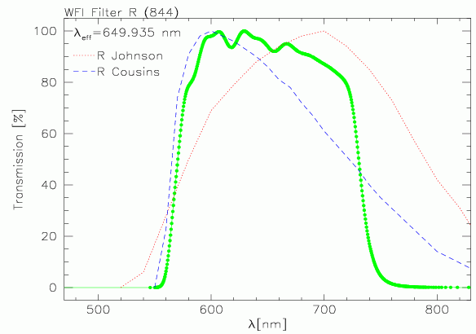
Alas, Even The “Same” Photometric Systems Are Seldom Really The Same …

Slide 20
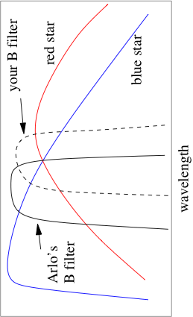
This Generates Color Terms …
… From mismatches between the effective bandpasses of your filter system and those of the standard system. Objects with different spectral shapes have different offsets:
A photometric system is thus effectively (operationally) defined by a set of standard stars - since the actual bandpasses may not be well known.

Slide 21
Hertzsprung-Russell Diagram (HRD)
The fundamental tool/framework for understanding stars and their evolution
Also used as a distance indicator, enabling the mapping of our Galaxy
The HRD classifies stars by their luminosity and temperature
Most stars fall on the Main Sequence of the H-R diagram, a sequence running from hot, luminous stars to cool, dim stars
Other stars, such as supergiants, giants, and white dwarfs, fall in different regions of the H-R diagram
Mass is the dominant parameter which determines where a star will fall on the HRD
Metallicity is a secondary parameter, an it shifts the stellar sequences at a given age

Slide 22
The Hertzsprung-Russell Diagram
Plot T_{e} against L (theorists) or color (e.g., B-V) against absolute magnitude (observers):
H-R diagram
Plot lines of constant
stellar radius on the
H-R diagram using:
log L
large R
Individual star is a
single point in this
plane.
small R
log T_{e}
HOT, BLUE stars
COOL, RED stars
It is a 2-D parameter space in which stars form 1-D sequences, which evolve in time. Metallicity is a “hidden” (2nd) parameter

Slide 23
Hipparcos HRD
The giant branch
The red clump
The subgiant branch
The (Pop I) main sequence
The subdwarfs (Pop II main seq.)
The white dwarf cooling sequence

Slide 24
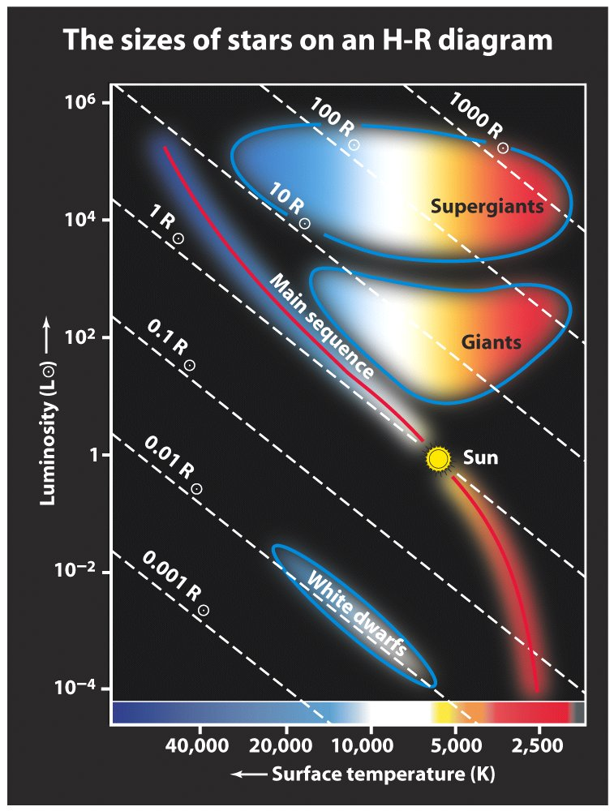
Luminosity Classification
Ia Bright supergiant
Ib Supergiant
II Bright giant
III Giant
IV Subgiant
V Main sequence star

Slide 25
Absorption by the Earth’s Atmosphere
The line shows the optical depth
Ionosphere [
However, even going into space does not always help: there is the absorption by the Galaxy’s ISM:
O₂,
etc.
Dust absorbs from soft X-rays to IR
H I absorbs from 912Å to soft X-rays
Plasma absorbs long wavelength radio
etc., etc.
H₂O,
OH,
etc.
Optical astronomy
Radio astronomy

Slide 26
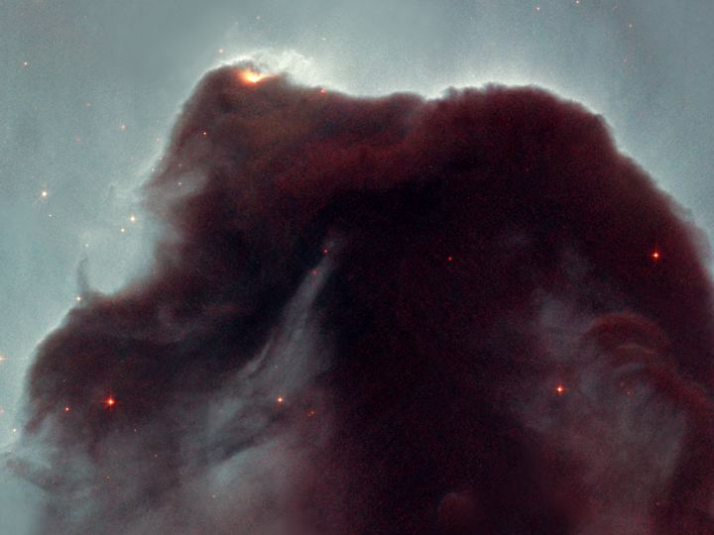
Interstellar Absorption (Extinction) and Reddening:
Caused by Interstellar Dust

Slide 27
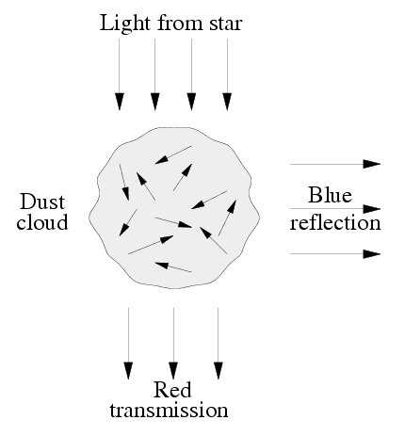
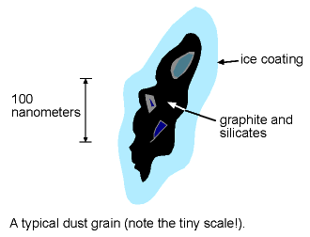
Interstellar Dust Grains
Probability of interaction with a photon increases for photons whose wavelength is comparable to or smaller than the grain size; longer wavelength photons pass through. Thus interstellar extinction = f(λ). (Note: this breaks down for high-energy photons)

Slide 28
Absorption of Light (In General)
If the radiation travels through a medium which absorbs (or
scatters) radiation, the energy in the beam will be reduced:
I_{n}
I_{n}+dI_{n}
dA
dS
Number density of absorbers (particles per unit volume) = n
Each absorber has cross-sectional area = s_{n} (units cm²)
If beam travels through ds, total area of absorbers is:
(From P. Armitage)

Slide 29
Fraction of radiation absorbed = fraction of area blocked:
absorption coefficient (units cm⁻¹⁾
Can also write this in terms of mass:
κ_{ν} is called the mass absorption coefficient or the opacity
Opacity has units of cm² g⁻¹ (i.e. the cross section of a gram
of gas).
(From P. Armitage)

Slide 30
Equation of radiative transfer for pure absorption:
Rearrange previous equation:
Different from emission because depends on how much
radiation we already have
Integrate to find how radiation changes along path:
s=s₀
s
(From P. Armitage)

Slide 31
e.g., if the absorption coefficient is a constant (example, a
uniform density gas of ionized hydrogen):
Specific intensity after
distance Ds
Radiation exponentially
absorbed with distance
Initial
intensity
Radiative transfer equation with both absorption and emission:
absorption
emission
(From P. Armitage)

Slide 32
Optical Depth
Look again at general solution for pure absorption:
Imagine radiation traveling into a cloud of absorbing gas,
exponential defines a scale over which radiation is attenuated.
When:
s=s₀
…intensity will be reduced to
1/e of its original value.
(From P. Armitage)

Slide 33
Define optical depth τ as:
or equivalently
A medium is optically thick at a frequency
if the optical depth for a typical path through
the medium satisfies:
Medium is said to be optically thin if instead:
Interpretation: an optically thin medium is one which a
typical photon of frequency ν can pass through without
being absorbed.

Slide 34
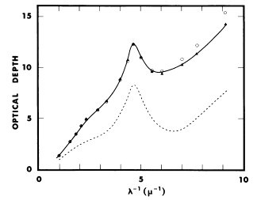
Interstellar Extinction Curve
Note: this is a log of the decrement!
(i.e., just like magnitudes)
IR
UV
The bump at λ ~ 2200 Å is due to silicates in dust grains. This is true for most Milky Way lines of sight, but not so in some other galaxies, e.g., the SMC

Slide 35
Extinction Curves are Not Universal
It depends on the chemical composition and size distribution of the dust grains
Often parametrized by
R_{V} = A_{V} / E_{B-V}

Slide 36
Color Sequence(s)
main sequence
supergiants
Since the extinction affects different colors differently, the shift of the color seq. can be used to estimate the reddening/extinction

Slide 37
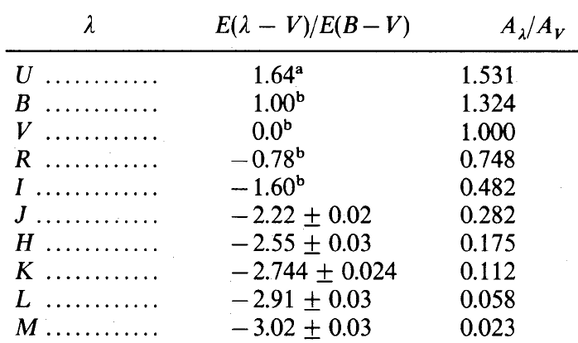
Interstellar Extinction in Standard Photometric Bandpasses
Note:
This is the ratio of extinction in magnitudes!
Dramatically lower extinction in IR! Which is why we use IR imaging to see through the dust…

Slide 38
The Cosecant Law
A rough estimate of the extinction along a given line of sight:
Approximate the dust layer as a uniform, finite slab of dust.
Then the path length along a line of sight to some Galactic latitude b is proportional to cosec b.
Then just multiply the extinction towards the Galactic poles (A_{V} ~ 0.1 mag) by cosec b (all in magnitudes)
Nowadays we actually use dust maps, derived from the FIR and radio emission maps, e.g., by Schlegel, Finkbeiner, & Davis

Slide 39
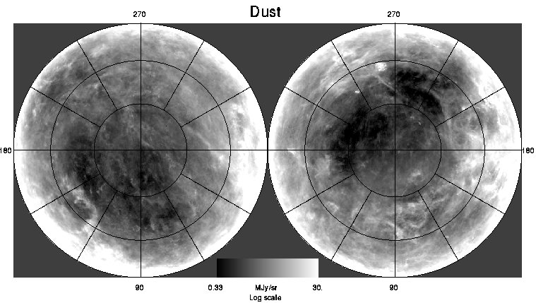
Galactic Extinction Map
From IRAS FIR fluxes (thermal emission from dust, and H I and molecular gas maps. These are the two Galactic hemispheres:
(Schlegel, Finkbeiner, & Davis)

Slide 40
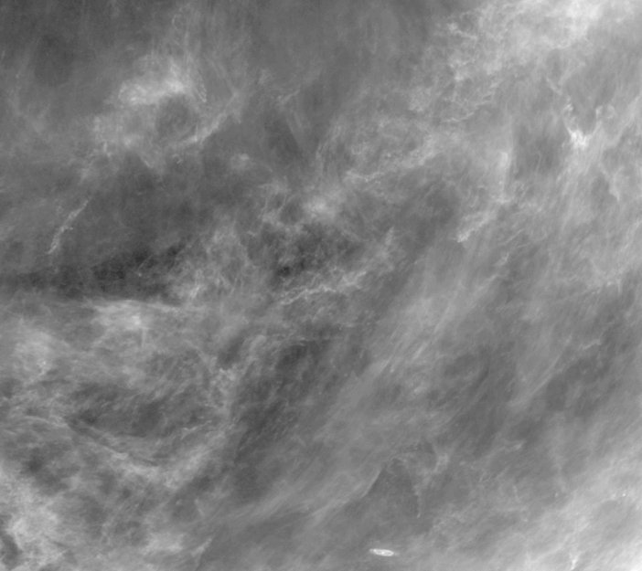
Dust Map: Detail
Note the complex,
multi-scale (fractal?)
structure

Slide 41
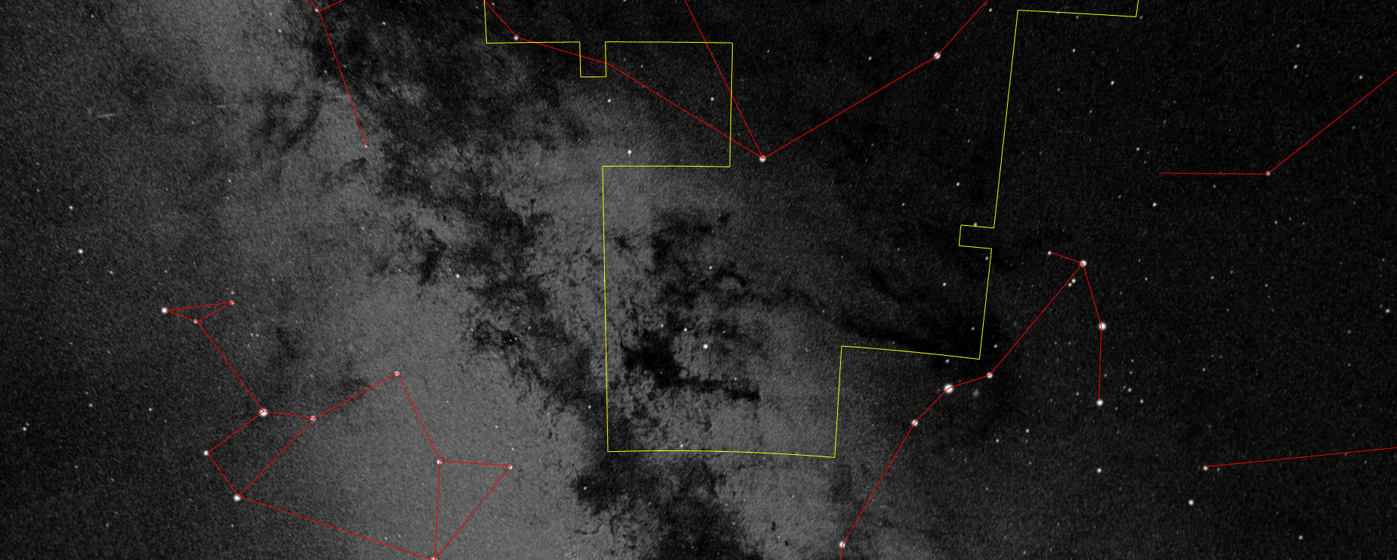
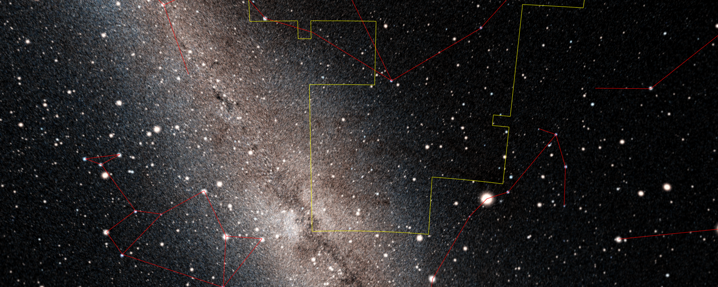
Visible Light
Near IR

Slide 42
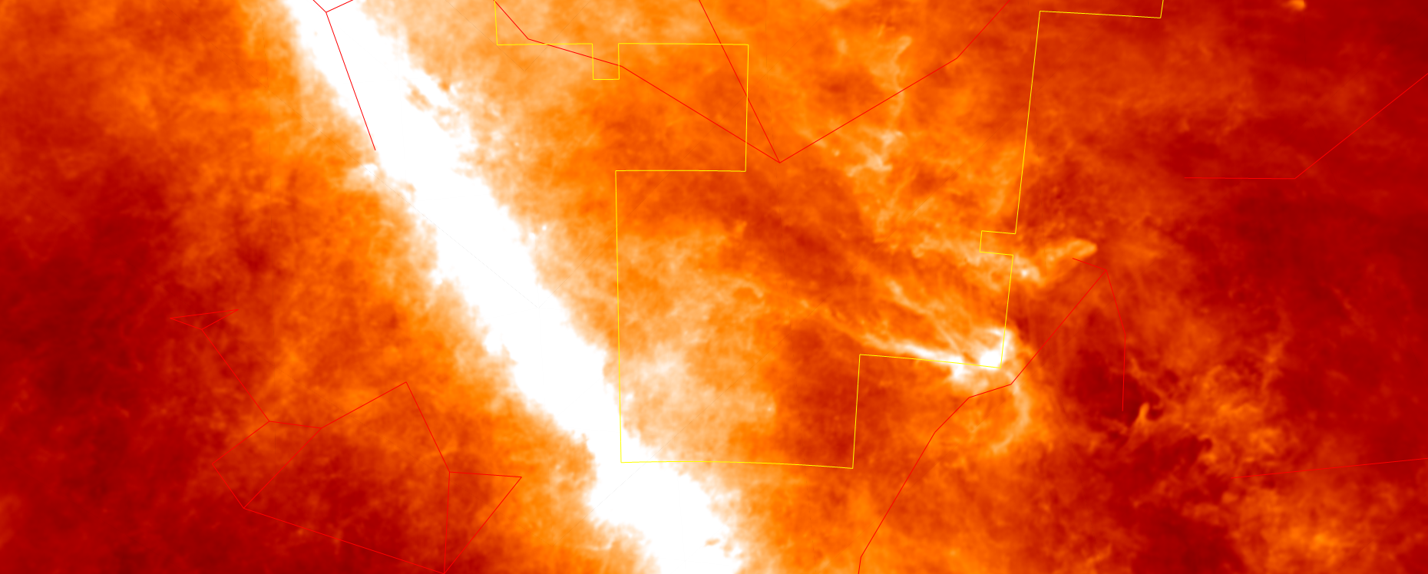
Visible Light
Dust Map

Slide 43
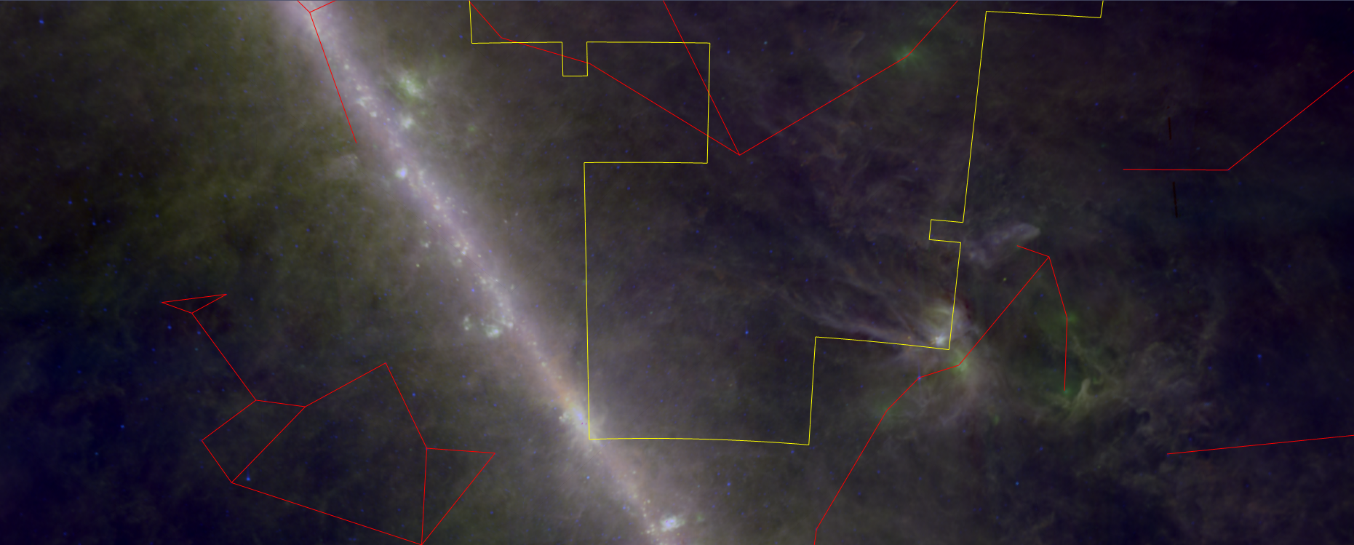
Visible Light
Far IR

Slide 44
Interstellar Polarization
Interstellar magnetic field orients the dust grains, which then serve as a polarizing screen. Measuring the polarization of starlight can then be used to map the field.

