Slide 1
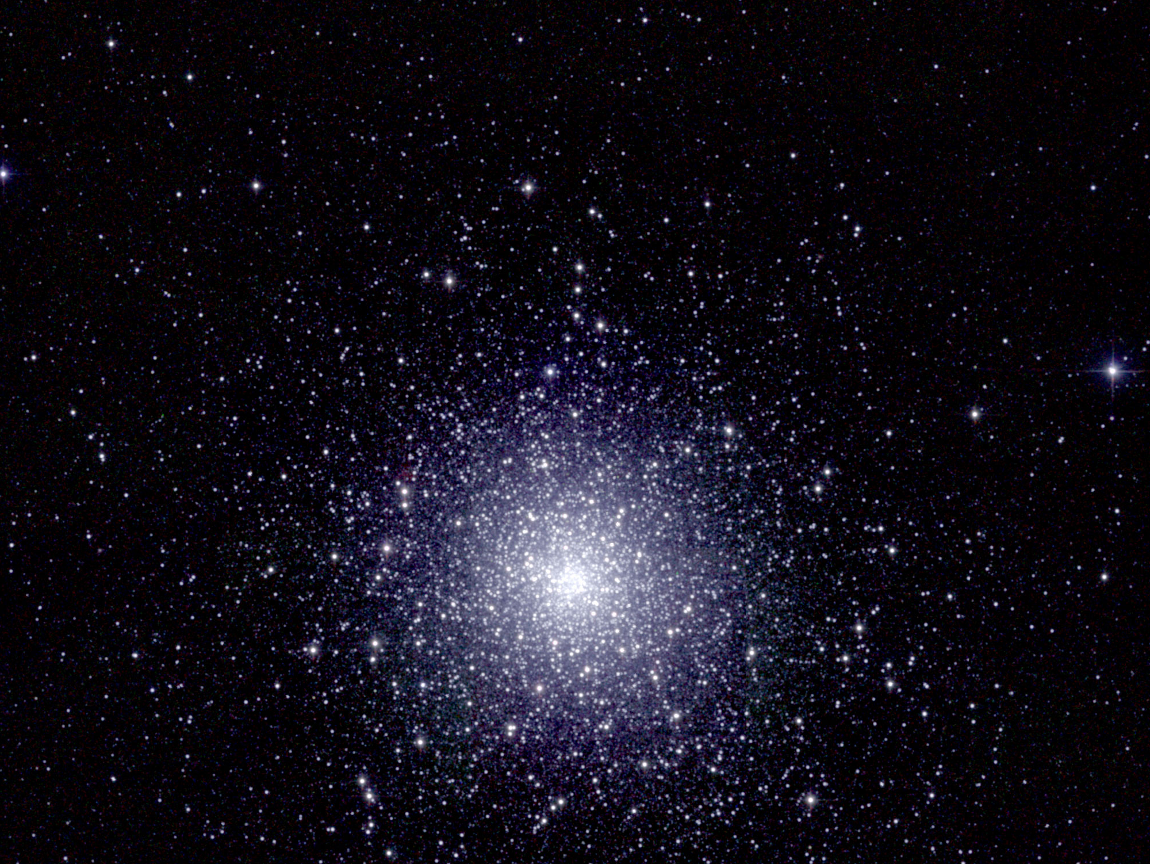
Ay 124 – Lecture 3 Stars, Their Evolution, Their Luminosity and Mass Functions

Slide 2
Understanding Stellar Populations
The HRD (CMD) is the fundamental tool and framework for understanding of stars and their evolution
And thus, for the modeling and understanding of the evolution of galaxies and their stellar populations
It is also a distance indicator for stars and stellar systems
Mass is the dominant parameter which determines where a star will fall on the HRD, and how it will evolve
It also determines the luminosities, lifetimes, evolutionary end products, chemical enrichment potential, etc.
Metallicity is a secondary parameter, and it shifts the stellar sequences at a given age
It also affects the spectra of stellar populations
Stellar structure and evolution are now very well understood, and can be used to interpret the observations of galaxies near and far

Slide 3
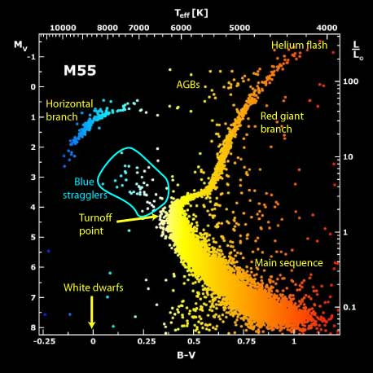
Typical HRD for an old (evolved) stellar population, e.g., a globular cluster

Slide 4
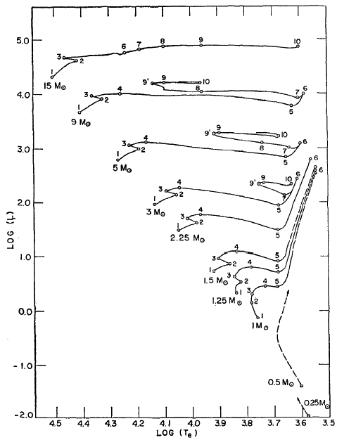
Stars of Different Mass Evolve Off the MS Along Different Paths in the HRD, but the Physics is Basically the Same
Note that the nonlinearity of the mass-luminosity relation(s) for stars decouples the stellar population components which dominate the mass from those which dominate the light
(From Iben)

Slide 5
Main Sequence and the Range of Stellar Masses
MS is the locus where stars burn H into He in their cores
Objects which cannot reach the necessary [T,ρ] to ignite this fusion, because of their low mass (M < 0.08 M) are called brown dwarfs (however, they may burn the trace amounts of primordial deuterium)
Not obvious why should stars form a (nearly) 1-dim. family of objects with the mass as the dominant parameter
The high-mass end of the stellar family is set by the Eddington limit
Believed to be ~ 100 M for ~ Solar metallicities
Current record: A1 in NGC3603 (~ 84 M)
Zero-metallicity stars could have been more massive

Slide 6
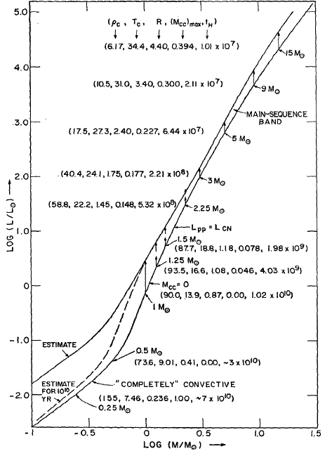
Life on the MS
Burning H into He changes the chemical composition and lowers the pressure
Core shrinks, heat up and burns H at a higher rate
Luminosity increases, which causes the outer envelope to swell up
The MS stars begin on the lower edge of the MS band and move up and to the right

Slide 7
Stellar Lifetimes on the Main Sequence
The duration of a star’s MS lifetime depends on the amount of hydrogen in its core (fuel supply) and the rate at which it is consumed, i.e., luminosity
Core H burning ends when the star converts a certain fraction of its total mass into He, the so-called Schönberg-Chandrasekhar limit,
(M_{core} /M ) ≈ 0.37 (μ_{e} /μ_{core})² ≈ 0.08 - 0.1
Since the M-L relation is so non-linear, L ~ M^{α}, with α ~ 3 - 5, the more massive a star, the shorter is its MS lifetime:
The same principle applies to post-MS stages of stellar evolution
Generally, later stages of stellar evolution last shorter, because there is less fuel to burn, and because of the non-linearity of the M-L relation, which may be driven by the highly non-linear dependence of the TNR rates on [T,ρ]

Slide 8
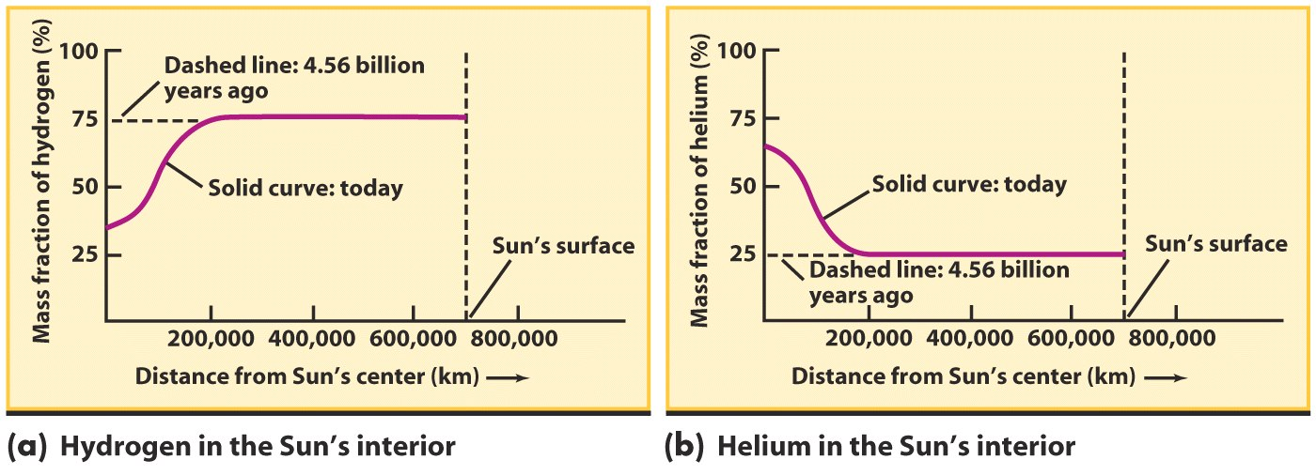
Stellar Lifetimes on the Main Sequence

Slide 9
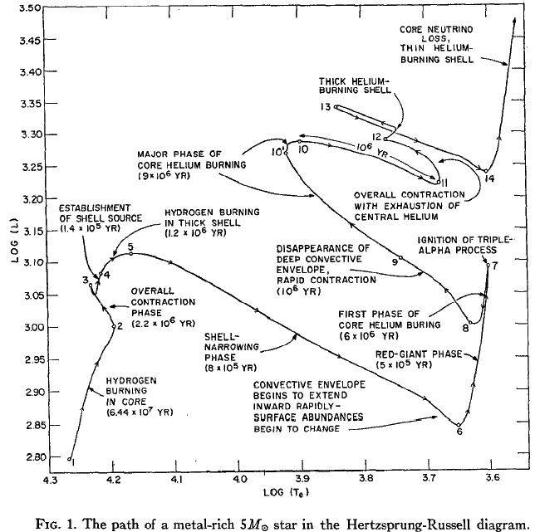
Stellar Evolution is a Sequence of Different Energy Production (Nuclear Fusion) Mechanisms
(From Iben)

Slide 10
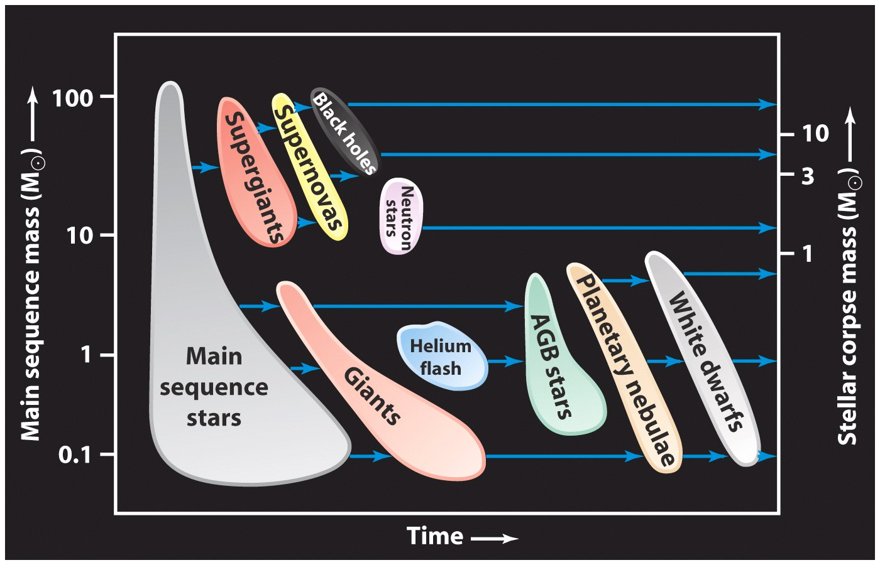
Pathways of Stellar Evolution

Slide 11
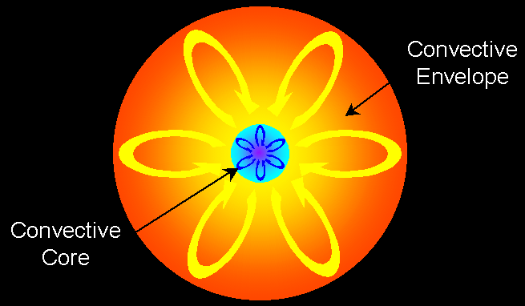
Very Low Mass Stars: Red Dwarfs
Mass < 0.4 M
Their structure is all convection zone, H and He is mixed throughout the star
Just burn H slowly
Will never build up a He core, and never ignite He
Could perhaps survive on the MS for a 100 Gyr!
Then just fade as a WD / Black Dwarf
Unimportant contributor to the total luminosity of a galaxy, but contain most of the stellar mass

Slide 12
The End of the MS Phase
On the MS, a star is in a hydrostatic equilibrium, and its core is sufficiently hot to fuse H into He
Now the star has two chemically distinct zones, a core of inert He surrounded by an H envelope - the core of a MS star is not sufficiently hot for He burning
When the core becomes pure He, a new evolutionary phase stars - the ascent to the Red Giant Branch (RGB)
Without energy generation, the core cannot support itself against gravitational collapse and so it begins to shrink; as it collapses it heats up
This heat is transferred to a thin shell of H around the core which reaches a temperature in which H fusion can occur
This He flash ends the ascent to the RGB, star descends to HB

Slide 13
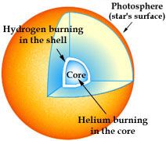
Red Giants
As the core continues to collapse, the temperature in the H fusing shell continues to rise and thus the luminosity in the shell increases as does the pressure
The entire star is no longer in a hydrostatic equilibrium, and the envelope begins to expand
As they expand these outer layers cool - the star becomes redder, while its luminosity increases: the star slowly ascends the RGB
When the core has heated to T ~ 10⁸ K, it starts the fusion of He into C (He flash), which dominates the total energy production
The star is in a quasi-static equilibrium. The lifetime of a star as a Red Giant is about 10% of its MS lifetime

Slide 14
Helium Flash: The End of the RGB
H fusion leaves behind He ash in the core of the star which cannot begin to fuse until the core reaches temperature of ~ 10⁸ K. How a star begins He fusion depends on its mass:
M > 3 M stars contract rapidly, their cores heat up, and He fusion begins gradually
Less massive stars evolve more slowly and their cores contract so much that degeneracy occurs in the core
When the temperature is hot enough He fusion begins to make energy and the T rises, but pressure does not increase due to degeneracy
Higher T increases He fusion even further resulting in a runaway explosion: the Helium Flash which for a few minutes can generate more luminosity than an entire galaxy. The flash does not destroy the star: the envelope absorbs the energy
The star then sheds its convective envelope, and the radiative core settles on the Horizontal Branch (HB), the He main sequence

Slide 15
Low-mass stars go through two distinct red giant stages
A low-mass star becomes
A red giant (RG) when shell H fusion begins
A horizontal branch (HB) star when core He fusion begins
An asymptotic giant branch (AGB) star when the He in the core is exhausted and shell He fusion begins
AGB stars shedding their envelopes are the major sources of interstellar dust

Slide 16
Dredge-ups bring the products of nuclear fusion to a giant star’s surface
As a low-mass star ages, convection occurs over a larger portion of its volume
This takes heavy elements formed in the star’s interior and distributes them throughout the star
When the star looses is envelope at the end, the ISM is enriched

Slide 17
The End Phases of Stellar Evolution
The evolution and eventual fate of stars in the late stages of their lives are critically dependent on the amount of matter they have at birth:
Stars with initial masses of less than ~ 8 M end their lives as white dwarfs (WD). The star sheds its RG envelope, which becomes a planetary nebula (PN), and the inert, degenerate core cools passively, and it photoionizes the PN
Stars with initial masses greater than ~ 8 M end their lives by exploding as supernovae (SNe, generally type II). The stellar remnants are neutron stars (NS) or black holes (BH), depending on the progenitor mass
Note: this is not the only way to produce a SN; type Ia SNe come from accreting WD
SNe are the main agents of the chemical enrichment of the ISM and subsequent generations of stars

Slide 18
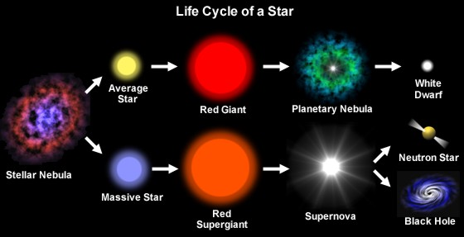
The Life and Death of Stars

Slide 19
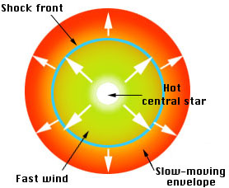
Planetary Nebulae
A RG brightens by a factor of ~ 10³ - 10⁴. The outer, H-rich envelope swells up to a few au, with T ~ 2,000 - 3,000 K
A strong stellar wind begins to blow and it carries away most of the H envelope
During the final shedding of its envelope, when the mass loss is the greatest, the star becomes unstable and pulsates, with periods ~ few months to > 1 yr. Such stars are called long-period variables (LPVs)
The envelope material ejected by the star forms an expanding shell of gas that is known as a planetary nebula (PN)
PNe expand with V ~ 10 - 20 km/s, and plow into the surrounding ISM, contributing to its chemical enrichment

Slide 20
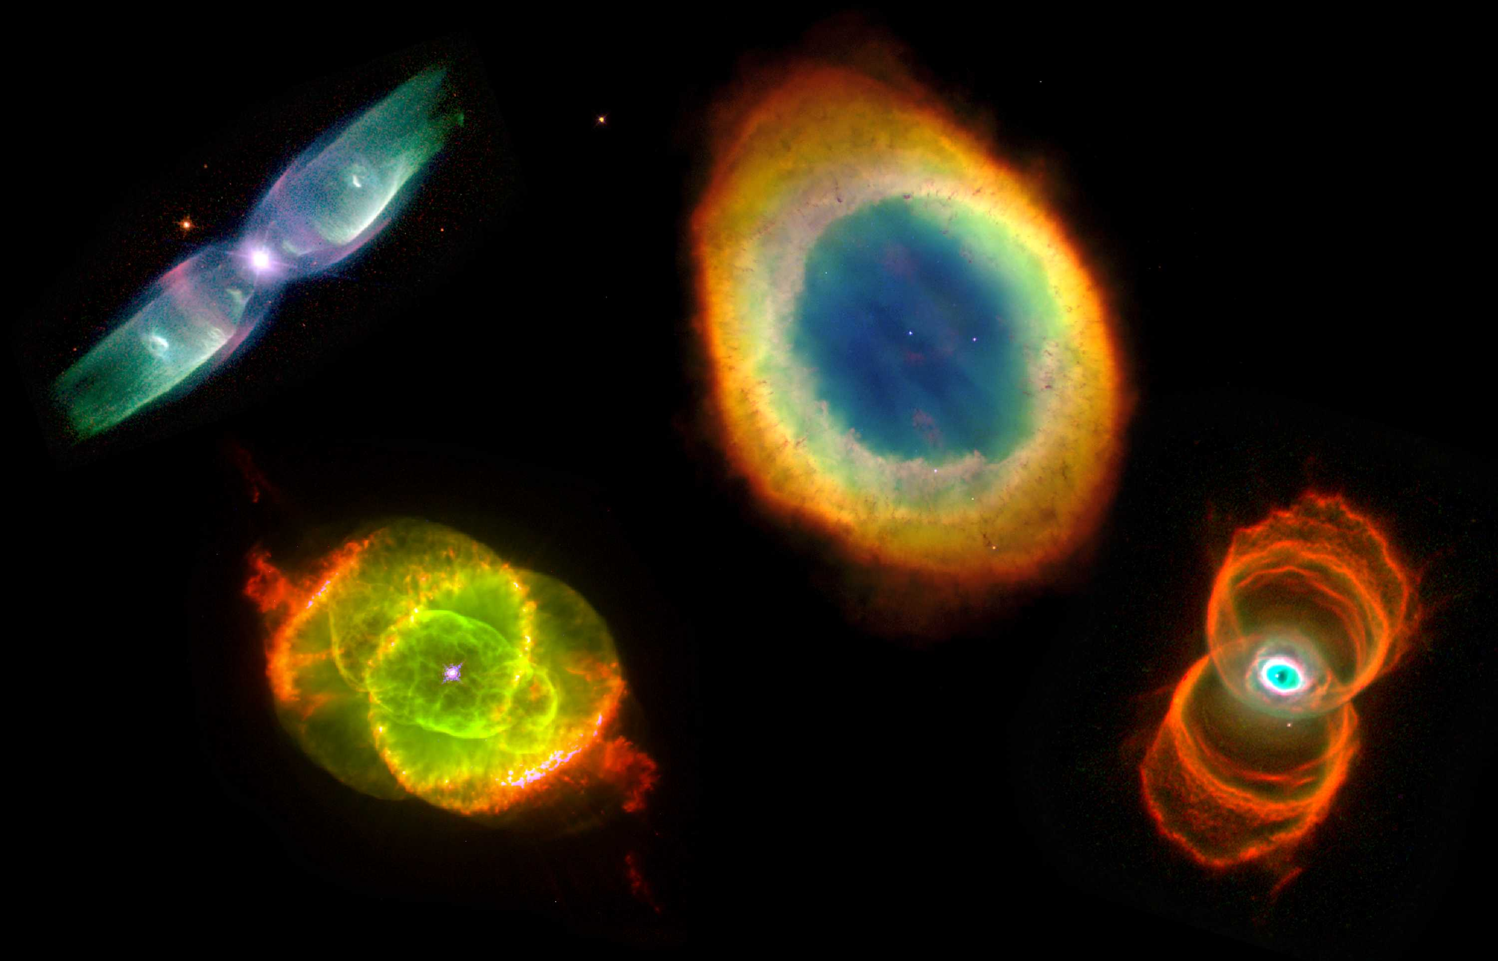
Planetary Nebulae From HST
Note the prevalence of bipolar ejection morphologies

Slide 21
The Future of the Sun
PN
WD

Slide 22
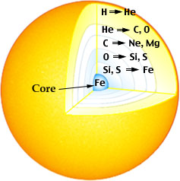
High-mass stars create heavy elements in their cores
A high mass star undergoes an extended sequence of thermonuclear reactions in its core and shells: He to C, N, O, then to Ne, Mg, then to Si, S, all the way to Fe
Beyond Fe, TNRs are endothermal; heavier elements are produced in SN explosions

Slide 23
Stellar Lifecycle Summary
Initial stellar mass
in Solar masses
C, O, Si etc
Black holes
SUPERNOVA EXPLOSIONS
20
He burning
Neutron stars
8
Main sequence
hydrogen burning
Carbon / oxygen
white dwarfs
0.5
Deuterium
burning
Helium white
dwarfs
0.08
Brown dwarfs
Time / yr
10⁷
10⁸
10⁹
10¹⁰
10¹¹
(From P. Armitage)

Slide 24
Testing Stellar Evolution
The problem: stellar evolution happens on Gigayear time scales
The solution: use H-R Diagrams of star clusters with a wide range of ages and stellar masses
Open clusters contain ~ 10² – 10⁴ stars with a broad mass range; globular clusters contain ~ 10⁴ – 10⁶ stars
All stars are at the same distance, so it is easy to measure their relative luminosities
They (generally) have the same age, have the same chemical composition, i.e., they are “simple stellar populations”
Each cluster thus provides a snapshot of what stars of different masses look like at the same age and composition (coeval populations)
Lines describing stellar population loci at a given age are called isochrones; they are metallicity-dependent

Slide 25
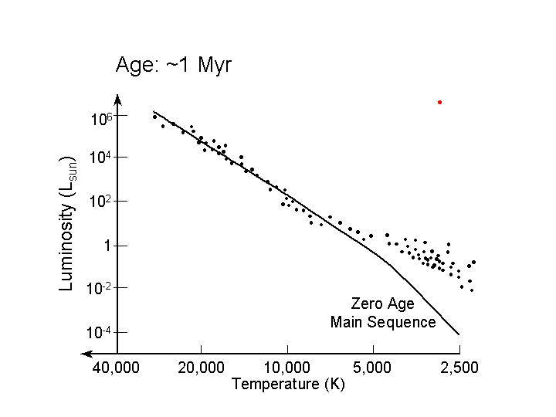
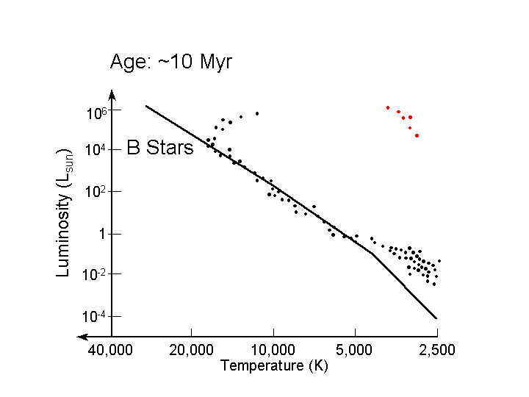
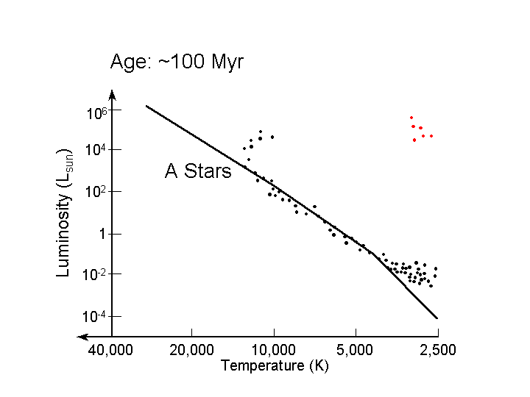
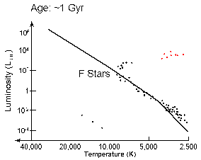
The RGB peels off from the MS at different spectral types as a f(age)

Slide 26
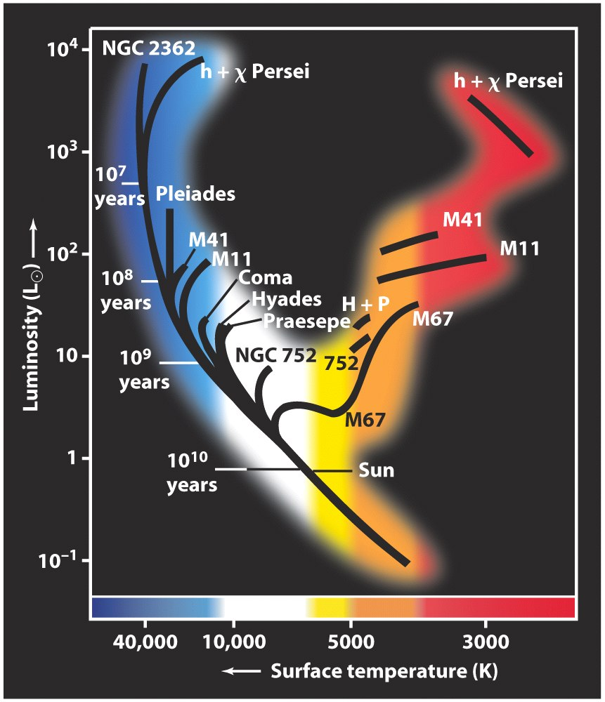
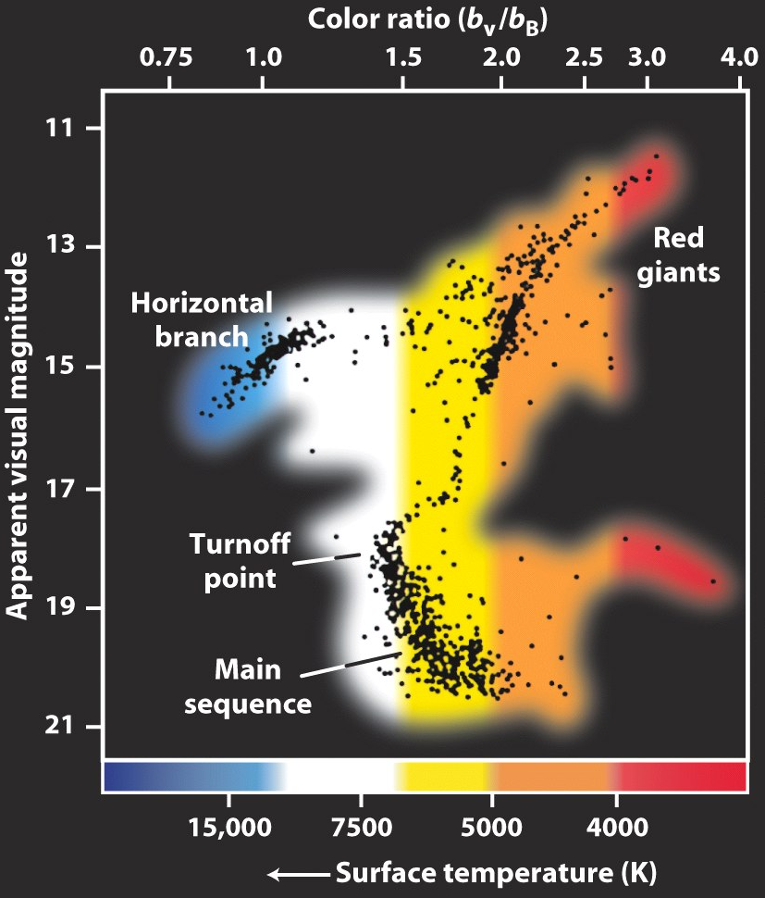
HRDs of open clusters with a range of ages
Typical old globular cluster HRD

Slide 27
Stellar Masses
The most important physical property of stars: determines everything else (L, T, evolution …)
Mass-luminosity relation is a key concept
It is only from binary stars that we can accurately determine the masses of individual stars
A key uncertainty is the orbit inclination
Eclipsing binaries are the most useful in that the masses and radii of the individual stars can be determined from the light curve and radial velocity data, using the Kepler’s laws:
M₁ + M₂ = const.  a³ / P²
(Note: exactly the same approach is used in radial velocity searches for extrasolar planets)

Slide 28
Stellar Masses From Binaries
Kepler’s Law: consider for simplicity circular orbits
Stars mass: M₁
and M₂, orbital
radii a₁ and a₂
In orbit around the center of mass (CM)
of the system
CM
M₂
M₁
a₂
a₁
From definition of center of mass:
Let total separation:
Then:
(From P. Armitage)

Slide 29
Apply Newton’s law of gravity and condition for circular
motion to M₂:
is angular velocity of the binary
Substitute for a₂:
Visual binary: see each orbit so know immediately a₂ / a₁:
determines ratio of masses M₁ / M₂
If we know distance, then angular separation + d gives a,
which with period P determines sum of masses M₁ + M₂
(From P. Armitage)

Slide 30
So this is enough information to get both M₁ and M₂…
Now consider spectroscopic binaries with circular orbits
(often a good approximation because tides in close binaries
tend to circularize the orbits)
Velocities are constant around
the orbit:
v₁
M₂
M₁
a₂
a₁
v₂
But alas, there are projection effects…
(From P. Armitage)

Slide 31
We don’t observe v₁ and v₂ - only the component of those velocities along our line of sight:
i
Direction to
observer
v₁
Orbital plane
Maximum component of velocity along the line of sight is:
i is the inclination angle of the
binary system
Radial velocities are
the observables
(From P. Armitage)

Slide 32
Ratio of maximum observed radial velocities is:
Ratio of masses can be found if we see spectral lines from
both stars (a “double-lined” spectroscopic binary), without
knowing the inclination. To find the sum of the masses,
note:
Use Kepler’s law again:
(From P. Armitage)

Slide 33
Replace v₁ and v₂ with the observable radial velocities:
So… we can determine sum of masses (and hence the
Individual masses M₁ and M₂) only if the inclination i
can be determined.
Requires that the stars are also eclipsing:
Detailed shape of lightcurve gives i
Obviously must be close to i = 90º to see eclipses!
Rare binaries are main source of information on stellar
masses…
(From P. Armitage)

Slide 34
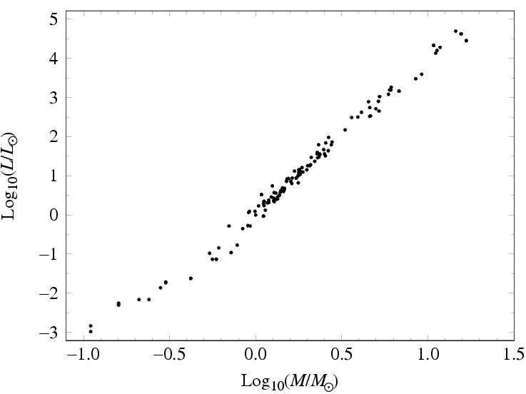
Stellar Mass-Luminosity Relation
L ~ M ⁴
A key relation for understanding of stellar physics
Main Sequence stars follow this relation, but giants, supergiants, & white dwarfs do not (different slopes)

Slide 35
Stellar Luminosity and Mass Functions
Basic statistical descriptors of stellar populations: probability distribution for stellar luminosities (a function of the bandpass) and masses
Most important: stellar Initial Mass Function (IMF) = mass function at the formation time
Key in understanding and modeling star formation and galaxy evolution
Needed in order to estimate stellar (baryonic?) mass content of galaxies (and other stellar systems) from the observed luminosities
Very, very hard to do - depends on having lots of very reliable, well-understood data and calibrations

Slide 36
Determining the IMF is a tricky business…
Observed star counts
Understand your selection effects, completeness
Get the distances
Estimate the extinction
Correct for unresolved binaries
Get the Present-Day Luminosity Function (PDLF)
Assume the appropriate mass-luminosity relation
It is a function of metallicity, bandpass, …
Theoretical models tested by observations
Get the Present-Day Mass Function (PDMF)
Assume some evolutionary tracks, correct for the evolved stars (also a function of metallicity, …)
Assume some star formation history
Get the Initial Mass Function (IMF)!

Slide 37
Luminosity Functions
Suppose we measure the distances and apparent magnitudes m of all stars within some limiting distance d_{max} (a “volume limited sample” - easier in theory than in practice!)
Convert from apparent magnitudes to absolute magnitudes M
using the known distance d to each star and the definition:
absolute magnitude in some
waveband, e.g. in the visual M_{V}
Finally count the number of stars with M between (M-0.5) and
(M+0.5), and divide by the volume surveyed. This gives
the luminosity function
(From P. Armitage)

Slide 38
More formally:
number density (stars per pc³) of stars
= with absolute magnitude M between
M and M+ΔM
luminosity function
Identical concept applies to galaxies (though typically measure
numbers of galaxies per Mpc³ rather than per pc³)
Can be hard to measure Φ(M):
for very low mass stars (M large), which are dim unless
very close to the Sun
for massive stars (M small), which are rare
Luminosity function is the basic observable for studying a
population of stars
(From P. Armitage)

Slide 39
Distances to Large Samples of Stars
In any survey volume, fainter objects will be missing at the progressively larger distances: the Malmquist Bias
Errors is parallax measurements will bring some stars “closer” than they really are, but some stars in the other direction, so they will be missing from the sample; this asymmetry is the Lutz-Kelker Bias
One way to select samples of nearby stars is through proper motions, which are much easier to measure than parallaxes

Slide 40
Examples of the Malmquist Bias Corrections
Dotted: as observed
Solid: MB corrected

Slide 41
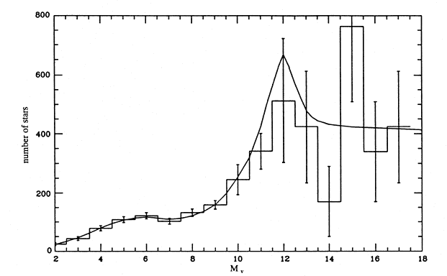
Local luminosity function (stars with d < 20 pc) for the Milky
Way measured by Kroupa, Tout & Gilmore (1993):
bright stars
faint stars
(From P. Armitage)

Slide 42
Local V Band Luminosity Function
Solid triangles: proper motion selected
Open squares: color-selected

Slide 43
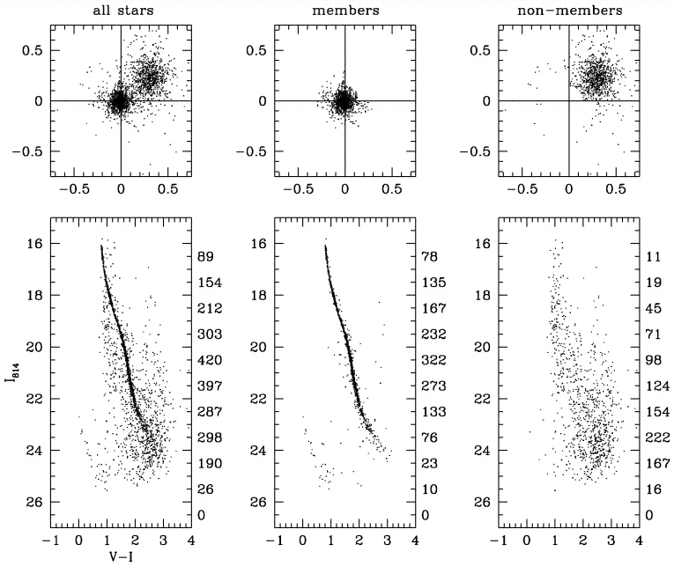
From The Astrophysical Journal Letters 492(1):L37–L40.
© 1998 by The American Astronomical Society.
For permission to reuse, contact journalpermissions@press.uchicago.edu.
Fig. 1.— Proper-motion distributions (top) and color-magnitude diagrams (bottom). The scale of the proper motions is displacement in Wide Field Camera (WFC) pixels over the 32 month time baseline; a full WFC pixel of displacement would correspond to 37.5 mas yr−1. Since all reference stars were cluster members, the zero point of motion is the mean motion of cluster stars. Left: The entire sample; center: stars within the proper-motion region described in the text; right: stars outside this region. Numbers at right are stars per unit-magnitude bin.

Slide 44
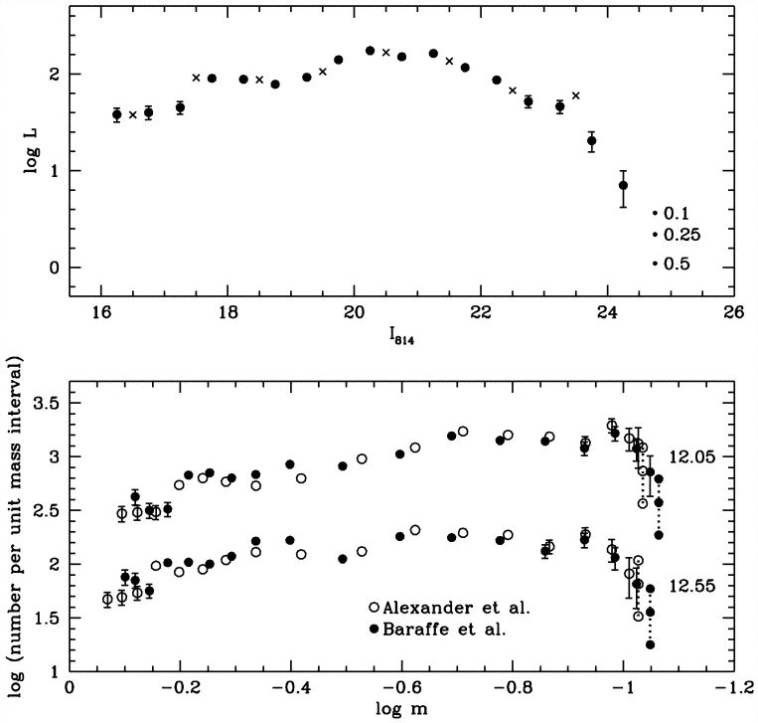
From The Astrophysical Journal Letters 492(1):L37–L40.
© 1998 by The American Astronomical Society.
For permission to reuse, contact journalpermissions@press.uchicago.edu.
Fig. 4.—Top: Our new luminosity function of NGC 6397, with Poisson error bars (plotted only when they are larger than the sizes of the symbols). The vertical array of three small circles is explained in the text. The crosses are the LF given by CPK, converted to the present field size. Bottom: Mass functions, as derived from each of the two MLRs indicated. For clarity, the sets of three points representing the empty bin have been connected with lines. The error bars arise from those of the log LF points. The MFs are shown for two different assumed distance moduli, as labeled.

Slide 45
Initial Mass Function (IMF)
Starting from the observed luminosity function, possible to derive an estimate for the Initial Mass Function (IMF). To define the IMF, imagine that we form a large number of stars.
Then:
the number of stars that have been
born with initial masses between
M and M+ΔM (careful not to confuse
mass and absolute magnitude here)
=
this is the Initial Mass Function or IMF
The IMF is a more fundamental theoretical quantity which is obviously related to the star formation process. Note that the IMF only gives the initial distribution of stellar masses immediately after stars have formed - it is not the mass distribution in, say, the Galactic disk today (PDMF)
(From P. Armitage)

Slide 46
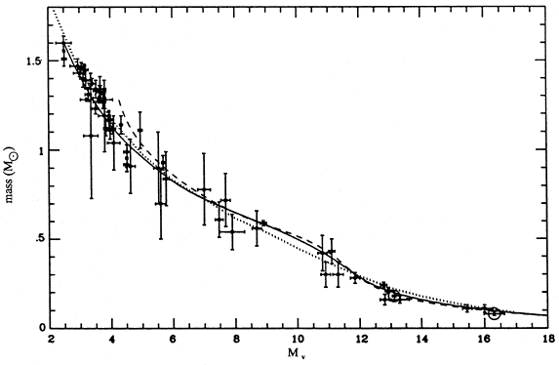
In practice: several obstacles to getting the IMF from the LF:
1. Convert from absolute magnitude to mass
Need stellar structure theory, calibrated by observations of
eclipsing binaries
(From P. Armitage)

Slide 47
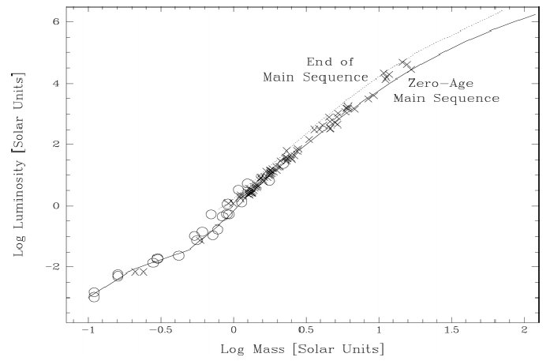
The Mass-Luminosity Relation
Use it to convert stellar luminosities into masses:
L ~ M ^{1.6}
L ~ M ^{3.1}
L ~ M ^{4.7}
L ~ M ^{2.7}
And, of course, it is a function of bandpass …

Slide 48
A problem: Massive stars have short lifetimes
Suppose we observe the luminosity function of an old cluster.
There are no very luminous main sequence stars. But this does
not mean that the IMF of the cluster had zero massive stars,
only that such stars have ended their main sequence lifetimes
More generally, we need to allow for the differing lifetimes of
different stars in deriving the IMF. If we assume that the star
formation rate in the disk has been constant with time, means
we need to weight number of massive stars by 1 / t_{ms}, where
t_{ms} is the main sequence lifetime.
Massive stars are doubly rare - few are formed plus they don’t live as long as low mass stars… Thus, poor statistics
(From P. Armitage)

Slide 49
Another problem at the high mass end: Mass loss
For massive stars, mass loss in stellar winds means that the
present mass is smaller than the initial mass
A problem at the low mass end: Completeness
These faint stars cannot be seen very far, and are easy to miss
* * *
All these difficulties mean that although the local IMF is well
determined for masses between ~0.5 M_{sun} and ~50 M_{sun}, but:
not well determined at the very low mass end (mainly
because the relation between luminosity and mass
is not so well known)
for very massive stars - simply too rare
in other galaxies, especially in the distant Universe
(From P. Armitage)

Slide 50
Salpeter Mass Function
The Initial Mass Function for stars in the Solar neighborhood was determined by Salpeter in 1955:
constant which sets the local stellar density
Using the definition of the IMF, the number of stars that form
with masses between M and M+ΔM is:
To determine the total number of stars formed between M₁ and M₂, integrate the IMF between these limits:
(From P. Armitage)

Slide 51
Can similarly work out the total mass in stars born with mass
M₁ < M < M₂:
Properties of the Salpeter IMF:
most of the stars (by number) are low mass stars
most of the mass in stars resides in low mass stars
following a burst of star formation, most of the
luminosity comes from high mass stars
Salpeter IMF must fail at low masses, since if we extrapolate
to arbitrarily low masses the total mass in stars tends to infinity!
Observations suggest that the Salpeter form is valid for roughly
M > 0.5 M_{sun}, and that the IMF flattens at lower masses. The
exact form of the low mass IMF remains uncertain
(From P. Armitage)

Slide 52
What is the origin of the IMF?
Most important unsolved problem in star formation. Many theories but no consensus
Observationally, known that dense cores in molecular clouds
have a power-law mass function rather similar to the IMF. So
the IMF may be determined in part by how such cores form
from turbulent molecular gas
Is the IMF universal?
Most theorists say no. Predict that fragmentation is easier if the gas can cool, so primordial gas without any metals should form more massive stars (Pop III)
Observationally, little or no evidence for variations in the IMF in our Galaxy or nearby galaxies, but it is not excluded
(From P. Armitage)

Slide 53
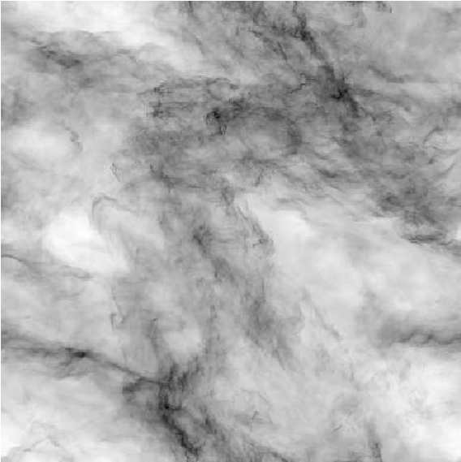
The Physical Origin of the IMF
Not yet well understood …
Interstellar turbulence
↓
Power-law scalings
↓
Protostellar cloud fragmentation spectrum
↓
Power-law IMF?
Numerical simulation of ISM turbulence 

Slide 54
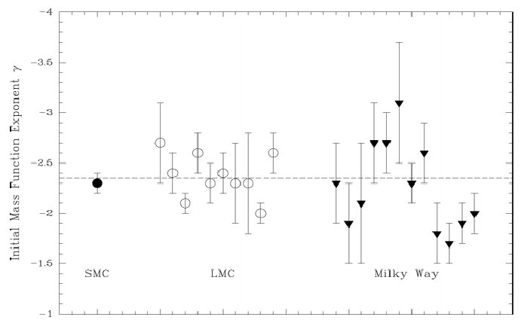
The Universality of the IMF?
Looks fairly universal in the normal, star-forming galaxies nearby.
However, it might be different (top-heavy?) in the ultraluminous starbursts (if so, the inferred star formation rates would be wrong).
It might be also a function of metallicity: top-heavy for the metal-poor systems (including the primordial star formation)

Slide 55
Where are the Baryons?
log dN/dM
This is where most of the mass is
?
This is where most of the light is
?
Brown dwarfs
Normal MS stars
?
?
log M/M
100
10
1
0.1
0.001
Secondary peak?
Planets?
Slushballs?

Slide 56
Gravitational Microlensing
Lensing event occurs as a MAssive Compact (Halo) Object, MACHO (could be a main sequence star, white or brown dwarf, neutron star or black hole, or … ?), passes within an angular distance θ_{E} of a background star:
background star initially brightens
eventually fades as the alignment is lost
MACHO crossing the line of sight
Sun
Line of sight to a background star
Since the cross section for a strong lensing is small compared to interstellar separations, such events must be exceedingly rare

Slide 57
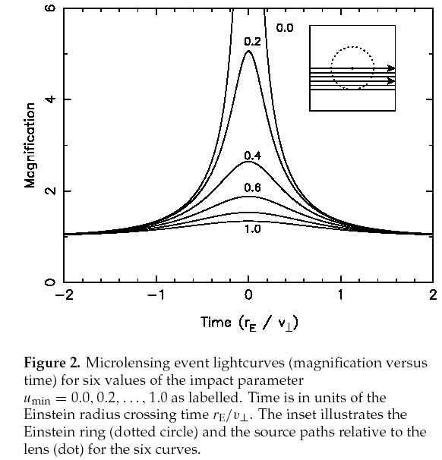
Expected Gravitational Microlensing Lightcurves:
The peak magnification depends on the lens alignment (impact parameter)
The event duration depends on the lens velocity

Slide 58
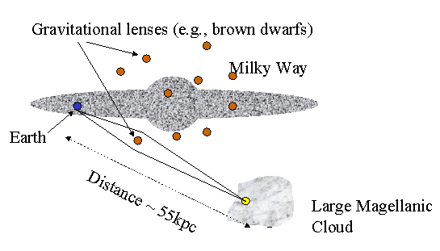
How Can We Detect MACHOs ?
Problem: a probability of a distant star being lensed is maybe ~ 10⁻⁷ per year
Solution: monitor ~ 10⁷ stars simultaneously!
Typically in the LMC or the Galactic Bulge

Slide 59
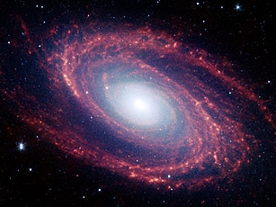
Microlensing Experiments
Several experiments have searched
for microlensing events:
toward the Galactic Bulge (lenses
are disk or bulge stars)
toward the Magellanic Clouds
(lenses could be stars in the
LMC / SMC, or halo objects)
MACHO (Massive Compact Halo Object):
observed 11.9 million stars in the Large Magellanic Cloud
for a total of 5.7 years
OGLE (Optical Gravitational Lensing Experiment):
ongoing experiment
presently monitor ~ 33 millions stars in the LMC, plus
~ 170 million stars in the Galactic Bulge

Slide 60
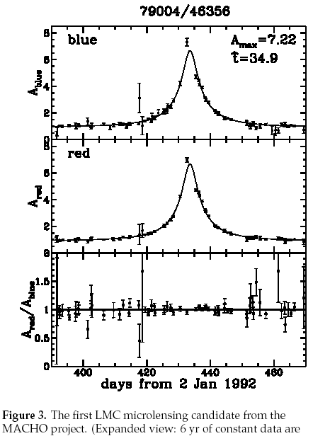
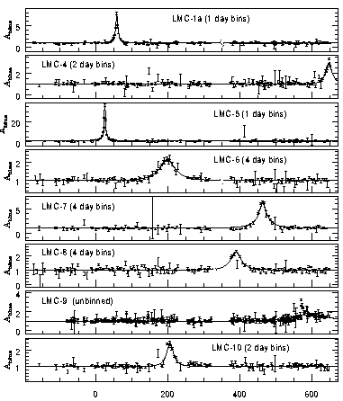
The First MACHO Event Seen in the LMC Experiment 
To date, hundreds (or more) of microlensing events have been detected by various groups

Slide 61
The Einstein radius for a single lens of mass M, at distance d_{L},
observer-source distance is d_{S},
lens-source distance is d_{LS} =d_{S}- d_{L}
Probability that this lens will magnify a given source is:
directly proportional to
the mass of the lens
Same is obviously true for a population of lenses, with total
mass M_{pop} - just add up the individual probabilities. Conclude:
The fraction of stars that are being lensed at any one time measures the total mass in lenses, independent of their individual masses
Geometric factors remain - we need to know where the lenses are to get the right mass estimate

Slide 62
Lensing time scale: equals the physical
distance across the Einstein ring divided
by the relative velocity of the lens:
Time scale is proportional to the square
root of the individual lens masses
Put in numbers appropriate for disk stars lensing stars in the
Galactic bulge:
d_{S} = 8 kpc, d_{L} = d_{LS} = 4 kpc
M = 0.3 M
v_{L} = 200 km s⁻¹
Events with τ ~ 1 day: M < Jupiter mass (~10⁻³ M )
Events with τ ~ 1 year: M ~ 25 M (e.g. stellar black holes)

Slide 63
For each event, there are only two observables:
Duration τ - if we know the location of the lens along the
line of sight this gives the lens mass directly
Peak amplification A: this is related to how close the line
of sight passes to the center of the Einstein ring
b
Note: amplification tells us nothing useful about the lens!
Additionally, observing many events gives an estimate of the probability that a given source star will be lenses at any one time (often called the optical depth to microlensing). This measures the total mass of all the lenses, if their location is known.

Slide 64
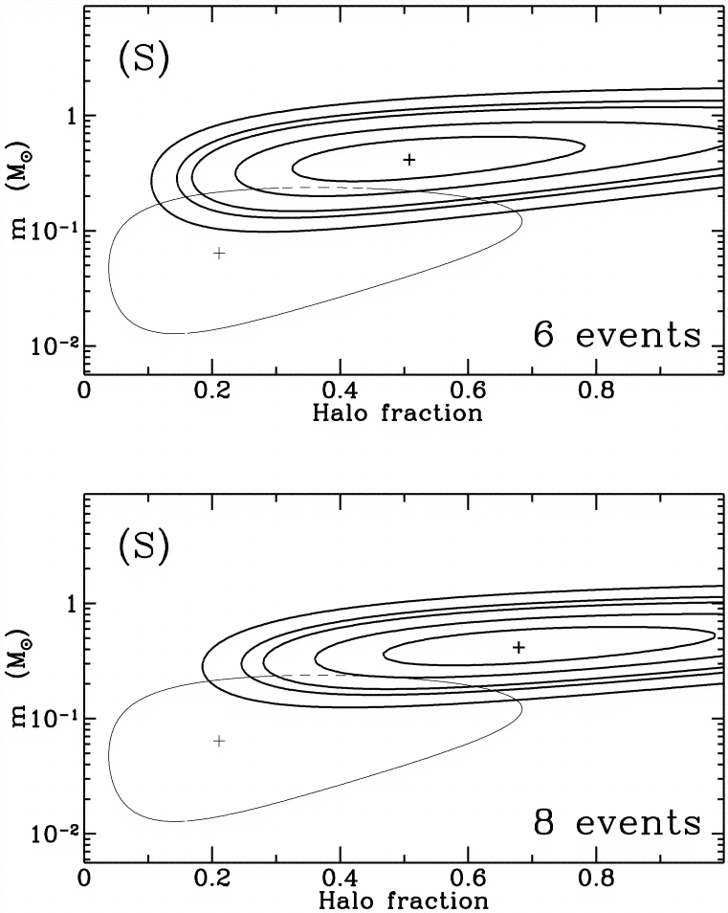
What Are MACHOs?
Analysis of the LMC microlensing experiments suggest that MACHO masses are ~ 0.5 M: too heavy for brown dwarfs.
Old halo white dwarfs??
(There are problems with that…)
(Alcock et al. 1997)

Slide 65
MACHO Results
Based on the number and duration of MACHO events,
if the lenses are objects in the Galactic Halo:
20% of the mass of the Galactic halo (inferred from the Galactic rotation curve) is in the form of MACHOs; the idea that all the mass in the halo is MACHOs is definitely ruled out
Typical mass is between 0.15 M and 0.9 M
One interpretation of these results is that the halo contains a
much larger population of white dwarf stars than suspected.
This poses other problems: requires a major epoch of early star formation to generate these white dwarfs - but what about the corresponding metals?
Ambiguity in the distance to the lenses is the main problem!

Slide 66
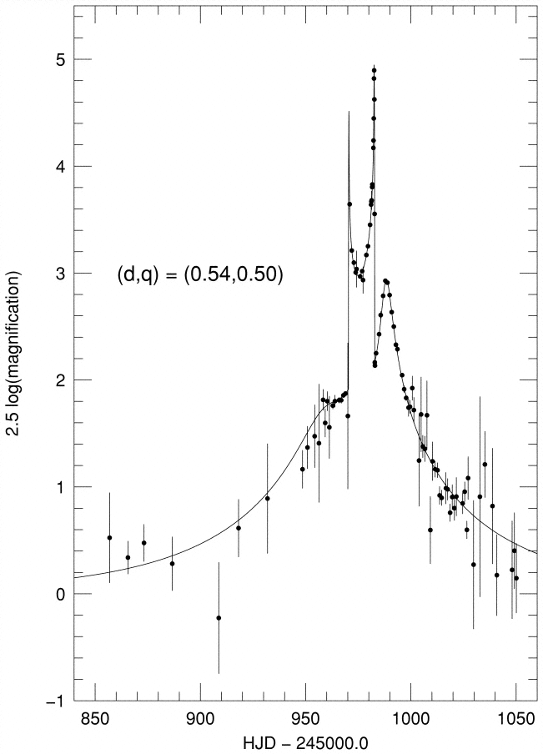
Distance ambiguity can be resolved in a few special cases:
If distortions to the light curve caused by the motion of the
Earth around the Sun can be detected (parallax events)
b) If the lens is part of a binary system. Light curves produced
by binary lenses are much more complicated, but often
contain sharp spikes (caustic crossings) and multiple maxima.
This provides more information about the event. (This one was close to the SMC)

