Slide 1
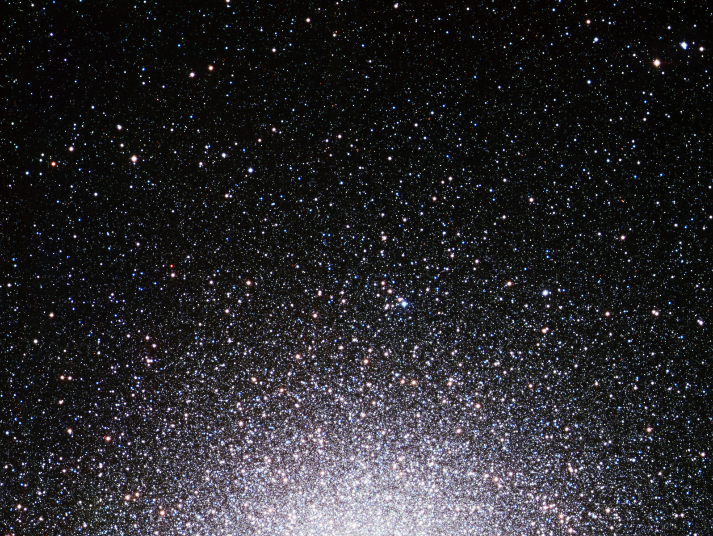
Ay 124 – Lecture 4 – Supplementary Slides Stellar Dynamics

Slide 2
Stellar Dynamics
Gravity is generally the only important force in astrophysical systems (and almost always a Newtonian approx. is OK)
Consider astrophysical systems which can be approximated as a self-gravitating “gas” of stars (~ point masses, since in most cases R << r.m.s.): open and globular star clusters, galaxies, clusters of galaxies
If 2-body interactions of stars are important in driving the dynamical evolution, the system is called collisional (star clusters); if stars are mainly moving in the collective gravitational field, it is called collisionless (galaxies)
Sometimes stars actually collide, but that happens only in the densest stellar systems, and rarely at that

Slide 3
Dynamical Modeling of Stellar Systems
A stellar system is fully described by an evolving phase-space density distribution function, f(r,v,t)
Unfortunately, in most cases we observe only 3 out of 6 variables: 2 positional + radial velocity; sometimes the other 2 velocity comp’s (from proper motions); rarely the 3rd spatial dimension
… And always at a given moment of t. Thus we seek families of stellar systems seen at different evolutionary states
Not all of the phase space is allowed; must conserve integrals of motion, energy and angular momentum:
The system is finite and f(r,v,t) ≥ 0. The boundary conditions:

Slide 4
Dynamical Modeling of Stellar Systems
The evolution of f(r,v,t) is described by the Bolzmann eqn., but usually some approximation is used, e.g., Vlasov (= collisionless Boltzmann) or Fokker-Planck eqn.
Their derivation is beyond the scope of this class …
Typically start by assuming f(v,t), e.g., a Maxwellian
Density distribution is obtained by integrating ρ(r) = ∫ f(r,v) dv
From density distribution, use Poisson’s eqn. to derive the gravitational potential, and thus the forces acting on the stars:
The resulting velocities must be consistent with the assumed distribution f(r,v)
The system can evolve, i.e., f(r,v,t), but it can be usually described as a sequence of quasi-stationary states

Slide 5
Dynamics of Stellar Systems
The basic processes are acceleration (deflection) of stars due to encounters with other stars, or due to the collective gravitational field of the system at large
Stellar encounters lead to dynamical relaxation, wheby the system is in a thermal equilibrium. The time to reach this can be estimated as the typical star to change its energy by an amount equal to the mean energy; or the time to change its velocity vector by ~ 90 deg.
There will be a few strong encounters, and lots of weak ones. Their effects can be estimated through Coulom-like scattering

Slide 6
Strong encounters
In a large stellar system, gravitational force at any point due
to all the other stars is almost constant. Star traces out an orbit
in the smooth potential of the whole cluster.
Orbit will be changed if the star passes very close to another
star - define a strong encounter as one that leads to Δv ~ v.
Consider two stars, of mass m. Suppose that
typically they have average speed V.
Kinetic energy:
When separated by distance r, gravitational
potential energy:
(From P. Armitage)

Slide 7
By conservation of energy, we expect a large change in the
(direction of) the final velocity if the change in potential energy
at closest approach is as large as the initial kinetic energy:
Strong encounter
Strong encounter radius
Near the Sun, stars have random velocities V ~ 30 km s⁻¹,
which for a typical star of mass 0.5 M_{sun} yields r_{s} ~ 1 au.
Good thing for the Solar System that strong encounters are
very rare…
(From P. Armitage)

Slide 8
Time scale for strong encounters:
In time t, a strong encounter will occur if any other star intrudes
on a cylinder of radius r_{s} being swept out along the orbit.
r_{s}
V
Vt
Volume of cylinder:
For a stellar density n, mean number of encounters:
Typical time scale between encounters:
(substituting for the strong encounter
radius r_{s})
Note: more important for small velocities.
(From P. Armitage)

Slide 9
Plug in numbers (being careful to note that n in the previous
expression is stars per cubic cm, not cubic parsec!)
Conclude:
stars in the disks of galaxies (V ~ 30 km s⁻¹, n ~ 0.1 pc⁻³
near the Sun), never physically collide, and are
extremely unlikely to pass close enough to deflect
their orbits substantially.
in a globular cluster (V ~ 10 km s⁻¹, n ~ 1000 pc⁻³ or more),
strong encounters will be common (i.e. one or more
per star in the lifetime of the cluster).
(From P. Armitage)

Slide 10
Weak encounters
Stars with impact parameter b >> r_{s} will also perturb the
orbit. Path of the star will be deflected by a very small angle
by any one encounter, but cumulative effect can be large.
Because the angle of deflection is small, can approximate
situation by assuming that the star follows unperturbed
trajectory:
Distance Vt
Velocity V
θ
Star mass M
Impact
parameter b
Distance d
Star mass m
Define distance of closest approach to be b; define this
moment to be t = 0.
(From P. Armitage)

Slide 11
Force on star M due to gravitational attraction of star m is:
(along line joining two stars)
Component of the force perpendicular to the direction of
motion of star M is:
Velocity component
perpendicular to
the original direction
of motion
Using F = mass x acceleration:
Integrate this equation with respect to time to get final velocity
in the perpendicular direction.
Note: in this approximation, consistent to assume that
remains unchanged. Whole calculation is OK provided that
the perpendicular velocity gain is small.
(From P. Armitage)

Slide 12
Final perpendicular velocity is:
As before, small V leads
to larger deflection
during the flyby
Deflection angle is:
V
α
Setting V = c, see that this is exactly half the correct
relativistic value for massless particles (e.g. photons).
(From P. Armitage)

Slide 13
If the star receives many independent deflections, each with
a random direction, expected value of the perpendicular
velocity after time t is obtained by summing the squares of the
individual velocity kicks:
Writing this as an integral (i.e. assuming that there are very
many kicks):
Where dN is the expected number
of encounters that occur in time t
between impact parameter b and
b + db.
(From P. Armitage)

Slide 14
Using identical reasoning as for the strong encounter case:
Area of the annulus
between impact
parameter b and
b + db
Number density
of perturbing stars
Distance star travels
in time t
This gives for the expected velocity:
Logarithm means in a uniform
density stellar system, `encounters’
with stars at distances (b -> 10b)
and (10b -> 100b) etc contribute
equally to the deflection.
(From P. Armitage)

Slide 15
Relaxation time
After a long enough time, the star’s perpendicular speed will
(on average) grow to equal its original speed. Define this as
the relaxation time - time required for the star to lose all memory
of its initial orbit.
Set:
…and solve for t_{relax}:
Recall that the strong encounter time scale was:
Frequent distant interactions are more effective at changing
the orbit than rare close encounters…
(From P. Armitage)

Slide 16
Relaxation time for a stellar cluster
The factor ln[b_{max} / b_{min}] depends upon the limits of integration.
Usually take:
b_{min} to be the strong encounter radius r_{s} (~1 au for
the Sun). Approximations made in deriving the
relaxation time are definitely invalid for r < r_{s}.
b_{max} to be the characteristic size of the whole stellar
system - for the Sun would be reasonable to
adopt either the thickness of the disk (300 pc)
or the size of the galaxy (30 kpc).
Because the dependence is only logarithmic, getting the limits
exactly right isn’t critical.
(From P. Armitage)

Slide 17
Evaluate the relaxation time for different conditions:
Sun
Globular cluster
Open cluster
V / km s⁻¹
30
10
1
n / pc⁻³
0.1
10⁴
10
size / pc
1000
5
5
3 x 10¹³ yr
~100 Myr
~100 Myr
Predict that clusters ought to evolve due to star-star
interactions during the lifetime of the Galaxy.
(From P. Armitage)

Slide 18
Can use the virial theorem to write this result in an alternate
form:
Average value of
the kinetic energy
Average value of gravitational
potential energy
For a cluster of N stars, each of mass m, moving at average
velocity V in a system of size R:
total mass M = Nm
total kinetic energy:
gravitational potential energy:
Applying the virial theorem:
(From P. Armitage)

Slide 19
Number density of stars = number of stars / volume:
Range of radii over which weak interactions can occur is:
Finally define the crossing time for a star in the cluster:
(From P. Armitage)

Slide 20
Ratio of the relaxation time to the crossing time is:
Substitute for V, n and [b_{max} / b_{min}] and this simplifies to:
In a cluster, number of orbits a star makes before it is
significantly perturbed by other stars depends only on
the number of stars in the system.
Interactions are negligible for galaxy size systems, but very
important for small clusters.
(From P. Armitage)

Slide 21
Consequences of relaxation
Evaporation: two-body relaxation allows stars to exchange
energy amongst themselves. If at some moment a star
becomes unbound (kinetic + potential energy > 0) then
it will escape the cluster entirely.
Evaporation time t_{evap} ~ 100 t_{relax ,} and although long, it limits
the cluster lifetime.
Evaporation is accelerated by tidal shocks, which implant additional kinetic energy to the stars:
For globular clusters, passages through the Galactic disk or bulge
For open clusters, passages of nearby giant molecular clouds (GMCs) or spiral density waves
(From P. Armitage)

Slide 22
Mass segregation: two-body relaxation tries to equalize the
kinetic energy of different mass stars, rather than their
velocity. Since:
…more massive stars tend to have smaller velocities
and sink to the center of the cluster.
Core collapse: stars in the cluster core tend to have higher
velocities. If they attempt to equalize kinetic energy with
stars outside the core, they lose energy, and sink even
further toward the center.
Limit of this process is called core collapse - eventually
contraction is probably halted by injection of energy from
binary stars.
(From P. Armitage)

Slide 23
Analysis suggests that large-N, roughly spherical systems
are stable, long lived structures (elliptical galaxies, the bulges
of spiral galaxies).
Does not mean that anything goes as far as galaxy shapes:
most obviously, need to have consistency between the
mean stellar density and the gravitational force:
Gravitational
potential
Average stellar
density at any
point in the galaxy
Allowed orbits
of stars in the
galaxy
also more subtle issues - e.g. if the potential of the galaxy
admits chaotic orbits, then even small perturbations
can shift stars into qualitatively different orbits.
(From P. Armitage)

Slide 24
Dynamical Friction
Why does the orbit of a satellite galaxy moving within the
halo of another galaxy decay?
Stars in one galaxy are scattered by gravitational perturbation
of passing galaxy.
Stellar distribution around the intruder galaxy becomes
asymmetric - higher stellar density downstream than upstream.
Gravitational force from stars produces a `frictional’ force
which slows the orbital motion.
(From P. Armitage)

Slide 25
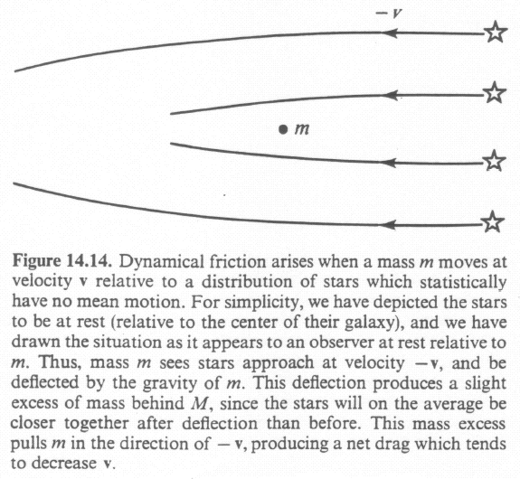
Dynamical Friction
(From F. Shu)

Slide 26
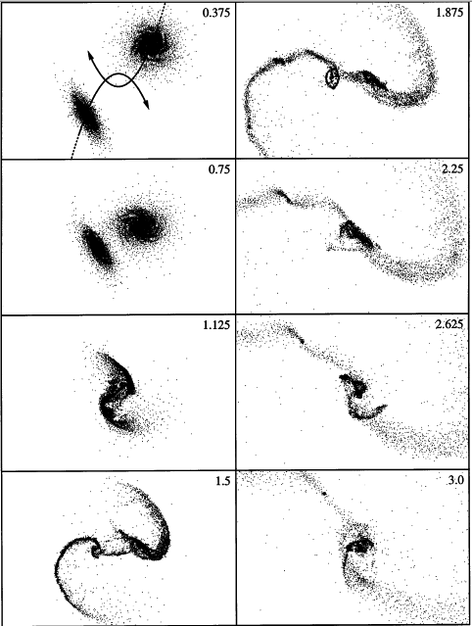
Numerical Simulation of Merging Disk Galaxies
(From Barnes & Hernquist)

Slide 27
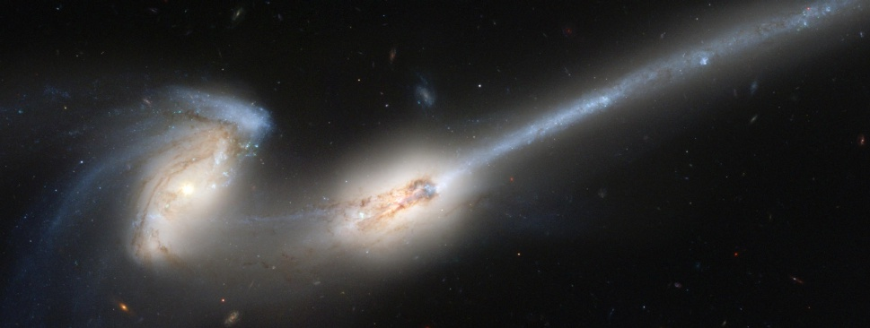
Major Galaxy Mergers
Direct consequence of dynamical friction
Formation of tidal tails, bridges, etc.
Stars, gas, and dark matter behave differently
Generally lead to onset of starburst and nuclear activity

Slide 28
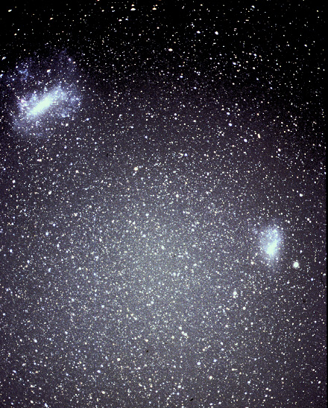
Major mergers between typical large galaxies are relatively rare, but Minor mergers between galaxies of very different masses are much more common.
Example: the Magellanic clouds,
bound satellites orbiting within the extended halo of the Milky Way, ~50 kpc distance.
Eventually will spiral in and merge into the Milky Way.
Sagittarius dwarf galaxy is another satellite which is now in process of merging…
This was much more common at high redshifts  galaxy evolution
(From P. Armitage)

Slide 29
How quickly will the LMC merge with the Milky Way?
Simple estimate - dynamical friction time:
200 km/s
~3
10¹⁰ Solar
masses
Galactic density at LMC -
for flat rotation curve estimate
3 x 10⁻⁴ Solar masses / pc³
With these numbers, estimate orbit will decay in ~3 Gyr
Close satellite galaxies will merge!
(From P. Armitage)

