Slide 1
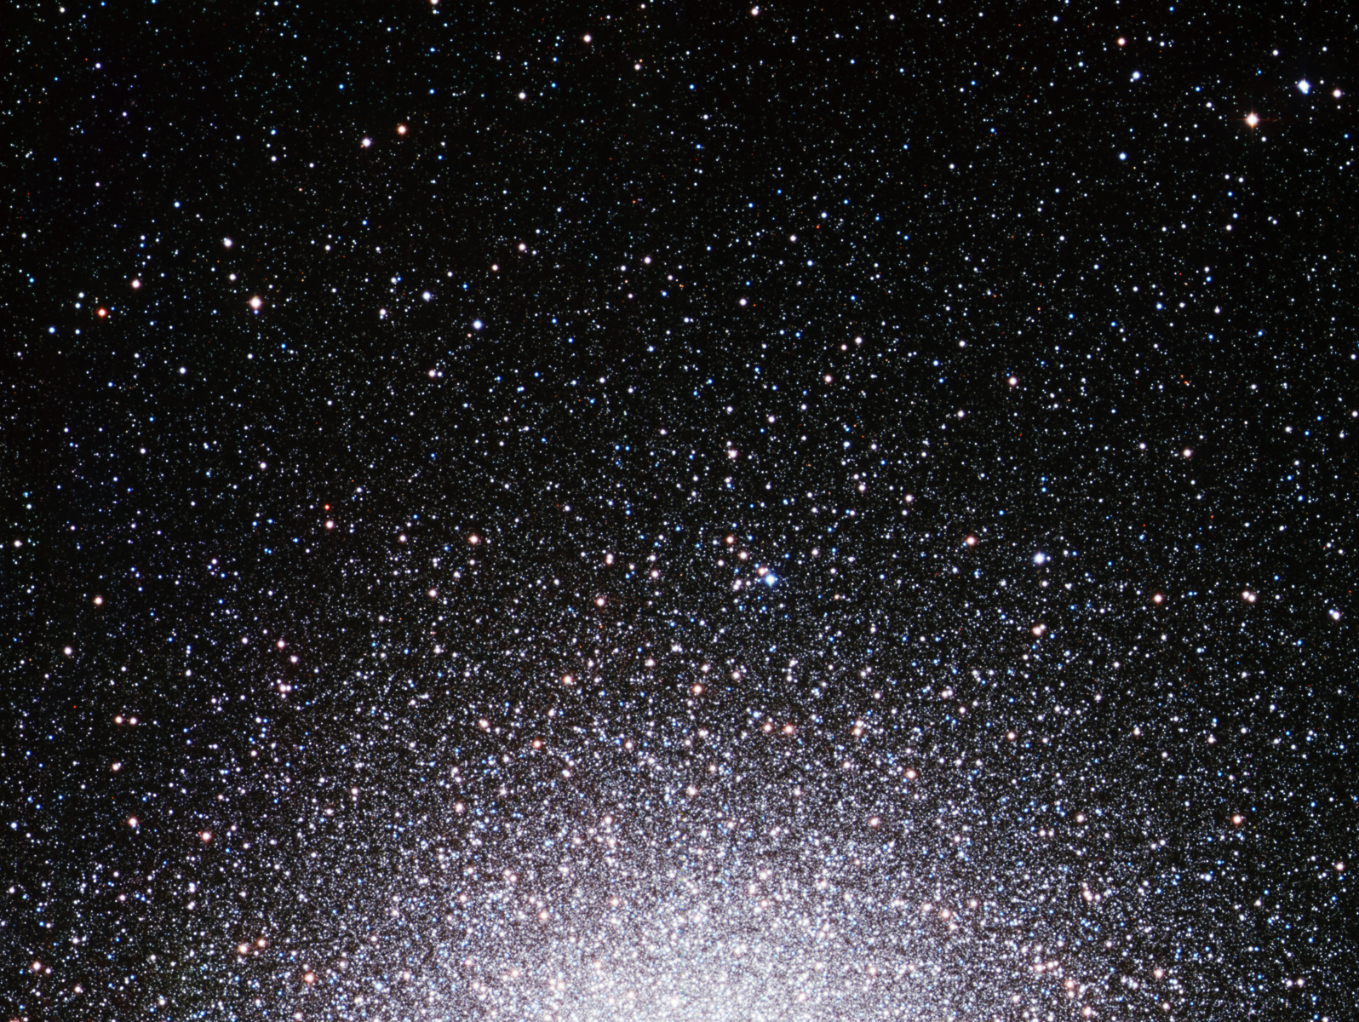
Ay 124 – Lecture 5 Star Clusters: Observable Properties

Slide 2
Star Clusters (Mostly Globular)
Definition and basic properties
Correlations and non-correlations of cluster parameters
Hints about their formation
Their stellar populations and cluster ages
Dynamical evolution of star clusters
King models
Core collapse and the role of binaries
Gravothermal oscillations
Tidal evaporation
Stellar collisions and modification of stellar populations
Formation mechanisms of globular clusters
Multiple stellar populations in globulars
Open clusters
Their origins and demise

Slide 3
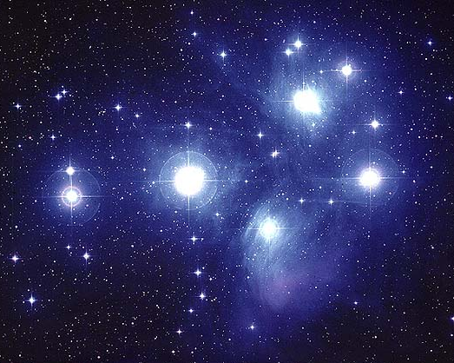
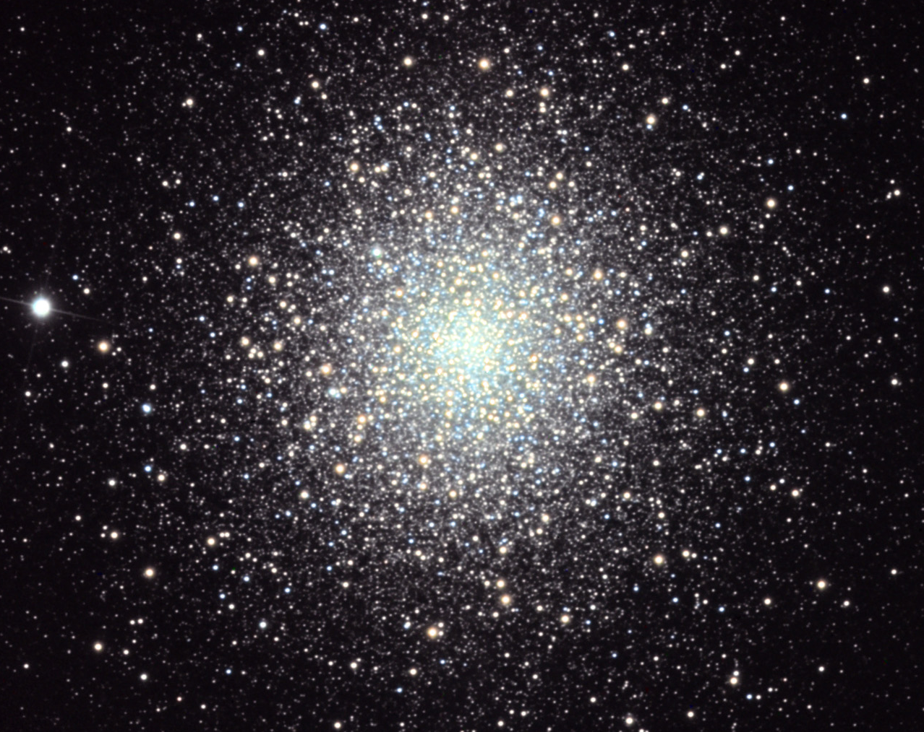
Star Clusters
Open (or Disk):
N ~ 10² - 10³
Ages ~ 10⁷ - 10⁹ yr
Globular:
N ~ 10⁴ - 10⁷
Ages ~ 10 - 13 Gyr
Great “laboratories” for stellar dynamics
Dynamical and evolutionary time scales < or << Galaxy’s age, and a broad range of evolutionary states is present

Slide 4
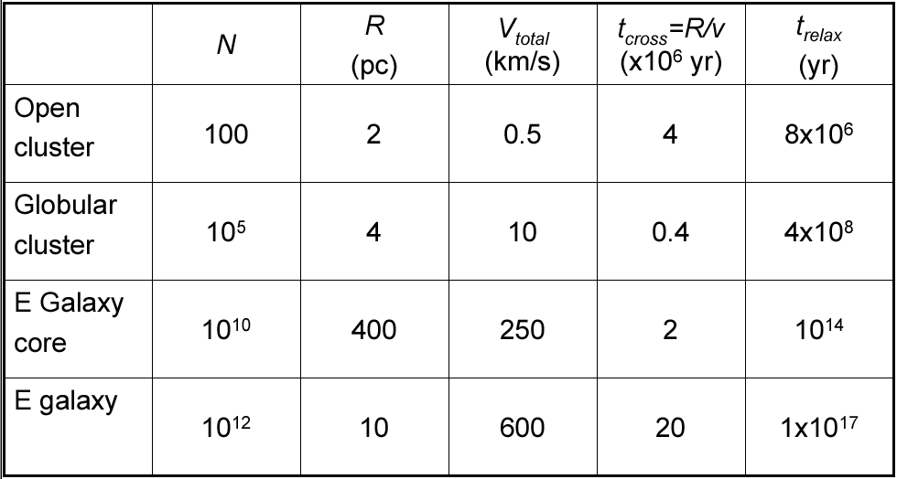
Basic Properties of Typical, Pressure-Supported Stellar Systems

Slide 5
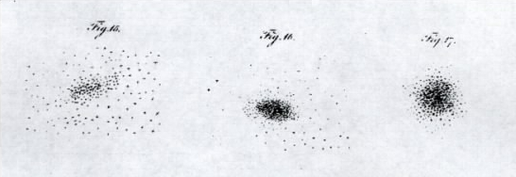
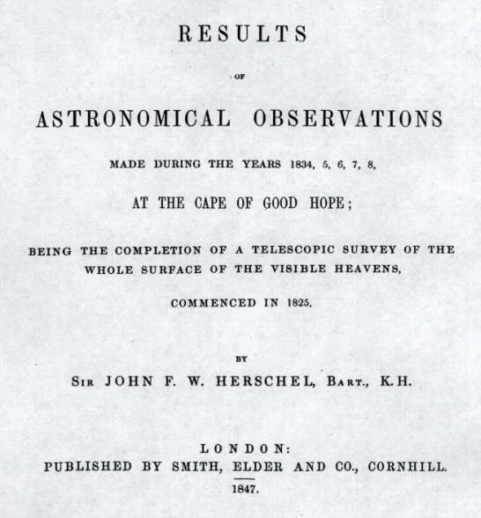
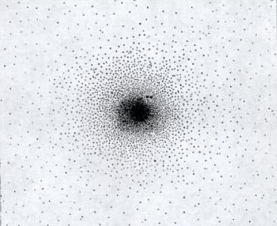
William Herschel (1738-1822)
Most Galactic GC’s were originally catalogued by Charles Messier and William Herschel
Globular cluster
1847
47 Tuc
John Herschel (1792-1871)
… and some are still being found today

Slide 6
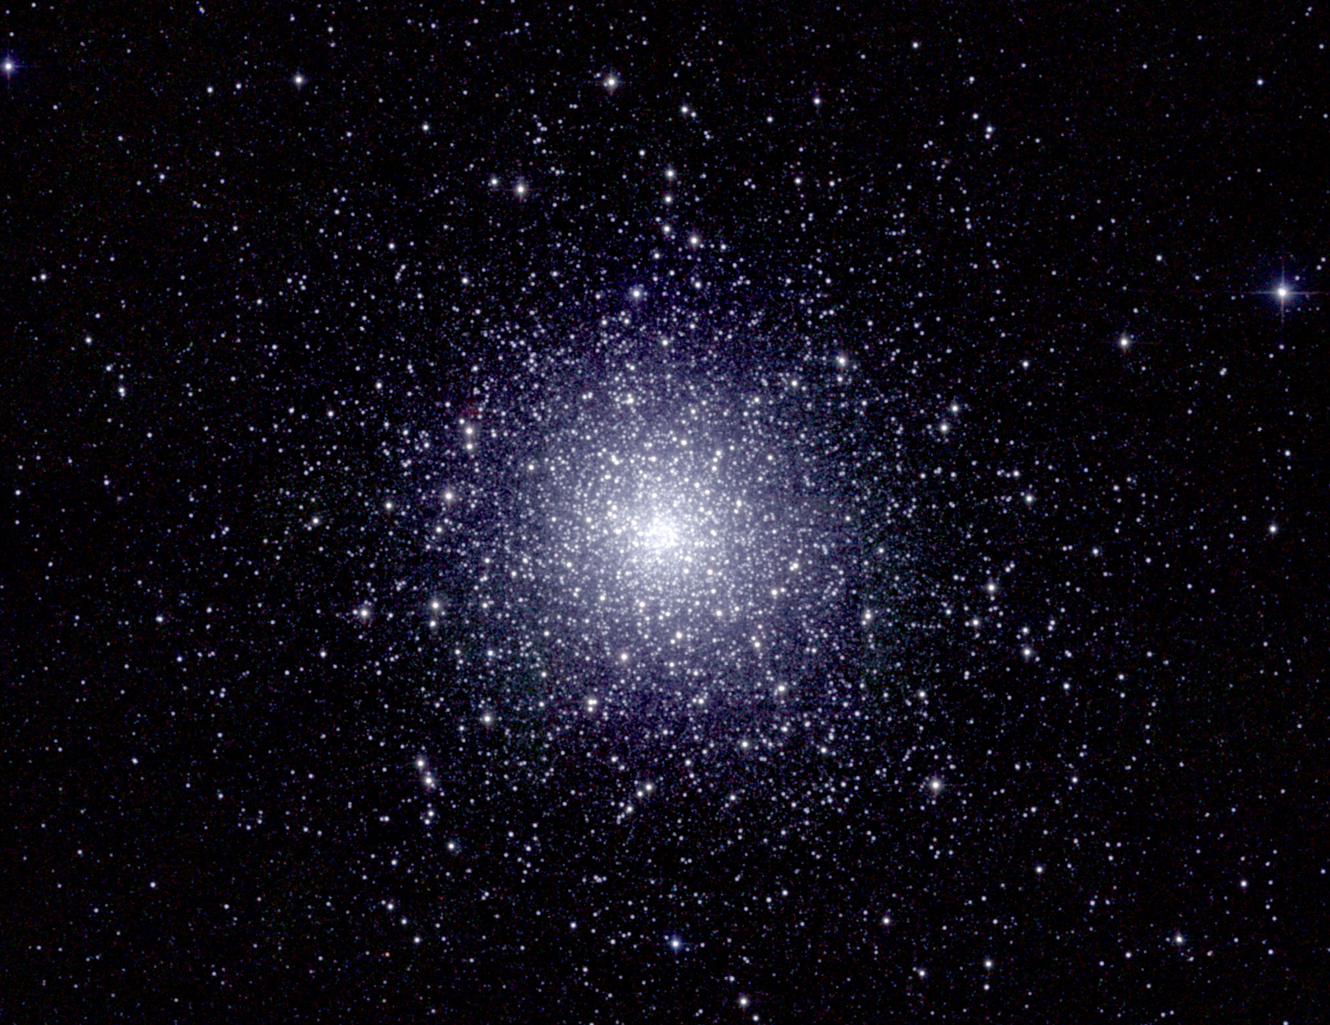
47 Tuc = NGC 104,
2MASS image

Slide 7
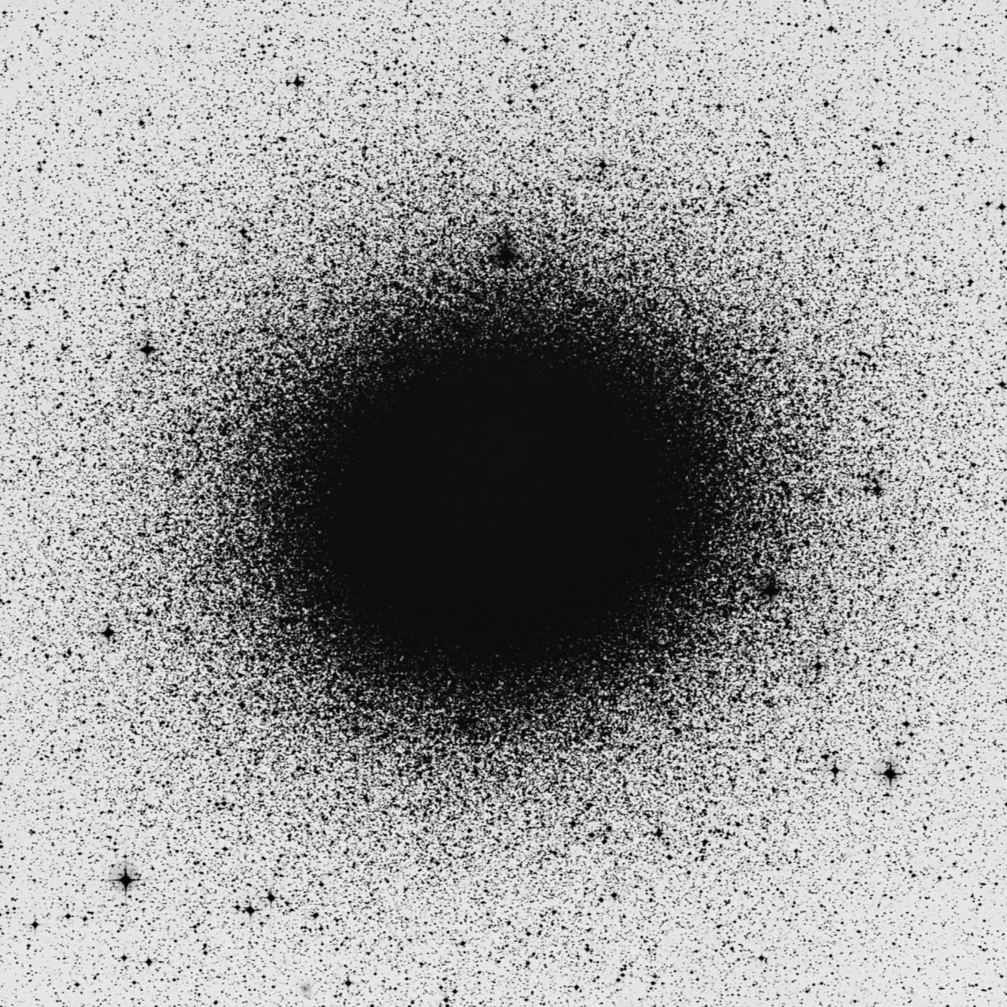
The Range of GC Luminosities
Omega Cen = NGC 5139 (M_{V} = -10.3)
AM 4 (M_{V} = -1.6)
DSS Blue, FOV = 36 arcmin

Slide 8
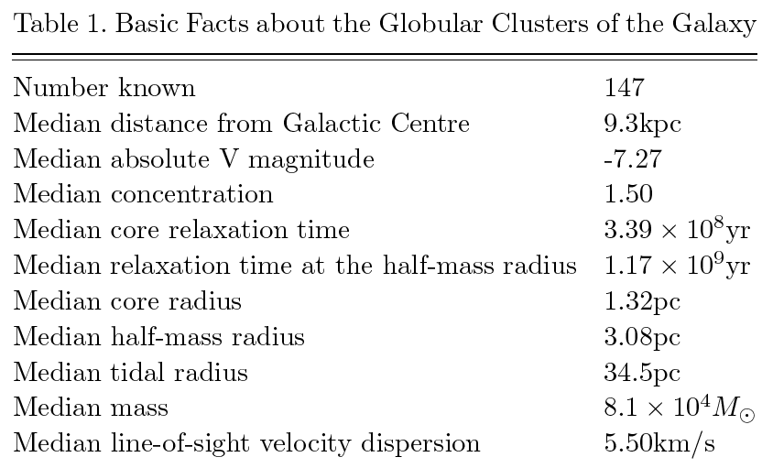
Globular Cluster Properties

Slide 9
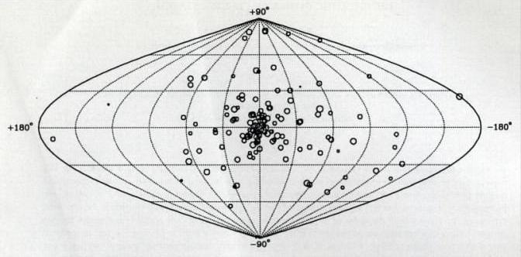
Globular clusters are strongly concentrated in the Galaxy, but their system extends out to tens of kpc. They belong to the stellar halo and thick disk populations. They are old, and generally metal-poor: fossil evidence from the early phases of Galaxy formation.
Projected distribution of the 143 known globular clusters with Galactic coordinates

Slide 10
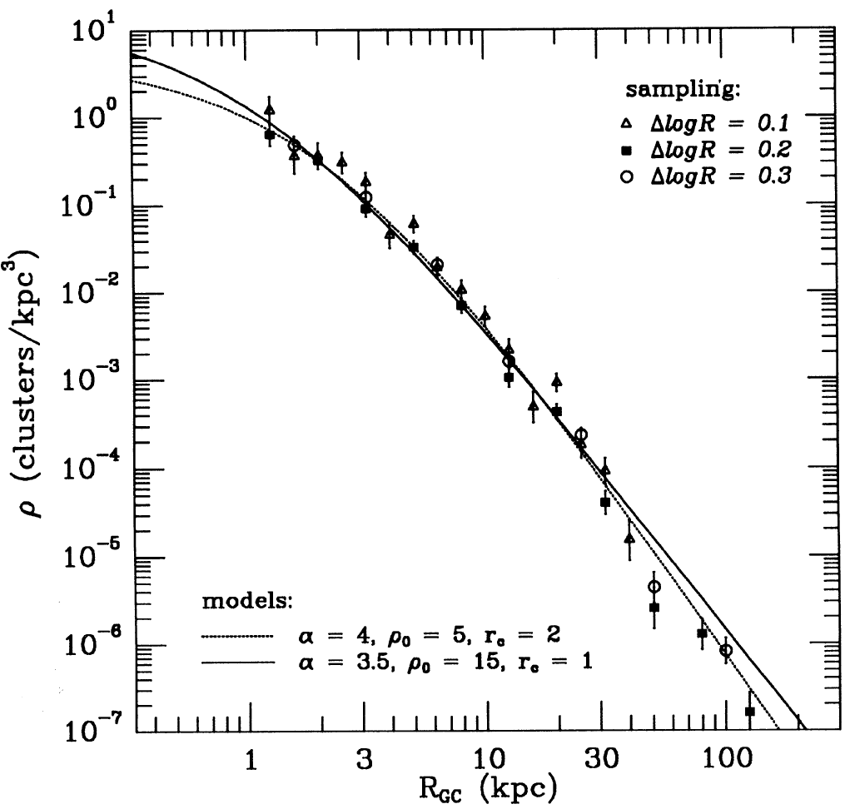
Radial Density Profile of the Galactic GC System
Note:
Much steeper than the dark halo profile, ρ ~ r ⁻²

Slide 11
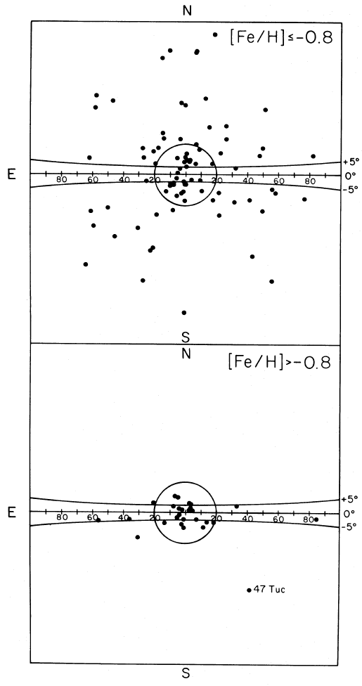
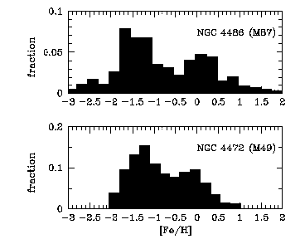
Disk and Halo GC Subsystems (Zinn 1985)
Bimodal metallicity distributions are common in globular cluster systems

Slide 12
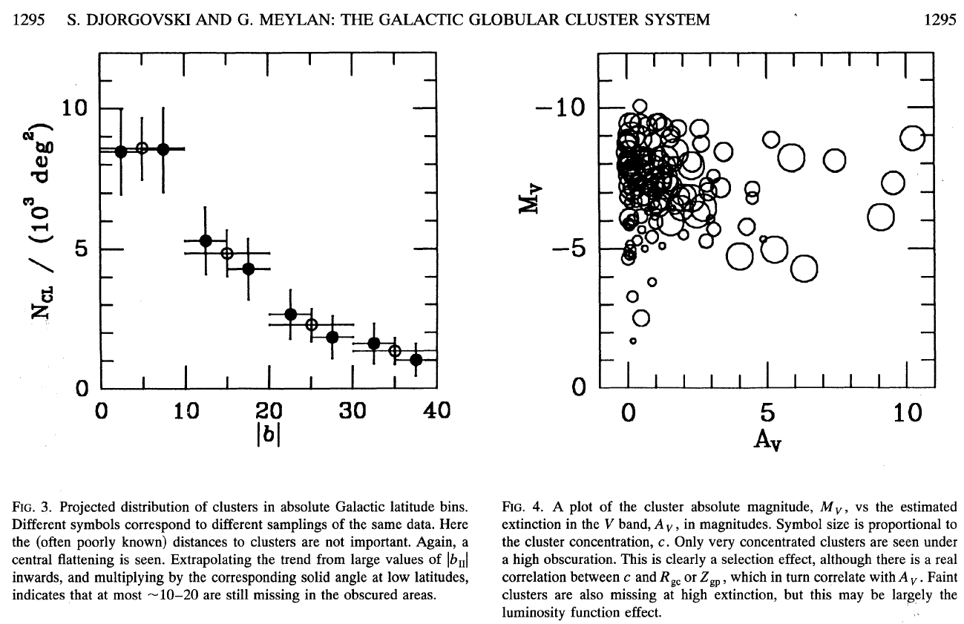
Selection Effects:
Missing clusters at low Galactic latitudes
Missing intrinsically faint clusters far away

Slide 13
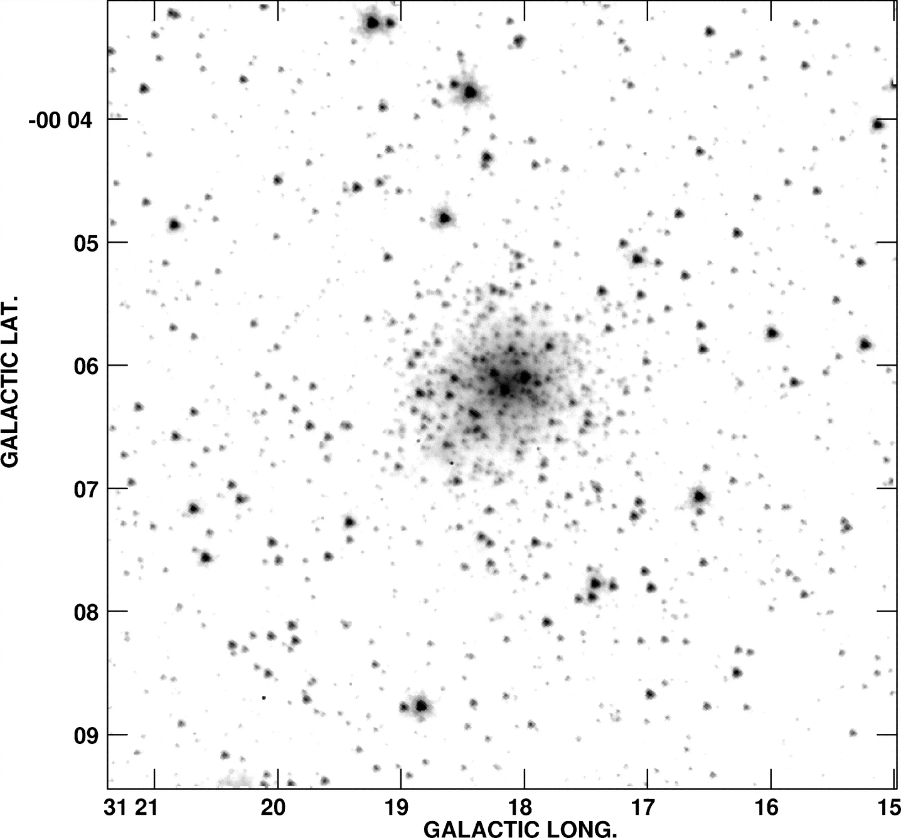
Some Recently Discovered Globulars:
GLIMPSE C01 (Kobulnicky et al. 2005)
Spitzer IRAC
DSS Red

Slide 14
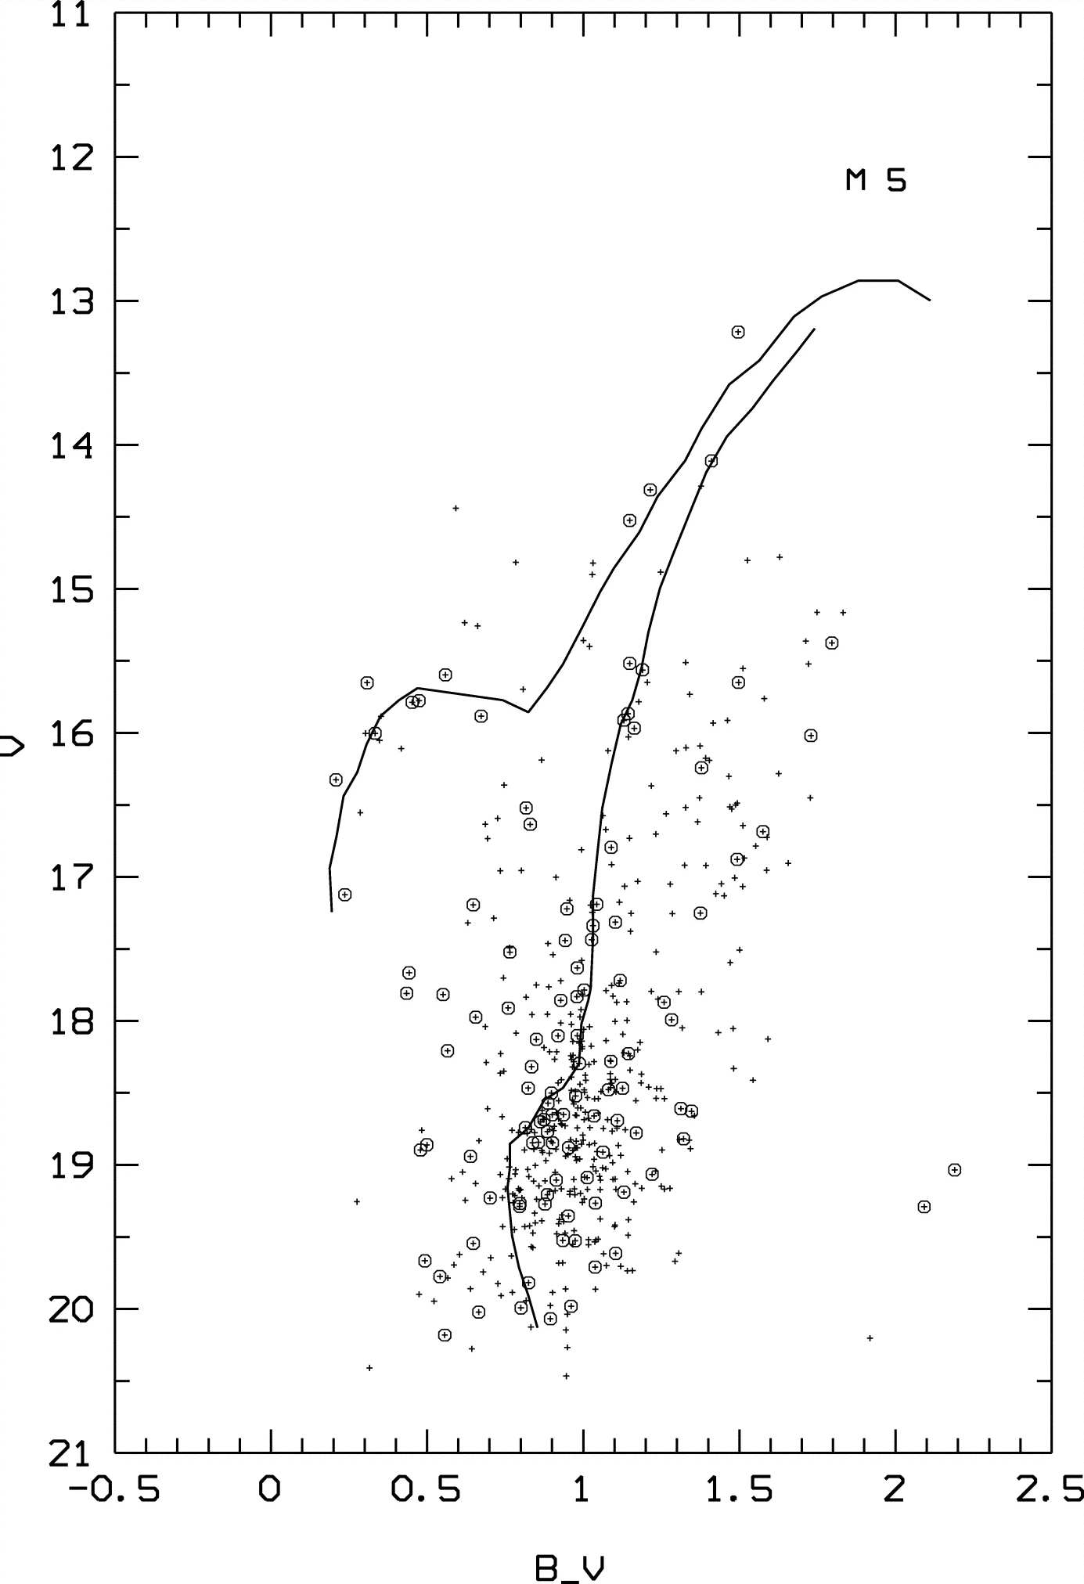
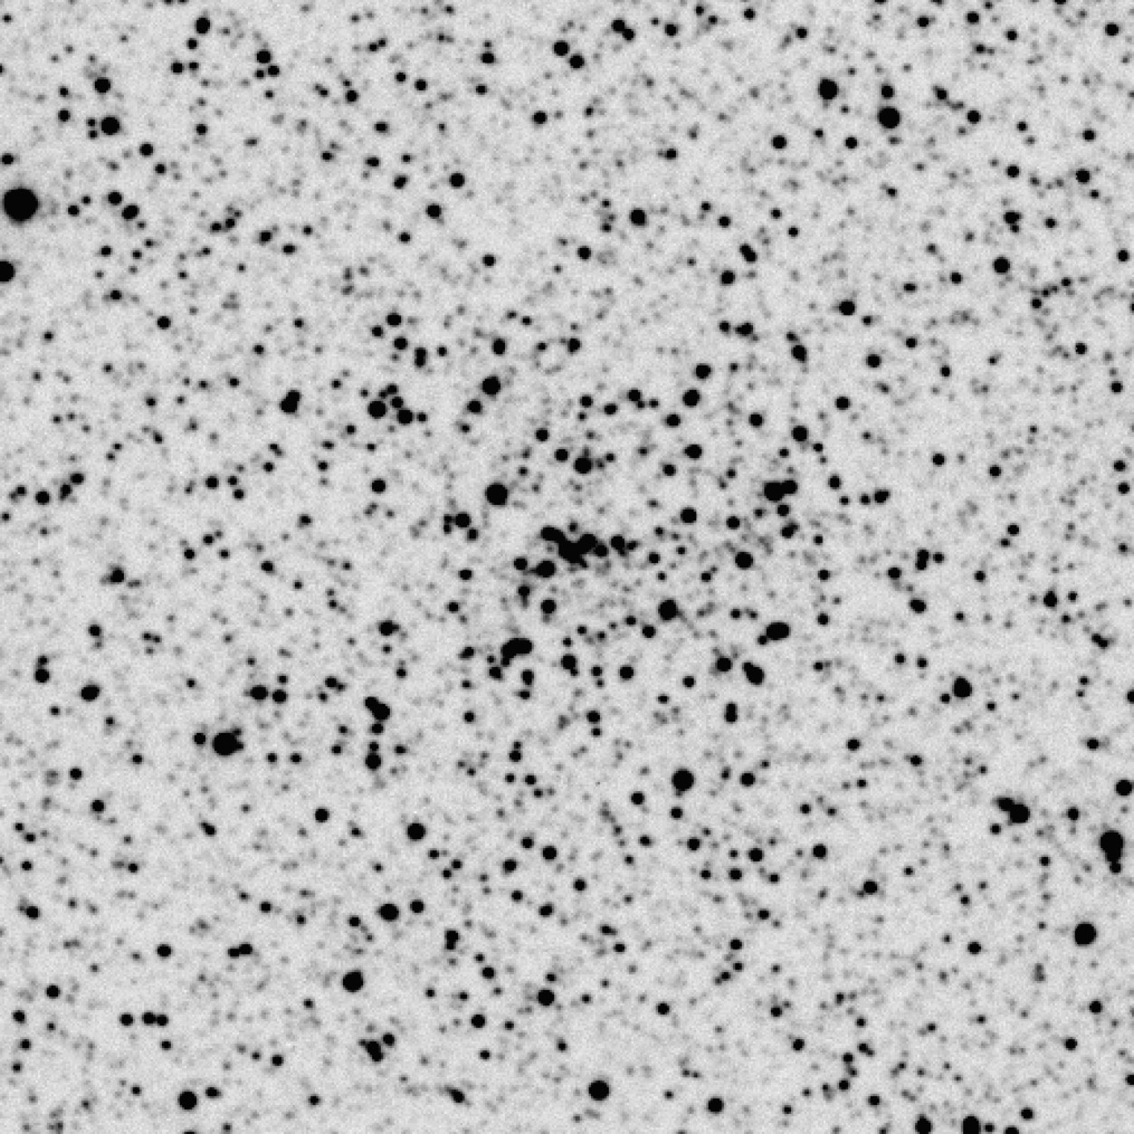
Some Recently Discovered Globulars:
AL # (Ortolani et al. 2006)

Slide 15
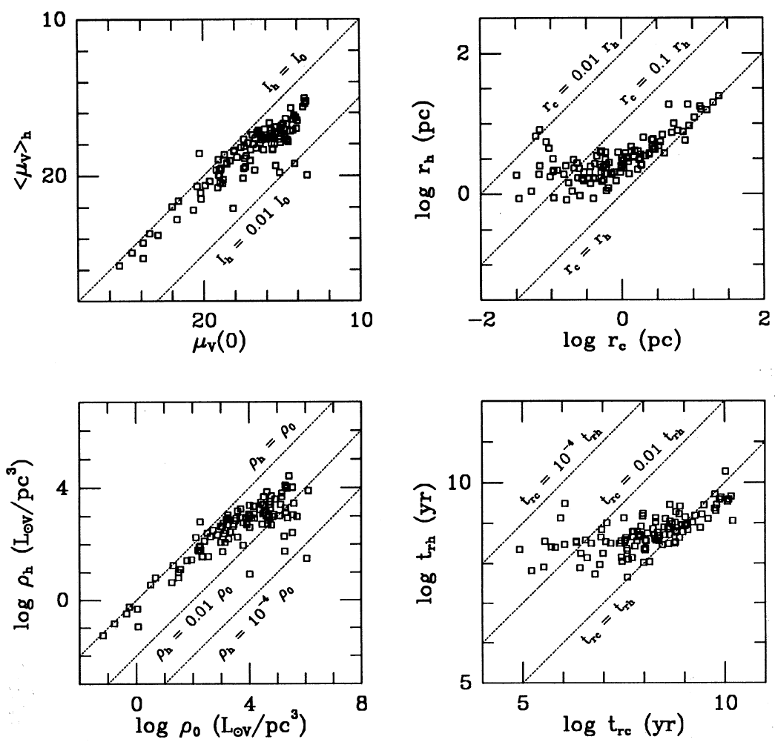
Dynamical Range of GC Parameters

Slide 16
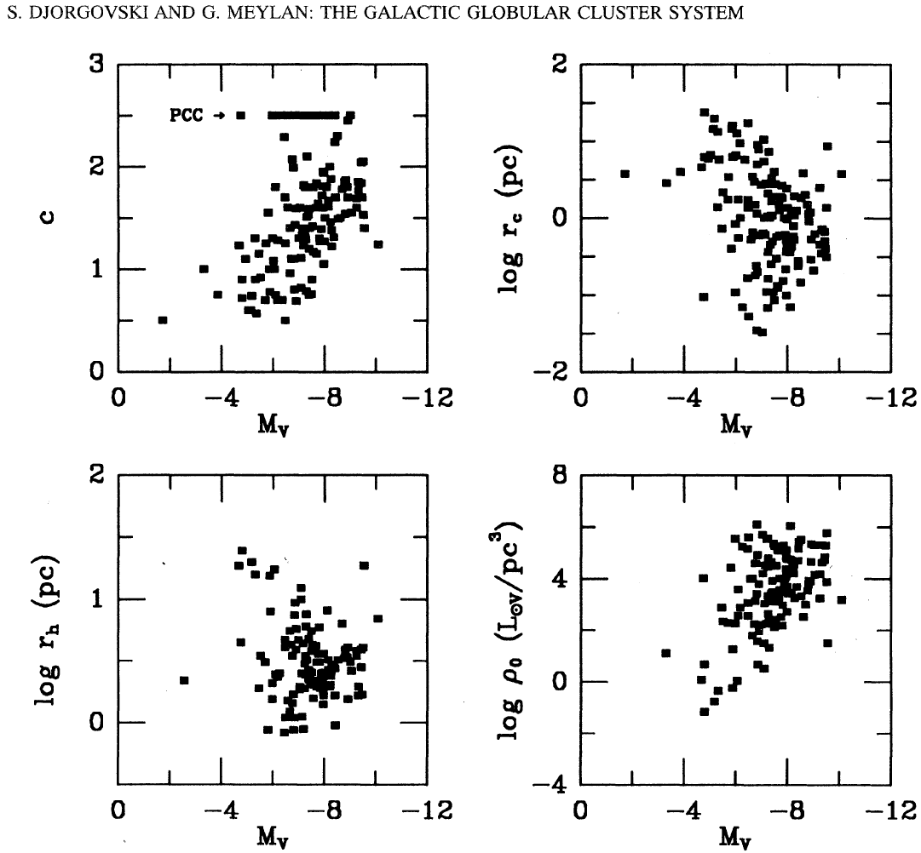
Correlations of GC Parameters

Slide 17
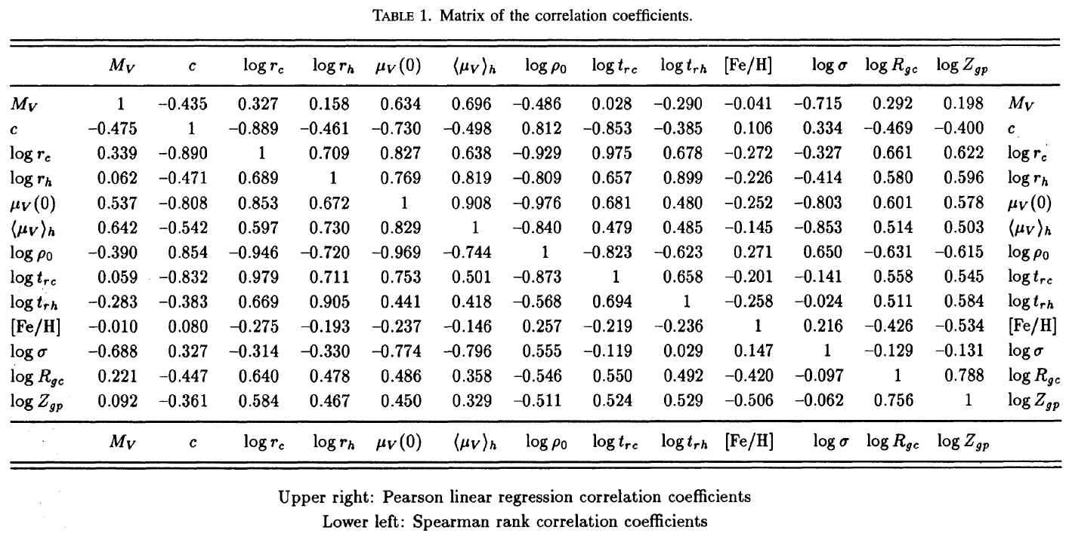
Correlations of GC Parameters
Djorgovski & Meylan 1994

Slide 18
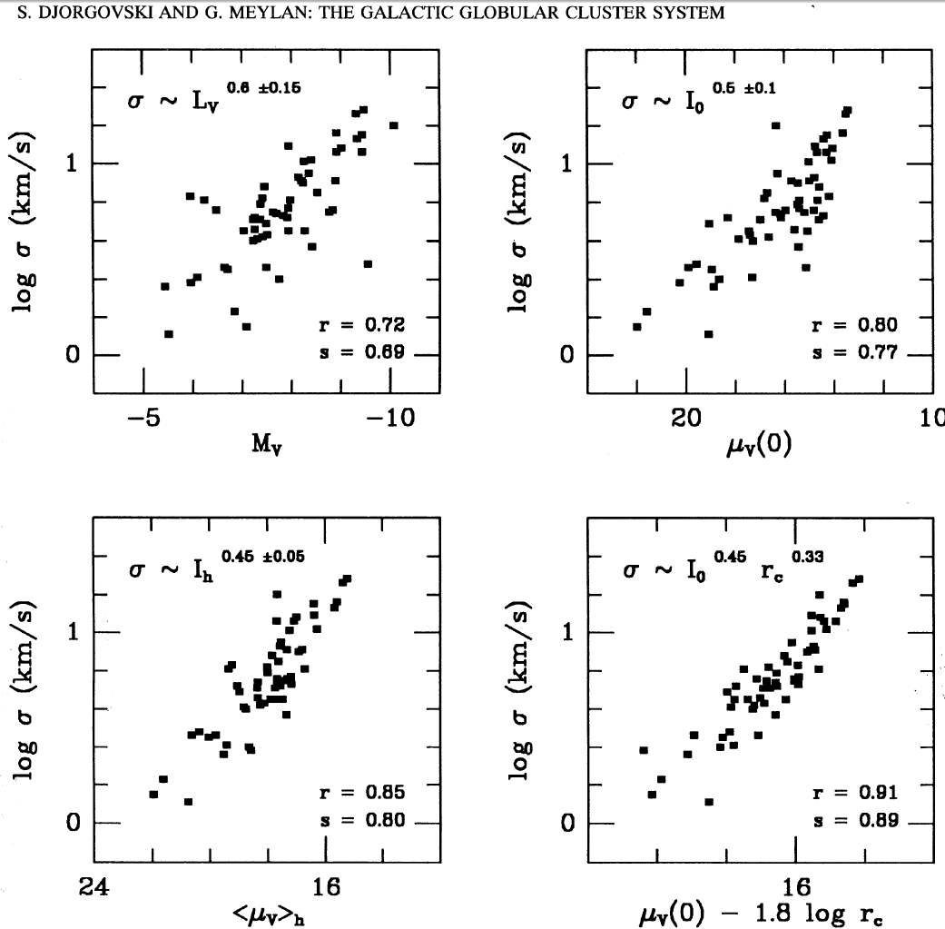
Velocity Dispersion Correlations

Slide 19
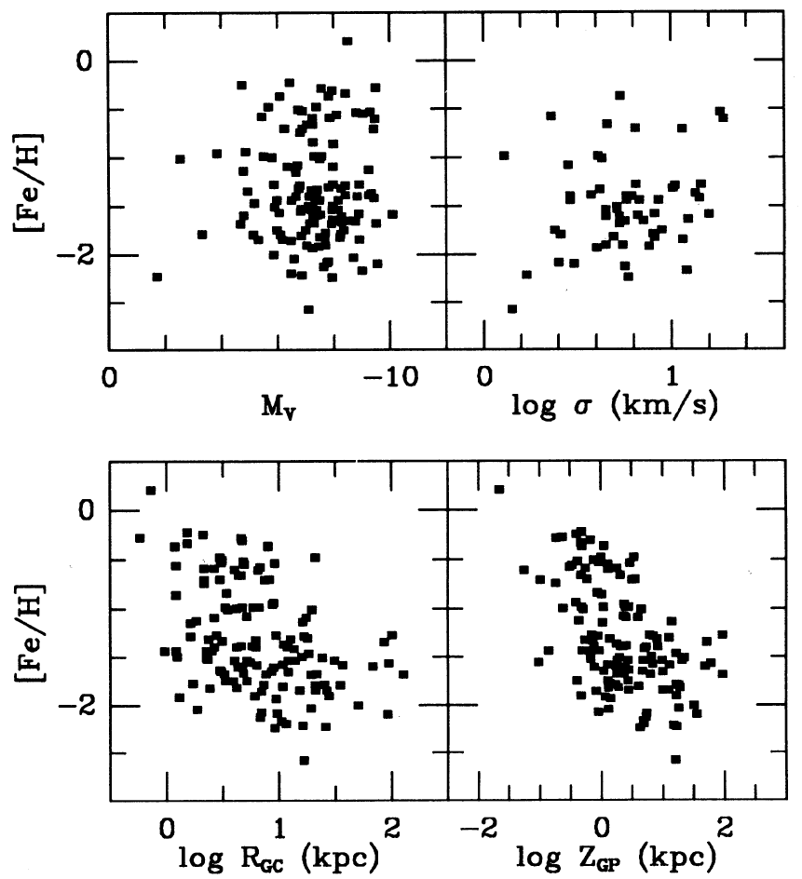
Metallicity Non-Correlations
Globular clusters are not self-enriched (?)

Slide 20
Stellar Populations in Globular Clusters
Remarkable similarities, but also some subtle differences
Used to: (1) test the stellar evolution theory; (2) measure the ages as a cosmological constraint; (3) probe the interplay of stellar dynamics sssssssssssssssssssssssssssssssssssssssssssssssssssssssssssssssssssssss and stellar populations
Metallicity effects

Slide 21
Ages of Globular Clusters
We measure the age of a globular cluster by measuring the magnitude of the main sequence turnoff or the difference between that magnitude and the level of the horizontal branch, and comparing this to stellar evolutionary models of which estimate the surface temperature and luminosity of a stars as a function of time
There are a fair number of uncertainties in these estimates, including errors in measuring the distances to the GCs and uncertainties in the isochrones used to derive ages (i.e., stellar evolution models)
Inputs to stellar evolution models include: oxygen abundance [O/Fe], treatment of convection, He abundance, reaction rates of ¹⁴N + p → ¹⁵O + γ, He diffusion, conversions from theoretical temperatures and luminosities to observed colors and magnitudes, and opacities; and especially distances

Slide 22
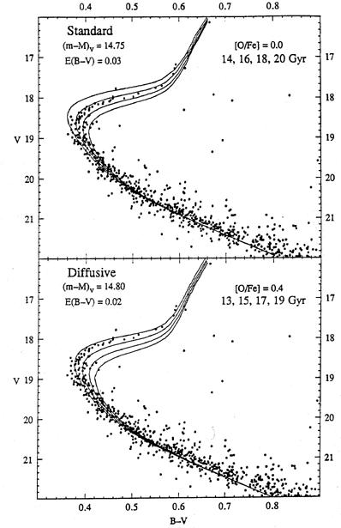
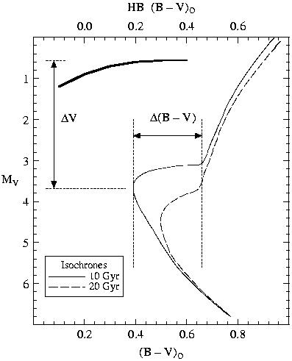
Globular Cluster Ages
Schematic CMD and isochrones
Examples of actual model isochrones fits

Slide 23
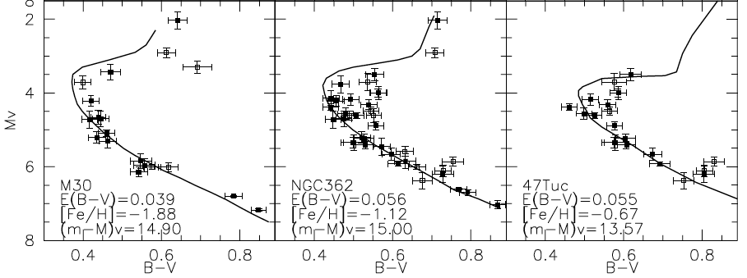
Globular Cluster Ages From Hipparcos Calibrations of Their Main Sequences
Examples of g.c. main sequence isochrone fits, for clusters of a different metallicity (Graton et al.)
The same group has published two slightly different estimates of the mean age of the oldest clusters:

Slide 24
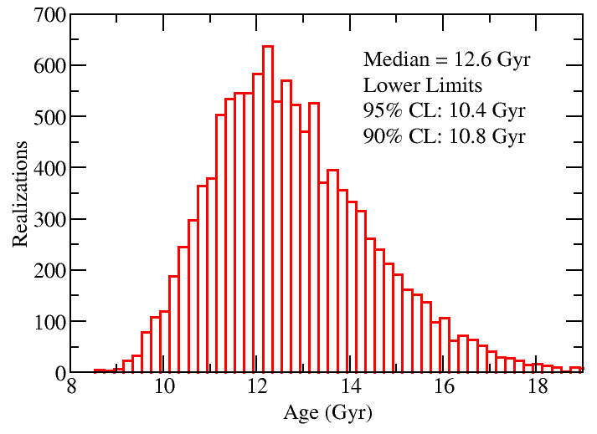
Range of possible GC ages (Chaboyer & Krauss 2003)

Slide 25
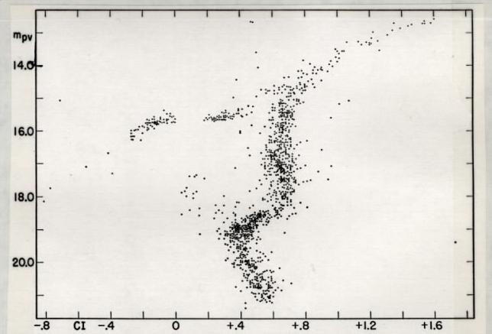
Blue Stragglers: Stellar Merger Products?
M3 CMD
Commonly seen in globular clusters, as an extension of the main sequence, and with masses up to twice the turnoff mass

Slide 26
White Dwarf Cooling Curves
White dwarfs are the end stage of stellar evolution for stars with initial masses < 8 M
They are supported by electron degeneracy pressure (not fusion) and are slowly cooling and fading as they radiate
We can use the luminosity of the faintest WDs in a cluster to estimate the cluster age by comparing the observed luminosities to theoretical cooling curves
Theoretical curves are subject to uncertainties related to the core composition of white dwarfs, detailed radiative transfer calculations which are difficult at cool temperatures
White dwarfs are faint so this is hard to do. Need deep HST observations
Only been done for one globular cluster, consistent with the ages of GCs found from the main sequence turnoff luminosities, would be nice if there were more

Slide 27
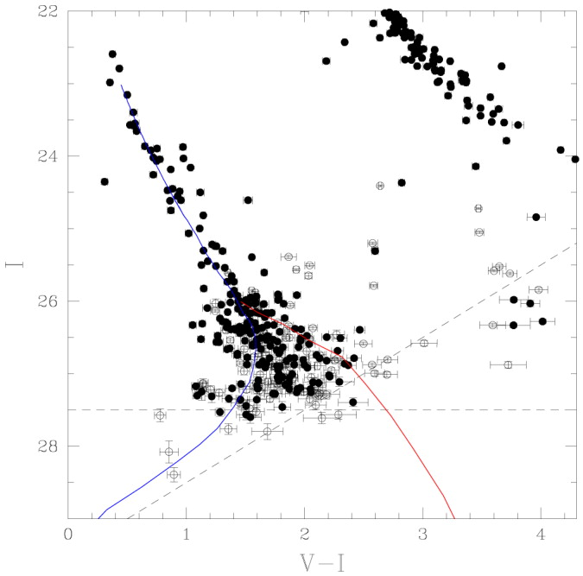
An Example: White Dwarf Sequence of M4
Main sequence

Hansen et al. (2002) find an age of
12.7 ± 0.7 Gyr for the globular cluster M4
White dwarfs
cooling sequence

Blue = hydrogen
atmosphere models
Red = helium
atmosphere models for a 0.6 M WD

Slide 28
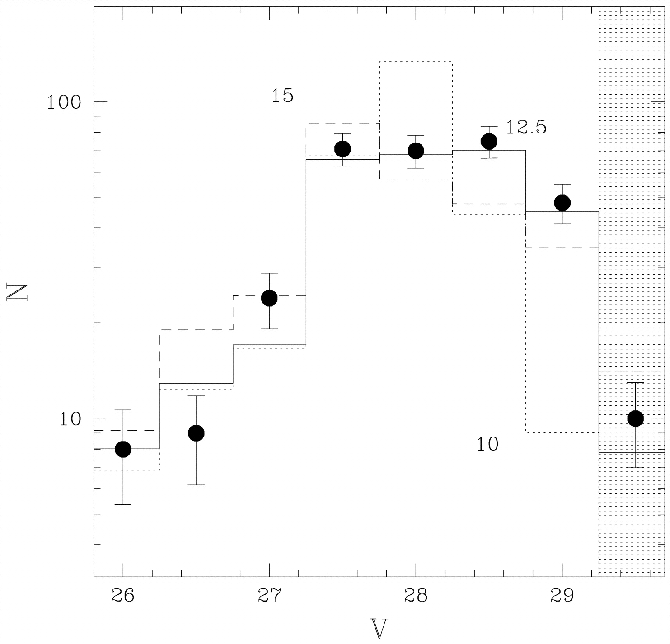
An Example: WD Luminosity Function of M4
Observed WD luminosity function compared to theoretical predictions
for various ages from
Hansen et al. (2002)

Slide 29
Characteristic Dynamical Time Scales:
Crossing time t_{c} ~ 10⁶ yr
Relaxation time t_{r} ~ 10⁸ yr
Evolution time t_{e} ~ 10¹⁰ yr
Open clusters: t_{c} ~ t_{r} < t_{e}  quickly dissolved
Globular clusters: t_{c} << t_{r} << t_{e}  a variety of dynamical evolution states must be present
Ellipticals: t_{c} << t_{r} ~ t_{e}  dynamical evolution not driven by 2-body relaxation
GCs represent an interesting class of dynamical stellar systems in which various dynamical processes take place on timescales shorter then the age of the universe. Thus, they are unique laboratories for learning about 2-body relaxation, mass segregation from equipartition of energy, stellar collisions and mergers, core collapse, etc.
Notes:
t_{cr}: a star moves across the cluster, orbits mix; t_{rlx}: stellar encounters redistribute energies, a near-maxwellian velocity distribution is set up; t_{ev}: stars escape, energy-
changing mechanisms operate, size and profile of the cluster change.

Slide 30
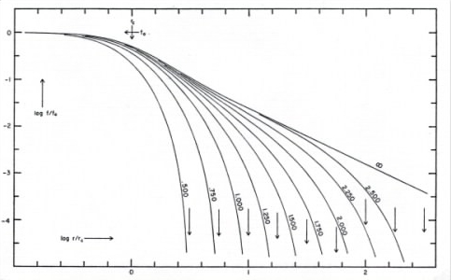
King Models: A Good Description of GC Structure
high concentration
low concentration
Assume isotropic, Maxwellian velocity distribution, in a cluster embedded in the Galactic tidal field. Parametrized by the mass, concentration (alias central potential), and tidal radius.
Notes:
The worlwide renown of the King model is probably due to King’s ideal combination of both theoretical and observational innovations, supported by a very simple and clear presentation and an ease of computation.

Slide 31
Core Collapse, aka The Gravothermal Catastrophe
Core
shrinks
a little
Gets a little hotter,
so that E_{kin} balances
the increased E_{pot}
Faster
stars
escape
Core
shrinks
some more
The only way to arrest the collapse is to provide a source of energy in the center, to replace the escaped heat.
In the case of (proto)stars, this is accomplished by thermonuclear reactions.
In the case of globular clusters, it is accomplished by hard binaries.

Slide 32
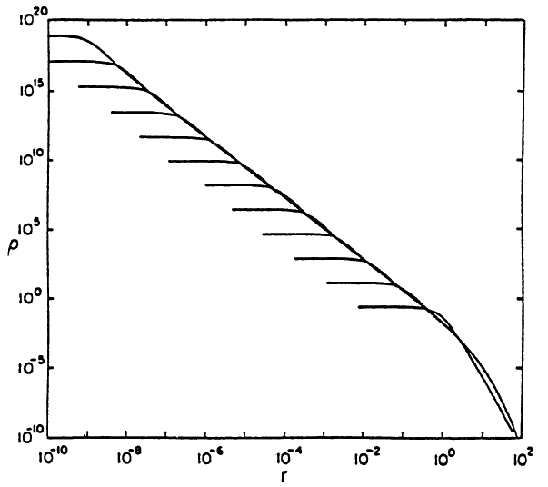
Evolution Towards the Core Collapse
King models are quasi-stationary. However, above a certain concentration, they become gravothermally unstable. The core shrinks, and the concentration increases. The density profile becomes a power-law cusp.
t_{n}
t₂
t₁
(Numerical simulation of a collapsing cluster, from H. Cohn)

Slide 33
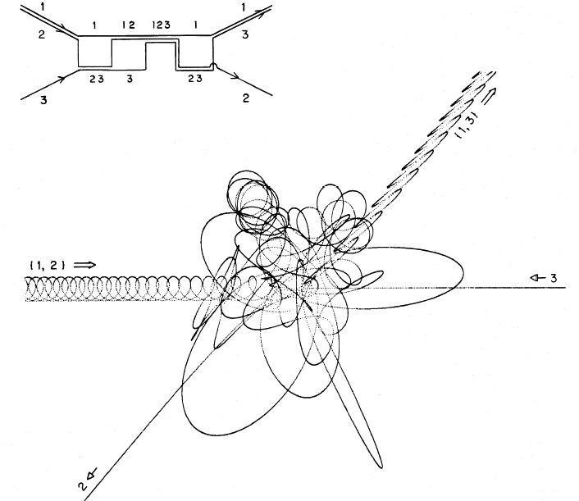
Examples of 3-Body Interactions
(Numerical simulation by P. Hut and J. Bahcall)
A binary can either take away or give kinetic energy to a passing star

Slide 34
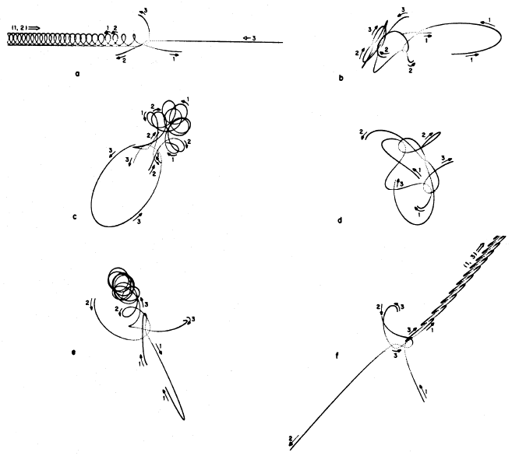
Examples of 3-Body Interactions
All types of interactions
can occur, but on average, hard binaries (those bound more tightly than the average binding energy in the cluster) give away more energy than they absorb, and become ever more tightly bound. They serve as the energy source which arrests the core collapse and stabilize the cluster.

Slide 35
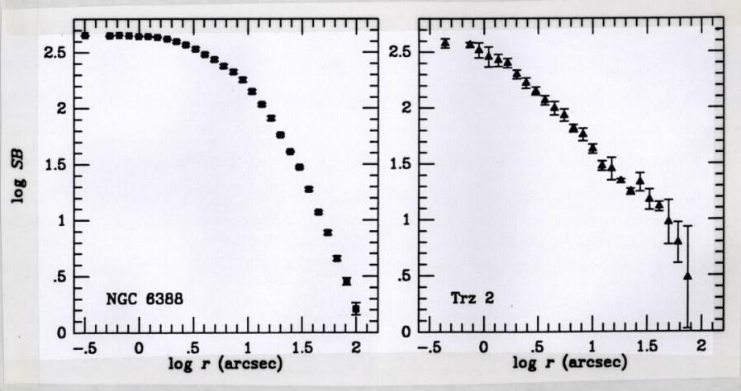
GC Surface Brightness Profiles: The Evidence for Core Collapse
Power-law profile
Note
flat core
Seeing disk
About 20% of all Galactic globulars show cuspy cores.

Slide 36
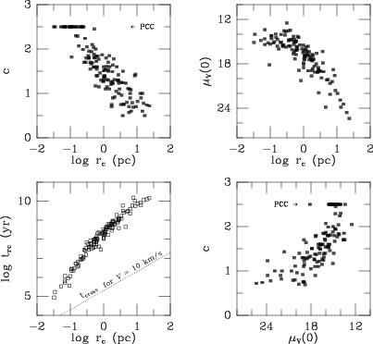
Core Properties of Globular Clusters: Driven by the Evolution Towards the Core Collapse?
concentration
central surface brightness
core radius
central relaxation time

Slide 37
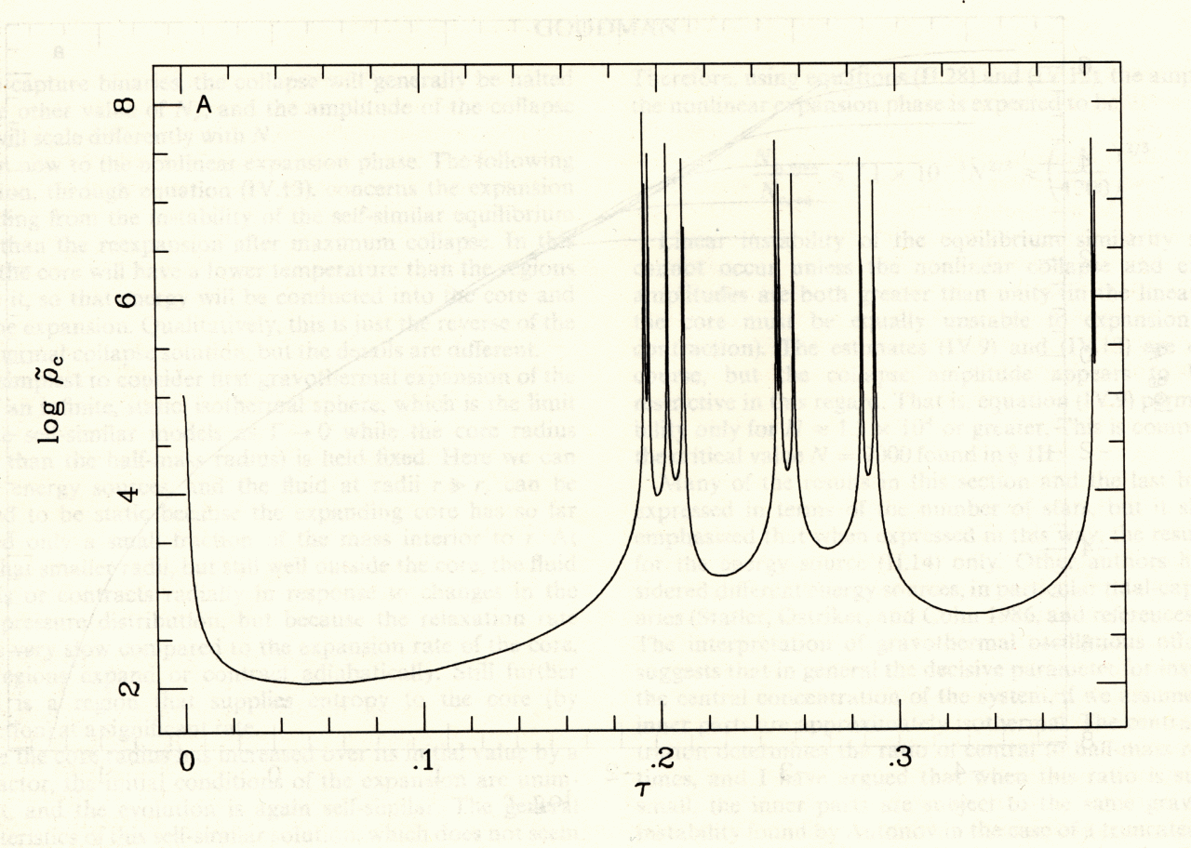
The Process Can Repeat Itself in Gravothermal Oscillations: Core Collapse  Bounce  Collapse …
core
density
collapsed
pre-collapsed
time

Slide 38
Tidal Evaporation of Globular Clusters
Stars evaporate from a cluster as they cross the Roche lobe boundary (equipotential surface)
All of the stellar content of the halo is probably due to dissolved clusters and dwarf galaxies
Tidal boundary
GC
V_{cl}
V_{star}
Galaxy

Slide 39
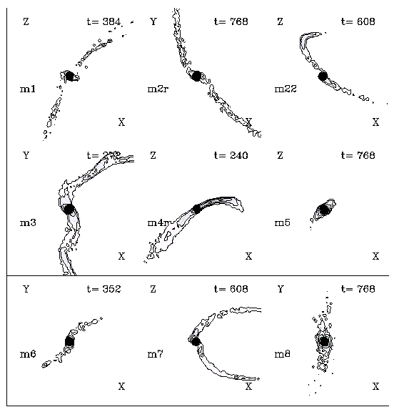
Tidal tails
Combes et al., 1999,
A&A, 352, 149
N-body simulations
of globular clusters tides
Once the particles
are unbound,
they slowly drift
along the GC path
and form
2 huge tidal tails

Slide 40
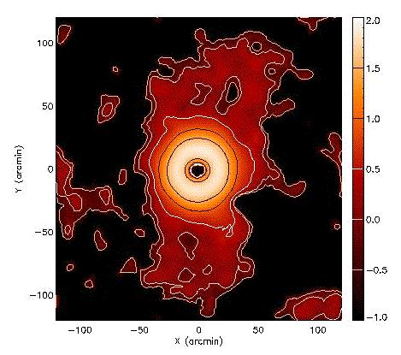
ω Centauri: Overdensities of Tidal-Tail Stars
5° x 5°
filtered
image

Slide 41
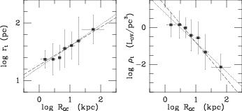
GC Tidal Radii and Densities Depend on the Distance to the Galactic Center
tidal radius
mean density
distance to the Galactic center
The trend follows the halo density profile, ρ ~ R⁻², as may be expected.
Cluster tidal radii are set by the mean density at the perigalacticon of their orbit.

Slide 42
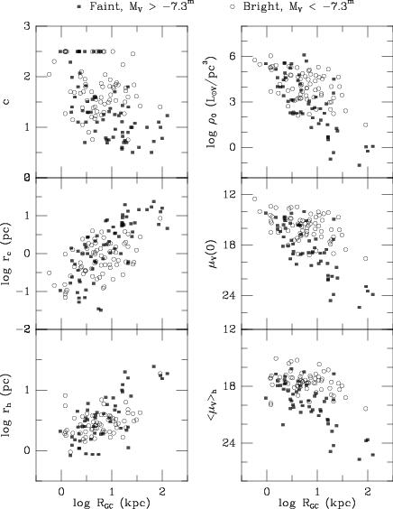
GC Properties Depend on Their Position in the Galaxy
More concentrated and denser clusters are found closer to the Galactic center and plane.
They are more likely to last in the tidal field, and tidal shocks also accelerate the evolution towards the core collapse.

Slide 43
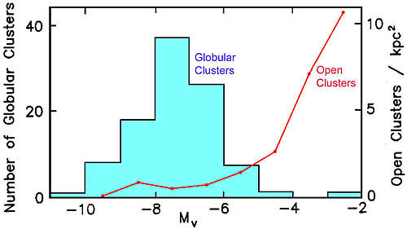
Tidal Dissolution of Open Clusters

