Slide 1
Galaxy Kinematics, Part II
Ay 124, Winter 2011
S. G. Djorgovski

Slide 2
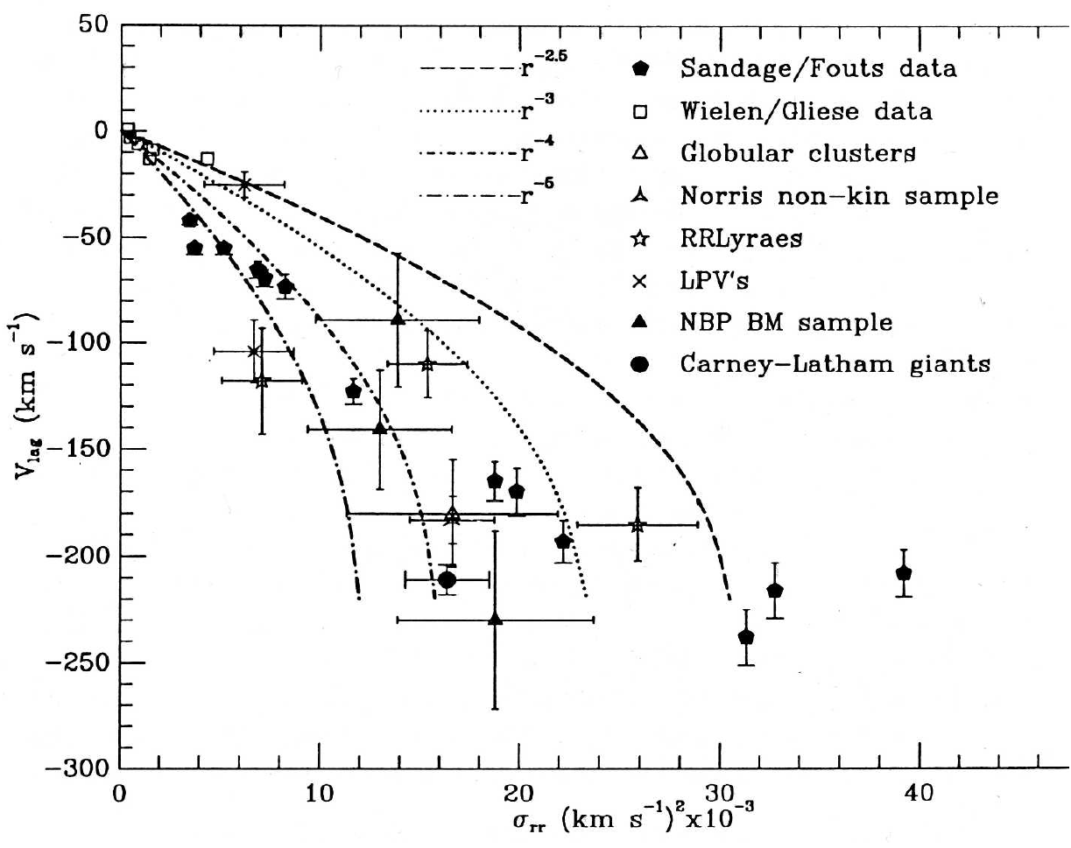
Kinetic Energy Evolution

Slide 3
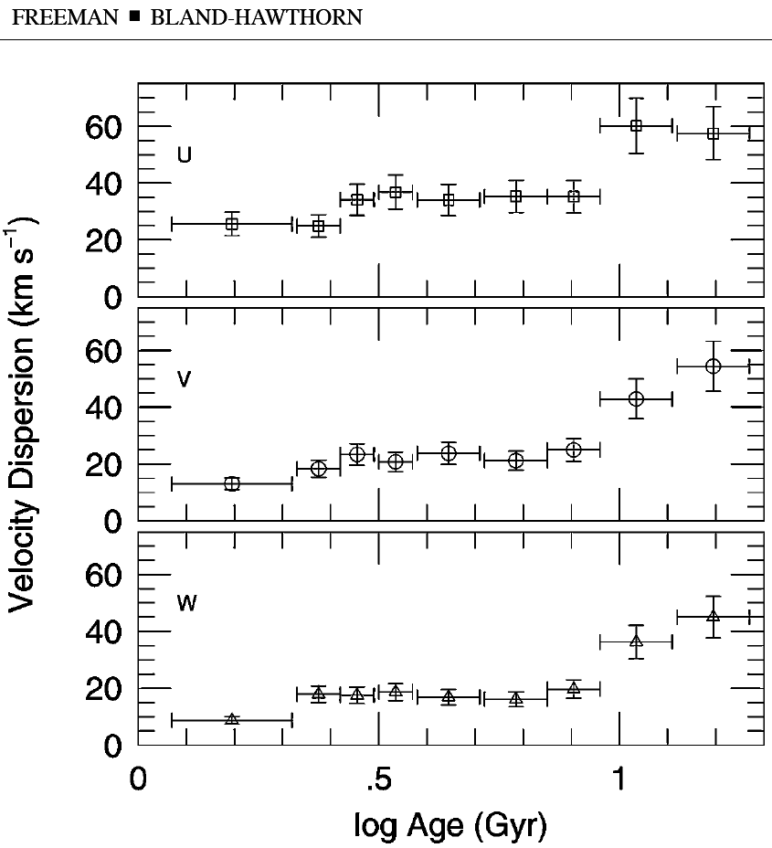
Stellar Kinematics and Age
2002, ARAA, 40, 487
Transition to the thick disk at ~ 10 Gyr

Slide 4
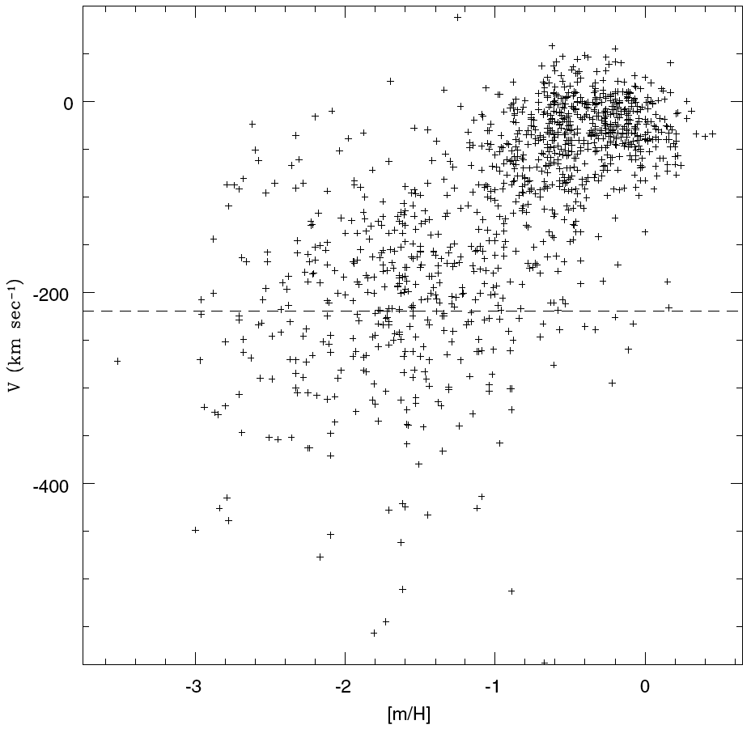
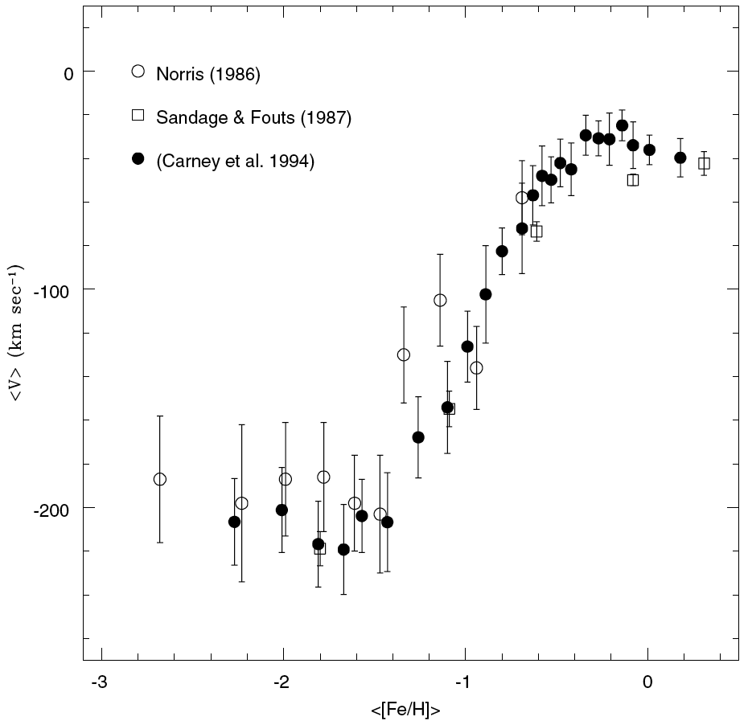
Stellar Kinematics and Chemical Enrichment
⇧
Change in velocity dispersion
Asymmetric drift
⏎

Slide 5
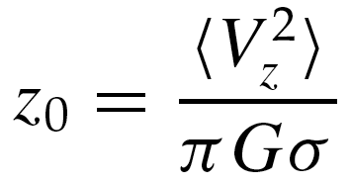
Vertical Velocity Dispersion
For a thin, self-gravitating stellar disk in a thermal equilibrium, the vertical velocity dispersion should be related to the projected surface density of the disk, and thus used to measure it.
It can be shown that the density distrib. of such a disk should be:
Where the scale height is given by:
And the projected surface density is:
At large z’s this distribution is close to an exponential:

Slide 6
Differential Rotation
Inner orbit
pulls ahead
Outer orbit
lags behind

Slide 7
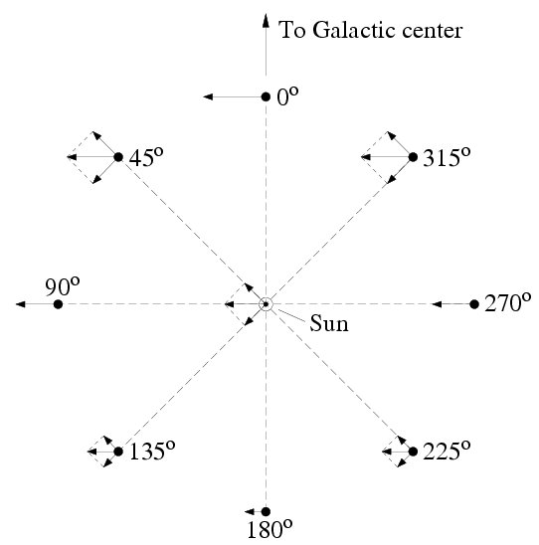
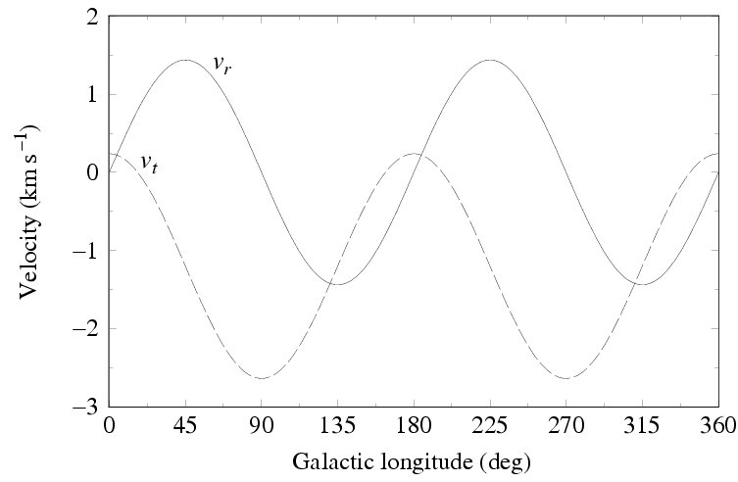
The Appearance of Differential Rotation

Slide 8
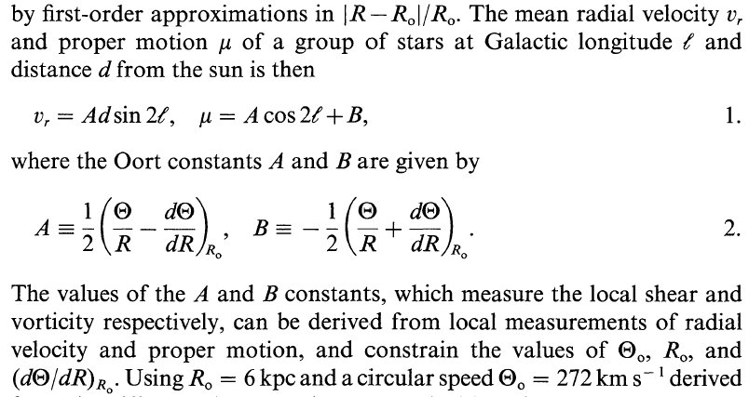
Quantifying the Differential Rotation
A and B are the Oort’s constants
Oort's A expresses local shear Oort's B expresses local vorticity, i.e., local rotation, × V

Slide 9
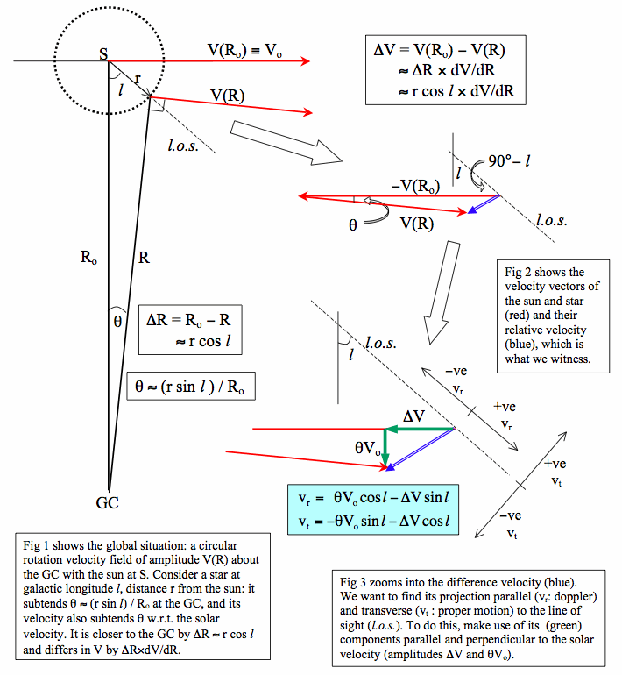
Derivation of Oort’s formulae:

Slide 10
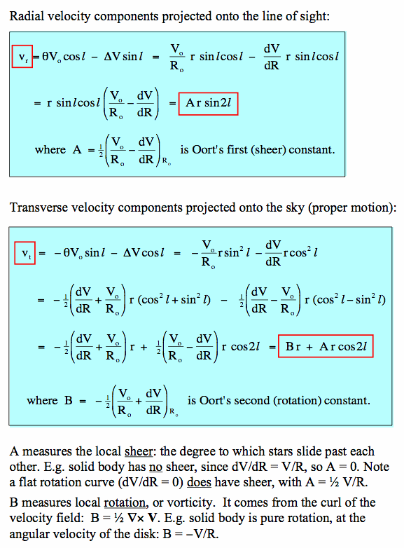
Derivation of Oort’s formulae:

Slide 11
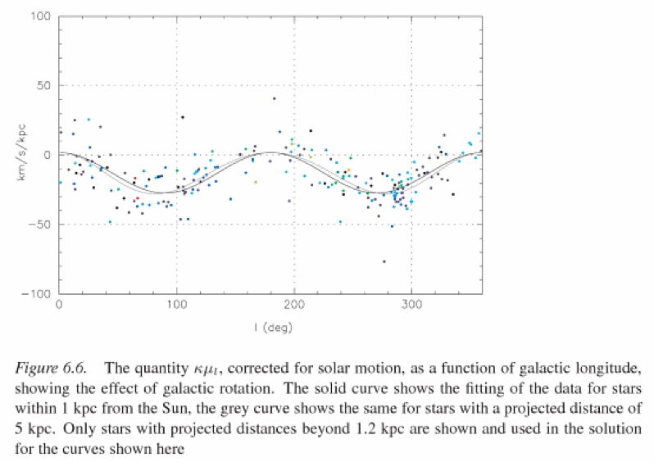
Measuring the differential rotation

Slide 12
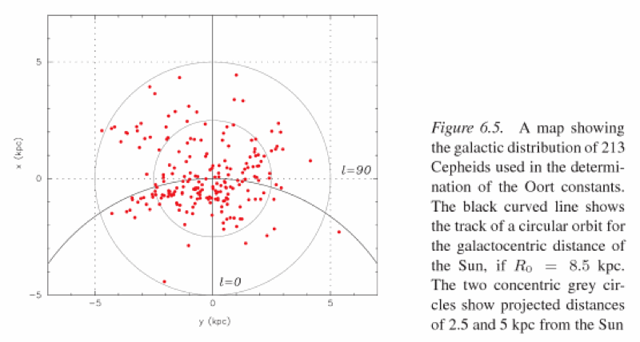
Measuring the Oort’s Constants

Slide 13
Oort’s Constants
Current best (Hipparcos) estimates for Oort's A and B are:
A = 14.8 ± 0.8 km/s/kpc
B = −12.4 ± 0.6 km/s/kpc
Notice that their dimensions are velocity gradients which are also frequencies, e.g., A = 0.0148 km/s/pc 0.014 Myr ⁻¹ = 14.8 Gyr ⁻¹
Note also that Oort’s formulae describe the local velocity field. To get the global rotation curve of our Galaxy, we need to measure velocities and distances of tracers over the full radial range of the disk.

Slide 14
Using Oort’s Constants
From their definition and the Hipparcos measurements we get:
The first of these confirms that the rotation curve is fairly flat near the Sun (gently rising).
The second yields an orbital period for the sun: P(R₀) = 2 / (R₀) = 2 / 27.2 Gyr⁻¹ = 0.23 Gyr = 230 Myr
Coupled with an estimate for the Galactocentric distance, R₀, it yields an orbital velocity: V_{c}(R₀) = 218 (R₀ / 8 kpc) km/s Which agrees fairly well with radio VLBI measurements of from proper motion of Sgr A*: V_{c}(R₀) = 241 (R₀ / 8 kpc) km/s

Slide 15
How Far is the Galactic Center?
Reid 1993, ARAA, 31, 345

Slide 16
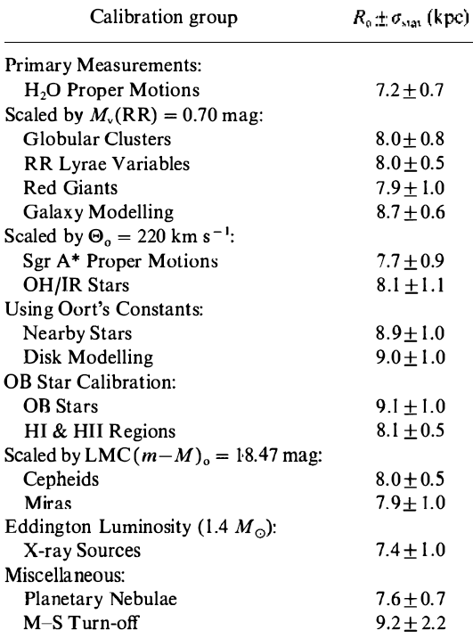
How Far is the Galactic Center?
Weighted average:
… and still not improved!
Reid 1993, ARAA, 31, 345

Slide 17
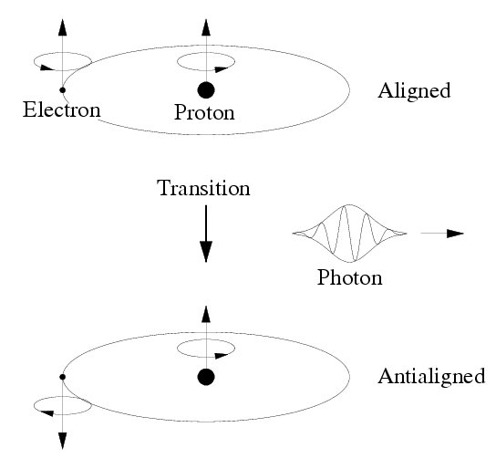
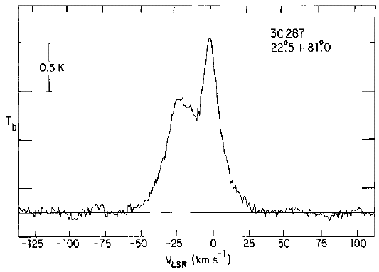
A Basic Tool: Spin-Flip (21 cm) Line of H I
In emission generally originates from warm (T ~ 100 - 6000 K) ISM, which accounts for ~ 30 - 65% of the total ISM volume in the Galactic disk. In absorption, it probes a cooler ISM (can be also self-absorbed).
Typical line profile 
A major advantage: it is not affected by the dust absorption!

Slide 18
L-V Diagrams
A radio telescope measuring a line (e.g., 21 cm line of H I, or a molecular line such as the CO) provides intensity as a function of velocity at any given pointing. If the resulting map is compressed in one spatial direction (e.g., latitude), the result is an “L-V diagram”, which shows the line intensity in a plane of velocity and the other coordinate (typically the Galactic longitude)
If one has a rotation curve of the Galaxy, this can then be translated into a 3-D distribution of gas and its kinematics – or v.v.

Slide 19
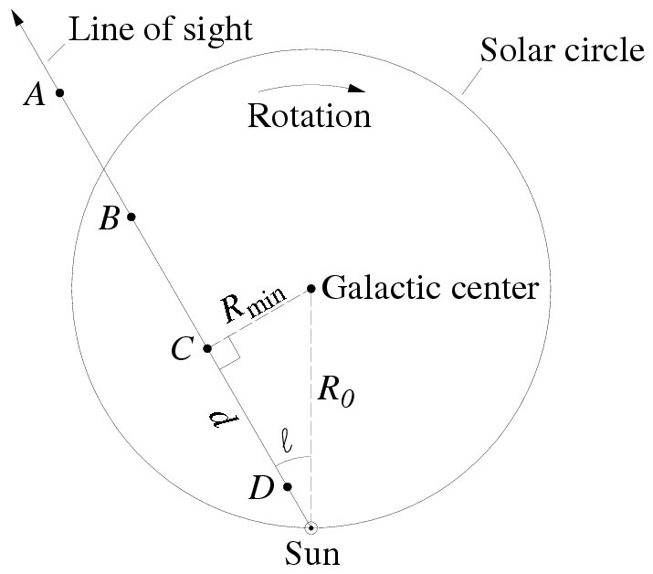
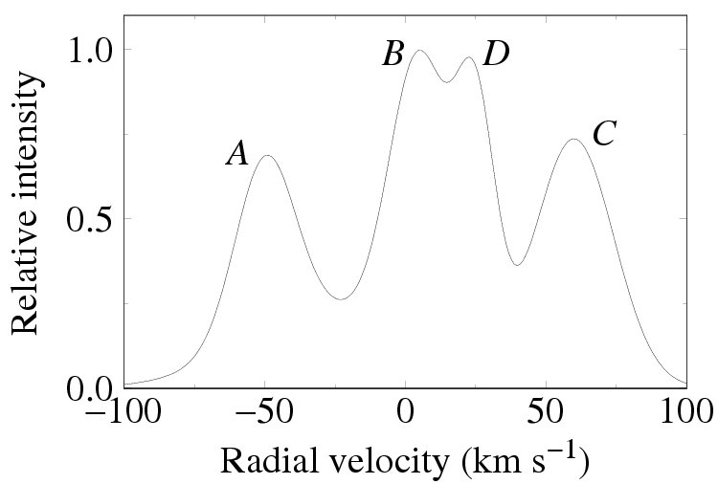
Thus, by measuring radial velocities, if we knew the distances, we could map out the differential rotation pattern
The trick, of course, is knowing the distances…
Photometric distances to OB stars and young clusters are used.

Slide 20
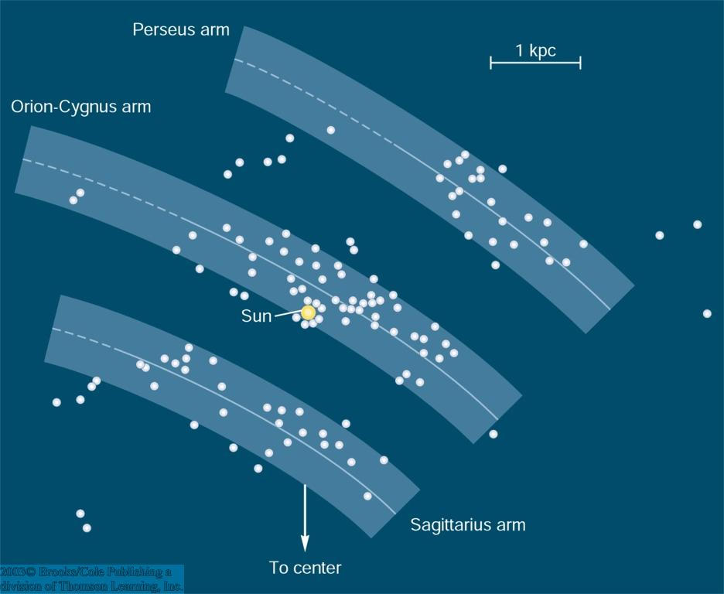
Combining Distances and Velocities
Since the spiral density waves concentrate the H I, and also may trigger star formation, we can associate young stars, OB associations and clusters with ISM peaks
Since these stars must be young, they could not have moved very far relative to the gas
Fortunately, they are also very bright and can be seen far away
Of course, the extinction must be also understood very well

Slide 21
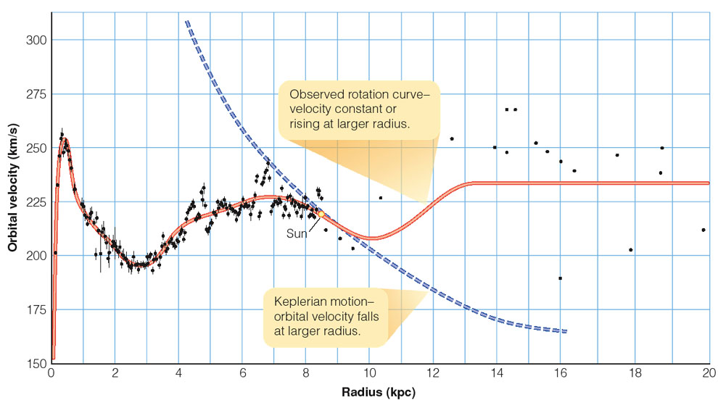
The Observed Rotation Curve of the Milky Way
0
If all mass was concentrated in the center, rotation curve would follow a modified version of Kepler’s 3rd law.

Slide 22
Interpreting the Rotation Curve
Motions of the stars and gas in the disk of a spiral galaxy
are approximately circular (v_{R} and v_{z} << v_{φ}).
Define the circular velocity at radius r in the galaxy as V(r).
Acceleration of the star moving in a circular orbit must be
provided by a net inward gravitational force:
To calculate F_{r}(r), must in principle sum up gravitational
force from bulge, disk and halo.
If the mass enclosed within radius r is M(r), gravitational
force is:

Slide 23
Simple model predicts the rotation curve of the Milky Way
ought to look like:
This number is about right -
Sun’s rotation velocity is
around 200 km s⁻¹.
Scaling of velocity with
R^{-1/2} is not right - actual
rotation velocity is roughly
constant with radius.
Implies:
gravity of visible stars and gas largely explains the
rotation velocity of the Sun about the Galactic center.
Flat rotation curve requires extra matter at larger
radii, over and above visible components.
Dark matter…
(From P. Armitage)

Slide 24
Mass Distribution in a Uniform Sphere:
If the density ρ is constant, then:
Rotation curve rises linearly with radius, period of the
orbit 2πr / V(r) is a constant independent of radius.
Roughly appropriate for central regions of spiral
galaxies.
(From P. Armitage)

Slide 25
Power law density profile:
If the density falls off as a power law:
…with α < 3 a constant, then:
For many galaxies, circular speed curves are
approximately flat (V(r) = constant). Suggests that
mass density in these galaxies may be proportional
to r⁻².
(From P. Armitage)

Slide 26
Simple model for a galaxy with a core:
Spherical density distribution:
Density tends to constant at small r
Density tends to r⁻² at large r
Corresponding circular velocity curve is:
(From P. Armitage)

Slide 27
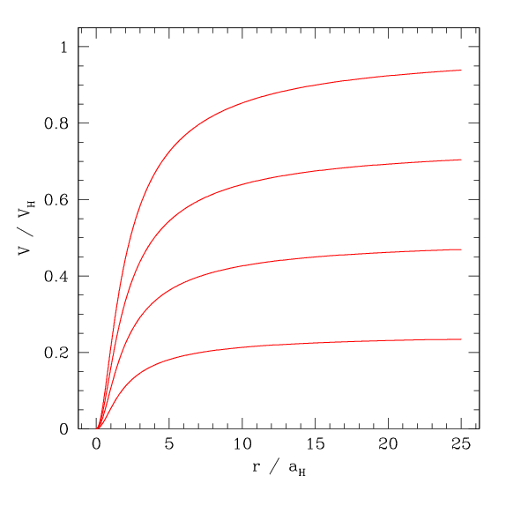
Resulting rotation curves:
Not a bad representation of the observed rotation curves …
(From P. Armitage)

Slide 28
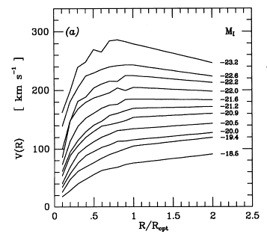
Rotation Curve Shapes Depend on Luminosity
As luminosity increases, the rotation amplitude increases; the initial rise steepens; the outer slope drops; and the radius R_{max} decreases.

Slide 29
Spiral Arms
Defining feature of spiral galaxies - what causes them?
Observational clues:
Seen in disks that contain gas, but not in gas poor S0 galaxy disks.
Defined mainly by blue light from hot massive stars, thus lifetime is << galactic rotation period
When the sense of the galactic rotation is known, the spiral arms almost always trail the rotation

Slide 30
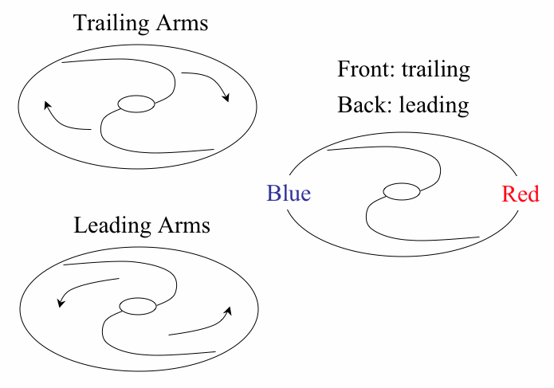
Which Way the Spiral Arms Turn?
Arm ends point forward a leading spiral
Arm ends point backwards a trailing spiral
To decide: need to know which side is nearest. Difficult, but try to identify the least obscured by dust (near side)
a Arms are almost always trailing

Slide 31
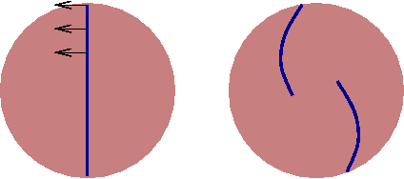
Differential Rotation of Galaxian Disks
First ingredient for producing spiral arms is differential rotation. For galaxy with flat rotation curve:
Angular
velocity
Any feature in the disk will be wrapped into a trailing spiral
pattern due to differential rotation:
Tips of spiral arms point away from direction of rotation

Slide 32
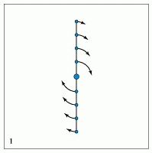
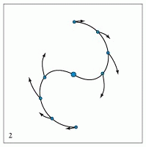
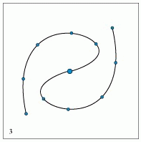
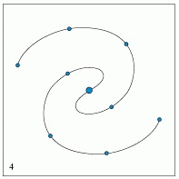
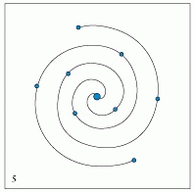
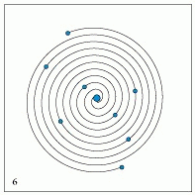
The Winding Dilemma
Due to differential rotation, stars near the galactic center don’t need to travel far to circle the galaxy, but stars further out can take a long time to go around. An initial line of stars will be drawn out into a spiral:
But this is not why galaxies have spiral arms!

Slide 33
Orbit Crowding Schematic
Nested Elliptical
Orbits, each one
slightly rotated.

Slide 34
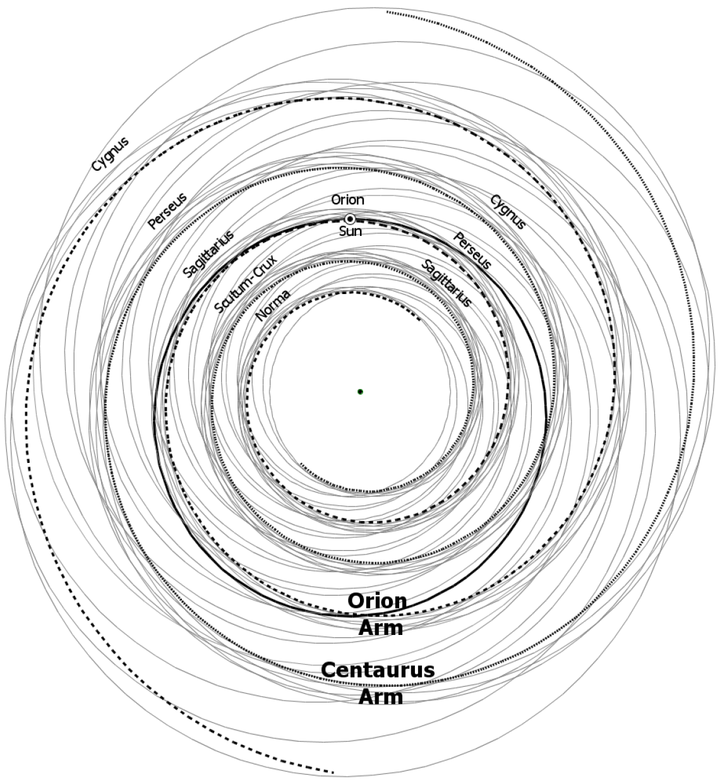
Modeling Milky Way as a 2-Arm Spiral
(from Francis & Anderson 2009, Proc. Roy. Soc. Lond. A465, 3425; also astro-ph/0901.3503)

Slide 35
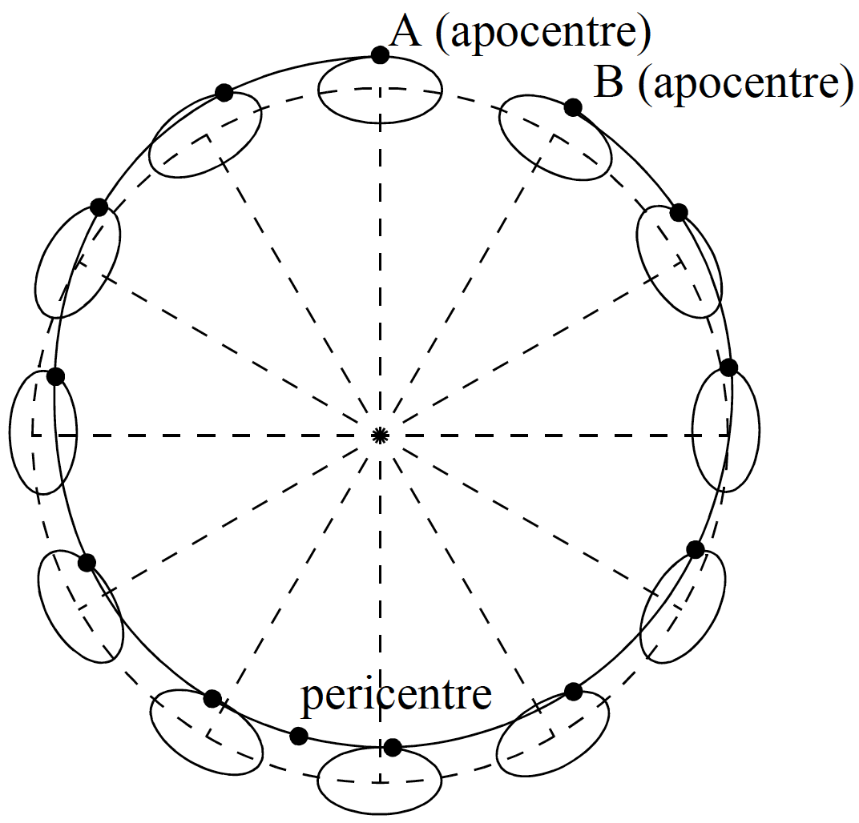
Epicycles Redux
Lindblad’s epicycle theory perturbs a circular orbit by superimposing an elliptical motion
Frequency of circular motion: Ω
Frequency of radial oscillation (i.e., elliptical motion): κ

Slide 36
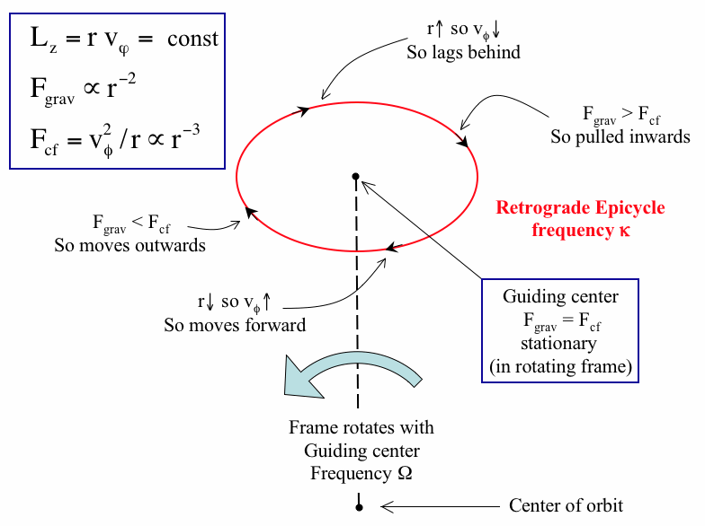
Epicyclic Motion

Slide 37
Why Epicycles?
Disk stars have approximately circular orbits with small deviations and can be described by superposition of:
Circular orbit along guiding center (GC, deferent), angular velocity Ω
Smaller elliptical epicycle, angular velocity κ, retrograde
Assume gravity/centrifugal balance & conservation of ang. momentum:
Consider star at a GC and give it a kick radially outwards
Since mrv = const., if r increases, v decreases w.r.t. the GC, and the star moves backwards
Since F_{cf} = v²/ r ~ r⁻³ while F_{grav} falls more slowly than r⁻² if r increases, F_{grav} > F_{cf} and the star gets pulled back inwards
As it falls in, r decreases so v increases and the star moves forward relative to the GC
But now F_{cf} > F_{grav}, the star moves outwards again, the cycle repeats

Slide 38
From Epicycles to Spiral Arms
For epicycle phases which vary systematically with radius, nested elliptical orbits may crowd in a spiral pattern, called a kinematic density wave (bars are another possibility)
Orbits are in turn perturbed by the spiral density pattern, this modifies the simple epicycles. Self-consistent solution is a density wave
These patterns are neither stationary nor move with the disk stars, but move at some intermediate angular velocity, Ω_{p}, called the pattern speed
The interaction of these patterns with the epicyclic motion can lead to resonances:
Ω_{p} – Ω_{stars} = –κ/2 a Inner Lindblad Resonance
Ω_{p} – Ω_{stars} = +κ/2 a Outer Lindblad Resonance

Slide 39
Density Wave Theory
Spiral arm patterns must be persistent. Density wave theory provides an explanation: the arms are density waves propagating in differentially rotating disks
Spiral arm pattern is amplified by resonances between the epicyclic frequencies of the stars (deviations from circular orbits) and the angular frequency of the spiral pattern
Spiral waves can only grow between the inner and outer Linblad resonances (Ω_{p} = Ω - κ/m ; Ω_{p} = Ω + κ/m ) where κ is the epicyclic frequency and m is an integer (the # of spiral arms)
Stars outside this region find that the periodic pull of the spiral is faster than their epicyclic frequency, they don’t respond to the spiral and the wave dies out
Resonance can explain why 2 arm spirals are more prominent

Slide 40
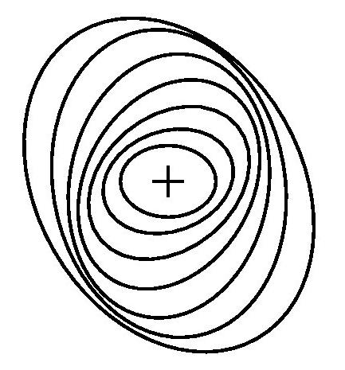
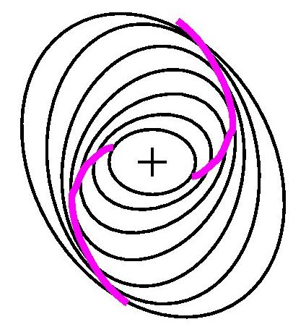
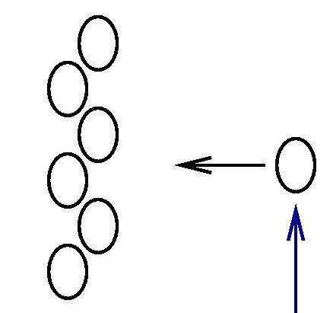
Spiral Density Waves
The orbits in spiral galaxies are not quite circles – they are ellipses. These ellipses are slightly tilted with respect to each other.
Thus there are regions of slightly higher density than their surroundings. The higher density means higher gravity.
Objects (such as a gas cloud) will be attracted to these regions and will drift towards them.

Slide 41
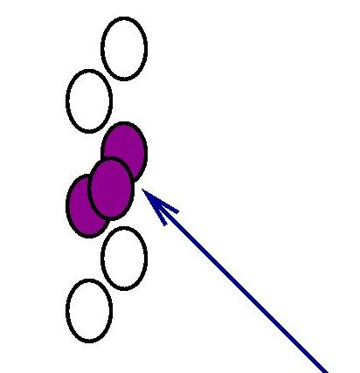
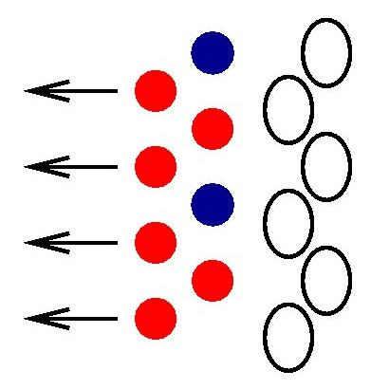
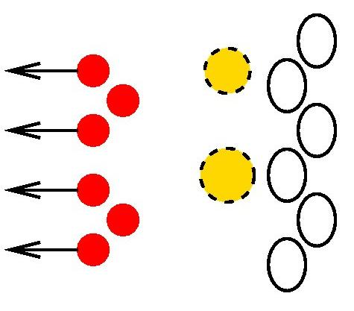
Spiral Density Waves
When the gas cloud collides with other gas clouds, stars will be formed. (This is where most of the galaxy’s star formation takes place.)
Many of the stars will be faint, red main sequence stars, but some will be bright blue OB stars. These stars will continue to drift through the region.
The OB stars don’t go far before they explode. The brightest (and bluest) of a galaxy’s stars will never be far from the spiral arm where they were born.

Slide 42
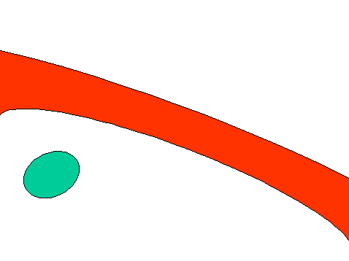
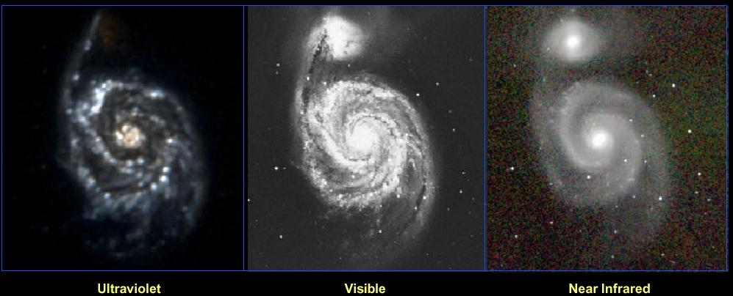
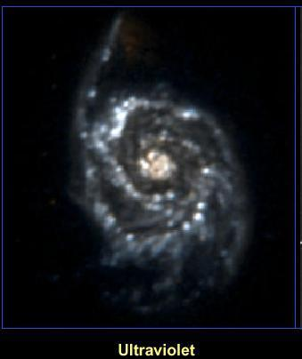
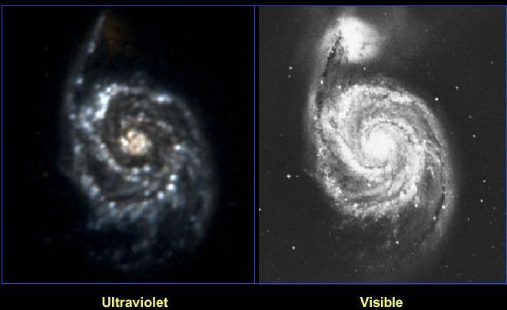
Spiral Density Waves
Since all the bright blue stars die before leaving the spiral arm, the spiral density waves must show up better at ultraviolet wavelengths.

Slide 43
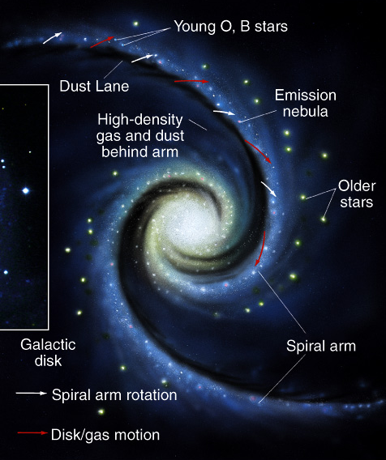
The Density Wave Theory

Slide 44
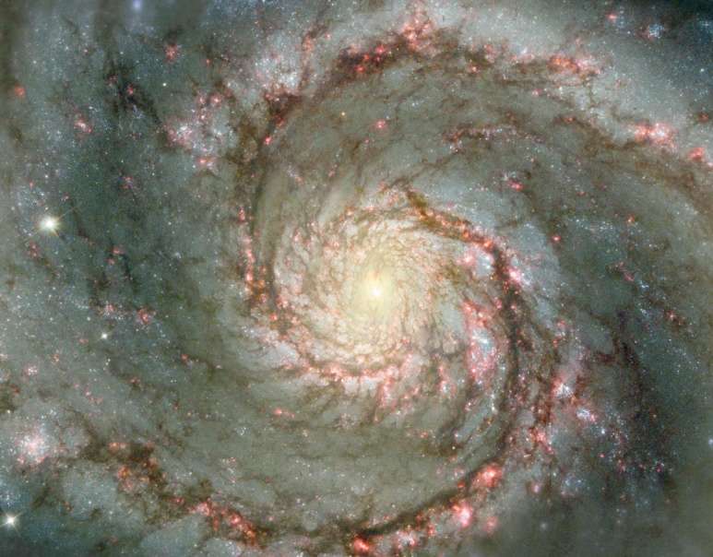

Slide 45
Density Wave Theory Summary
Spiral arms are waves of compression that move around the galaxy and trigger star formation
Star formation will occur where the gas clouds are compressed
Stars pass through the spiral arms unaffected
This theory is successful in explaining the properties of spiral galaxies
Two outstanding problems with it:
What stimulates the formation of the spiral pattern?
Tidal interactions?
What accounts for the branches and spurs in the spiral arms?

Slide 46
Star Formation in Spiral Arms
Spiral density wave creates spiral arms by the gravitational attraction of the stars and gas flowing through the arms
Even if there was no star formation, there would be spiral arms - but star formation makes them more prominent
This can explain the so-called “grand design” spirals
Star formation can self-propagate in a differentially rotating disk, e.g., as supernova shocks compress neighboring molecular clouds
Self-propagating star formation may be responsible for the branches and spurs in the spiral arms, or disks without evident spiral density waves (the so-called flocculent spirals)

Slide 47
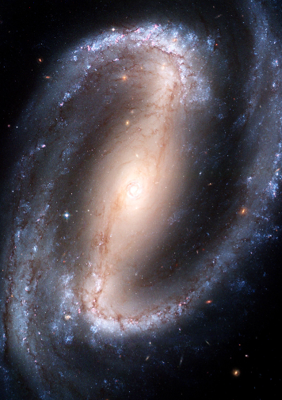
GalaxyBars
Very common: occur in ~50% of all spirals (MW included)
Isophotes not fit by ellipses; more rectangular, probably flat in disk plane
IR images can show bars within bars (inner bar ~independent)
Bars are straight, and stars stay in the bar rigid rotation of pattern with Ω_{bar}
Bars are not density waves: Stars move along the bar on closed orbits in frame rotating at Ω_{bar} Such orbits only occur for Ω_{bar} < Ω_{stars} a bars occur inside co-rotation (CR)
Bars can drive a density wave in disk and help maintain spiral structure.

Slide 48
Galactic Bar: Timeline
1950s: Oort and others posit an “explosive event” at Galactic Ctr. to explain expanding spiral features, but energy budget exorbitant (van der Kruit 1971)
Short bar/triaxial bulge
Long bar
1964: de Vaucouleurs first suggests central bar
1991: Blitz & Spergel suggest rotating triaxial spheroid to explain large-scale l-v asymmetries in HI; Binney et al. model HI, CO & CS i.t.o. central bar
1995: COBE/DIRBE detects IR diffuse emission asymmetries in gal. long. (Dwek et al.); Unavane & Gilmore (NIR point sources)
1998: Freudenreich (model of COBE/DIRBE diffuse NIR maps)
2005: Babusiaux & Gilmore (NIR point sources)
1975: Peters (modelling HI flow)
1992: Weinberg (AGB stars)
2000: Hammersley et al. (NIR point sources)
2005: Benjamin et al. (GLIMPSE)
2006: Cabrera-Lavers et al. (red clump sources)

Slide 49
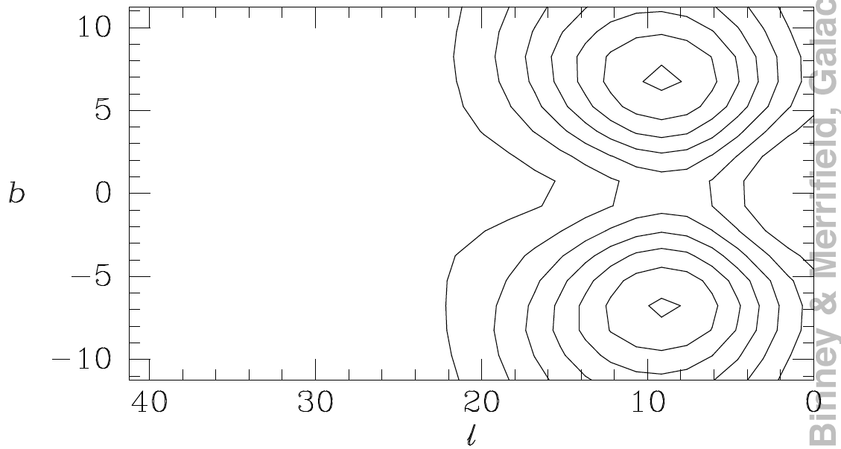
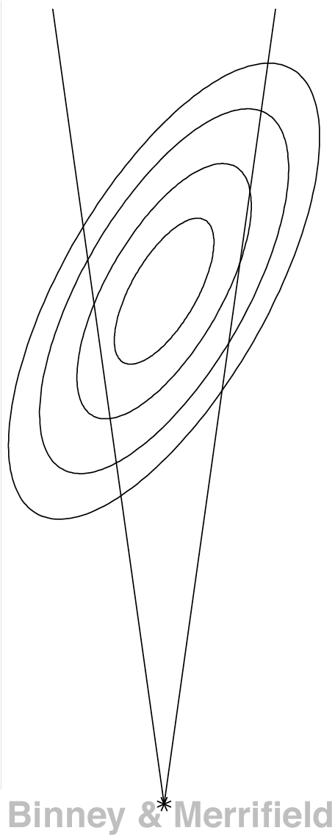
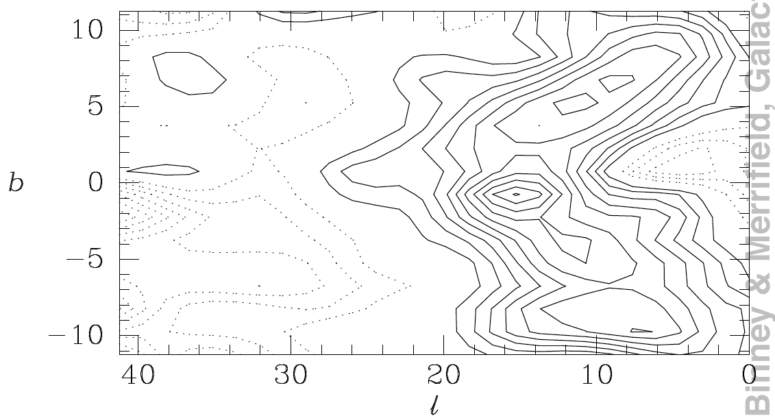
Looking for a Bar
Expect asymmetry of surface brightness or source counts on the opposite sides of the Gal. ctr.
Model
Contours of
I(l,b) / I(-l,b)
Observed

Slide 50
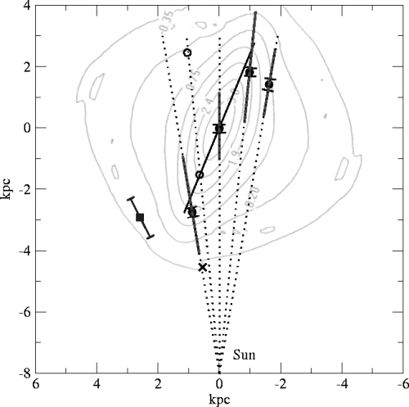
Inner Bar
Deep NIR photometry of RC stars in five l.o.s. very close to GP
Fat bar (b/a = (3-4/10)
ϕ = 22 +/- 5 deg
At l = -9.8 deg a pseudo-ring defining end of bar (Hammersley et al. 2000 point interpreted as lying on pseudo-ring)
Babusiaux & Gilmore (2005), fig. 7:
Overlaid is Bissantz & Gerhard (2002) model of the bar

Slide 51
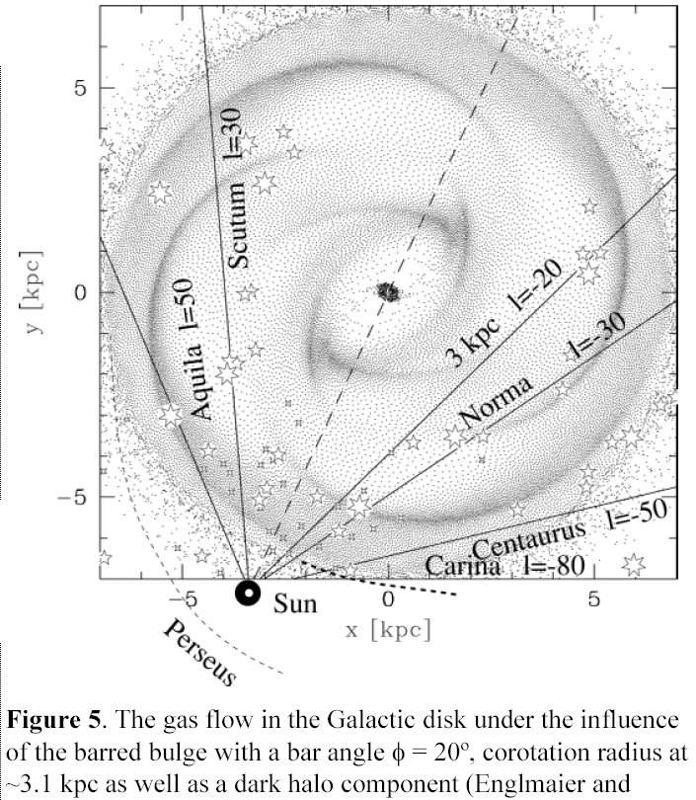
Gas Responds to the Spiral Density Wave Pattern, and the Rotating Bar

Slide 52
The Galactic Bar
Gas towards the GC moving away at ~150km/s

Slide 53
to Sun
Expected if Galaxy barred

Slide 54
Galactic Bulge
Old, metal-rich stellar pop. (self-enrichment)
Roughly flat velocity dispersion ~ 110 km/s

