Slide 1
Best Programming Practices
Ashish Mahabal, Caltech
Ay/Bi 199b
31 Mar 2011

Slide 2
The zen of bug-free programming
If debugging is the process of removing bugs, programming must be the process of introducing them.
- Edsger W. Dijkstra (1930-2002)
Don’t program!

Slide 3
Obfuscated programming contests
touch selfreproducingprogram.c
makefile:
cp selfreproducingprogram.c a.out
chmod 755 a.out
./a.out

Slide 4
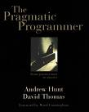
Programming style
Programming tools
My own experience/mistakes
The Pragmatic Programmer
By Andrew Hunt and David Thomas
Perl Best Practices
By Damian Conway

Slide 5
The scene keeps changing
Drupal http://drupal.org/node/287350
Django http://www.djangoproject.com/
iphone apps
http://mashable.com/2009/06/10/build-iphone-app/
Android apps: http://developer.android.com/guide/webapps/best-practices.html
Chrome extensions: http://blog.chromium.org/2010/06/making-chrome-more-accessible-with.html
… and yet the basics stay the same

Slide 6
Coding by instinct
Variable names (caps, underscores, …)
Types of loops (for, while, …)
Formatting
Indents, brackets, braces, semicolons
Procedural versus object oriented approach
Conscious and consistent programming style

Slide 7
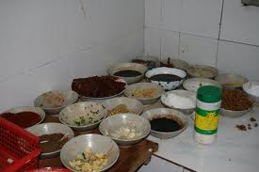
Necessary ingredients
Robustness
Efficiency
Maintainability

Slide 8
Robustness
Introducing errors
checking for existence (uniform style)
Edge cases
0? 1? last?
Error handling
exceptions? Verifying terminal input
Reporting failure
Traces? Errors don’t get quietly ignored

Slide 9
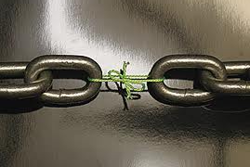
Efficiency
Working with strength
Proper data structures
Avoiding weaknesses
Dealing with version changes (backward compatibility)

Slide 10
Maintainability
More time than writing
You don’t understand your own code
You yourself will maintain it
Consistent practices
Braces, brackets, spaces
Semicolon (after last statement)
Trailing , in lists
Linelengths, tabs, blank lines
cb, bcpp, perltidy, jacobe, Jxbeauty

Slide 11
my @countries = (
USA,
UK,
UAE,
Ukraine
);
my @countries = (
USA,
UK,
UAE,
Ukraine,
);

Slide 12
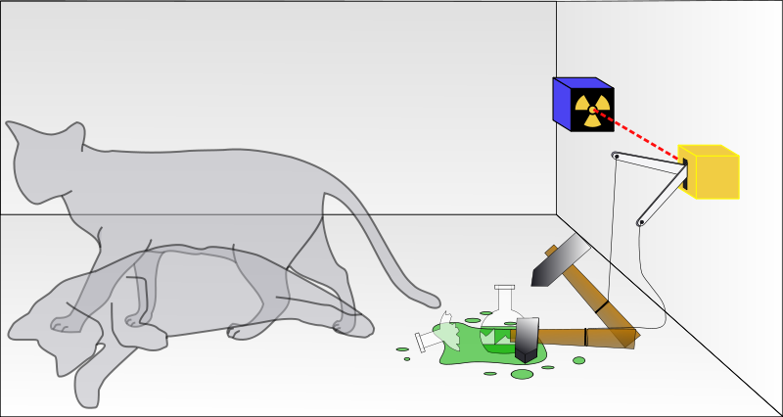
every piece of code splits the universe in two possibilities.
which future are you coding for?
if your code is most consistent, you have least to fear.

Slide 13
Some simple recommendations
Use underscores
$tax_form rather than $taxForm
Don’t use abbrvs
don’t drop all vowels if you do
Don’t use single letter variable names
Except perhaps in trivial small loops
Don’t use too common words as variable names
e.g. no, yes, count, left, okay
Empty strings: name and use them
my $empty_string = “ “;
Constants: use Readonly
my READONLY $PI = 3;

Slide 14
easy development versus easy maintenance
projects live much longer than intended
adopt more complex and readable language
check requirements
design, implement, integrate
validate

Slide 15
Don’t trust the work of others
Validate data (numbers, chars etc.)
Put constraints (-90 <= dec <= 90)
Check consistency

Slide 16
Don’t trust the work of others
Validate data
Put constraints
Check consistency
Don’t trust yourself
Do all the above to your code too

Slide 17
Design by contract (Eiffel, Meyer ’97)
Preconditions
Postconditions
Class invariants
Be strict in what you accept
Promise as little as possible
Be lazy
Inheritance and polymorphism result

Slide 18
Crash early
Sqrt of negative numbers (require, ensure, NaN)
Crash, don’t trash
Die
Croak (blaming the caller)
Confess (more details)
Try/catch (own error handlers e.g. HTML 404)
Exceptions – when to raise them
should it have existed?
Don’t know?

Slide 19
sub locate_and_open {
open my $fh,’<‘,”filename”;
return $fh;
}
sub load_header_from {
TRY TO READ HEADER HERE
}
my $fh = locate_and_open($filename);
my $head = load_header_from($fh);

Slide 20
sub locate_and_open {
open my $fh,’<‘,”filename” or croak “cant”;
return $fh;
}
my $fh = locate_and_open($filename);
my $head = load_header_from($fh);

Slide 21
If(my $fh = eval { locate_and_open($filename)}){
my $head = load_header_from($fh);
}
else{
carp “Couldn’t access $filename.\n”;
}

Slide 22
Tests
Comments
Arguments
Debugging

Slide 23
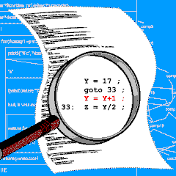
Tests
Test against contract
Sqrt: negative, zero, string
Testvalue(0,0)
Testvalue(4,2)
Testvalue(-4,0)
Testvalue(1.e12,1000000)
Test harness
Standardize logs and errors
Test templates
Write tests that fail
http://ib.ptb.de/8/85/851/sps/swq/graphix

Slide 24
All software will be tested
If not by you, by other users!
perl Makefile.pl
make
make test
make install
Don’t use code you do not understand

Slide 25
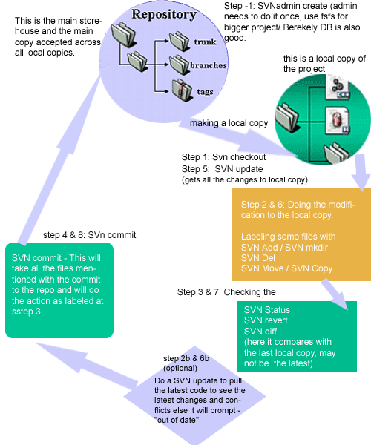
Source Code Control
SVN
Checkin
Checkout
Comment
Merge
Git, google docs, wiki, trac
http://img.idealwebtools.com/blog/svn.gif

Slide 26
Modification cycle
write test
run and make sure it fails
Checkout
change, comment, edit readme etc.
Compile
run: make sure test passes
checkin

Slide 27
Comments
If it was difficult to write, it must be difficult to understand
bad code requires more comments
tying documentation and code
use Euclid;

Slide 28
Documentation/comments in code
List of functions exported
Revision history
List of other files used
Name of the file

Slide 29
Documentation
Algorithmic:
# full line comments to explain the algorithm
Elucidating: # end of line comments
Defensive: # Has puzzled me before. Do this.
Indicative: # This should rather be rewritten
Discursive: # Details in POD

Slide 30
Arguments
Don’t let your subroutines have too many arguments
universe(G,e,h,c,phi,nu)
Look for missing arguments
Set default argument values
Use explicit return values

Slide 31
Needing/demanding arguments
unless(@ARGV==4){exit;}
my ($a,$b,$c,$d) = @ARGV;
use Getopt::Euclid; # not just demands arguments
# but provides constraints

Slide 32
PROMPT> pq_images.pl
Missing required arguments:
-r[a] [=] <RA>
-d[ec] [=] <Dec>
(Try: pq_images.pl --help)
PROMPT>

Slide 33
PROMPT> pq_images.pl --help
Usage:
pq_images.pl -r <RA> -d <Dec> [options]
Required arguments:
-r[a] [=] <RA>
Specify RA in degrees [0 <= RA <= 360]
-d[ec] [=] <Dec>
Specify Dec in degrees [PQ: -25 <= Dec <= 25]
Options:
-i[d] [=] <id> [string]
ID of the object

Slide 34
-c[leanup] [=] <cleanup>
Level of cleanup after the program is done [default: 2] 0: Do not
remove anything 1: Remove everything except individual mosiacs (and
final product) 2: Leave only final coadded image
-v
--verbose
Print all warnings
--version
--usage
--help
--man
Print the usual program information
PROMPT>

Slide 35
PROMPT>pq_images.pl --man
AUTHOR
Ashish Mahabal <aam@astro.caltech.edu>
BUGS
There are undoubtedly serious bugs lurking somewhere in this code. Bug
reports and other feedback are most welcome.
COPYRIGHT
Copyright (c) 2007, Ashish Mahabal. All Rights Reserved. This module is
free software. It may be used, redistributed and/or modified under the
terms of the Perl Artistic License (see
http://www.perl.com/perl/misc/Artistic.html)

Slide 36
use Getopt::Euclid;
…
=head1 REQUIRED ARGUMENTS
=over
=item -r[a] [=] <RA>
Specify RA in degrees [0 <= RA <= 360]
=for Euclid:
RA.type: number >= 0
RA.type: number <= 360
=item -d[ec] [=] <Dec>
Specify Dec in degrees [PQ: -25 <= Dec <= 25]
=for Euclid:
Dec.type: number >= -25
Dec.type: number <= 25
=back

Slide 37
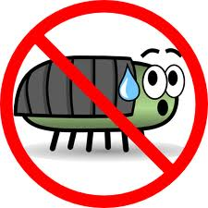
Debugging
there will be bugs!
the only bugfree program is one that does not do anything
tests: write unit tests first
make sure the program compiles without warnings (perl -c)

Slide 38
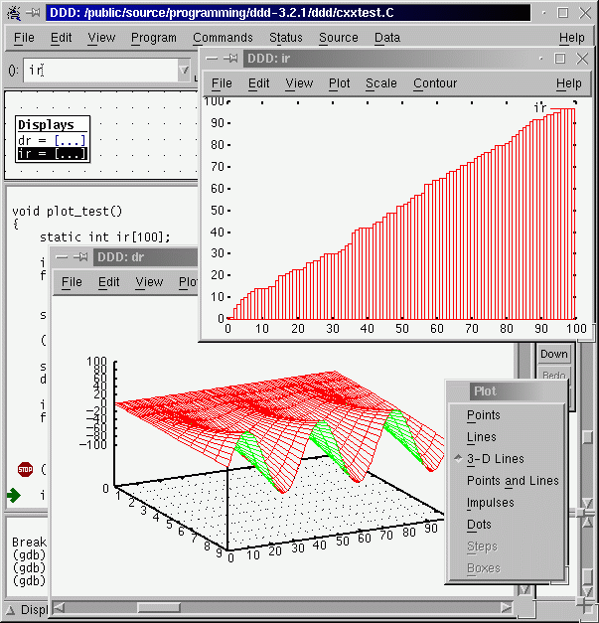
make bugs reproducible (with a single command)
visualize the data
ddd or perl -d
Breakpoints
use Smart::Comments;
http://www.gnu.org/software/ddd/plots.png

Slide 39
use Smart::Comments;
### seeing: $seeing
### calcmag: $cmag
### calcmag2: $cmag2;

Slide 40
When you find a bug …
check boundary conditions
first and last elements of lists
describe the problem to someone else
why wasn't it caught before
could it be lurking elsewhere (orthogonality!)
if tests ran fine, are the tests bad?

Slide 41
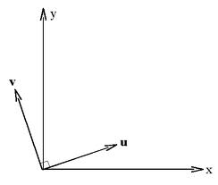
(non)Duplication
Orthogonality
Refactoring

Slide 42
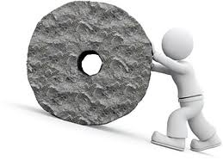
Duplication
Don't repeat yourself
Impatience
Reinventing wheels

Slide 43
Orthogonality
Decouple routines
Make them independent
Change in one should not affect the other
Changes are localized
Unit testing is easy
Reuse is easy
If requirements change for one function, how many modules should be affected? 1
Configurable

Slide 44
sub line{
my ($startpoint, $endpoint, $length);
…
}

Slide 45
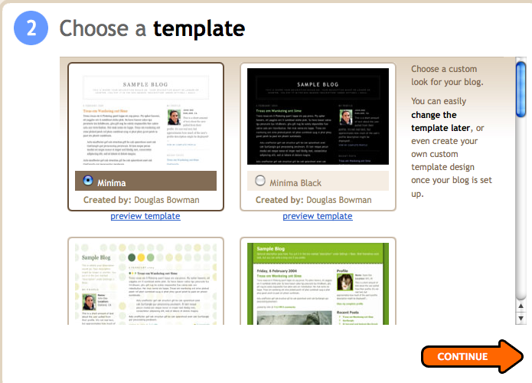

Slide 46
if while entertaining libraries you need to write/handle special code, it is not good.
avoid global data
avoid similar functions
even if you are coding for a particular flavor of a particular OS, be flexible

Slide 47
Refactoring
Early and often
Duplication
Non-orthogonal design
Outdated knowledge
Performance
Don’t add functionality at the same time
Good tests
Short deliberate steps

Slide 48
Portfolio building
learn general tools, invest in different ones
plain text
easier to test (config files, for instance)
Shells
find, sed, awk, grep, locate
.tcshrc, .Xdefaults
learn different (types of) languages
Editor
if you know emacs, learn just a little bit of vi
Configurable, extensible, programmable (cheat sheet)
syntax highlighting
auto completion
auto indentation
Boilerplates
built-in help

Slide 49
Text manipulation
perl and ruby are very powerful

Slide 50
Metaprogramming
Configure
Abstraction in code, details in metadata
Decode design
Pod files (plain old documentation)

Slide 51
Code generators
make files, config files, shell scripts., …
Active code generator:
Skyalert (streams)
new transient
obtain new data
incorporate it
if certain conditions met,
run other programs
or raise alerts
drive other telescopes
and obtain feedback

Slide 52
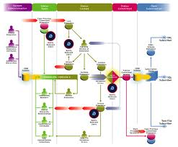
Workflow
Improving concurrency
Unified Modeling Language (UML) diagrams
Architecture
Action
Synchronization
Connect actions

Slide 53
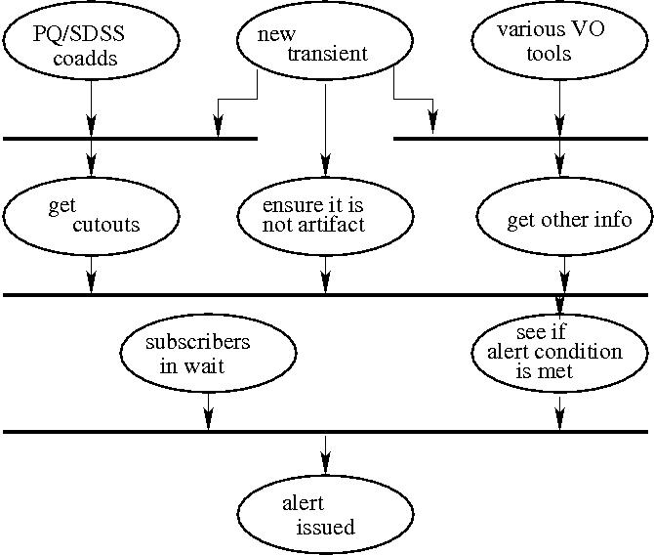

Slide 54
Publish-subscribe rather than push
Allow people to subscribe
Let them subselect
Allows separate view of model
Skyalert http://www.skyalert.org

Slide 55
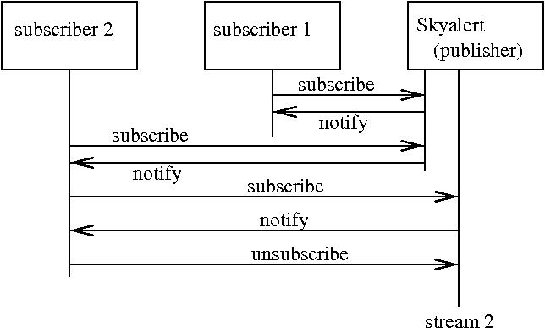

Slide 56
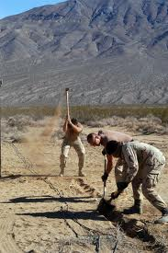
Before the project
Dig for requirements
Document requirements
Make use case diagrams
Maintain a glossary
document

Slide 57
Don’t optimize code – benchmark it
Don’t optimize data structures – measure them
Cache data when you can – use Memoize
Benchmark caching strategies
Don’t optimize applications – profile them
(find where they spend most time)

Slide 58
use Benchmark qw( cmpthese );
my @sqrt_of = map {sqrt $_} 0..255;
cmpthese -30, {
recompute => q{ for my $n (0..255) {
my $res = sqrt $n } },
look_up_array => q{ for my $n (0..255) {
my $res = $sqrt_of[$n] } },
};

Slide 59
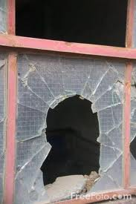
Summarizing …
Software entropy
Fix broken windows
Know when to stop
Don’t overperfect
Widen knowledge portfolio
Hotjava
Postscript
vi/emacs

Slide 60
Languages/tools/OSes/editors
99 bottles of beer
Programming shootout
Project Euler
Python
Perl
J
Haskell

Slide 61
Whats the lesson?
Chain as weak as its weakest link
Comment! For others and for yourself
Tests!
Orthogonality
Don’t duplicate
Designing by contract
Know the features

Slide 62
Review/balance
Public forums
Ask specific things
Check FAQs, webresults etc.
Maintain your own bookmarks
Use wikis
Use SVN, trac
CHECK REPOSITORIES (like CPAN)

Slide 63
Law 1: Every program can be optimized to be smaller.
Law 2: There's always one more bug.
Corollary: Every program can be reduced to a one-line bug.
From a Bug’s life

