Slide 1
Shocks & Blast-waves
S. R. Kulkarni

Slide 4
The Mouse

Slide 5
Stellar Wind Bubble
Bubble Nebula

Slide 6
Ionization Fronts (HII region)

Slide 7
Classical HII regions

Slide 9
Abell 39
Planetary Nebula

Slide 11
Shock fronts are thin (collisional less)

Slide 12
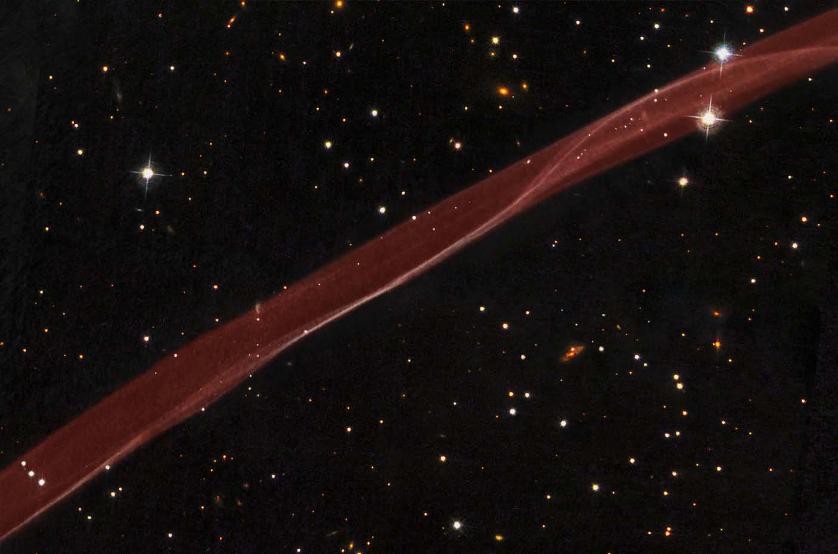

Slide 14
Bi-concial hypersonic flows

Slide 15
Herbig Haro object

Slide 19
Radiative Shocks

Slide 20
Cooling curve (Astrophysics)

Slide 21
Radiative Shocks

Slide 22
Sedov-Taylor Solution

Slide 23
Supernova remnants: Reverse Shock

Slide 24
Chandra X-ray Observatory collage
Blue – High Energy x-ray continuum
Hubble Space Telescope
Optical Image
(collisionally excited lines of SII, CaII …

Slide 25
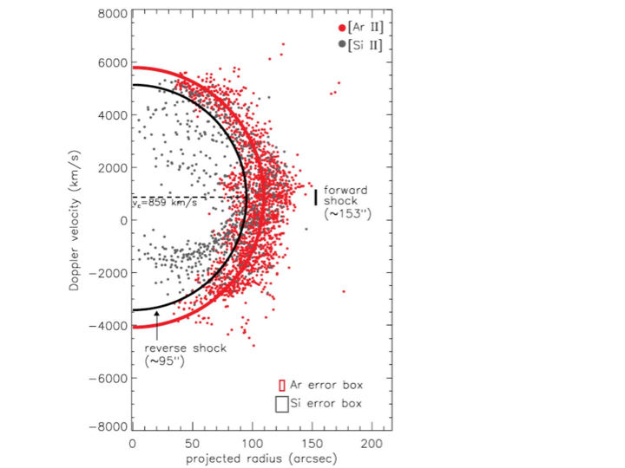
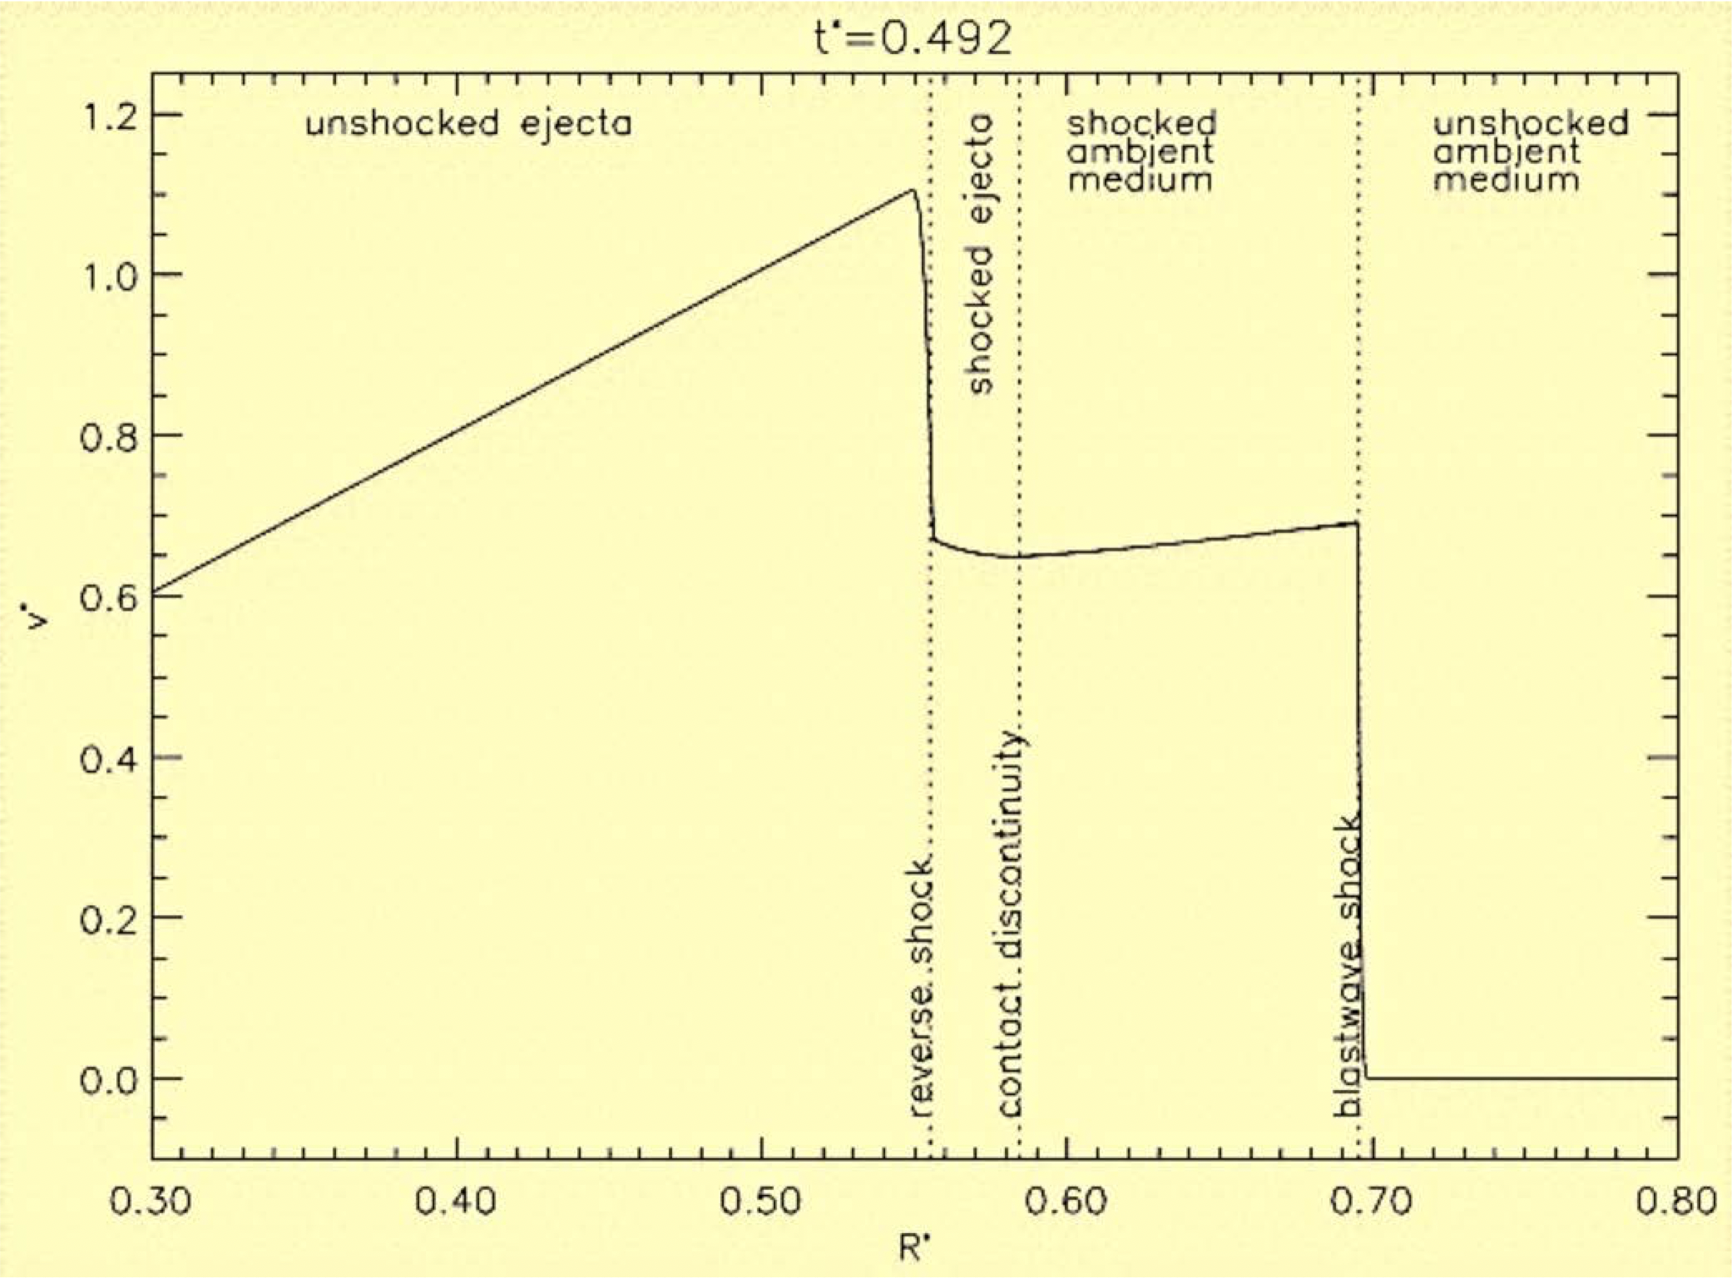

Slide 26
SN1006
Blue: X-ray
Yellow: optical
Red: radio

