Slide 1
Molecules & Molecular clouds

Slide 2
History of interstellar molecules

Slide 3
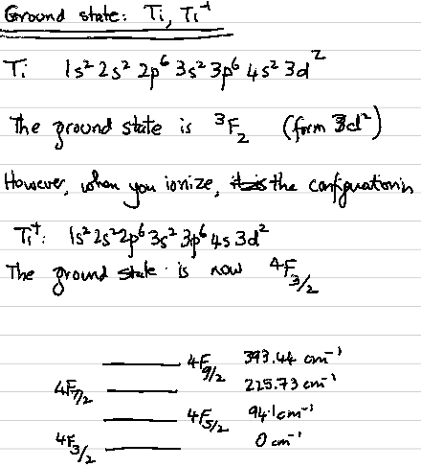

Slide 6
The discovery begins with Mt. Wilson!
Dunham & Adams (1937) obtain high resolution spectrum of early stars with the goal of studying interstellar lines
They detected lines of strong lines of Ti⁺ in the region 3073-3275 Angstrom.
  The authors noted that the only optical transitions were from the ground state, ⁴F_{3/2} where stronger transitions from ⁴F_{5/2}, ⁴F _{7/2}, and ⁴F _{9/2} were not detected. The, authors concluded that long wavelength fine structure lines must be radiated by the ISM!
  Separately, quite a few lines were not identified
Swings & Rosenfeld (Liege, Belgium) identified one with ground state of CH molecule (A2𝚫)

Slide 7
… continued
Adams (1941) gets a better spectrum from Mt. Wilson
McKellar (Canada) identifies three ground state lines of CH (B2∑-) and three lines from CN
In 1941 Otto Struve organizes a meeting at Yerkes to sort out the remaining lines
Herzberg goes back to Canada and identifies lines of CH+
Notice this is a molecular ion

Slide 8
Uncovery of 3-K background!

Slide 9
Radio Astronomy
Townes and collaborators measure rotational ladder of OH in laboratory in 1955
Race is on to find OH in the heavens
Sandy Weinreb, for his PhD at MIT, builds first digital correlator to find hyperfine line of deuterium (1962)
  Places upper limit on D/H in ISM
Weinreb, Barrett, Meeks, Henry (1963) report OH in absorption against Cassiopeia A

Slide 10
…continued
Townes and students discovered NH₃ (1968) H₂0 (1969)
Wilson, Jefferts, Penzias discover intense CO emission (1970)
Note: Paper is 2 pages long. The abstract is one one sentence (above).

Slide 11
Molecular Hydrogen (Rocket Flight)
absorption spec. of ξ Persei
Carruthers 1970

Slide 12
Molecular Hydrogen

Slide 13
Gerhard Herzberg (Nobel Laureate)

Slide 15
Hydrogen, though simple, has a complex energy level diagram!

Slide 16
The very first molecule in the Universe

Slide 17
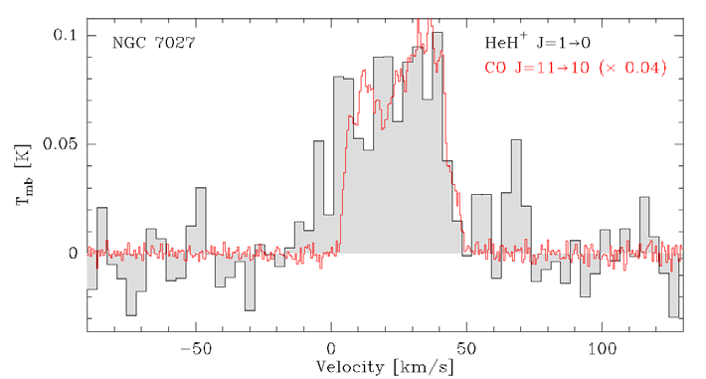
When the Universe was hot with Hydrogen ionized
  He + H⁺ → HeH⁺ + hν
As recombination proceeds
  HeH⁺ + e⁻ → He + H
  HeH⁺ + H → H₂⁺ + He
SOFIA observations towards NGC7027 (PN) by Gusten et al.

Slide 18
Your chance to become famous

Slide 19
Gerhard Herzberg

Slide 20
Diffuse Interstellar Bands

Slide 21
Diffuse Interstellar bands
The story again starts with high dispersion spectra of early type stars are Mt. Wilson (100-inch).
  Merrill, Sanford, Wilson, Burwell (1937) report unidentified lines
Wilson (Victoria)

Slide 22
At high spectral resolution the DIBs
are resolved with hints of rotational
lines.

Slide 23
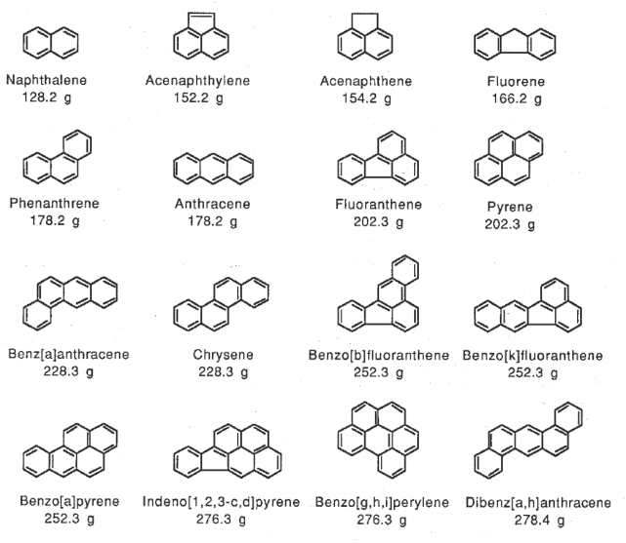
Polycyclic hydrocarbons

Slide 24
DIBs: Your chance to become famous (once again)

Slide 25
List of Astrophysical Molecules
http://www.astrochymist.org/astrochymist_ism.html

Slide 26
Astrophysical Masers

Slide 27
From Hat Creek Radio Observatory
(UC Berkeley)
Weaver, Williams Dieter, Lum
(1965)

Slide 28
The following species have been observed in stimulated emission from astronomical environments:^{[9]}
OH
CH
H₂CO
H₂O
NH₃, ¹⁵NH₃
CH₃OH
HNCNH^{[10][11]}
SiS
HC₃N
SiO, ²⁹SiO, ³⁰SiO
HCN, H¹³CN
H (in MWC 349)
CS^{[12]T}
Locations: solar system moons, comets, star-forming regions, shocked regions, late type stars, SMBH disks

Slide 29
Giant Molecular Clouds

Slide 30
Galactic Distribution

Slide 32
Other methods to detect dense molecular regions: long wavelength IR radiation, gamma-rays (pions)

Slide 33
Linewidth-size relation

Slide 34
Magnetic Field Strength

