Slide 1
Thermal balance of HII regions

Slide 3
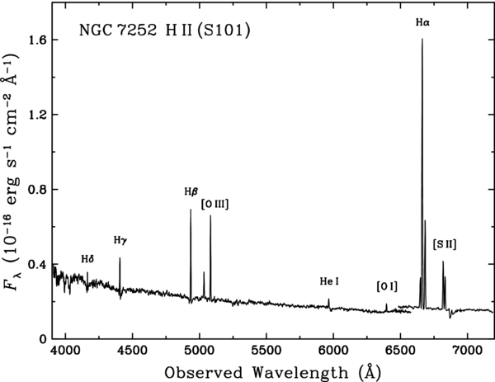

Slide 4
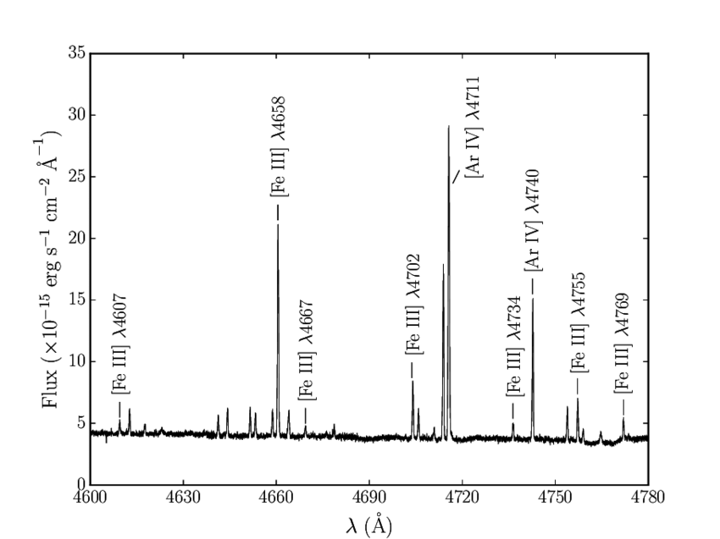
Spectrum of HII region in SMC (N81)

Slide 5
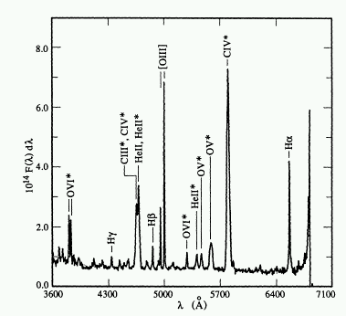
Spectrum of Planetary Nebula NGC 1501

Slide 13
Question
H-alpha is one of the brightest lines from HII regions. Why did we not include H-alpha line in our thermal balance budget?

Slide 14
Weird Lines

Slide 15
Bowen Fluorescence (weird lines of OIII)

