Slide 1
Global ISM model

Slide 2
Two phase model (Field, Goldsmith, Habing)

Slide 4
Coronal (hot) gas

Slide 5
Cooling of hot gas (in collisional ionization equilibrium)

Slide 8
Supernovae→Tunnels→Three-phase model
Radiative lifetime of hot gas (supernova interior) is long
If the star-formation is high then multiple supernovae in given regions
The supernovae connect
Subsequent supernovae take place in a medium which is hot
Radiative lifetime increases
Soon the galactic disk is occupied by hot gas (displacing the WNM and WIM
→ Three=phase model of the ISM

Slide 9
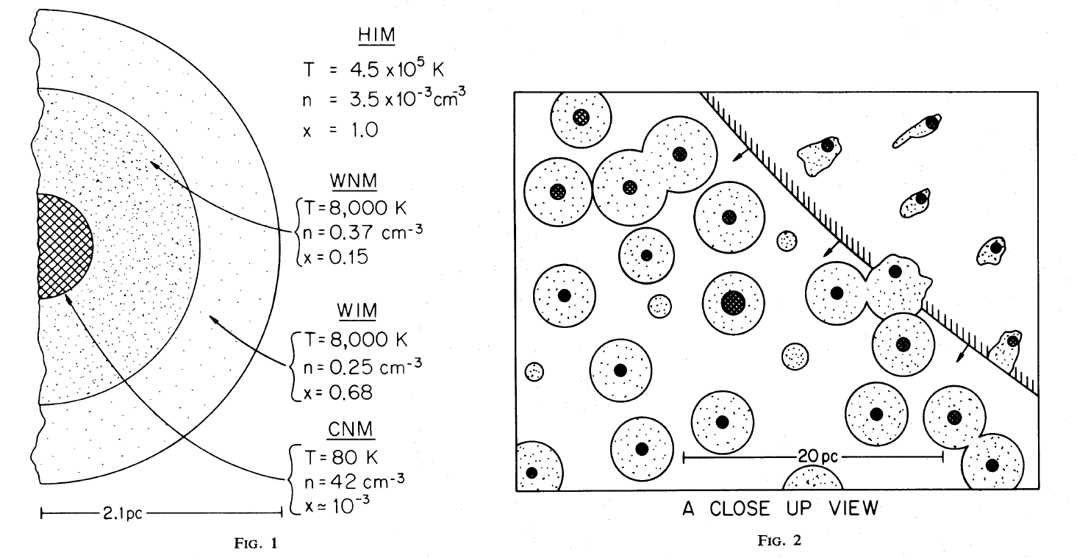
Three phase model (McKee, Ostriker)

