Slide 1
Ay215: Lecture 9

Slide 2
Mass transfer on sub-thermal scales

Slide 3
Misra+ 2020

Slide 4
Mass transfer on nuclear time scales

Slide 6
Bifurcation

Slide 7
Bifurcation

Slide 9
Accretion Induced Collapse

Slide 12
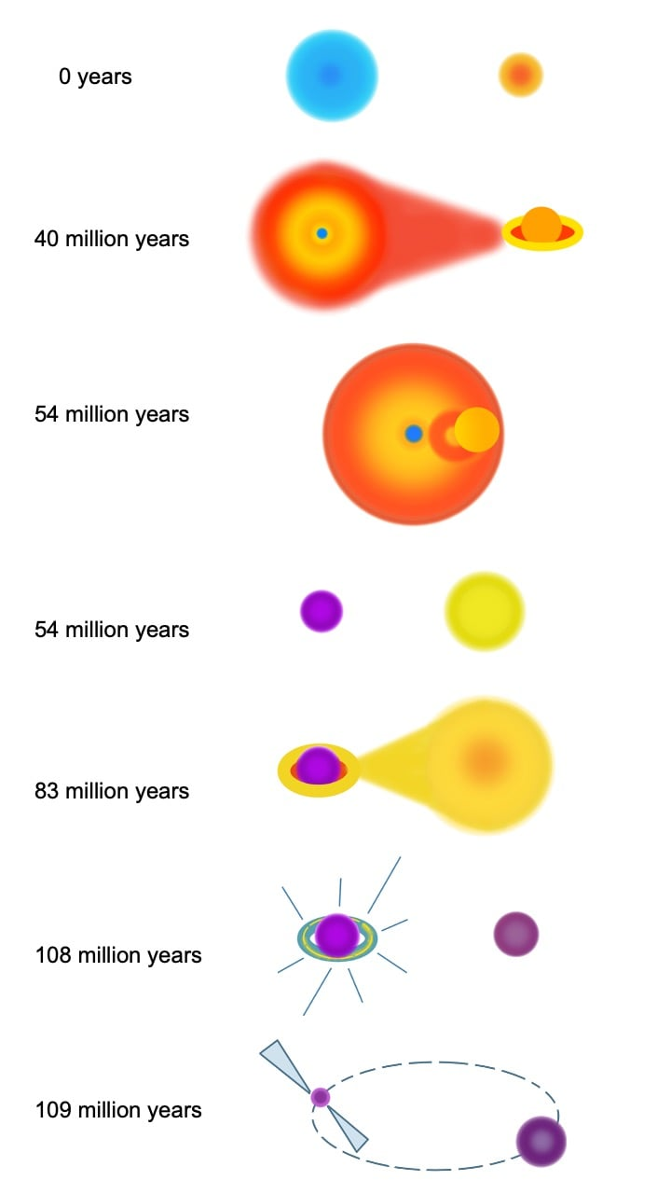
Accretion induced collapse

