Slide 1
Ay215: Lecture 13

Slide 2
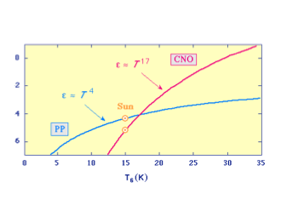


Slide 3
p-p and CNO
p-p burning: M<1.2 Msun
CNO burning; M>1.2 Msun

Slide 4
Cores
Low-mass cores (below, say, 2 Msun)
  p-p burning has low temperature dependence and so nuclear fusion is not peaked (as in CNO)
  flux is not concentrated and radiation can carry it
  core is radiative
  in the sun, the temperature gradient is close to the adiabatic gradient and so is susceptive to convection
High-mass cores (above, 2 Msun)
  higher core temperature favor CNO burning which is temperature sensitive leading to fusion being concentrated in the core
  the resulting increased temperature gradient tips it over being convective core

Slide 5
Kippenhahn diagram

Slide 6
Envelopes
Low mass
  opacity in H and He ionization zones is very high which then favors convection over radiative transfer
  very low mass stars (0.3 Msun and below) are fully convective
High Mass
  H and He are fully ionized, so opacity is small. This leads to radiative envelopes
  in very high mass stars (>10 Msun), ionized Fe and Ni can result in thin convective cores near the surface

Slide 7
Summary
Low mass stars (<0.3 Msun): fully convective
Intermediate mass stars (0.3 < M < 1.3 Msun): radiative p-p core and convective envelope
High mass stars (M > 1.3 Msun): convective CNO core and radiative envelope

Slide 9
1: ZAMS
2: End of H burning
3: start of H-shell burning
4: Ignition of He in core

Slide 10
1: H-burning center
2: end of H-burning
core is convective.
it rapidly contract
3: shell burning ignited
In contrast, the core is radiative
in lower mass stars and so do not
contract rapidly upon reaching
point 2.

Slide 11
Misra+ 2020

Slide 12
Case A
5+9 Msun
Pb=1.2 days
Subgiant at this point: 3.73Msun
Evolution on nuclear timescale

Slide 13
Case B

