Slide 1
Supernova Classification
(+Rates, Hosts, and Progenitors)
Daniel Perley
(Liverpool John Moores University)

Slide 2
Stellar Classification
O | B | A | F | G | K | M
violet | blue | blue | blue-white | white-yellow | orange-red | red
more than 28,000K | 10,000-28,000K | 7,500-10,000K | 6,000-7,500K | 5,000-6,000K | 3,500-5,000K | less than 3,500K
few visible absorption lines, weak Balmer lines, ionised helium lines | neutral hydrogen lines, more prominent Balmer lines | strongest Balmer lines, other strong lines | weaker Balmer lines, many lines including neutral metals | Balmer lines weaker still, dominant ionised calcium lines | neutral metal lines most prominent | strong neutral metal lines and molecular bands
https://astronomy.swin.edu.au/cosmos/H/Harvard+Spectral+Classification

Slide 3
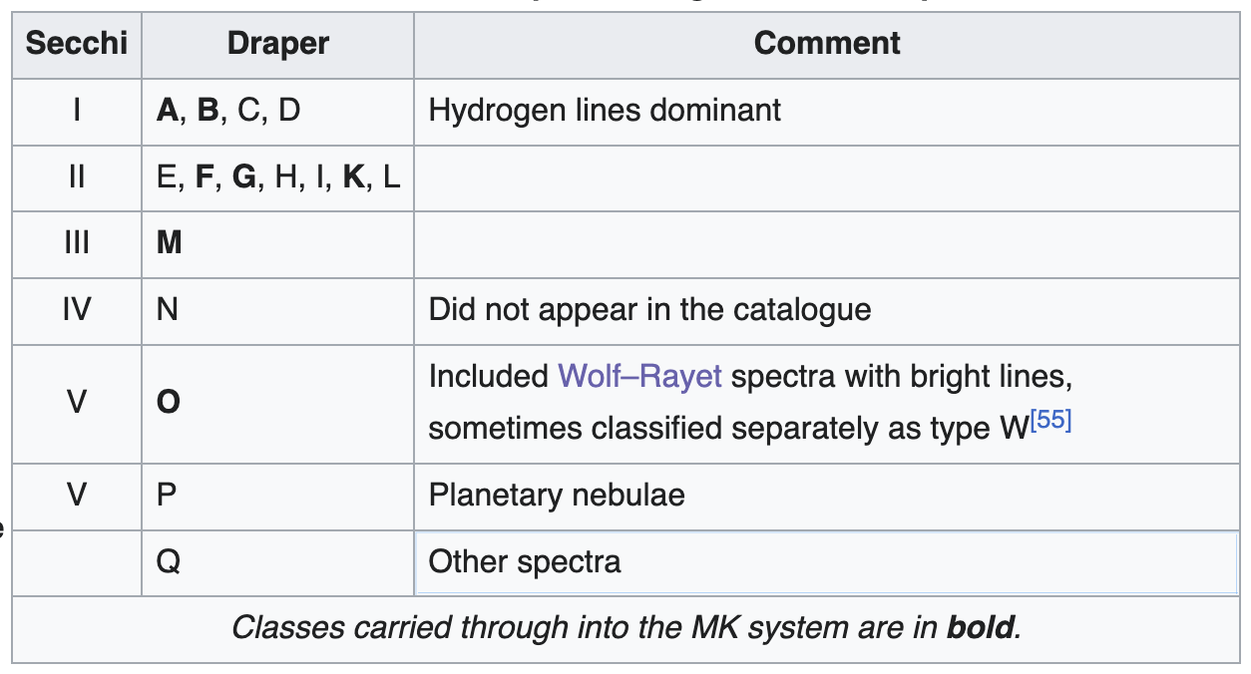
Stellar Classification
https://en.wikipedia.org/wiki/Stellar_classification

Slide 4
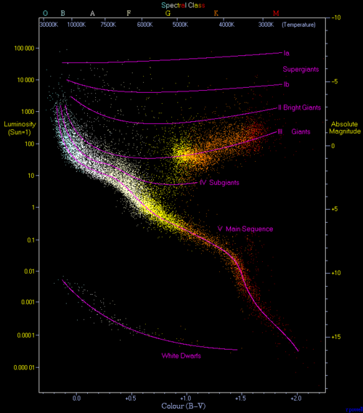
Hertzprung-Russel Diagram
https://en.wikipedia.org/wiki/Hertzsprung%E2%80%93Russell_diagram

Slide 5
"Traditional" SN classification
Ia – No hydrogen or helium, strong silicon
Ib – Helium, no hydrogen
Ic – No hydrogen or helium, weak silicon
II – Hydrogen (usually as P-cygni)

Slide 6
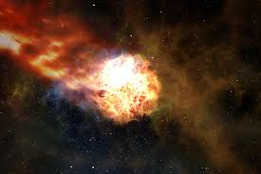
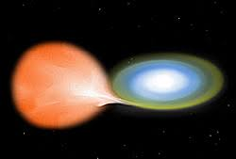
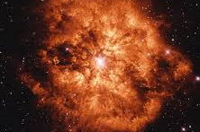
A Story about SN Progenitors
Type Ia
Type II
Type
Ib/Ic

Slide 7
A Story about SN Progenitors
Ia – Many in old galaxies with no star-formation (progenitor cannot be massive), light curves standard (similar ejecta mass and explosion energy), lack of hydrogen: WD thermonuclear explosion
Ib/Ic – Always in star-forming galaxies, usually in spiral arms: Core collapse of stripped massive star
II – Always in star-forming galaxies, usually in spiral arms, dominated by hydrogen: Core collapse of massive star

Slide 8
The current "official"(?) classification roster
Type | # |  | Type | # |  | Type | #
SN Ia | 12,349 |  | SN Ia-91bg | 164 |  | SN Ia-SC [03fg] | 18
SN II | 2,979 |  | SLSN-II | 120 |  | SN II-pec | 17
SN IIn | 536 |  | SN Ia-pec | 101 |  | SN Ib-Ca-rich | 12
SN Ia-91T | 471 |  | SN | 91 |  | SN Icn | 8
SN Ic | 419 |  | SN Ib/c | 84 |  | SN IIn-pec | 5
SN Ib | 330 |  | SN Ibn | 71 |  | SN Ic-pec | 3
SN IIP | 313 |  | SN Iax [02cx] | 65 |  | SN IIL | 3
SN IIb | 301 |  | SN I | 60 |  | SN Ibn/Icn | 2
SLSN-I | 219 |  | SN Ia-CSM | 46 |  | SN Ic-Ca-rich | 1
SN Ic-BL | 183 |  | SN Ib-pec | 18 |  | SN Ia-Ca-rich | 1
From https://www.wis-tns.org/stats-maps (2026-05-13)

Slide 9
Hierarchically organized
Ia (thermonuclear)
  Ia-normal
  Ia-91T
  Ia-91bg
  Ia-CSM
  Ia-SC (/03fg)
  Iax (/02cx)
  Ia Ca-rich
Core-collapse
  II
    II-normal
      IIP
      IIL
    IIn
    IIb
  Ib
    Ib-normal
    Ibn
  Ic
    Ic-normal
    Ic-BL
    Ic-SL (SLSN I)
    Icn
Pair Instability
MS stellar merger(?)
  LRN
  ILRT
Tidal disruption
  TDE
Ultrarelativistic
  Long GRB
  Short GRB
  Kilonova
Other/unknown
  LFBOT
Nonterminal non-WD
  LBV eruption
Nonterminal WD
  Classical nova
  Dwarf nova
+ Id/Ie/Idn/Ien?

Slide 10
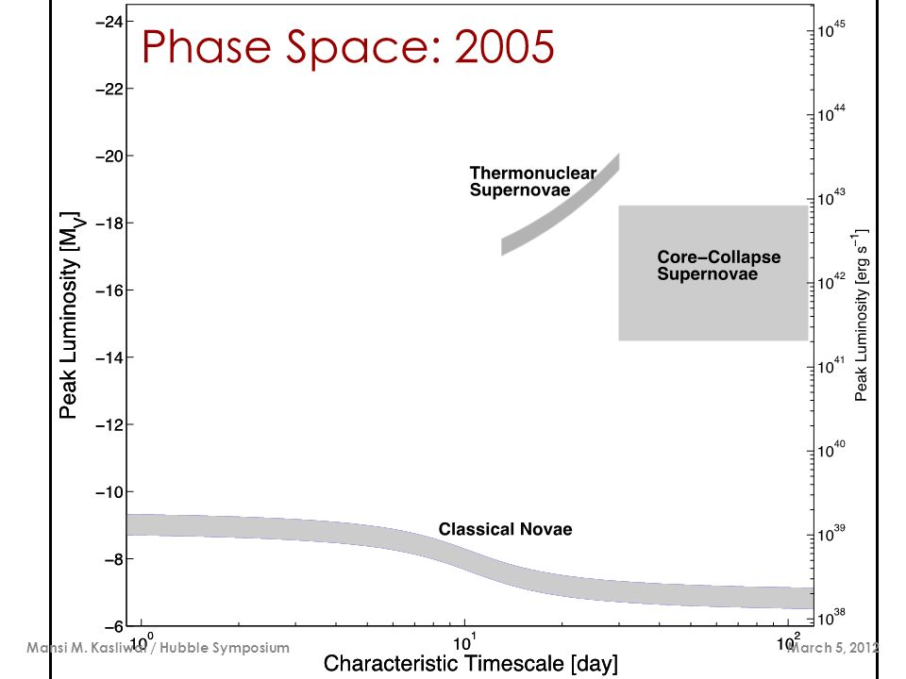
Timescale-Luminosity Diagram
other turn of 20th century SNe
SN 1885
Novae (M = -6 to -9)

Slide 11
Timescale-Luminosity Diagram
other turn of 20th century SNe
SN 1885
Novae (M = -6 to -9)

Slide 12
Timescale-Luminosity Diagram
Nova
SN Ia
SN Iax
SN II
SN IIb
SN IIn
SN Ibn
SN Icn
SN Ibc
SN Ic-BL
SLSN-I
SLSN-II
TDE
LBV
Ca-rich
ILRT
LFBOT
Afterglow
Kilonova
10⁴⁸
Afterglows
10⁴⁶
10⁴⁴
Supernovae
L_{peak}
(erg/s)
Peak absolute magnitude (AB)
10⁴²
10⁴⁰
Novae
0.1 1 10 100
Rest-frame duration above half-maximum (days)

Slide 13
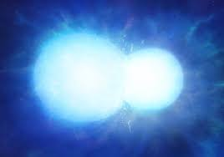
Thermonuclear SNe

Slide 14
Thermonuclear SN Ia
Most Ia's (~80-90%) are "normal":
  Very similar spectra
  Very similar light curves
  Very similar colors
  No signs of companion wind interaction at late times

Slide 15
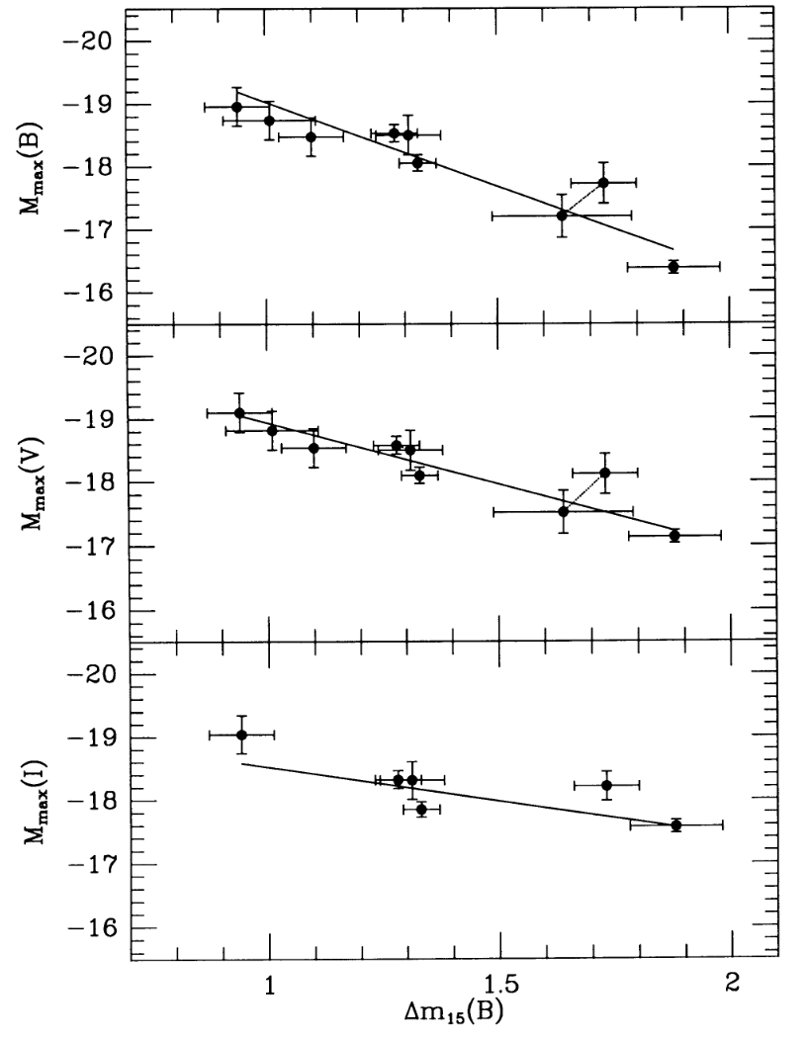
Thermonuclear SNe
Not standard, but standardizable ("Phillips relation" between luminosity and timescale)
Probably due to different amounts of ⁵⁶Ni synthesized
fast
← timescale
slow
Phillips+1992

Slide 16
Thermonuclear SNe
But plenty are abnormal!
  Ia-91T: Very weak silicon, overluminous, slow
  Ia-91bg: Strong titanium, underluminous, fast, red
  Ia-SC (/03fg): Very blue, overluminous, slow
  Ia-CSM: Strong narrow hydrogen lines, very slow
  Ia-02es: Underluminous, low velocity
  Iax (/02cx): Very underluminous, fast, low velocities
  Ia Ca-rich: Very underluminous, fast, strong nebular Ca

Slide 17
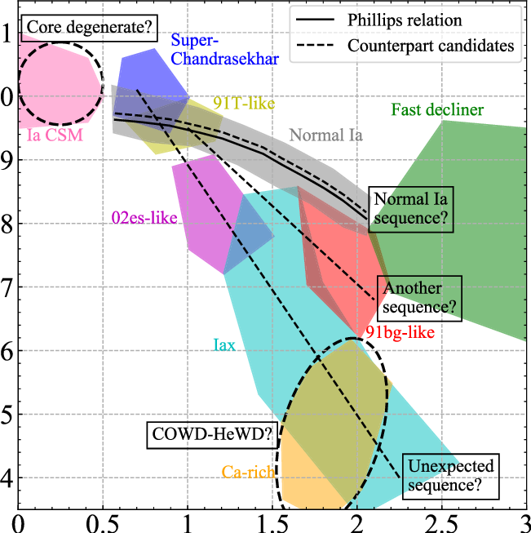
Thermonuclear SN Subtypes
Taubenberger+2007
91T: upper extreme of the normal relation
91bg: lower extreme of the normal relation
(or a bit fainter)
Most other subtypes below it. Incomplete destruction?
-20
-18
Peak absolute magnitude (AB)
-16
-14
Decline rate (mag/15 days)

Slide 18
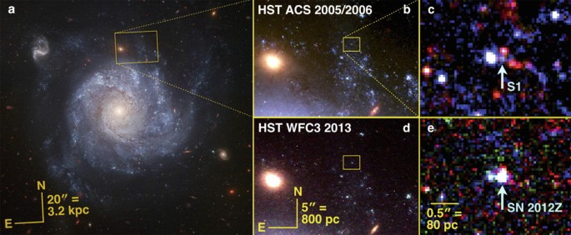
SN2012z (Iax): Progenitor star that survived?
c

Slide 19
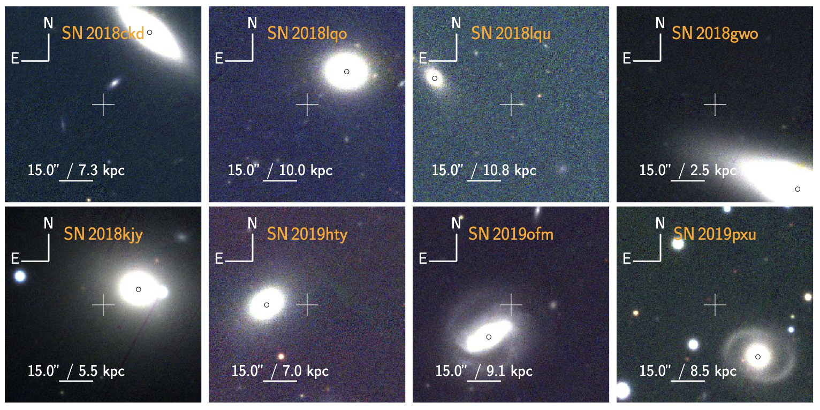
Ca-rich SNe: Only(?) in halos
De+2020

Slide 20
Thermonuclear SN Subtypes
Taubenberger+2007
Some subtypes are overluminous.
"Super-Chandra": more energy than a 1.4 Mo WD can produce? (debated)
Ia-CSM: strong hydrogen lines (on top of Ia photosphere)
-20
-18
Peak absolute magnitude (AB)
-16
-14
Decline rate (mag/15 days)

Slide 22
Core-collapse SNe

Slide 23
Core collapse SNe
  II
  Ib
    Ib-normal
    Ibn – Strong He lines in emission (weak H)
  Ic
    Ic-normal
    Ic-BL – Extremely high velocities
    Ic-SL – Extremely high luminosities and blue colors
    Icn – Strong C lines in emission (weak He)
II-normal
  IIP: "plateau-like" light curve
  IIL: "linear" decay
  87a-like: long rise
IIn – Narrow hydrogen lines in emission
IIb – Hydrogen weak or disappears

Slide 24
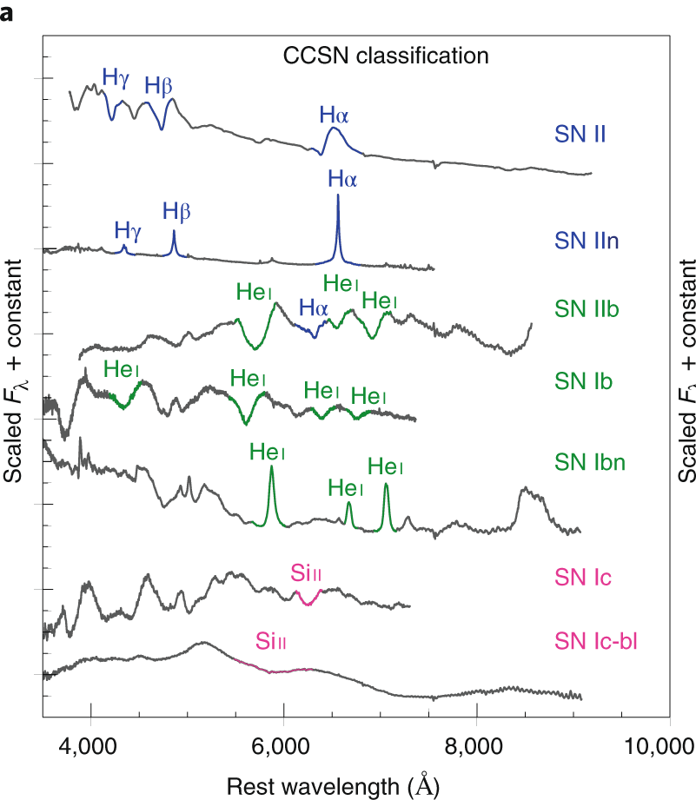
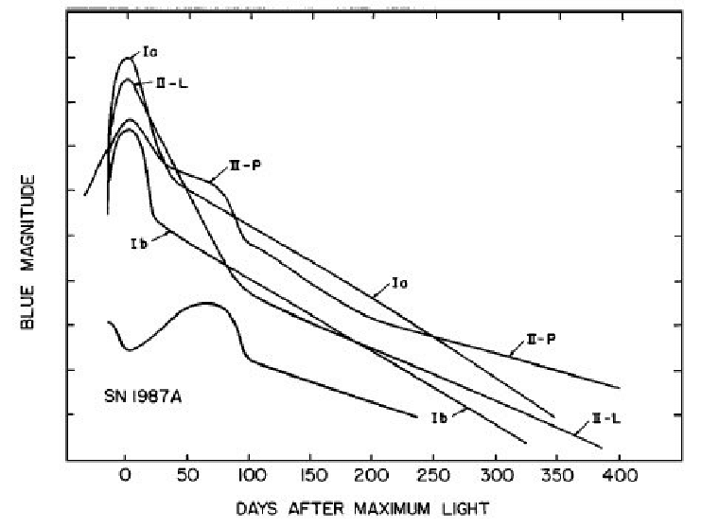
Core-collapse SNe
Modjaz+2019
Filippenko+1997

Slide 25
Core-Collapse Duration-Luminosity
SN II
SN IIb
SN IIn
SN Ibn
SN Icn
SN Ibc
SN Ic-BL
SLSN-I
SLSN-II

Slide 26
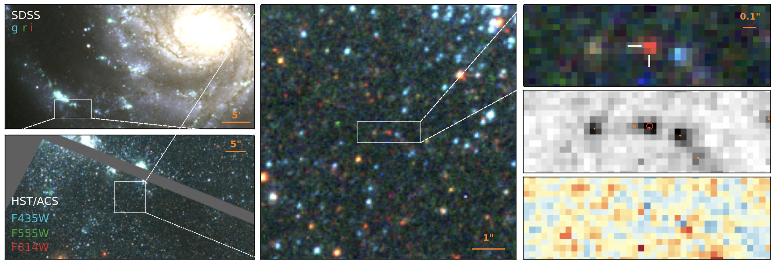
"Normal" Type IIs: RSG explosions

Slide 27
SN IIn: Signatures of Interaction
Dense CSM hydrogen shell
(ionized by shock UV radiation; recombining)
Forward shock
Shocked CSM/ejecta
Photosphere
λ

Slide 28
Type IIn: Luminous and slow
SN II
SN IIb
SN IIn
Long,
luminous light curves require
extended
CSM to be
be very massive (up to several solar masses of material) – CE ejection?
Peak absolute magnitude (AB)
Rest-frame duration above half-maximum (days)

Slide 29
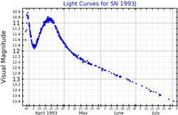
Type IIb: Mostly-stripped H envelope
Light curve often has two clearly distinct peaks – a fast peak from shocking the thin H envelope, and a main peak from radioactive heating of H-poor ejecta

Slide 30
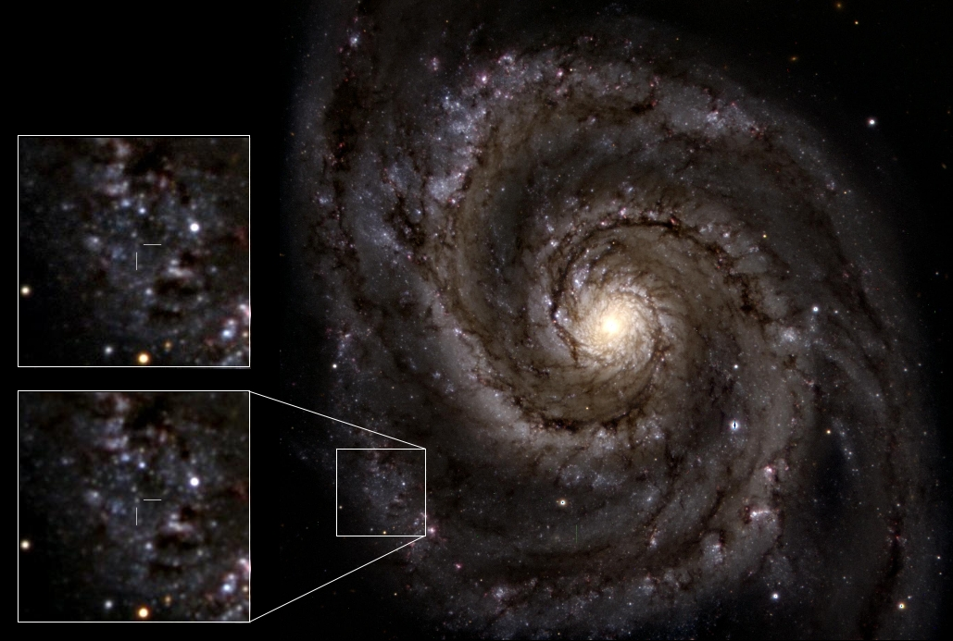
YHG progenitor of SN2011dh
https://ttt.astro.su.se/~maer0651/sn2011dh-progenitor.html

Slide 31
Type Ib, Ic: Entirely stripped H envelope
(Difference not always fundamental; He is hard to excite)
Storybook picture: these come from very massive stars which blew off their H envelopes from line-driven winds on the main sequence
Does not match reality! Too fast, too common

Slide 32
Ib/Ic Durations and Luminosities
Too fast: exploding cores of former W-R stars should have timescales of 40+ days,
not 20 days
Only a few Ib/Ic look like this...

Slide 33
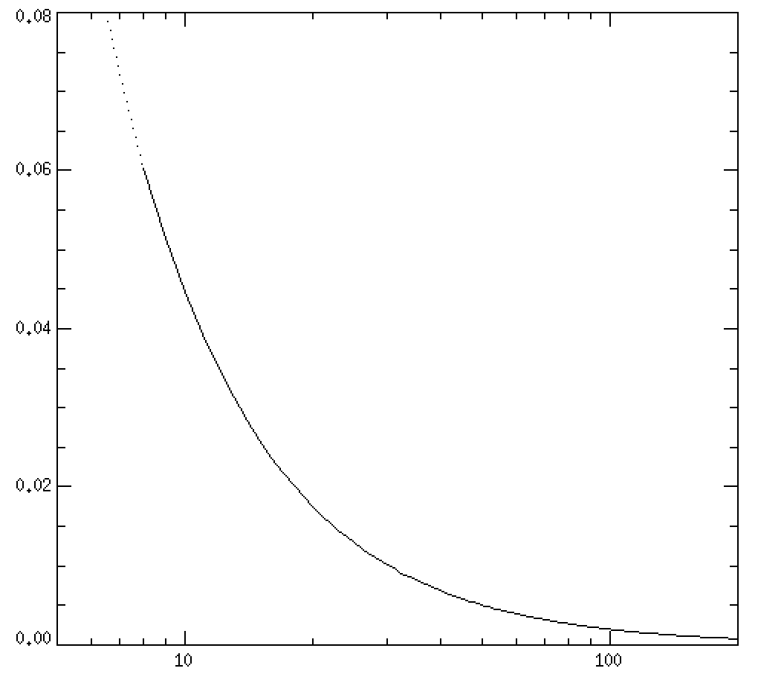
Type Ib, Ic: Binary origin
Too common: since 25% of CCSNe are Type Ib/Ic, if II -> Ib/c is (only) a mass sequence, all stars >20 M_{sol} would have to lose their envelopes
75%
25%
Modified from Smith+2010

Slide 34
Type Ic-BL: Very fast (ejecta) SNe
Prototype: SN1998bw, which also produced a (weak) gamma-ray burst
Very fast ejecta (solar masses at >0.1c) implies very high kinetic energies (10⁵² erg).
Preferentially found in metal-poor host galaxies
Extra energy input from an engine (e.g., BH jet?)

Slide 35
SLSNe: Superluminous Ic's (and Ib's)
SN Ibn
SN Icn
SN Ibc
SN Ic-BL
SLSN-I
A small fraction are much more luminous, much hotter, and much slower than the others!

Slide 36
Ultra-stripped SNe
SN Ibn
SN Icn
SN Ibc
SN Ic-BL
SLSN-I
Others are dimmer and faster, indicating sub-solar mass explosions (extreme stripping)

Slide 37
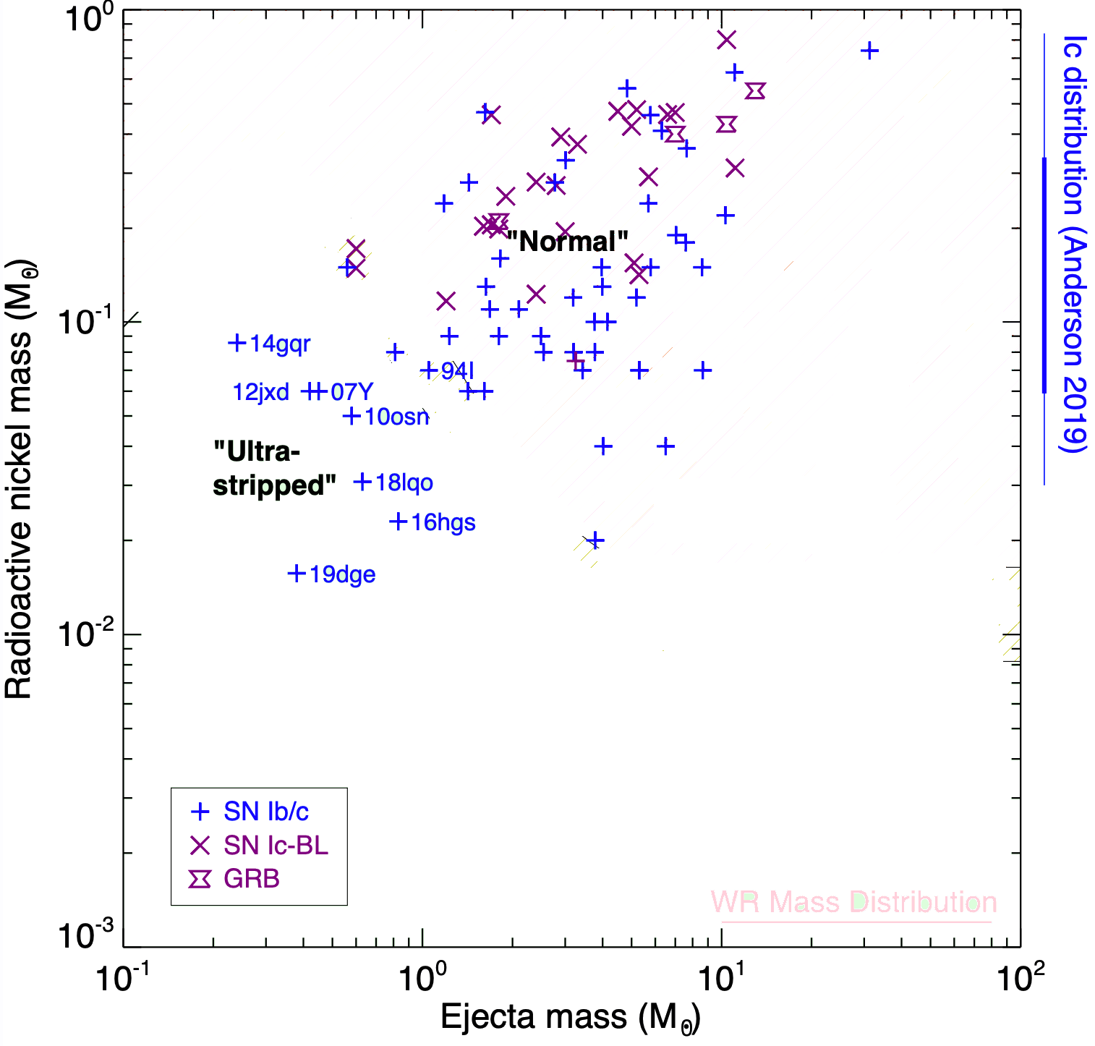
Masses from models

Slide 38
Ibn/Icn: Interacting Ib's (and Ic's)
Some Ib's explode into dense H-poor CSM
But interaction is short-lived! (Very different from IIn)
Ejecta masses very low – failed W-R collapse, or ultra-stripped?
SN Ibn
SN Icn
SN Ibc
SN Ic-BL
SLSN-I

Slide 39
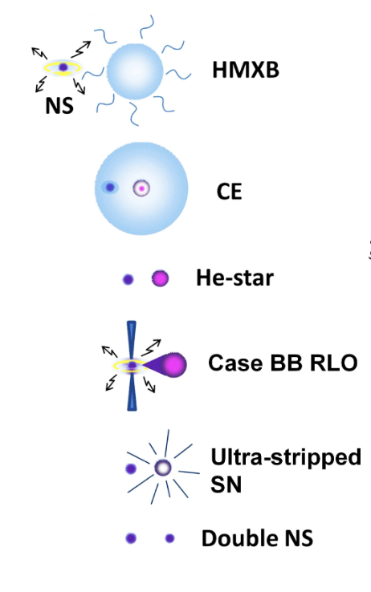
Progenitor scenario for ultra-stripped SNe

Slide 40
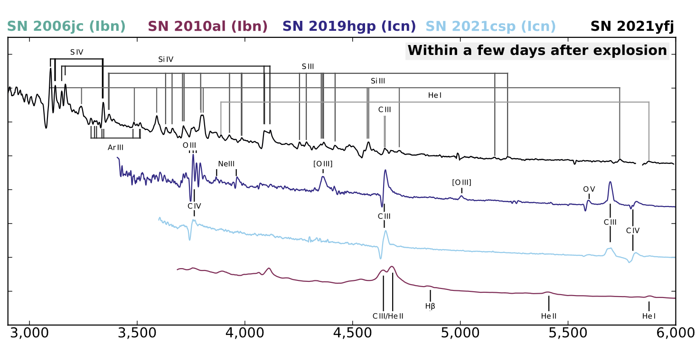
"Ien" supernova
One narrow-lined SN has a spectrum dominated by Si and S! A core can't strip itself this deeply...
Schulze+2025

Slide 41
Some other exotica

Slide 42
"Other" sources
Nova
SN Ia
SN Iax
SN II
SN IIb
SN IIn
SN Ibn
SN Icn
SN Ibc
SN Ic-BL
SLSN-I
SLSN-II
TDE
LBV
Ca-rich
ILRT
LFBOT
Afterglow
Kilonova
10⁴⁸
10⁴⁶
10⁴⁴
Peak absolute magnitude (AB)
10⁴²
10⁴⁰
L_{peak}
(erg/s)
0.1 1 10 100
Rest-frame duration (days)

Slide 43
"Other" sources
Nova
SN Ia
SN Iax
SN II
SN IIb
SN IIn
SN Ibn
SN Icn
SN Ibc
SN Ic-BL
SLSN-I
SLSN-II
TDE
LBV
Ca-rich
ILRT
LFBOT
Afterglow
Kilonova
10⁴⁸
Afterglows
10⁴⁶
LFBOTs
10⁴⁴
Peak absolute magnitude (AB)
TDEs
10⁴²
KN
ILRTs/
LRNe
10⁴⁰
L_{peak}
(erg/s)
0.1 1 10 100
Rest-frame duration (days)

Slide 44
Theoretical SNe
Pair-instability SNe?
  Simple prediction for very massive and metal-poor stars
  Various claims of candidates in the literature

Slide 45
Rates

Slide 46
Measuring rates
The relative numbers of reported transients do not reflect their real rates! Malmquist bias.
SN Ia: 75% of discovered SNe by number, but only 20% by volume
To measure a rate: restrict to a volume-complete region (look only at nearby galaxies), or perform (V/Vmax) weighting to downweight events that could have been detected out to great distances
To get absolute rate, must also consider sky area surveyed and length of survey (and completeness corrections)

Slide 47
Supernova Rates
SN rate from SFR density
(Minit > 8 M_{o})
core collapse
core collapse total rate (8 x 10⁴ Gpc⁻³yr⁻¹)
core collapse
Ia total rate
(2.4 x 10⁴ Gpc³yr⁻¹)
Ia
Tension with cosmic
star-formation rate?
Perley+2020

Slide 48
Luminosity Functions
core collapse
Ia
Perley+2020

Slide 49
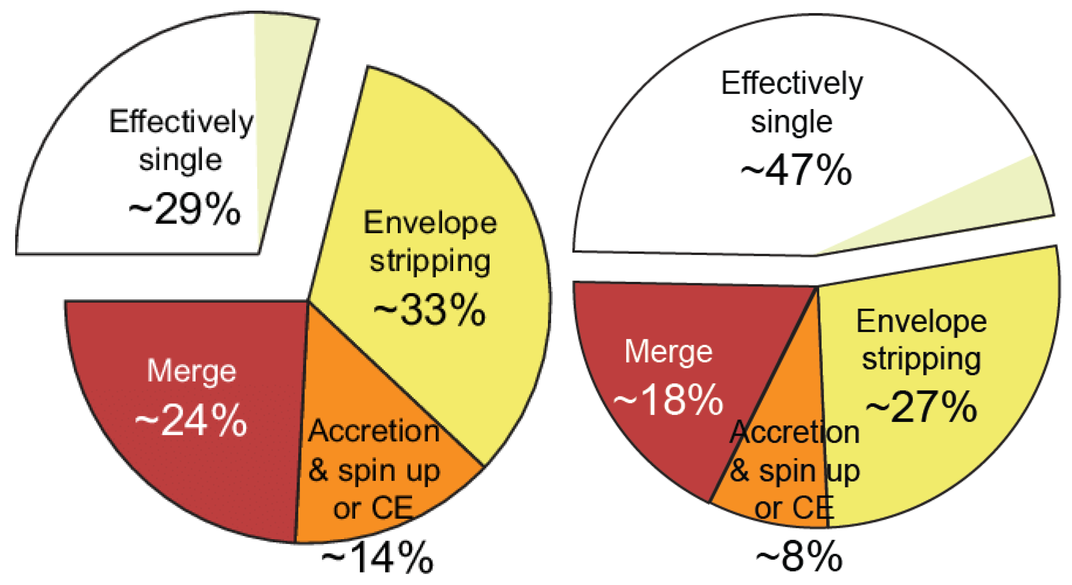
Rates by Subtype
SN II: ~75% of CCSN rate
SN Ib/c: 22% (±6%) of CCSN rate
Milky Way
LMC
H-poor
H-rich
Sana+2011

Slide 50
CCSN Rates by Subtype
SN II: ~75% of CCSN rate
SN Ib/c: 22% (±6%) of CCSN rate
IIn: 2-5%
Ic-BL: 1-4% (5-20% of Ib/c)
Ibn: 0.05-0.5%
SLSN I: 0.01-0.05%
SLSN II: 0.01-0.03%

Slide 51
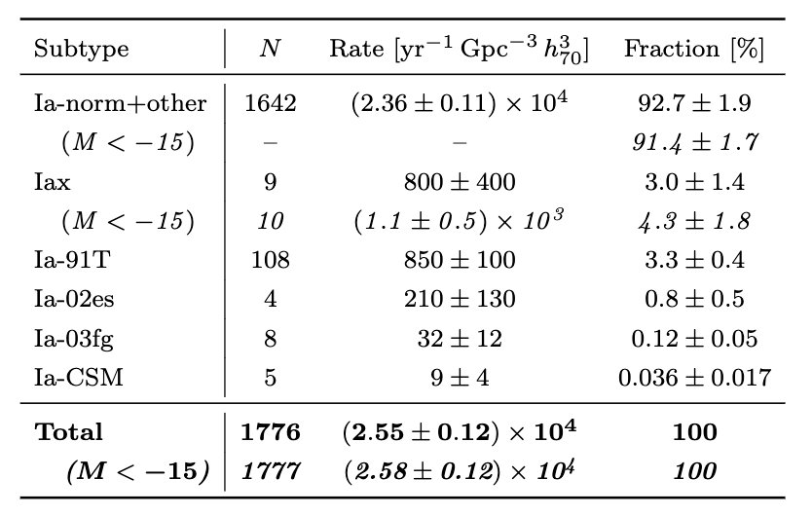
Ia Rates by Subtype
Desai+2026

