Slide 1
Ay 215: Lecture 14

Slide 2
Two key diagrams
Kippenhahn diagram (convective & radiative makeup of stars)
  Notice that the fraction of the convective core increases along the main sequence. This increases the lifetime of higher mass stars and also resulting in higher mass core product. Correspondingly the envelopes are smaller.
Trimble diagram (nuclear processes as a function of density & temperature)

Slide 3
Kippenhahn diagram

Slide 5
Schonberg-Chandrashekar limit

Slide 6
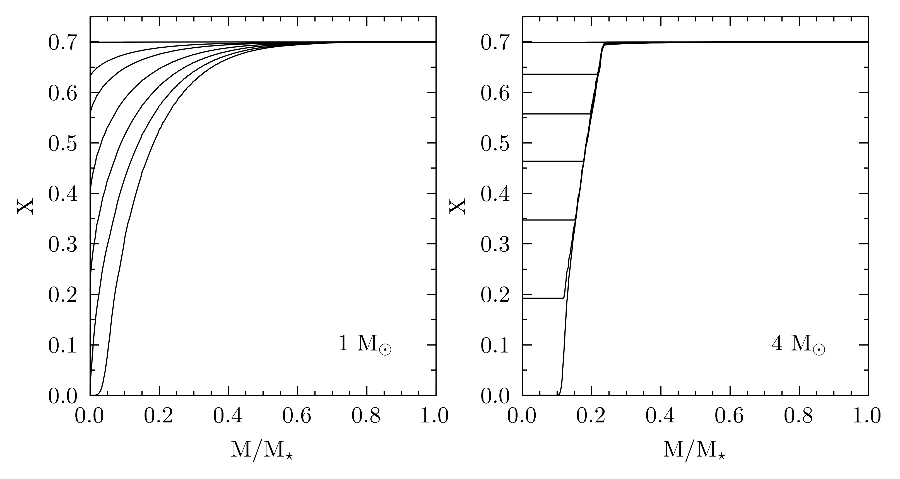
[0,1,2,4,6,8,10] Gyr
[0,25,50,75,100,125,150]Myr
Notes:
1-solar mass: X decreases in the core but slight increase in temperature ensures that fusion power increases as you approach the center, up until 8 Gyr. Fusion power then shifts outward between 8 and 10 Gyr. By 10 Gyr, the central X<0.001 and the central region is 0.02 Msun.
4-solar mass: On ZAMS the mass of the convective core is 0.2M*. However, owing to higher temperature the opacity drops to electron opacity the convective core shrinks to 0.1M* by TAMS.

Slide 7
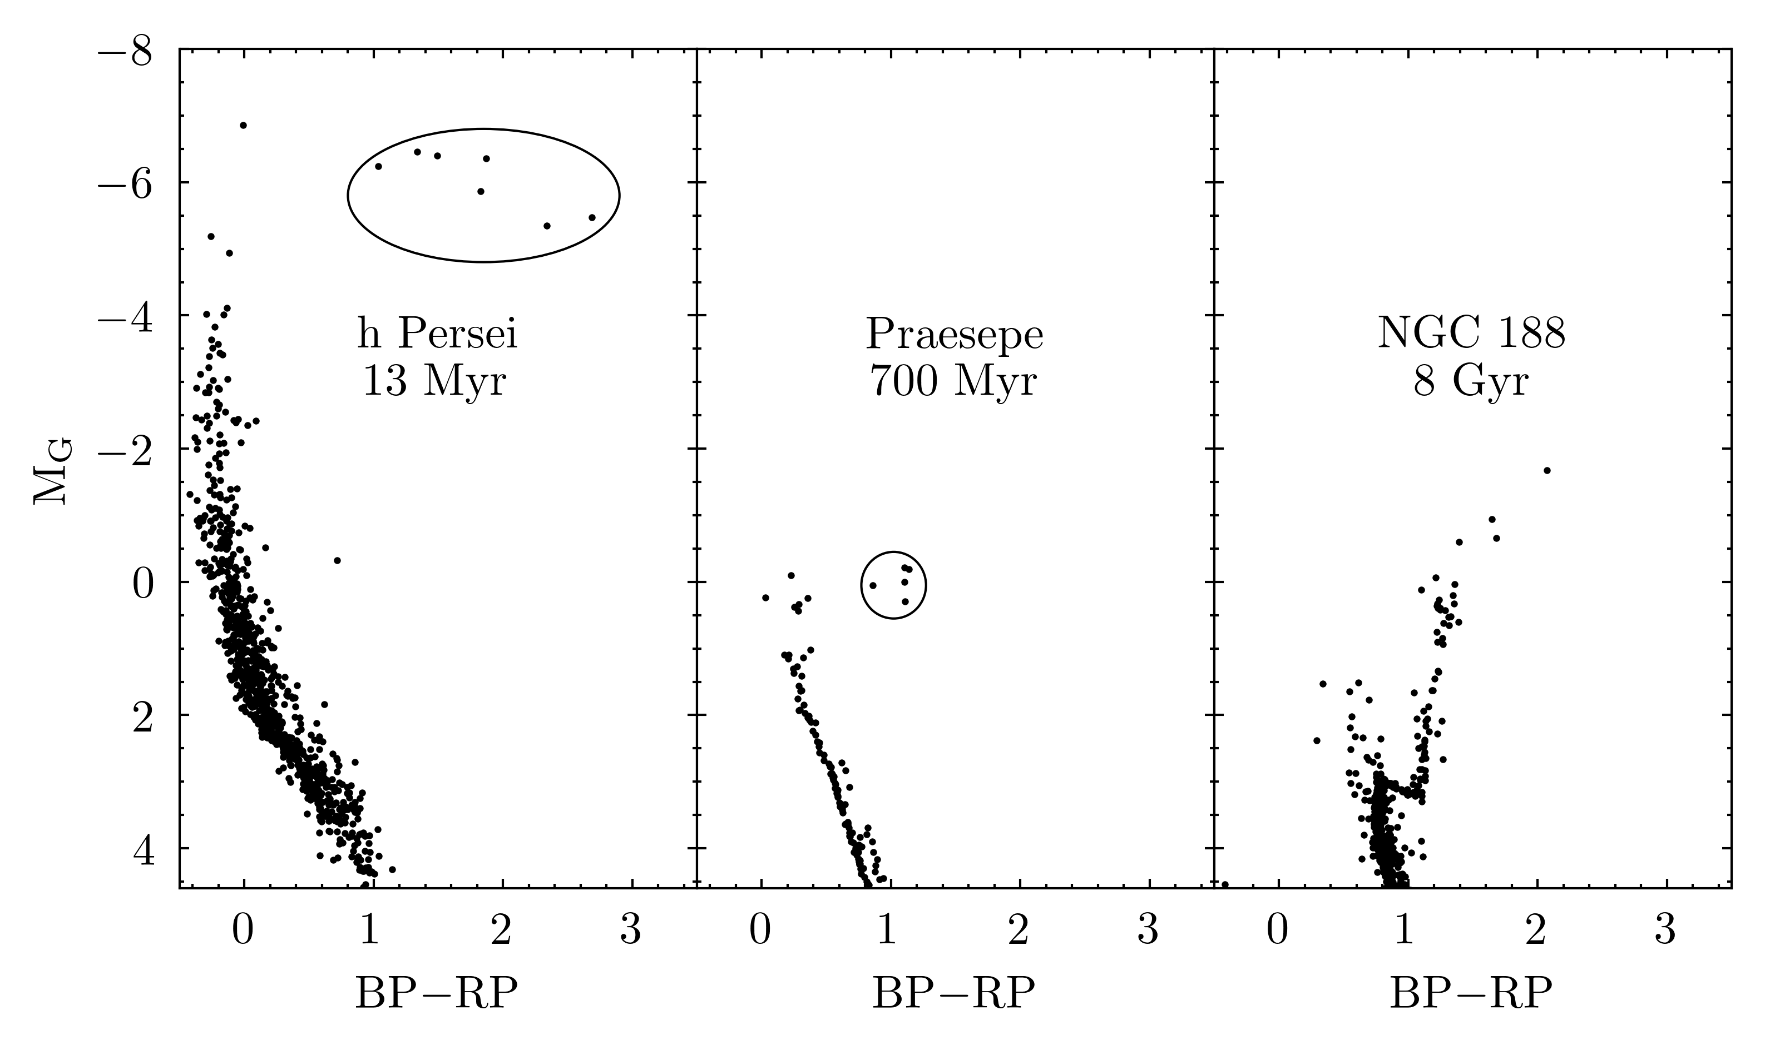
yellow and red super-giants
Hertzsprung gap
subgiants (class IV)

Slide 8
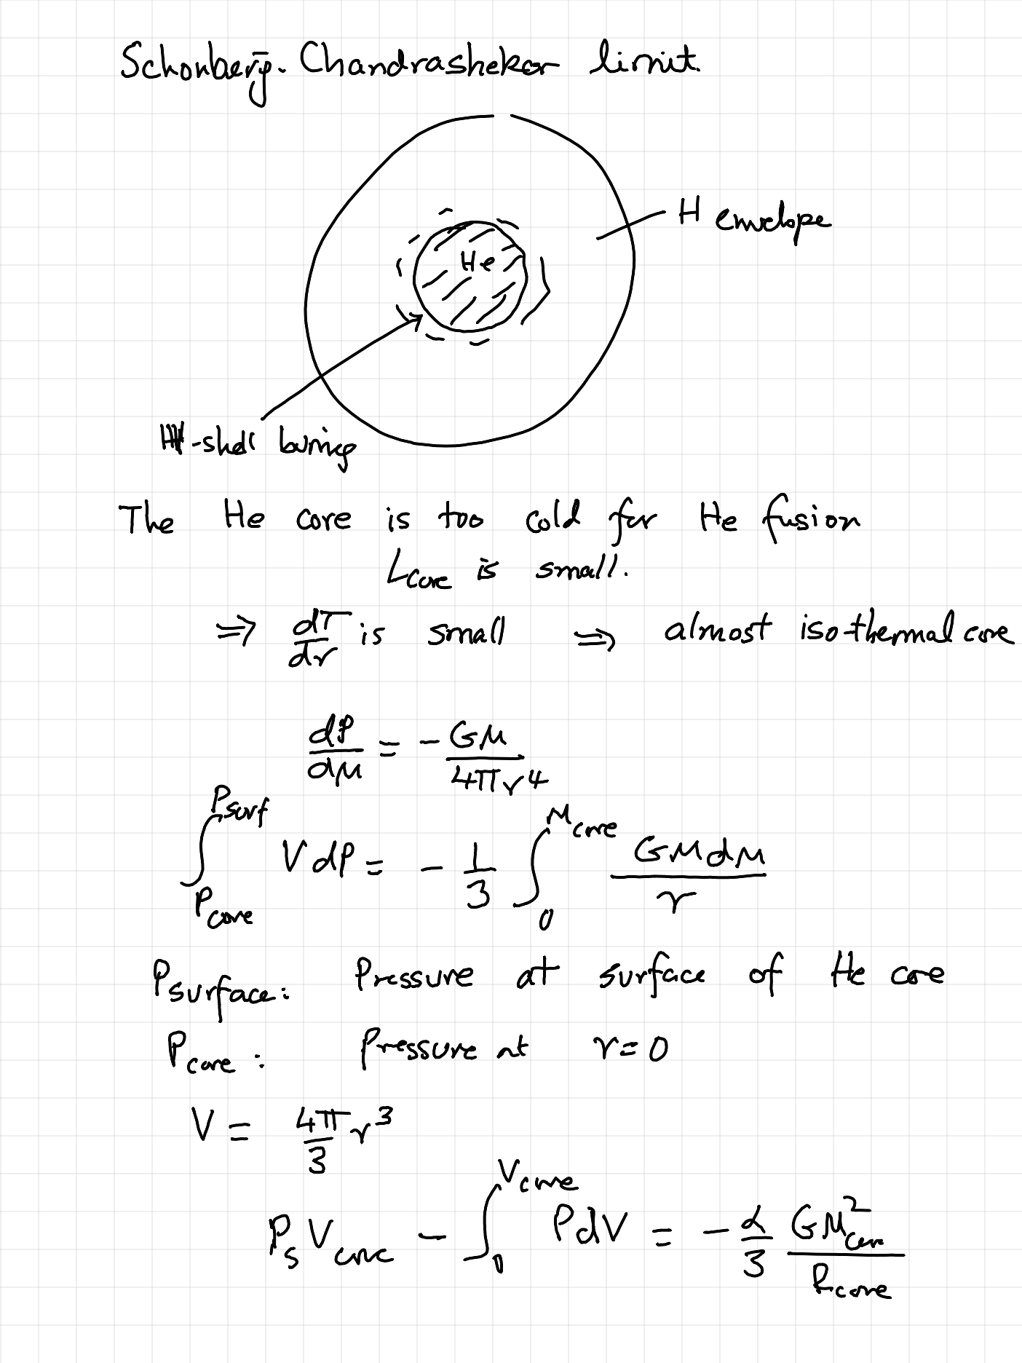

Slide 9
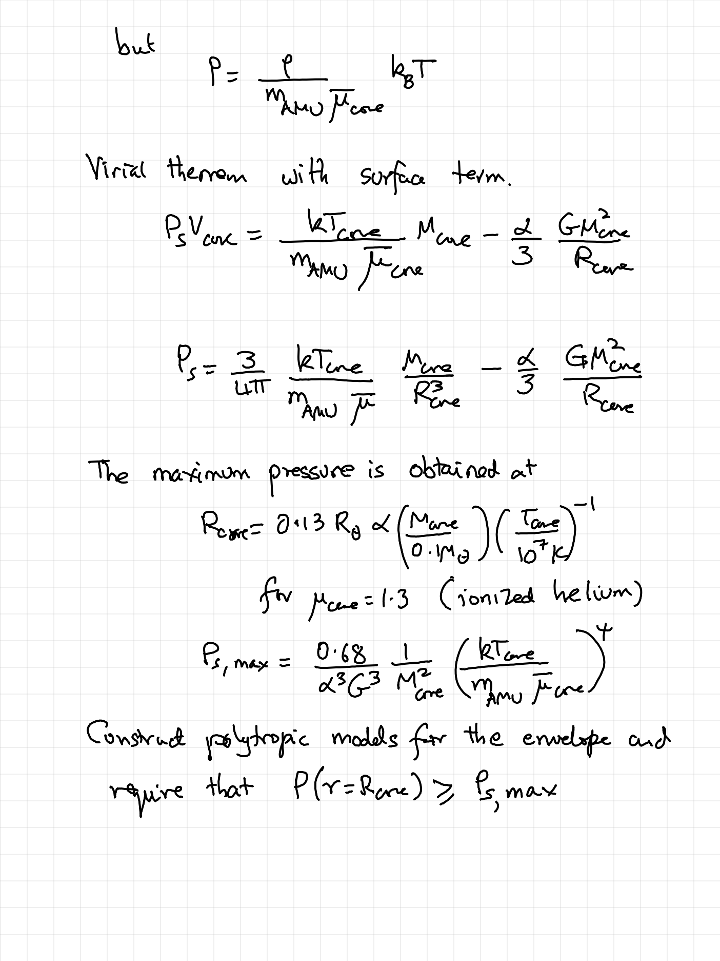

Slide 10
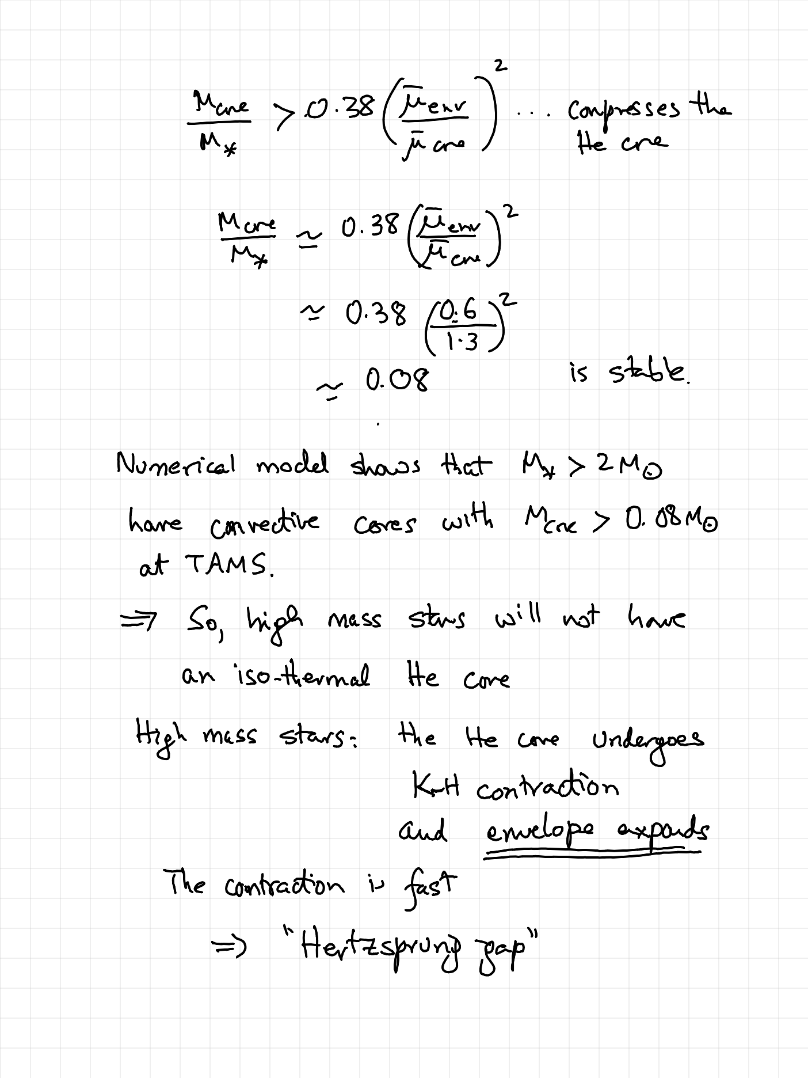

Slide 11
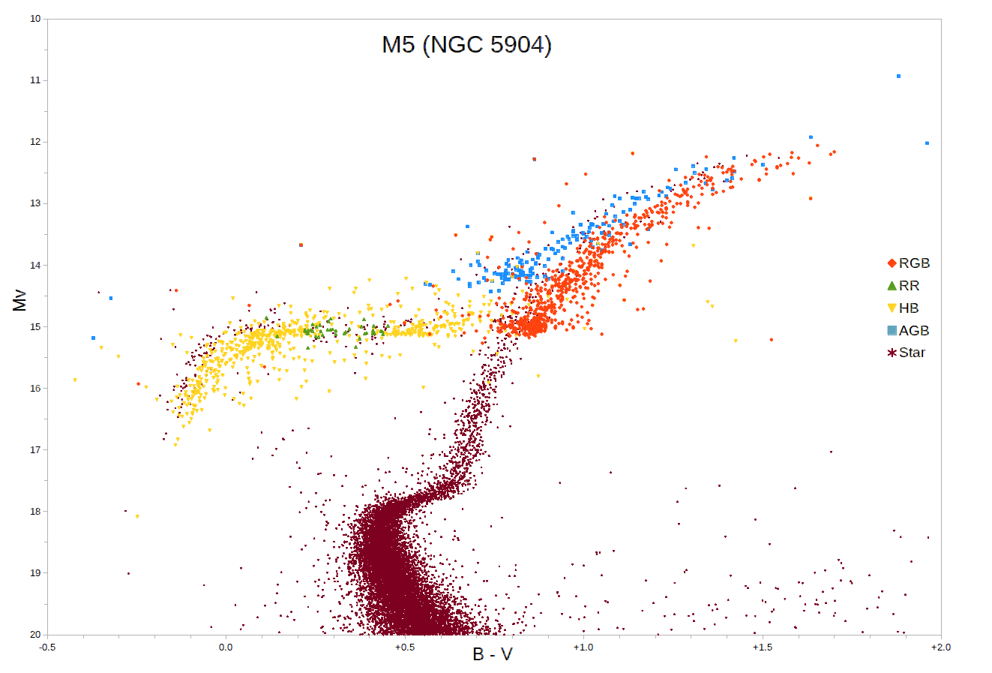
Messier 5
Globular Cluster
Fe/H = -1.30
Turnoff = 0.9 Msun
HB: core He + H-shell fusion
M≈0.7 Msun
Red-clump stars
ZAMS: hydrogen fusion has just started
TAMS: hydrogen fusion in the core ends

Slide 12
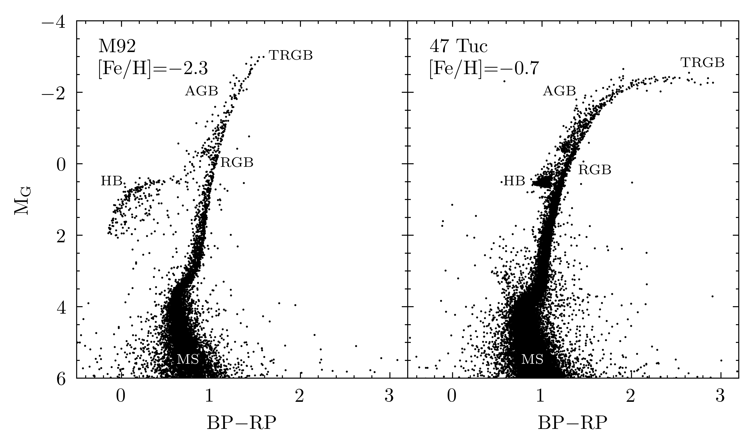

Slide 13
Wolf-Rayet Stars

Slide 14
Two types of WR stars
Massive stars which are young
  For M>30 Msun (ZAMS) the stellar wind is > 10⁻⁵ Msun/yr and the star undergoes ”self stripping” on the main sequence
  The spectra show both H and N ➔ “WNh”
WR stars in binaries
  These are the classical WR stars which show no hydrogen in the spectra
  H-envelope is lost due to mass transfer (whence, no H in spectra)
  Self-stripping results in the sequence: WN→WC→WO
Very strong winds ➔ optically thick
  can be detected via free-free emission
  masks the true photospheric temperature

Slide 19
Many open questions in WR stars
WR stars result from single star channel (Conti wind loss mechanism) and via mass transfer
Wind loss is metallicity dependent
Differing WR population in the Galaxy, LMC and SMC favor WR in metal rich galaxies
However, some metal poor galaxies, which undergo a burst of star formation are teeming with WR stars

Slide 20
Evolution of single stars

Slide 21
Evolution of stars with M<8Msun
From Trimble diagram we see that M>9 Msun avoids degenerate carbon ignition
  For 3<M<8 Msun, degenerate carbon ignition is possible
  If so, sufficient energy (Carbon to Iron) to result in complete disruption of star via carbon deflagration
  However, severe mass loss following TAMS means that carbon core never reaches the necessary mass for carbon deflagration
There is a “initial mass to final mass” mapping which suggests that 8 Msun stars leave behind 1.1 Msun white dwarfs (C+O or O+Ne+Mg, is a matter of debate)

Slide 22
Evolution of stars with 8<M<12 Msun single stars
This is a forefront research area!
O+Ne+Mg core is formed (O from helium burning, Ne+Mg from carbon burning)
8<M<10 Msun: One possible outcome is electron capture when the core is sufficient dense
  The resulting NS should have a gravitational mass of 1.25 Msun
10<M<12 Msun: The consensus view is that these eventually undergo gravitational core collapse of an iron core

Slide 23
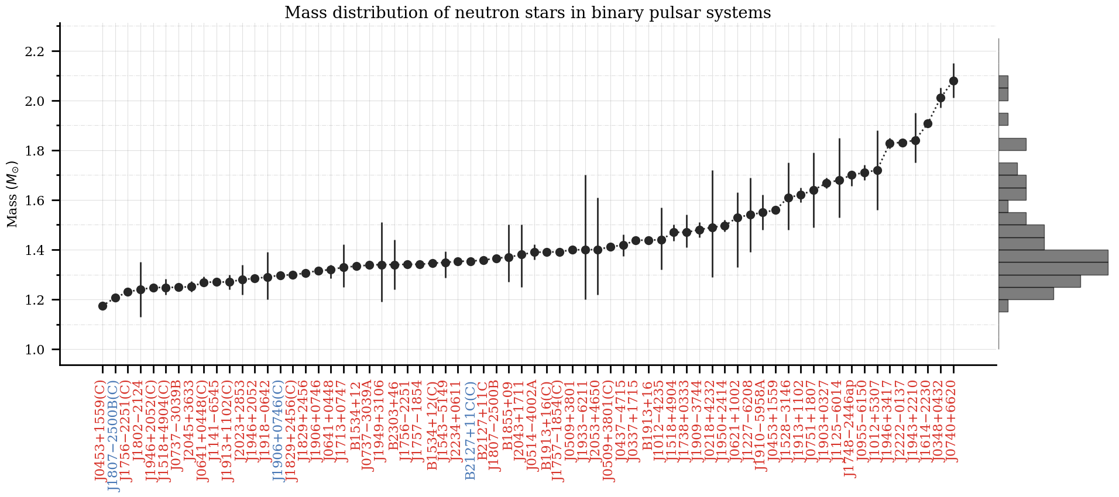
https://www3.mpifr-bonn.mpg.de/staff/pfreire/NS_masses.html

Slide 24
Evolution of >12 Msun single stars

Slide 27
Case B versus Case C mass transfer (Helium cores)

Slide 29
Helium Stars

