Slide 1
Ay215: Lecture 16

Slide 2
Observational history of LRN

Slide 3
Caltech thesis of Mike Rich

Slide 5
Discovered first by Japanese amateur astronomers (1990)

Slide 6
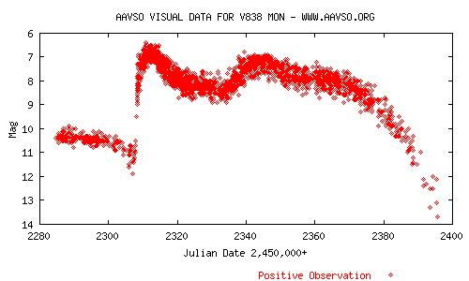
2002: Again discovery by amateurs
January 6, 2002: Nicholas Brown in Australia records a bright star in Monoceros on his film
AAVSO promotes this and there is intense world-wide visual observations of this object

Slide 7
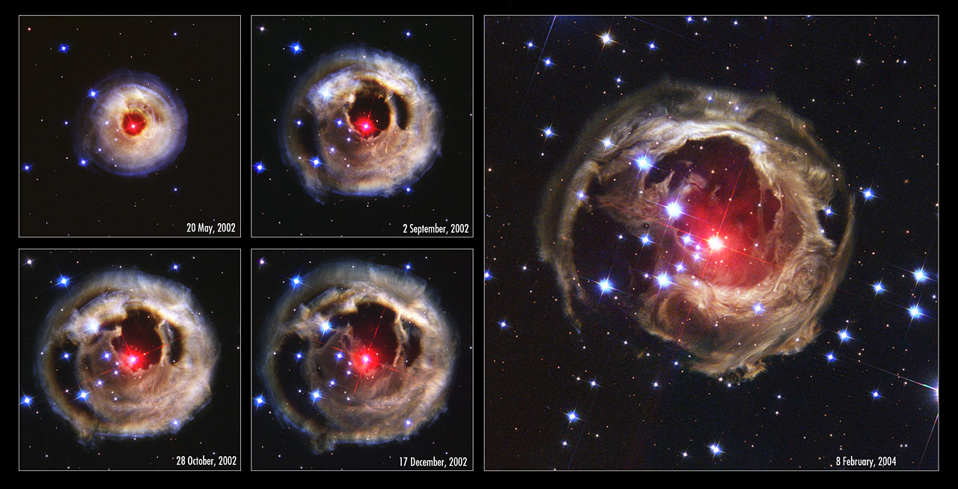
Hubble Space Telescope Imaging

Slide 8
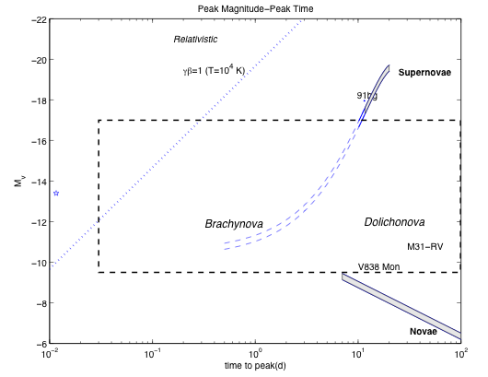
“Nova, Super-nova” & ”Phase Space”
Spring 2005: Teaching Ay125
Wondered if coalescence of two neutron
stars could power a short-lived nova
(Kulkarni 2005)
neutron decay?
? macronova ?
(neutron decay)
Notes:
It wasn’t hardly centuries ago that mankind thought the universe was unchanging. The discovery of transients has now led us to believe that the universe changes not only on month and weeks but also days, hours and minutes!
In Ay 1, or any introduction to cosmic explosions, two classes of optical transients are introduced - novae and supernovae. our understanding about them has grown in leaps and bounds in the past two decades. And for good reason. They are both easy to find and Novae are faint but plentiful, supernovae are rare but bright. Since the time of Hubble, this curious gap has been noted, and we have asked, are there are hitherto an undiscovered class of transients? Let us quantify this gap next.

Slide 9
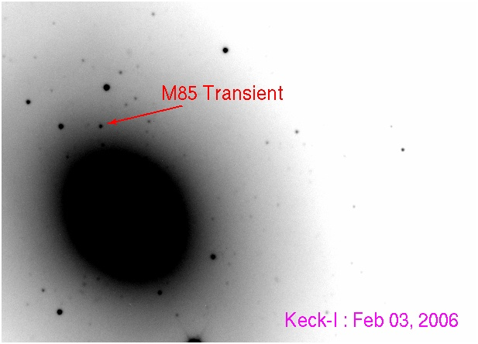
"In the fields of observation, chance favors only the prepared mind” -- Pasteur

Slide 12
“The distinctive physical parameters (relative to novae and supernovae) and the potential connection to a fundamental stellar process (merger) may warrant coining a name. We suggest the simple name luminous red nova with the adjectives highlighting the principal characteristics of M85 OT2006-1. Statistics (including especially the nature of the host galaxies) and follow up studies would help astronomers unravel the origin of these enigmatic transients and also study the physics of hyper-Eddington sources”
Kulkarni et al. (2007)

Slide 13
Caught in the act!

Slide 14
V1309 Sco – R. Tylenda et al. (2011)
Discovered by amateur astronomers
Followed up by Mason et al.
OGLE field

Slide 15
Going back to AD 1670

Slide 16
H-alpha+[NII]
CO

Slide 18
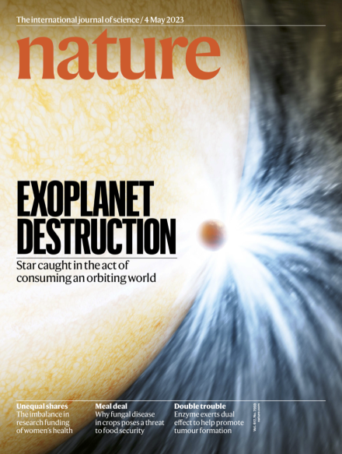
ZTF SLRN-2020
Kishalay De (Caltech PhD)

Slide 19
Karambelkar et al. (2026; submitted)

Slide 20
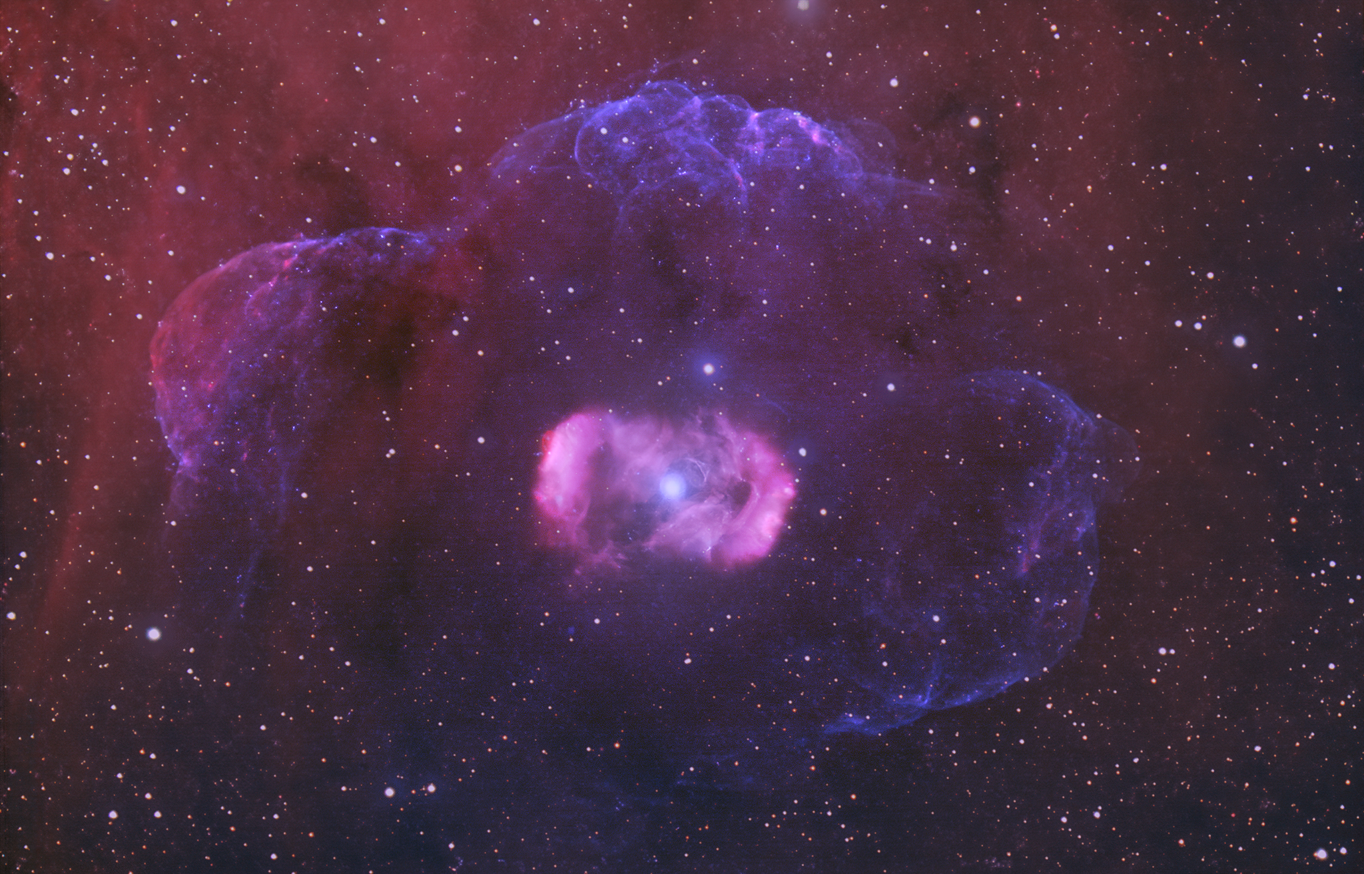
Dragon’s Egg Nebula
Magnetized O star!
Triple star -> binary
(stellar merger)

Slide 21
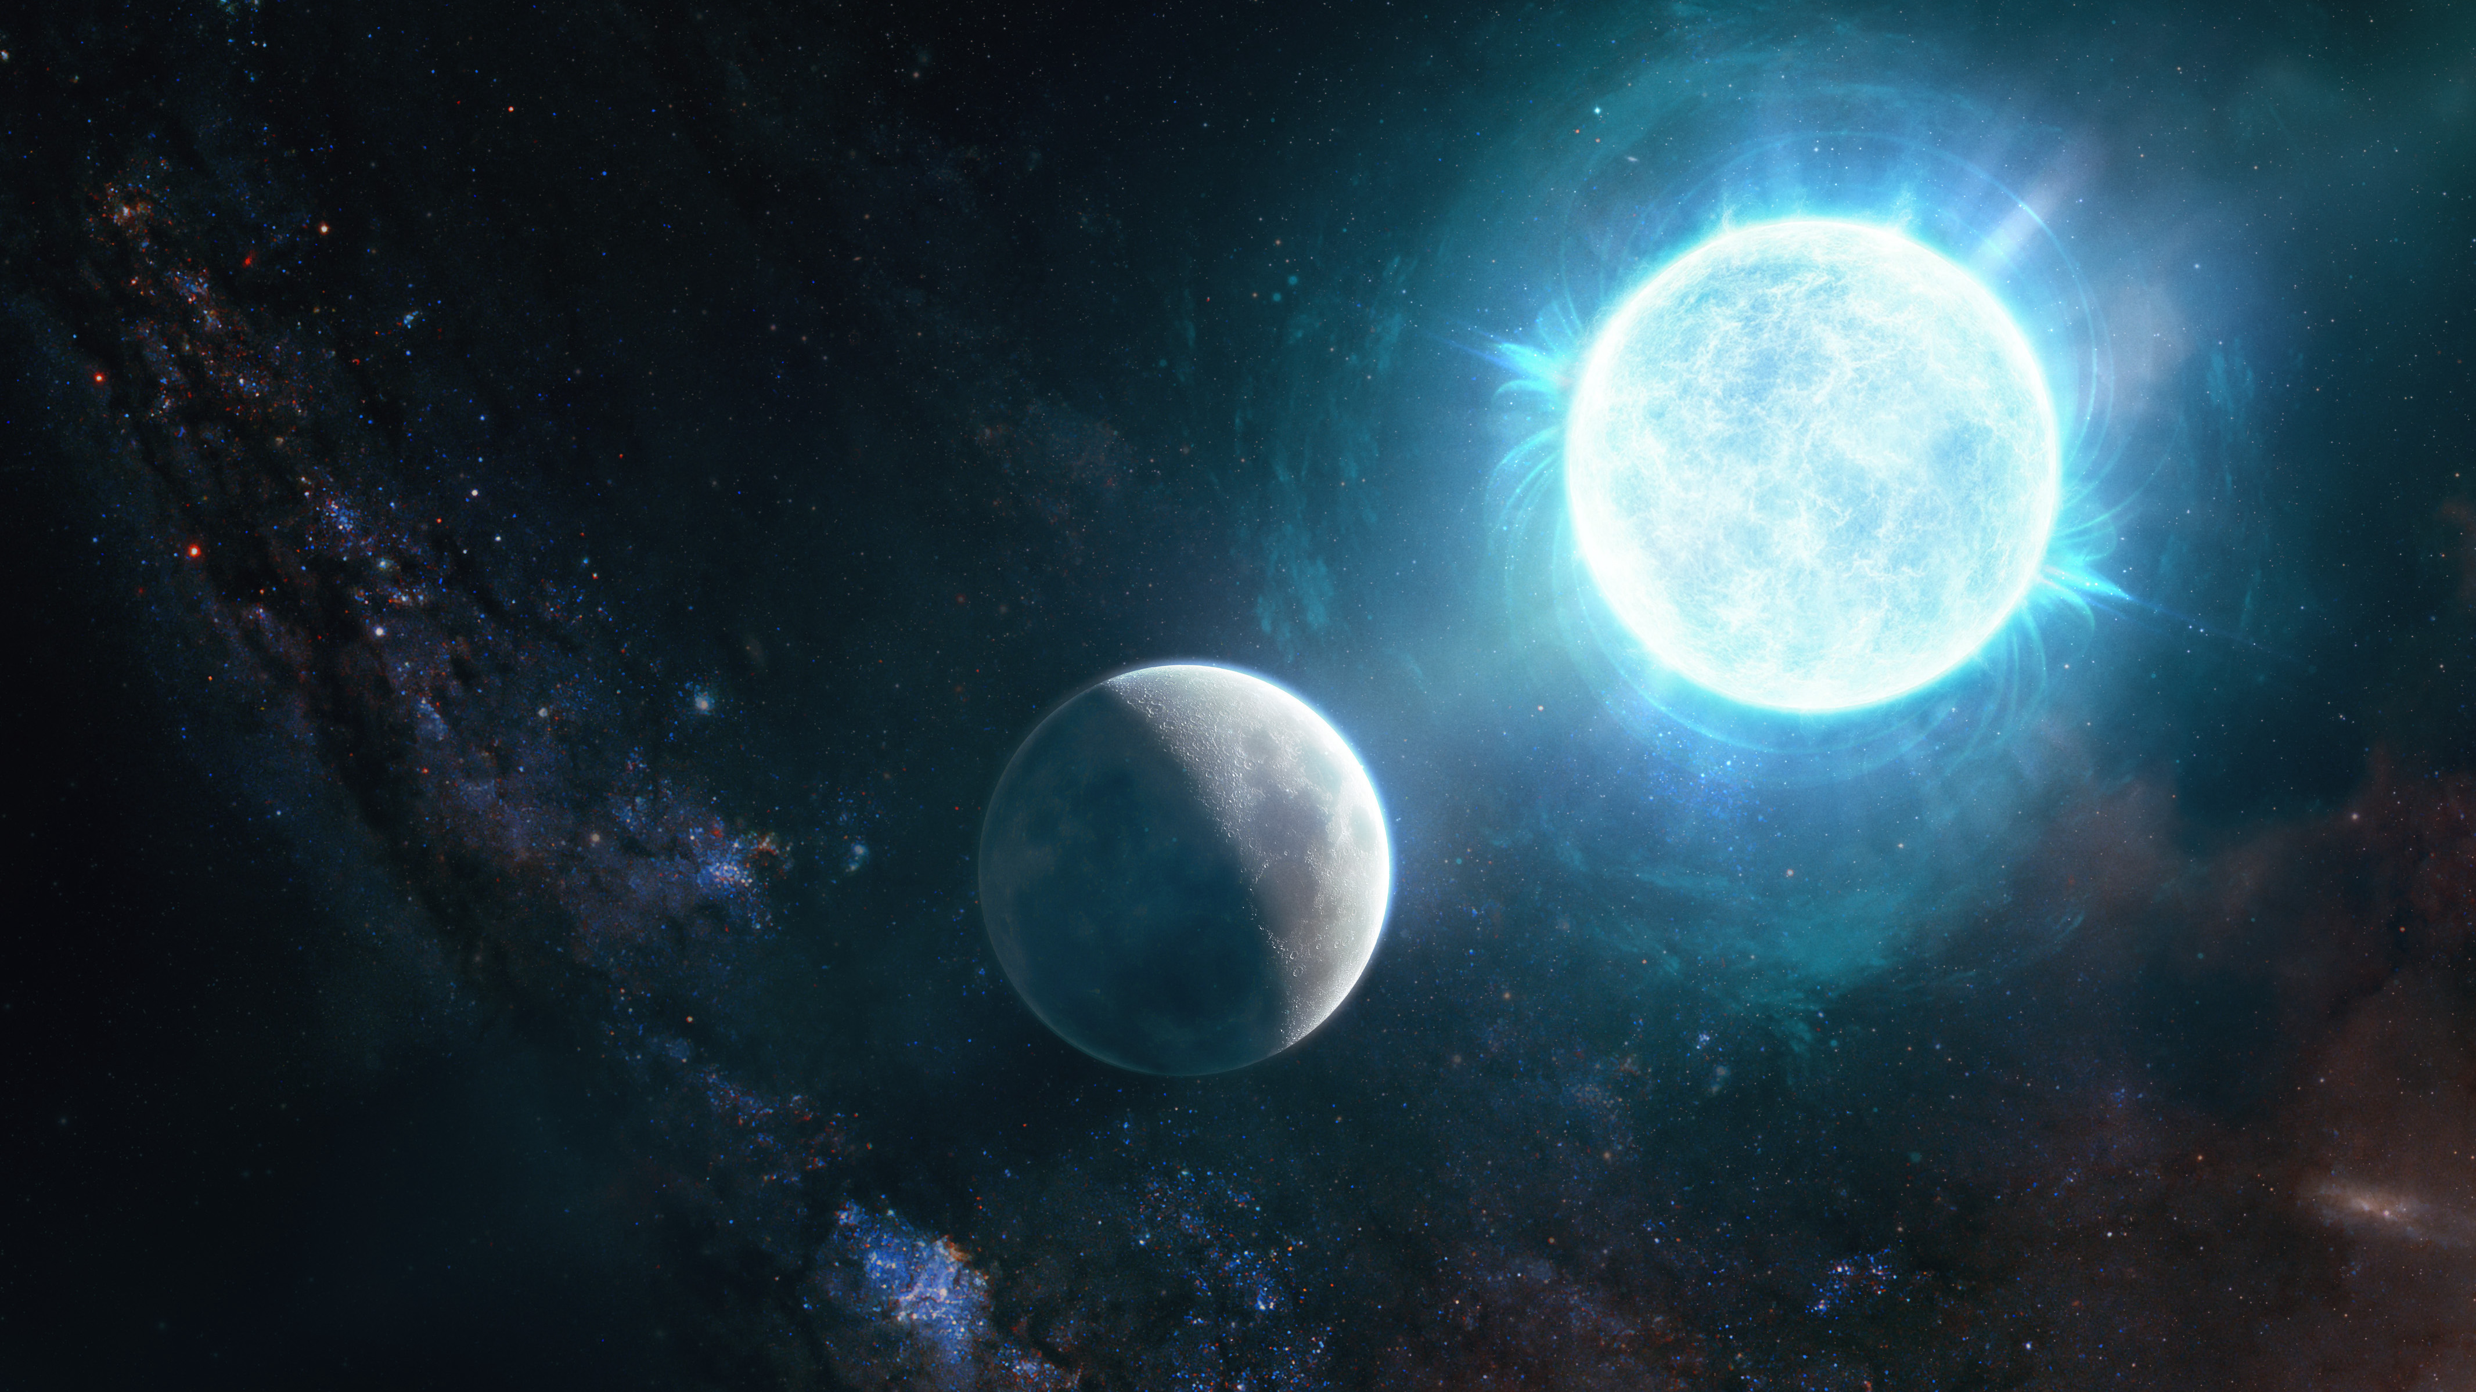
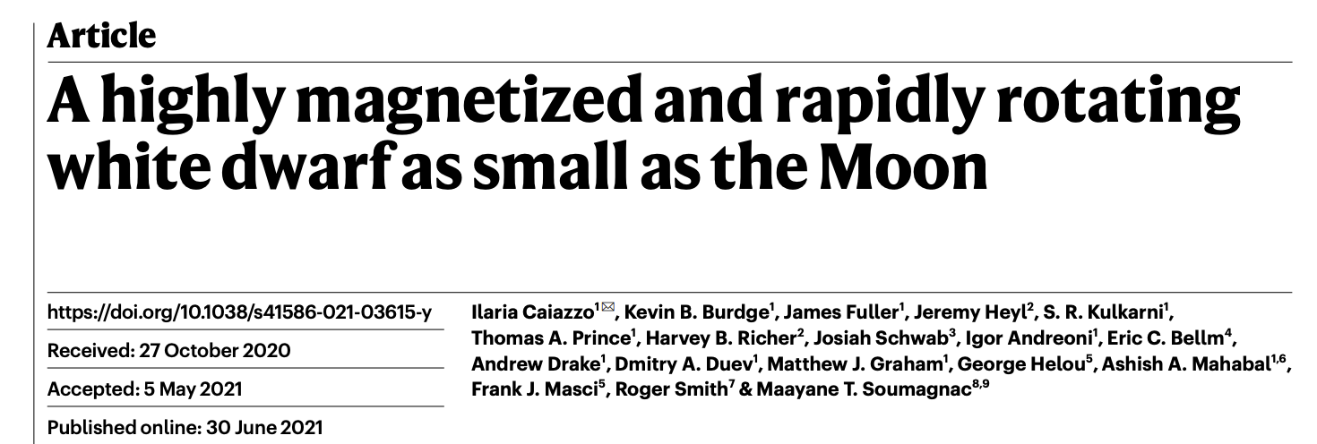
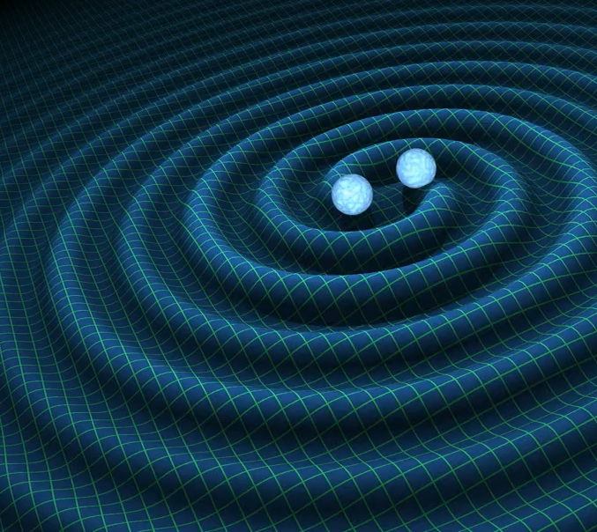
Image by Giuseppe Parisi
ZTF discovered the smallest white dwarf known, which has all the characteristic of a double white dwarf merger remnant:
Rapid rotation: 7 min period
Extreme magnetic field: ~800 MG
Smallest radius (and therefore larger mass) ever observed for a white dwarf: R~2000 km, M~1.35 Msun
So dense that electron capture is happening in the core

Slide 22
Planetary Nebulae

Slide 23
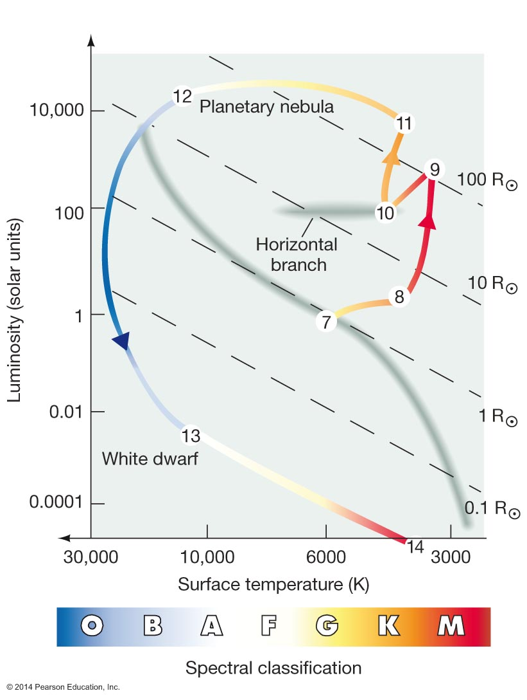
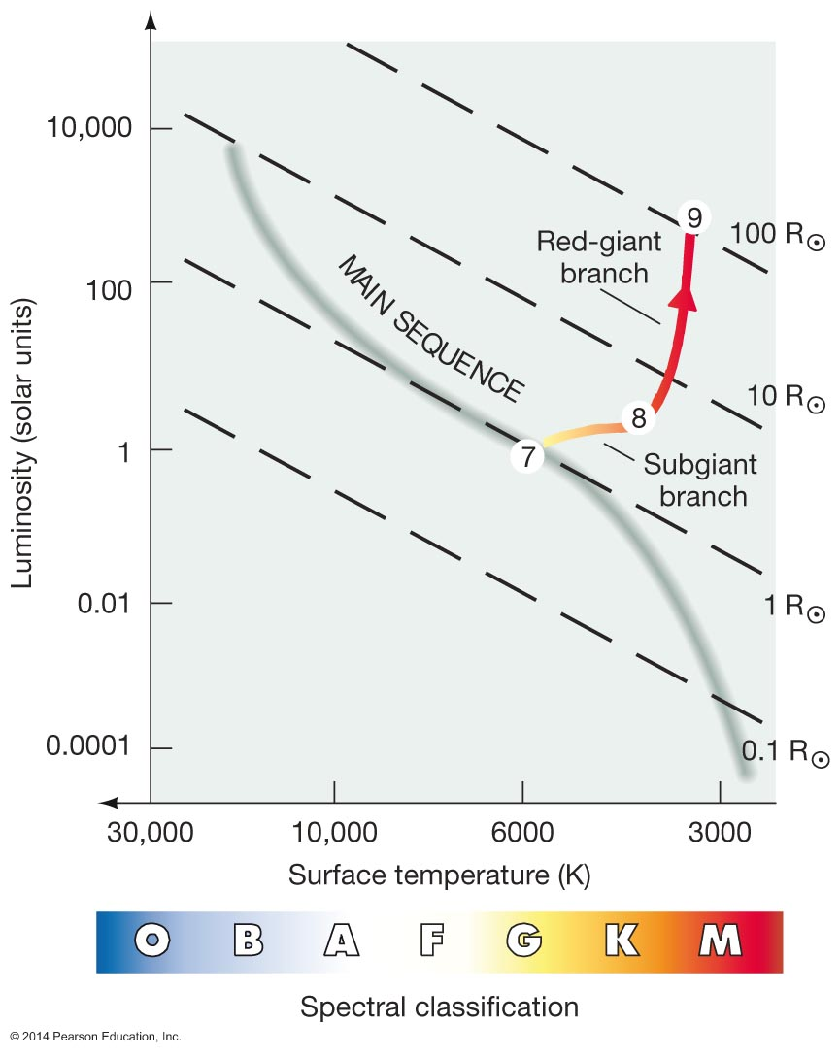
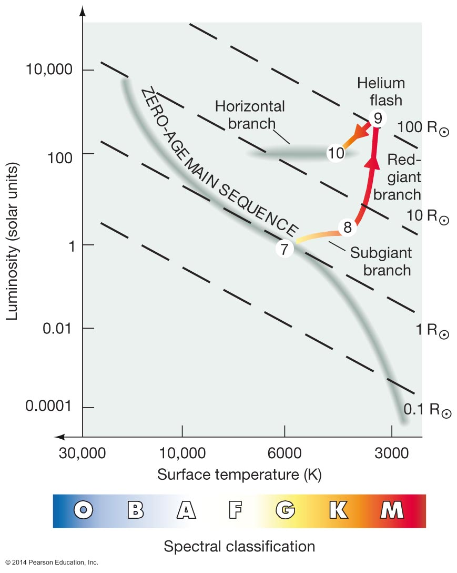

Slide 24
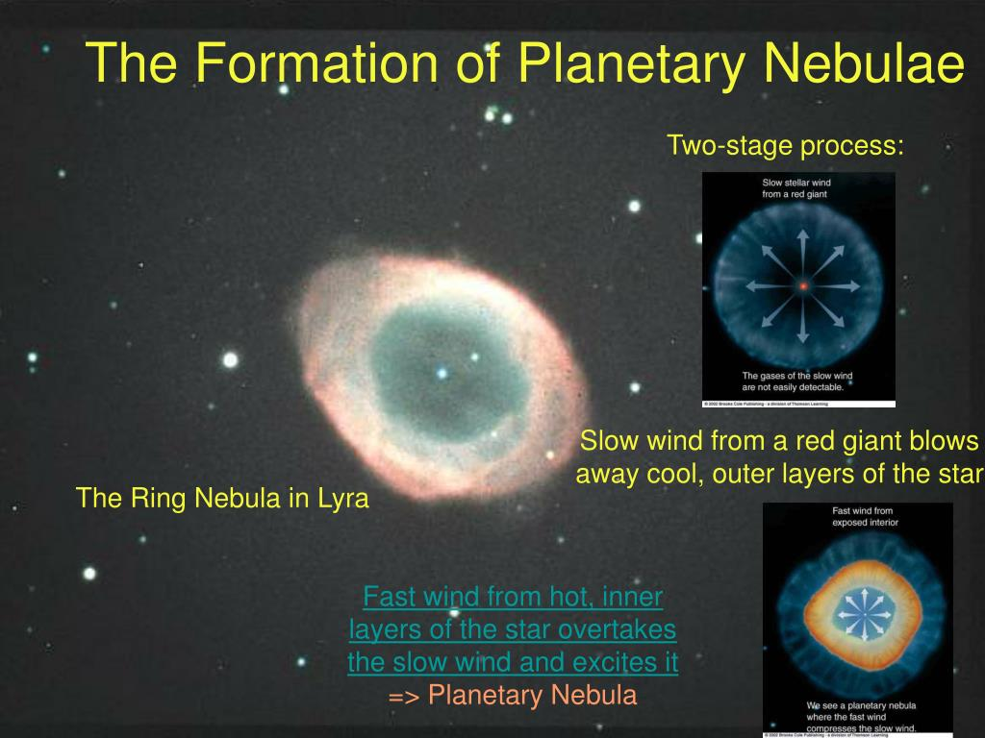
Conventional view of planetary nebulae

Slide 25
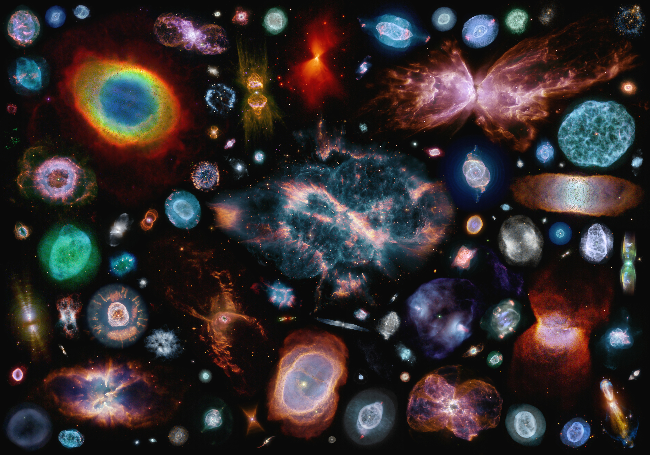
Notice the cylindrical symmetry

Slide 26
Common envelope evolution

