Slide 1
Ay215 Lecture18

Slide 2
Top questions:
V1309 Sco, prior to onset of CEE, was a contact binary
  Mass transfer onto the accretor inflated it, whence the system became contact binary
  Do all CEE go through a contact binary phase?
Does the acceptor gain any mass in the CEE process?
What fraction of CEEs result in merger of stars?
  What would these look like?
What fraction of planetary nebulae are a result of CEE?
  Is it possible that selection effects strongly favor CEE-origin PNe?
How do you explain PNe with very long period binaries in the center?

Slide 4
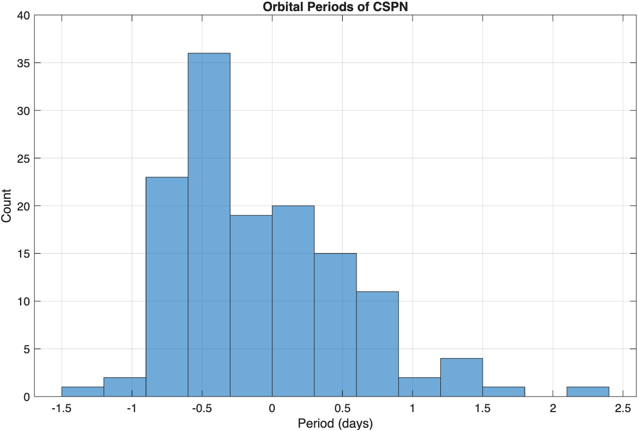
Period distribution
Data from
https://www.drdjones.net/bcspn/

Slide 5
Evidence of mass transfer prior to CEE

Slide 6
Fleming 1
Outer most knots emitted 16,000 yrs ago
Inner most about 10,000 ago
Nebula is 5,000 yrs old

Slide 7
Necklace Nebula
spectrum of main sequence companion
(carbon contamination)
Necklace nebula
jets/clumps
note clumpy jets

Slide 8
Long period CSPN

Slide 10
Likely, wind-fed Roche lobe is key to long-period CSPN. A more sophisticated approach
is that of Fuller & Bhattacharjee.

Slide 12
Long period companions (pre-CV)

Slide 13
Long period companions can affect PN shape
During AGB phase a companion can alter the outflow due to wind-fed Roche lobe overflow
W Aql (Mira variable) is orbited by a faint companion (F spectrum) with separation of 160 AU
ALMA CO image

Slide 14
Symbiotic stars
Red giant with a dwarf star (white dwarf, main sequence,neutrons star)
Mass transfer is via wind capture or wind+Roche lobe
Mass transfer is stable
In some cases (with white dwarf companion) the giant is enriched with s-process elements (which suggests that that the current phase is the second mass transfer)

Slide 15
Barium Stars
Barium stars are G- and K-giants showing clear signature of Carbon and s-process enrichment in their spectra
The unseen companion is a white dwarf, and the enrichment is due to a previous mass transfer episode while the WD was on the AGB
Orbital periods range from 200-10,000 days
  Pb<1000 days are circular and longer period systems are eccentric
Barium stars arise from systems with mass ratio above 1.5

Slide 16
Likely merger outcomes

Slide 17
Radiative stars which are peculiar
Main sequence A,O, B are radiative. However, 10% of these stars are magnetic (Ap, Bp)
Most radiative stars spin rapidly (because they have no magnetized winds carrying angular momentum)
  However, a subset are rotating slowly
Magnetic Ap and Bp stars lack binarity
Magnetic stars have exotic distribution of elements (Dy, Ga,Eu)

Slide 18
FK Comae stars
FK Comae is G4 III star with a rotation period of 2.4 days (which is unusually small for a cool giant)
Its surface is dominated by very large cool spots
Differential rotation

