Slide 1
Ay215: Lecture 2
S. R. Kulkarni

Slide 2
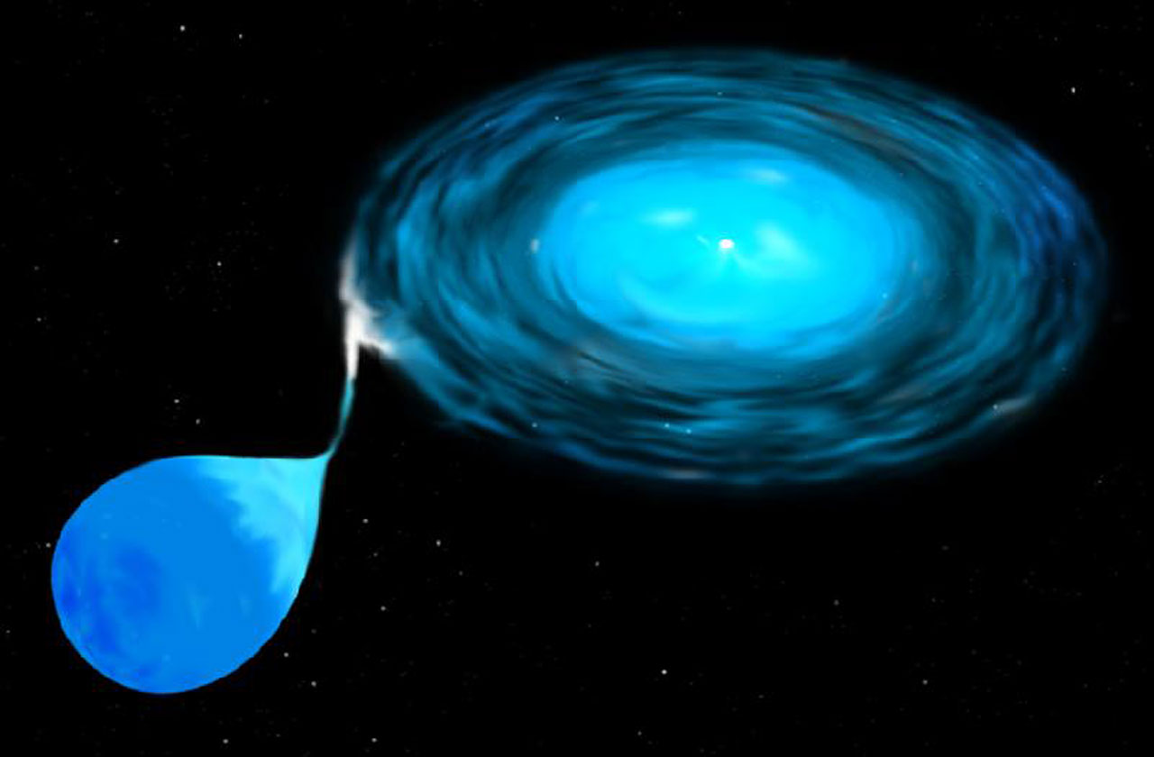

Slide 3
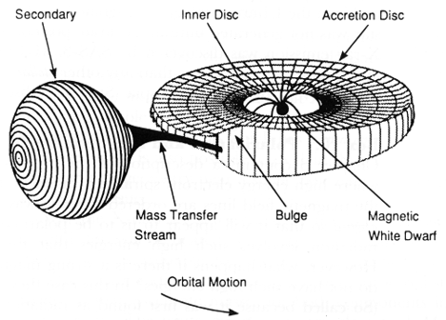
Intermediate polar

Slide 4
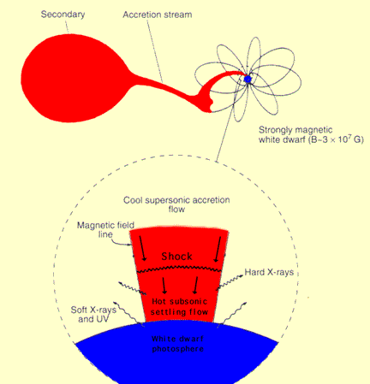
Polar
10
12
10
10
10
12
10
12
10
10
SS Cygni 1900-2010 (1-day means)
1928
2011

Slide 5
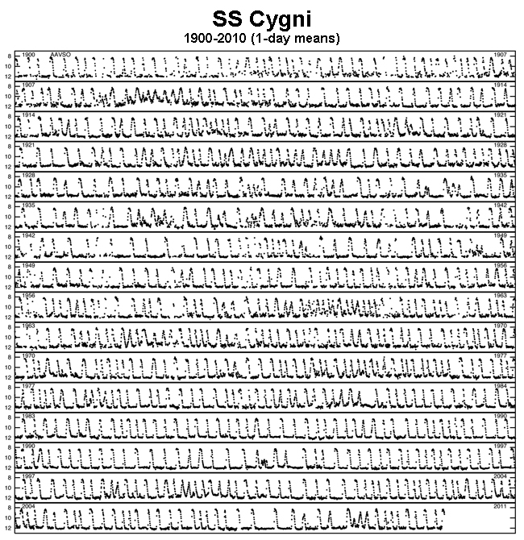
Dwarf novae

Slide 6
Novae

Slide 8
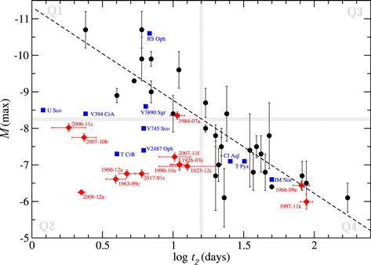
Maximum Magnitude, Rate of Decay (MMRD)

Slide 9
Recurrent nova T Corona Borealis
2026?

Slide 10
Recurrent nova in M31: once a year!
Darnley+ 2016

Slide 11
Cataclysmic variables

Slide 12
Dag+ 2026
(TESS)

Slide 13
Schreiber+ 2024

