Slide 1
Ay215: Lecture 6

Slide 2
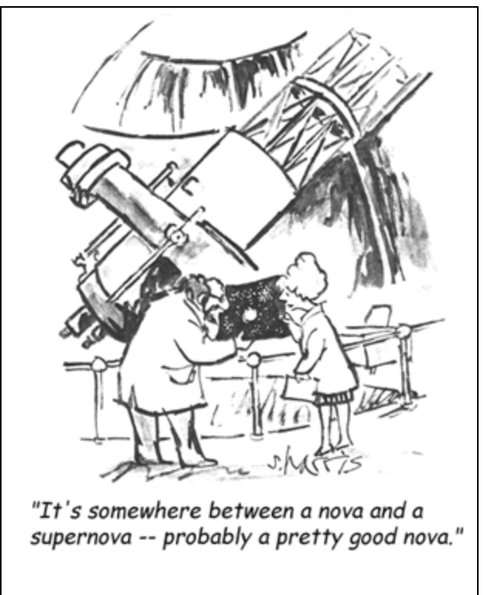

Slide 6
X1: primary to L1
X2: primary to L2

Slide 8
d_{min}
d_{min} /a = 0.0488 q^{-0.464}

Slide 11
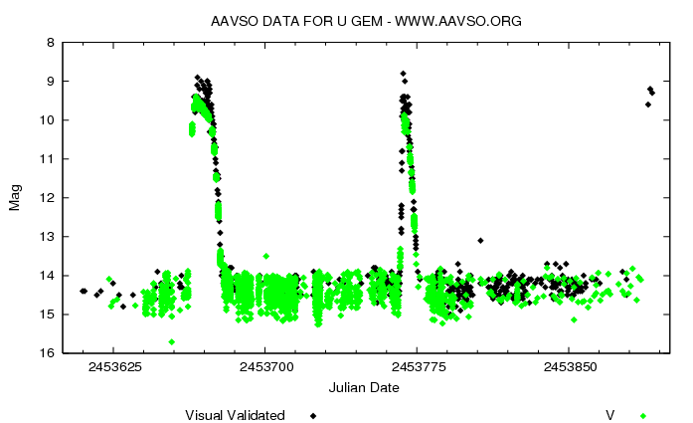

Slide 15
AM CVns: classification by disks
P<12 minutes, no disk
12<P<20 minutes, large stable disks (nova-like)
20<P<40 minutes, variable disks (SU UMa dwarf novae)
P>40 minutes, small stable disk, dwarf novae in quiescence

