Slide 1
Ay215: Lecture 7
(Chapter 6 of T Tauri & vdH)

Slide 2
Early years of X-ray astronomy
1962: Rocket flight → Sco X-1 (LMXB)
1964: Rocket flight → Cygnus X-1 (HMXB, black hole)
1966: Rocket flight → Cygnus X-3 (HMXB, micro-quasar)
1967: Rocket flight → Cen X-3 (accreting neutron star)
1971 .. Uhuru (2—6 keV) launched off east cost of Kenya
  339 sources with good positions (multiwavelength) → Cyg X-1 mass
  Cen X-3 … pulsations and binary orbit
1975: Ariel-5 → A0620-00 (X-ray nova)
1975: ANS & SAS-3 → Type I X-ray bursts

Slide 3
Units
Uhuru: 1 count/s = 1.7E-11 erg/cm²/s
Einstein (IPC): 1 count/s = 4E-11 erg/cm²/s
Rosat (PSPC): 1 count/s = 1.1E-11 erg/cm²/s
The Crab nebula has a df/d𝜈 𝛼 𝜈⁻² (photon index = 1)
  1 Crab = 2.4E-8 erg/cm²/s [2--10 keV]
  1 Crab = 1 mJy at 6 keV!

Slide 4
The Bright X-ray Sources
(>10⁻¹⁰ erg cm-² s⁻¹ in classical band)

Slide 5
HMXBs
LMXBs

Slide 6
With Lx = 10³⁶ to 10³⁸ erg/s need accretion rate of 10⁻¹⁰ Msun/yr to ¹⁰⁻⁸ Msun/yr

Slide 9
Why two distinct classes? (LMXB & HMXB)
To produce L_{X} of 10³⁶ erg/s to 10³⁸ erg/s need corresponding mass gain rate of 10⁻¹⁰ Msun/yr to 10⁻⁸ Msun/yr
Mass transfer has to be stable for sufficiently long time in order for us to see a size population on the sky
LMXBs: Mass transfer from low mass star to higher mass star
  Driven on nuclear time scale
  M_{donor} < 1.5 Msun
HMXBs: Mass transfer is due to the compact object capturing a port of the stellar wind via Bondi-Hoyle process
  Duration is the lifetime of the primary star
  M_{donor} > 15 Msun

Slide 14
Black hole binaries: Cygnus X-1, X-ray novae, micro-quasars

Slide 18
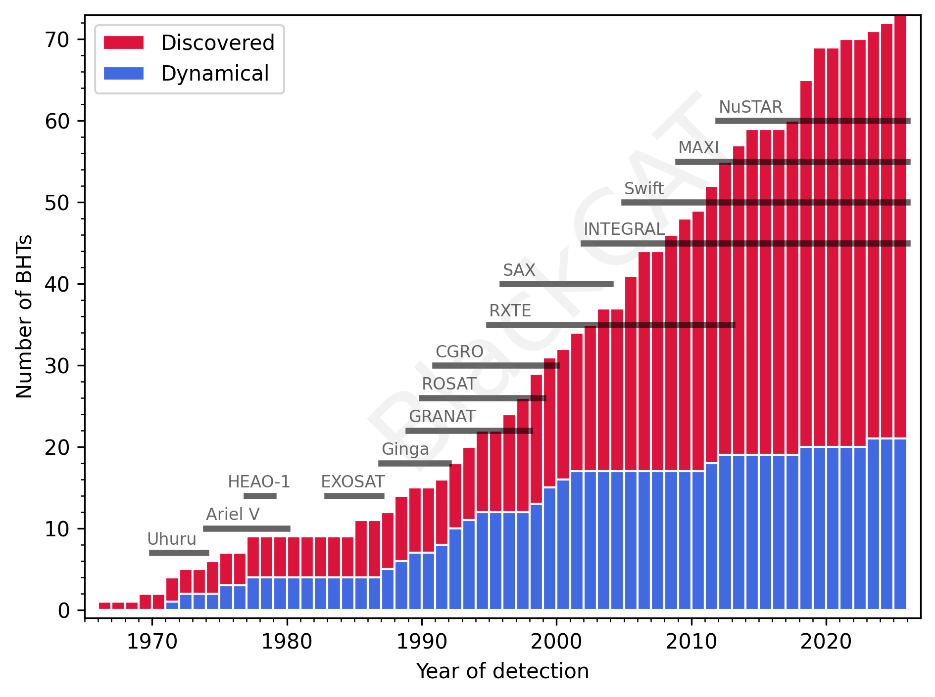

Slide 19
Note mass!

