Slide 1

X-ray Polarimeter
Biswajit Paul
Raman Research Institute, Bangalore
X-ray Polarimeter Team at RRI
Biswajit, Rishin, Gopala Krishna, Duraichelvan, Chandreyee, Ateequlla, Arasi, Jincy, Mamatha, Marykutty, Nagaraj, Rajagopal, Sandhya, …

Slide 2
X-ray Polarimeter
Polarisation is unexplored in High Energy Astrophysics
X-ray emission from the following processes should be polarised
Cyclotron
Synchrotron
Non-Thermal Bremsstrahlung
Scattering from non-spherical plasma
These objects should produce polarised X-ray radiation
Accretion powered pulsars
Rotation powered pulsars
Magnetars
Pulsar wind nebulae
Non-thermal supernova remnants
Black holes, micro-quasars and active galactic nuclei
Measurement Technique
Anisotropic Thomson Scattering
Crab nebula is the only source for
which X-ray polarisation measurement
exists. This was made in 1976 !!
Approved mission: GEMS

Slide 3
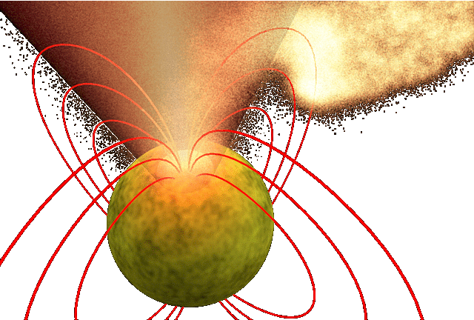
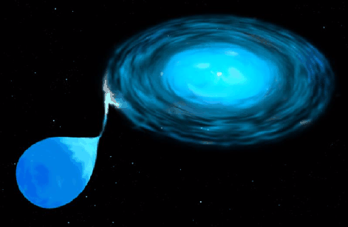
Accreting X-ray Pulsars

Slide 4
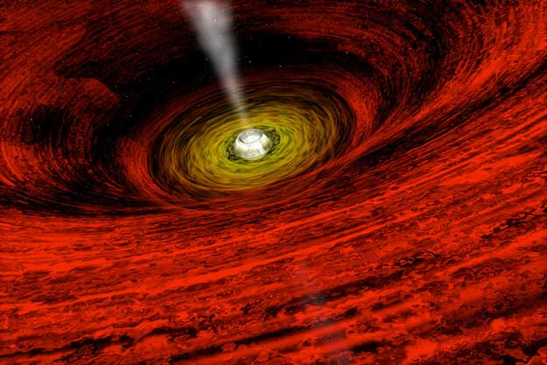
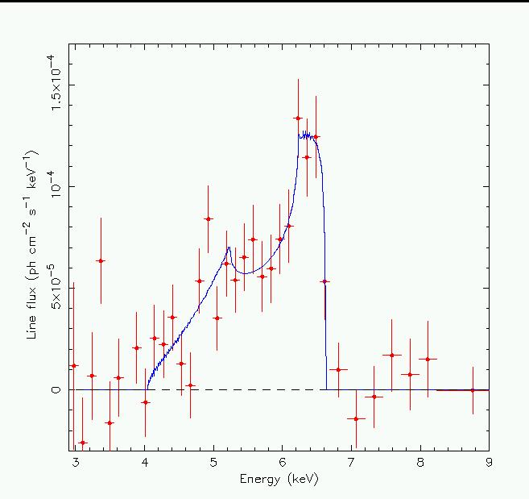
Jets & Motion in Accretion Disk
around Black Holes

Slide 5
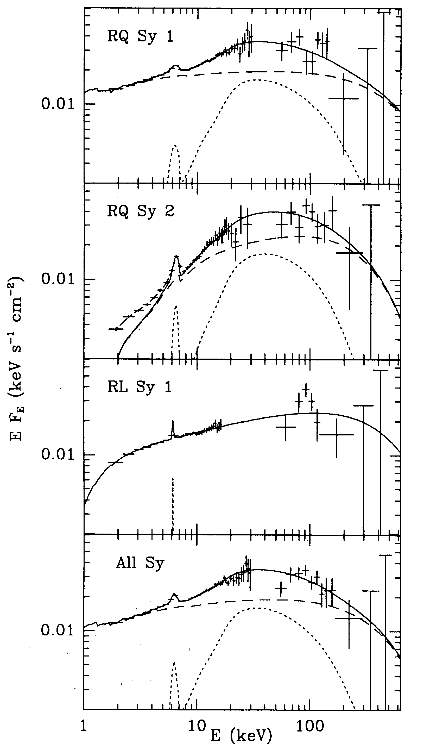
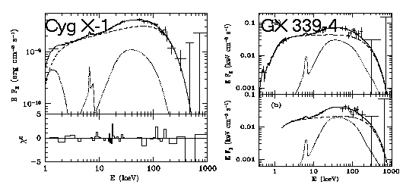
X-ray Reflection from BH Accretion Disk

Slide 6
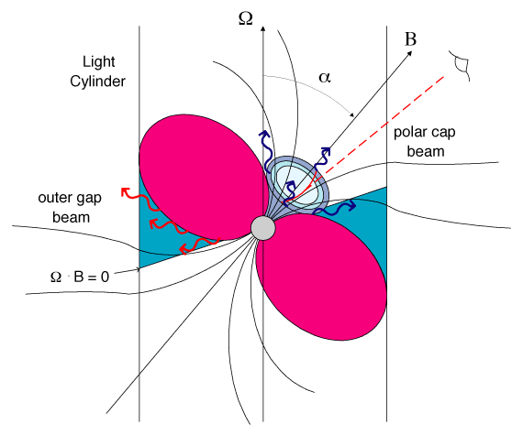
Rotation Powered Pulsars & Magnetars

Slide 7
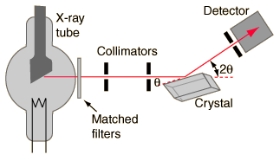
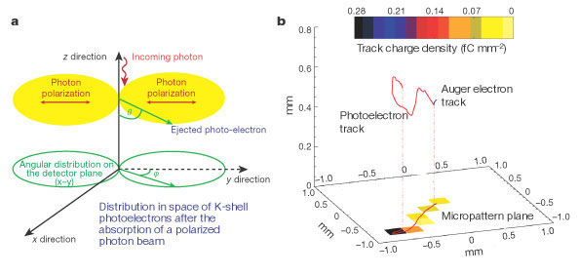
X-ray Polarisation Measurement Techniques
Bragg Reflection
Thompson Scattering
Photoelectron imaging

Slide 8
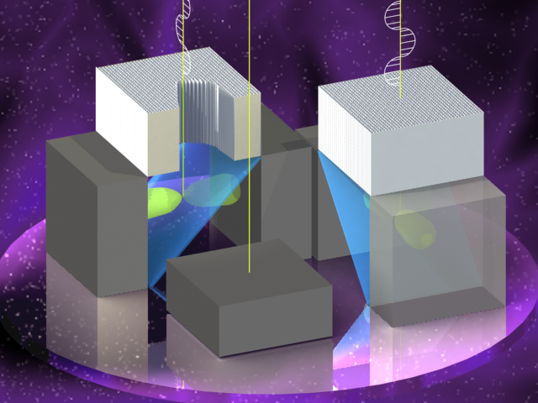
A Thomson X-ray Polarimeter
Photoelectron/Bragg: < 10 keV
Compton :> 30 KeV
Thomson: 5-30 keV

Slide 9
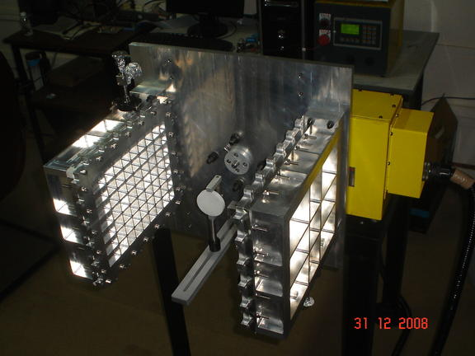
Test Setup

Slide 10
Polarised X-ray Source
Log (N)
Energy (keV)

Slide 11
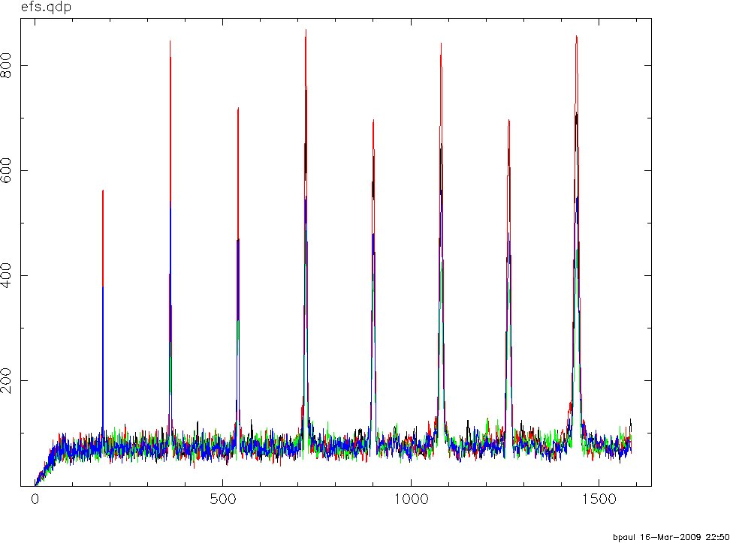
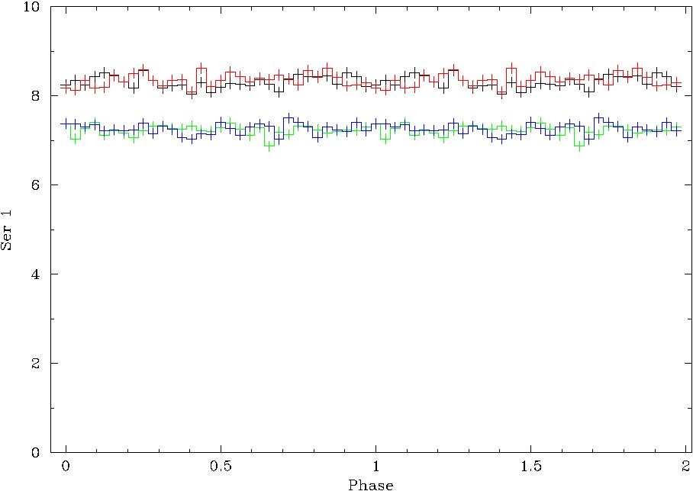
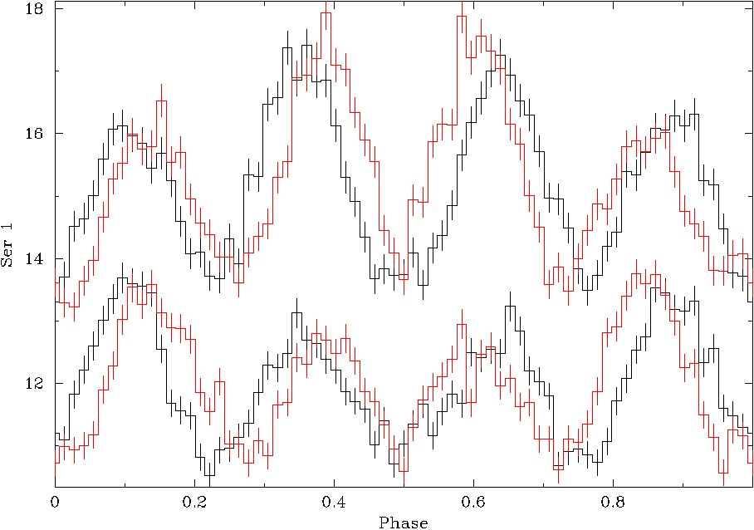
Test Results

Slide 12
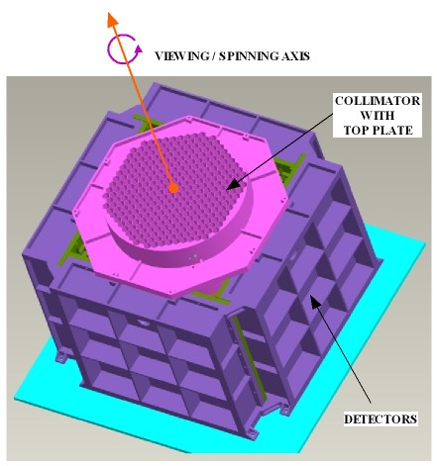
Engineering Model
The mechanical configuration
Similar to prototype
->Consists of 4 detectors placed symmetrically on all sides of the scattering element
->Larger area
->Overlapping arrangement to reduce corner dead area
->Detectors side-connected to increase stiffness

Slide 13
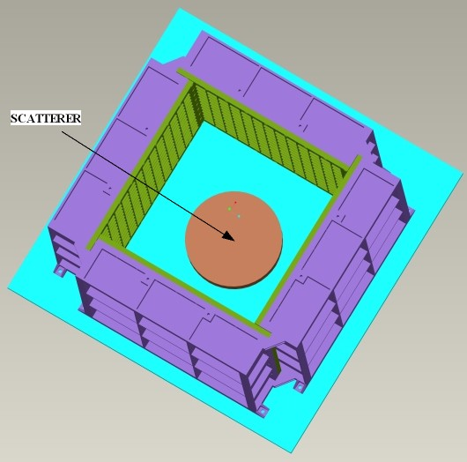
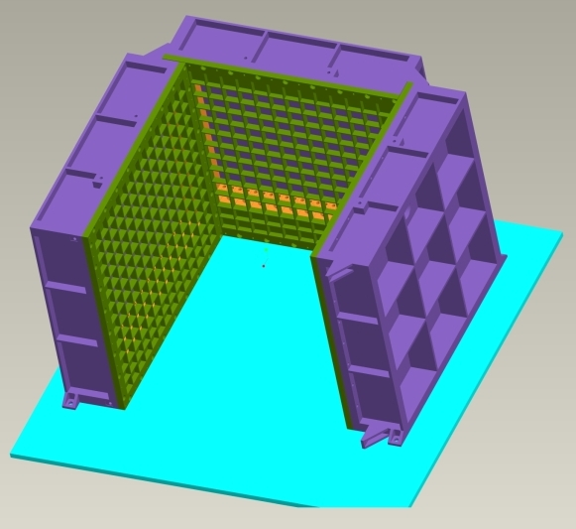
Mechanical configuration…..

Slide 14
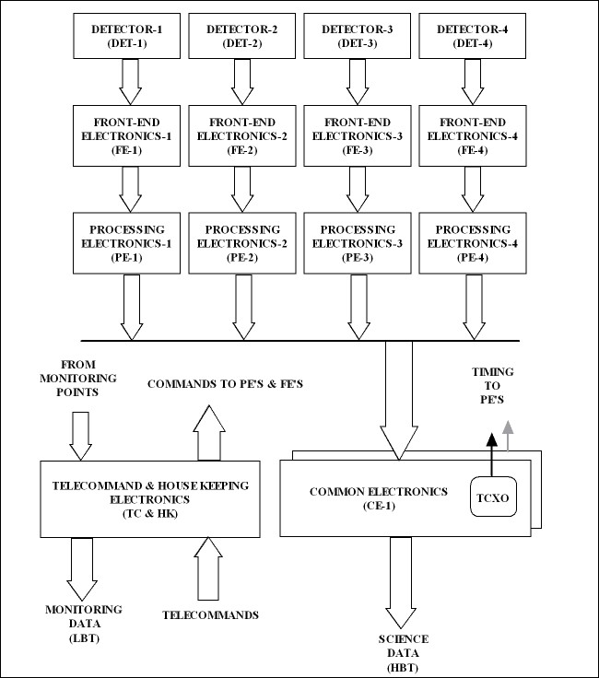
Polarimeter electronics:
The five main sections

Slide 15
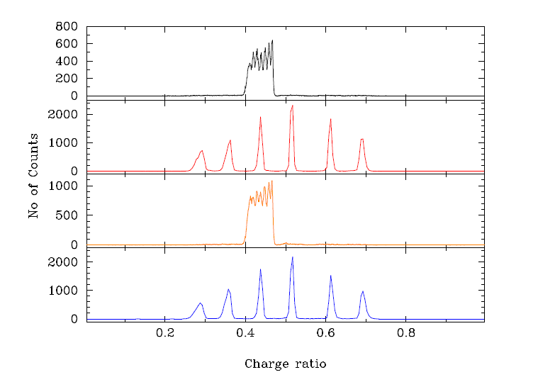
Results – Square Detector
Notes:
15

Slide 16
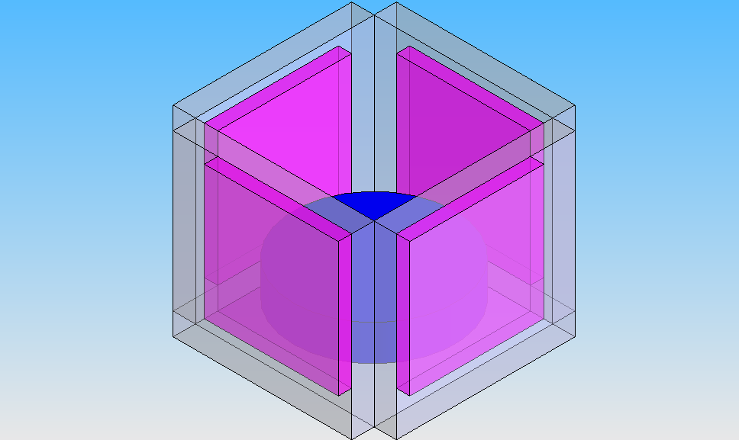
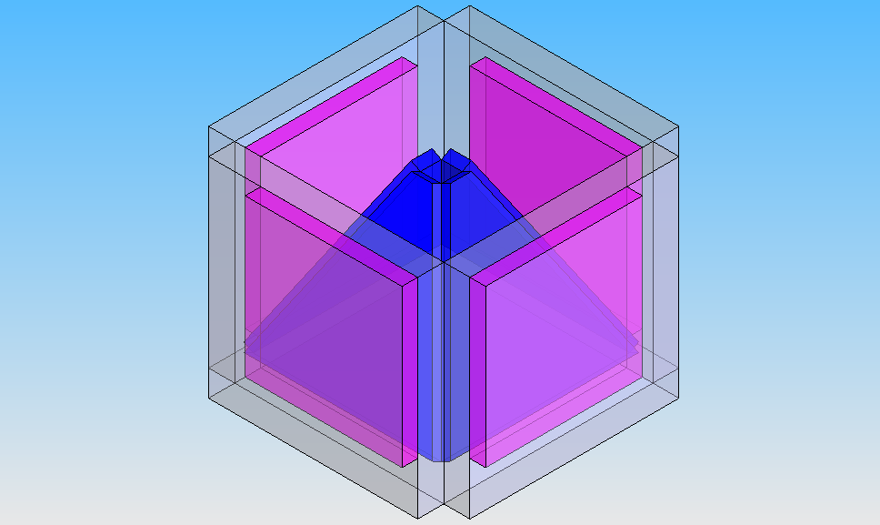
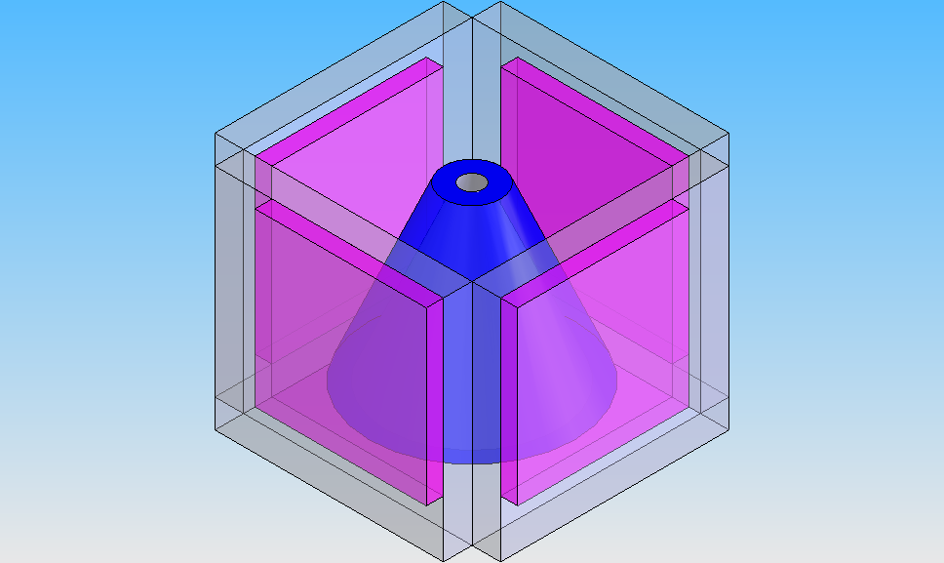
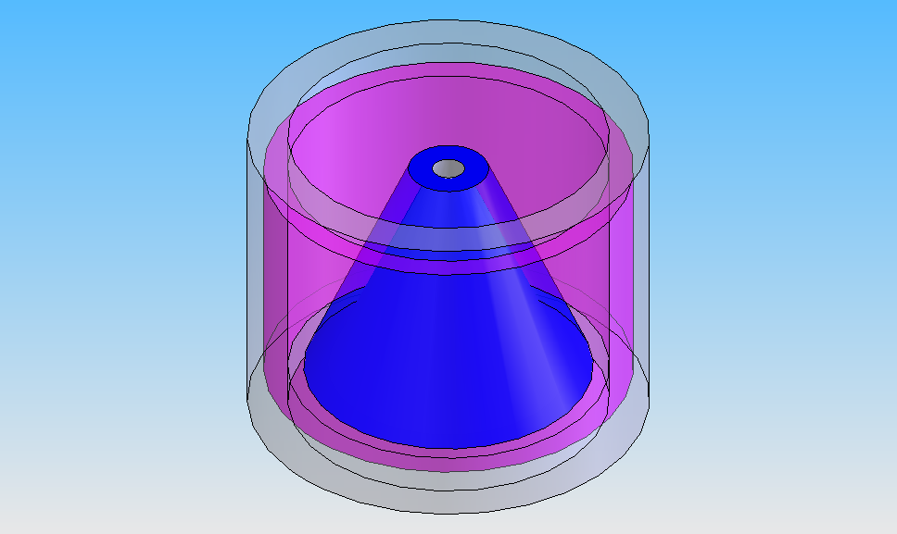
Design Simulations

Slide 17
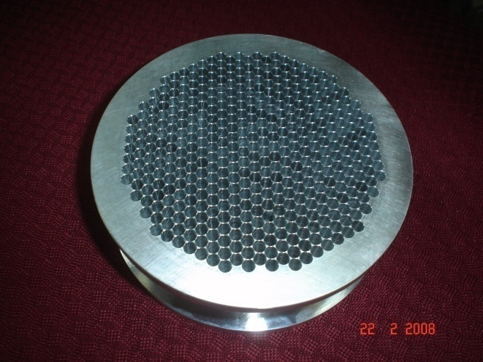
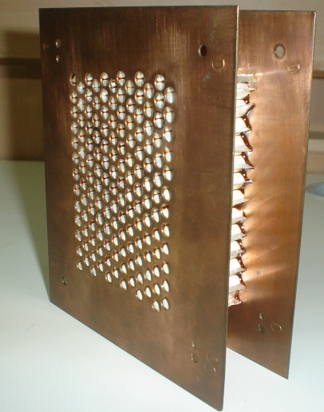
Collimators
Front
Back

Slide 18
Scientific Requirements & Experiment Configuration
Minimum Science goal:
MDP of 2-3% at 5 sigma level for 1 million sec exposure
of a 50 mCrab source.
Potential Sources :50
MDP (nσ) = (n / μ S) ×(2(S+B)/T) ^{1/2}

Slide 19
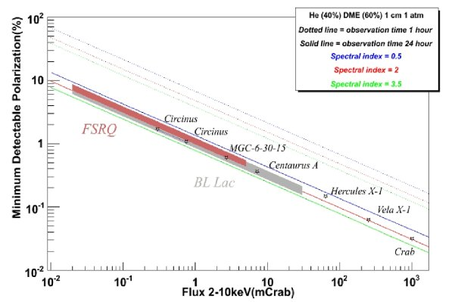
Sensitivity
MDP(nσ) =(n/μS) ×(2(S+B)/T) ^{1/2}
GEMS

Slide 20
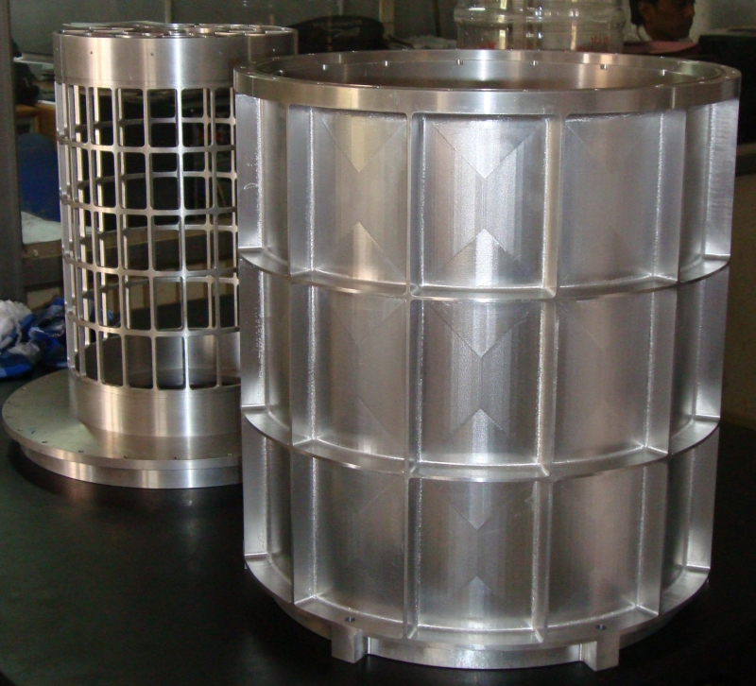
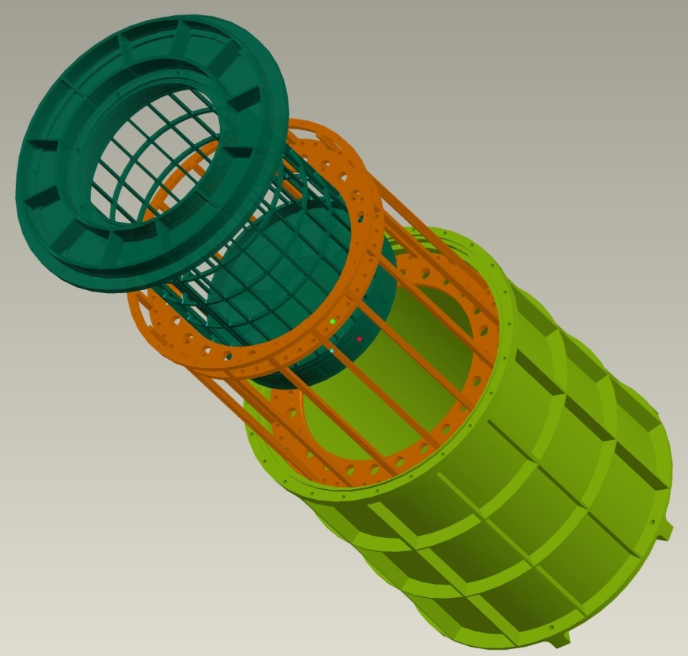
Cylindrical detector
An alternative approach
No dead area at corners
Uniform gain and quantum efficiency in all directions
Less systematic uncertainties

Slide 21
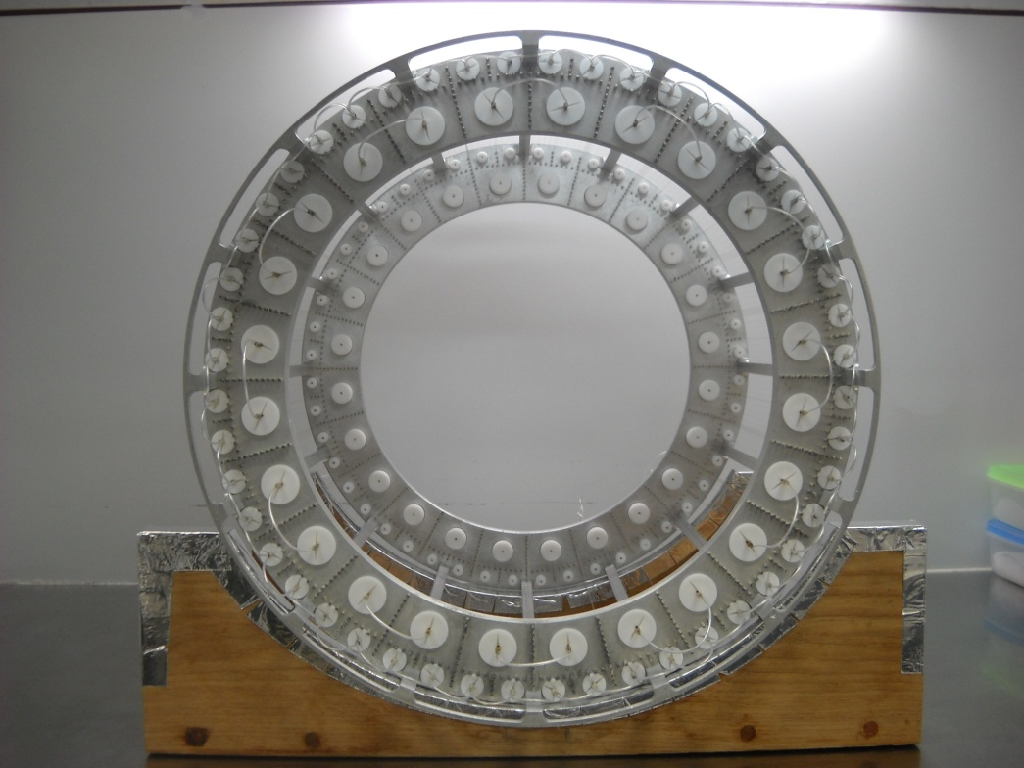
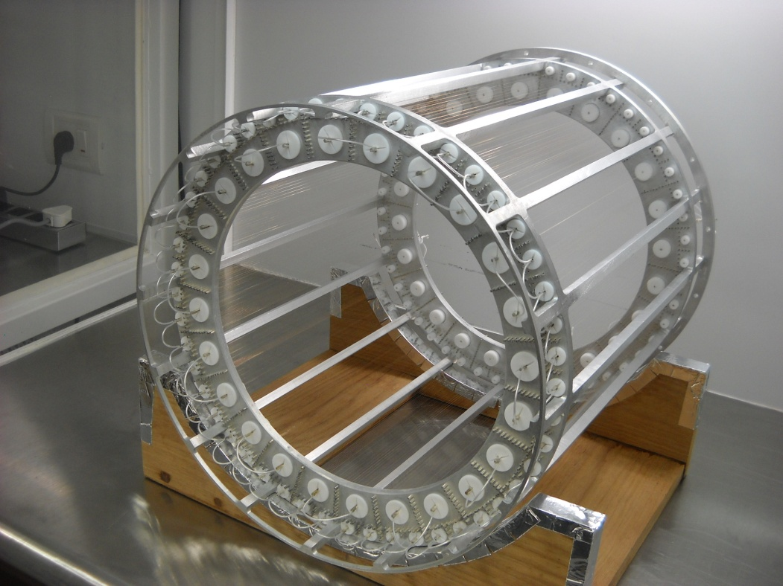
Cylindrical detector
The completed wire-frame
Total no of wires =24 anodes+48 anti anodes+648 cathodes = 720

Slide 22
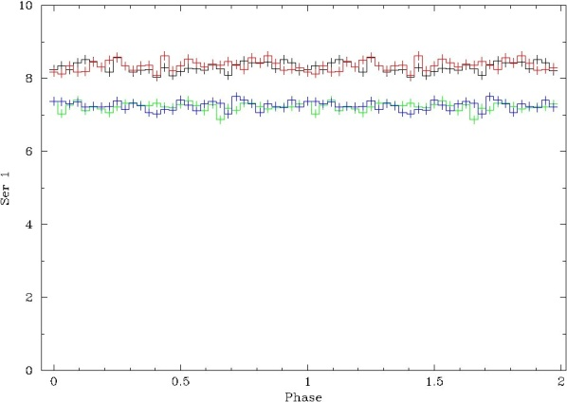
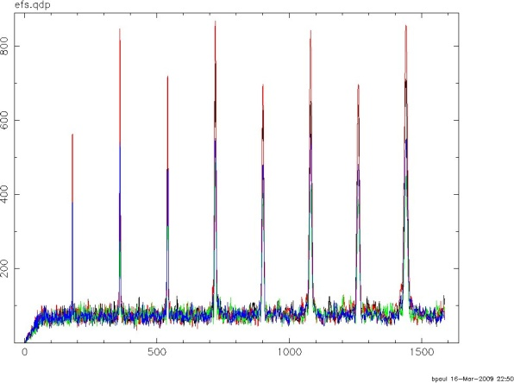
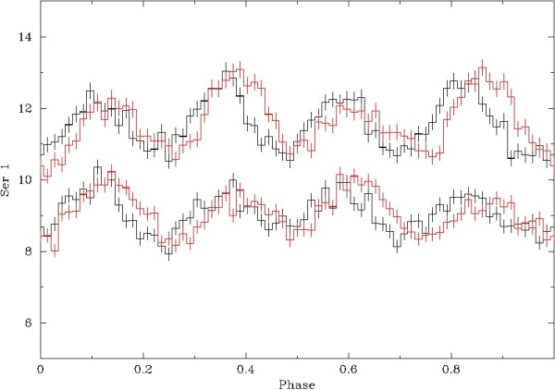
Development Status
A Thomson X-ray polarimeter has been designed, developed and successfully tested at RRI.
These have been made:
Detectors
Front end electronics
Processing electronics
Collimators with flat top response
Test and calibration setup
Rotational stage
Results
Power spectrum
Unpolarised source
Polarised source

Slide 23
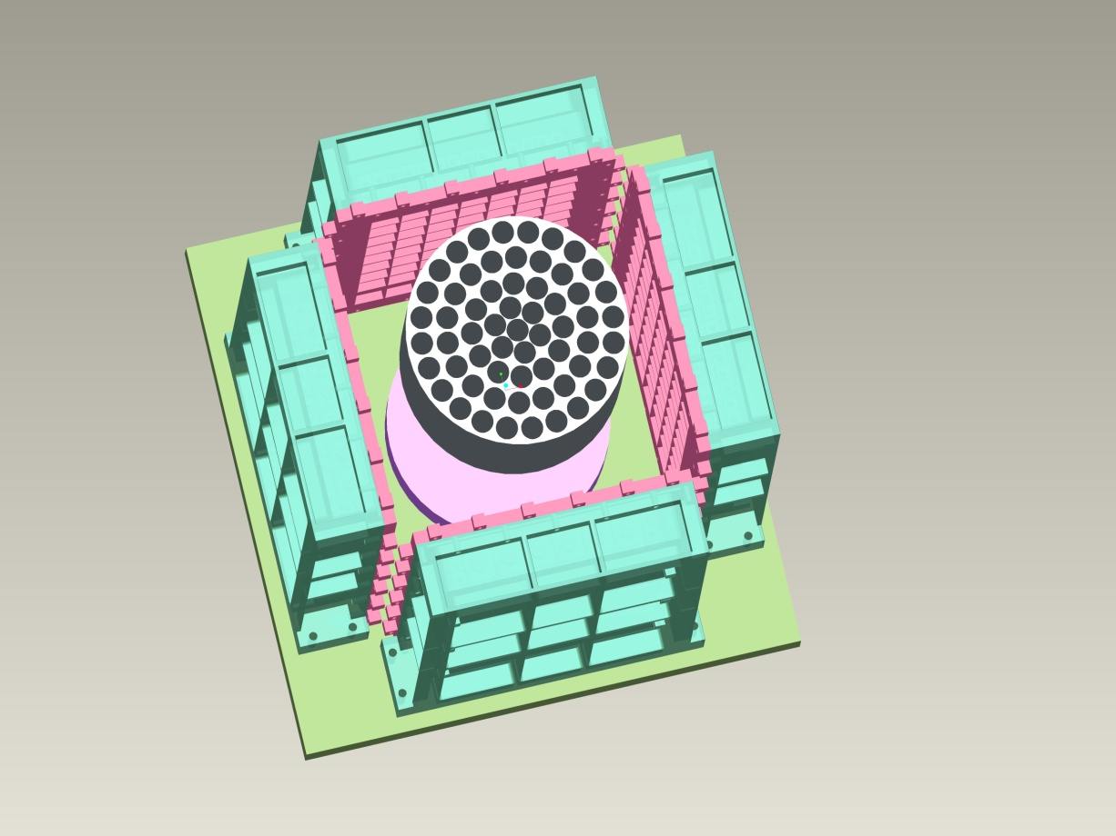
Thomson X-ray Polarimeter
Proposal submitted to ISRO
Key features of the polarimeter
Minimum detectable Polarisation of 2%
at 5 sigma level for a 50 mCrab source
No of sources: 50
Weight: 110 kg
Data rate: 300 Mb per orbit
Spacecraft requirements
Spinning platform/satellite, 0.5-5 rpm
Very long exposures required, one week to one month
Pointing accuracy required: 0.1 degree
Equatorial orbit, less than 10 degree
Altitude: 500—600 km
Collimator
Scatterer
Detectors

Slide 24
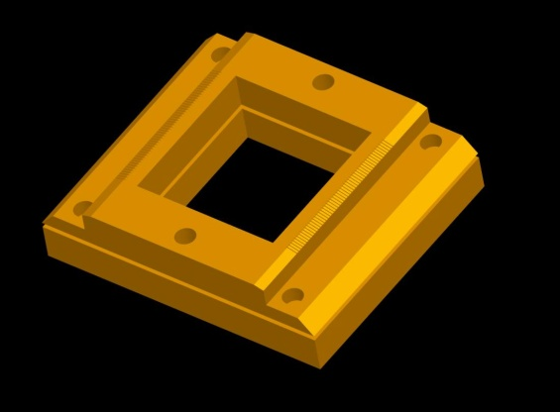
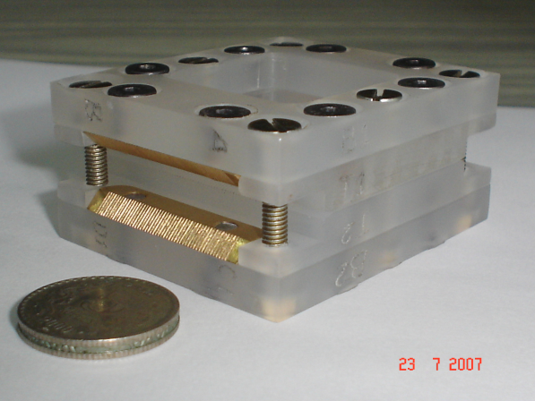
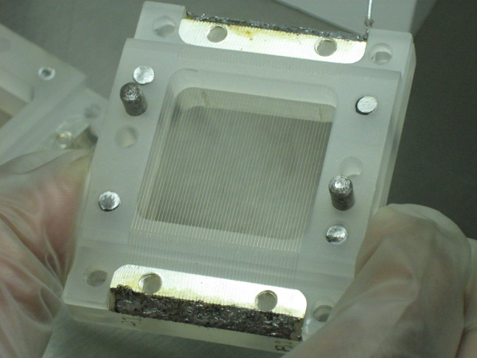
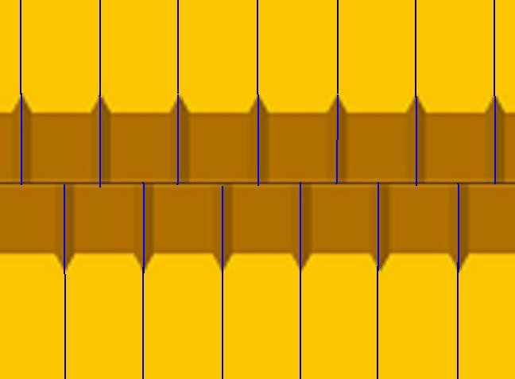
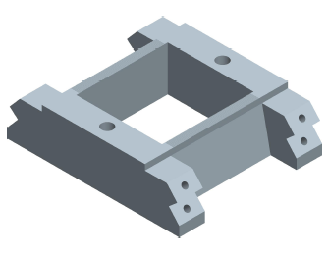
New Development/Technique
Photoelectron polarimeter with proportional counters
50mm
50.3mm
0.6mm
0.15mm
Initial two piece design
Anode wire
AN1
AN2
The new design

