Slide 1
X-ray Instruments for MiniSatellites
High Resolution Spectroscopic Survey
  Missing Baryons: Warm Hot Intergalactic Material(WHIM)
Wide Field Monitoring
  All Sky Monitoring with Large Duty Cycle
X-ray Polarimetry
  Unexplored

Slide 2
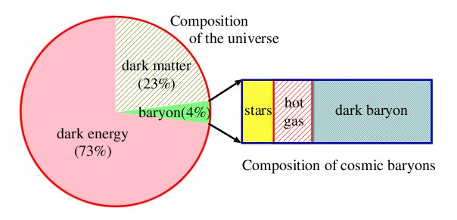
High Resolution Spectroscopic Survey
(Dark Universe)
30-50% as warm hot intergalactic medium (WHIM) 10⁵-10⁷ K
OVII-OVIII emission lines → 10-100 over-density regions
Outskirts of rich galaxy clusters (Ohashi et al. Suto et al. )

Slide 3
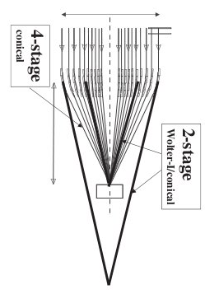
High Resolution Spectroscopic Survey
(Dark Universe)
Instrument: Large FOV
Four Stage XRT
Small Focal Length
High Reflectivity
Low Effective Background
2ev Energy Resolution

Slide 4
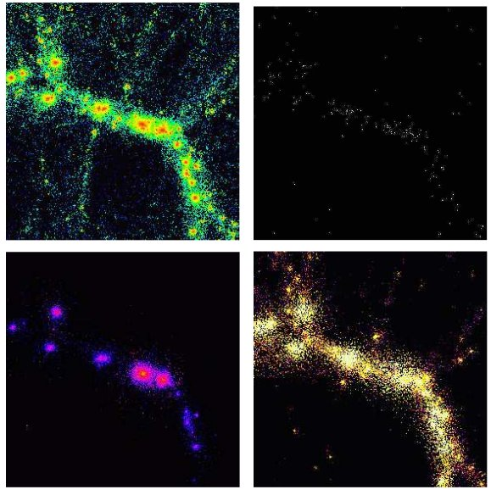

Slide 5
Search for Dark Baryons
Oxygen emission line tomography at different WHIM locations, thermal / enrichment history of the universe
Upto redshift 0.3
Redshift resolution 1/300
Also ISM, Galactic fountain

Slide 6
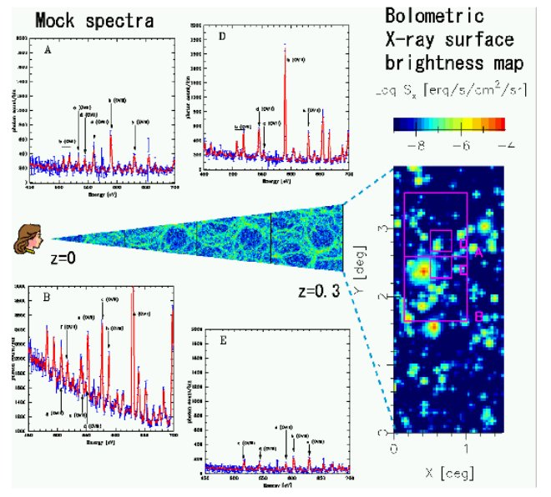

Slide 7
X-ray All Sky Monitor
Discover new transients
Provide context for observations with sensitive instruments
Long term light curves/colours
Transients
MSP (all)
BHC (most)
HMXB Pulsar (more than half)
Magnetars (some)
Normal LMXBs (few)
Sky survey would not find these transients
Though at any time the sky is dominated by persistent sources,
the X-ray catalog is dominated by transient sources

Slide 8
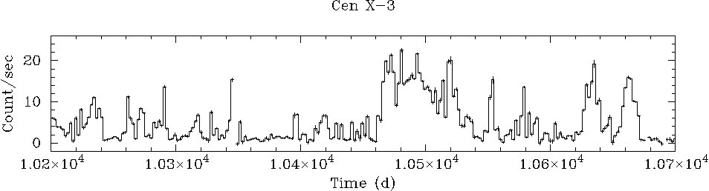
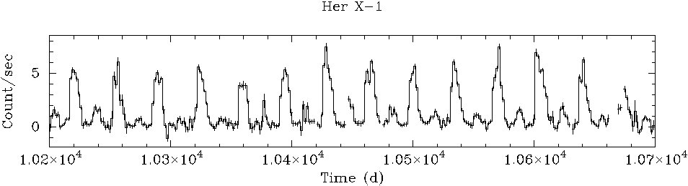
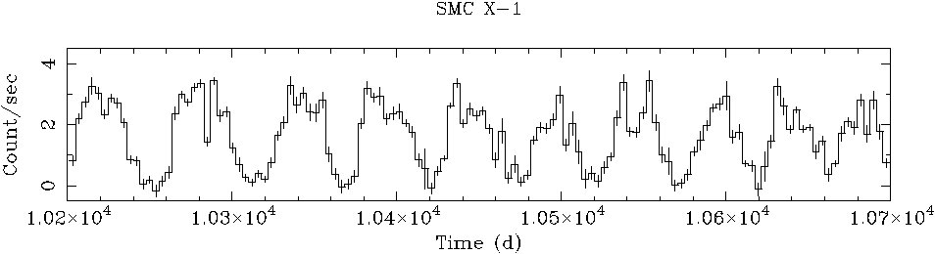
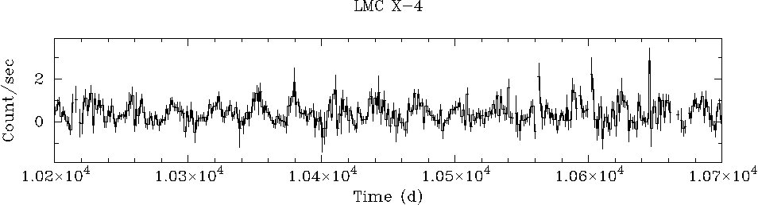
Long term intensity variations in Cen X-3

Slide 9
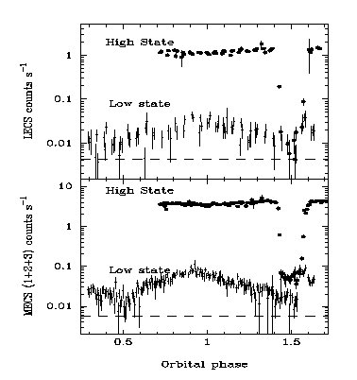
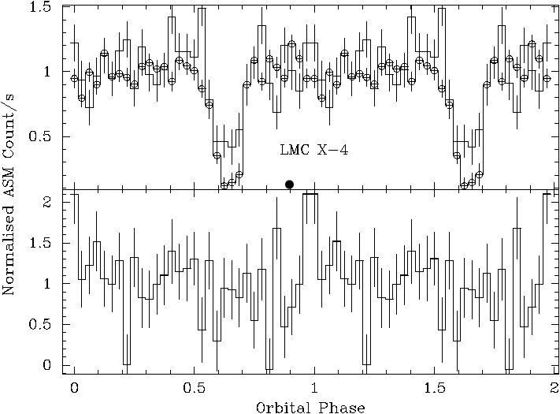
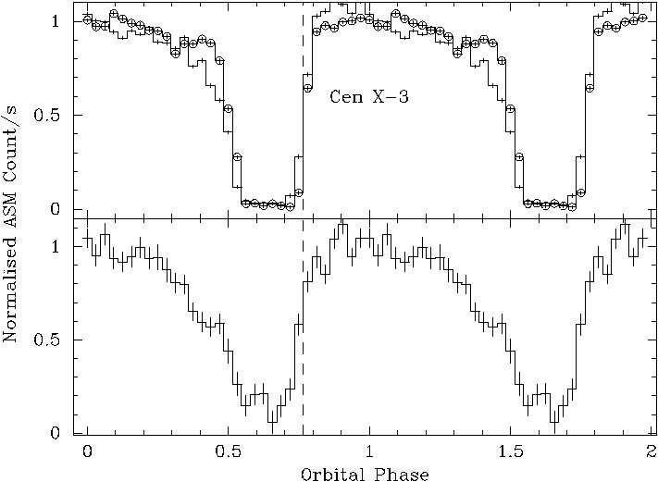
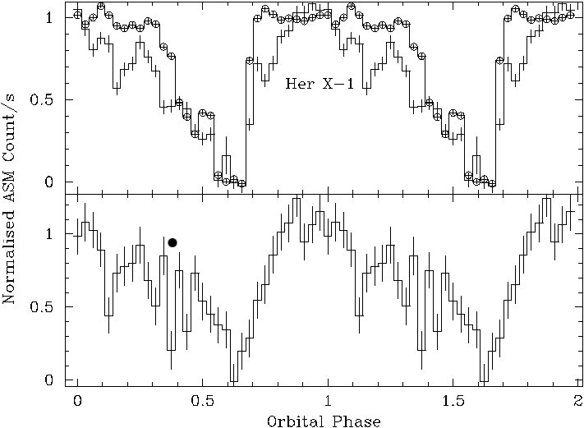
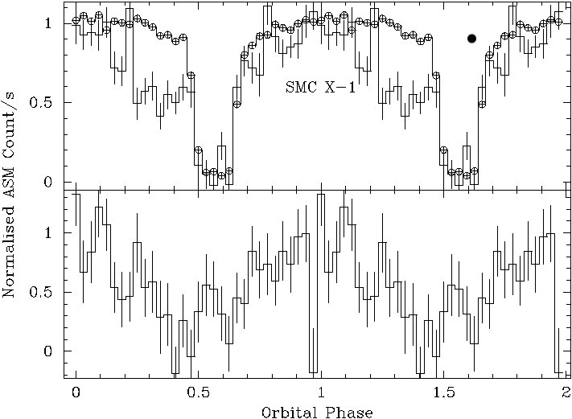
Long term intensity variations and the orbital modulation
Raichur & Paul 2008

Slide 10
X-ray All Sky Monitor
Current instruments: RXTE-ASM, Swift-BAT, INTEGRAL-IBIS, MAXI
  Duty cycle: 1-10%
Future ASM should have large duty cycle
GW + Neutrino +Xray flash from merging compact objects (short GRBs)

Slide 11
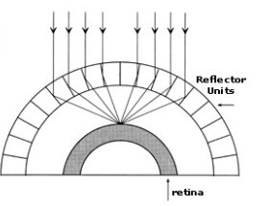
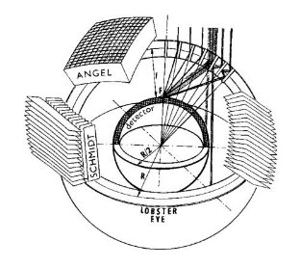
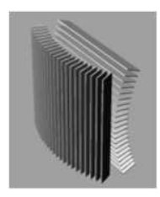
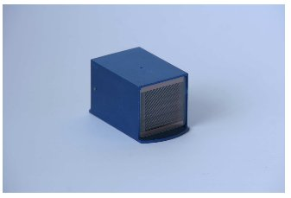
Lobster eye
Double sided reflective flats
MCPs
Large FOV
Hudec et al.

Slide 12
X-ray Polarimeter
Polarisation is unexplored in High Energy Astrophysics
X-ray emission from the following processes should be polarised
Cyclotron
Synchrotron
Non-Thermal Bremsstrahlung
Scattering from non-spherical plasma
These objects should produce polarised X-ray radiation
Accretion powered pulsars
Rotation powered pulsars
Magnetars
Pulsar wind nebulae
Non-thermal supernova remnants
Black holes, micro-quasars and active galactic nuclei
Measurement Technique
Anisotropic Thomson Scattering
Crab nebula is the only source for
which X-ray polarisation measurement
exists. This was made in 1976 !!
Approved mission: GEMS

Slide 13
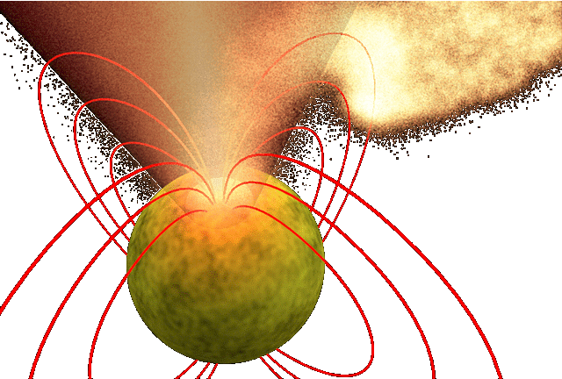
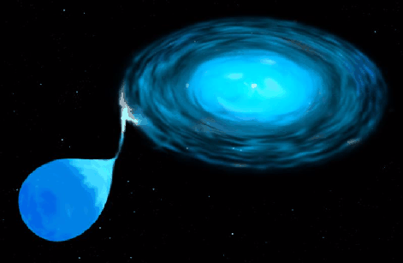
Accreting X-ray Pulsars

Slide 14
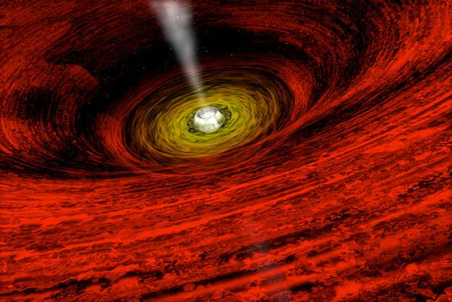
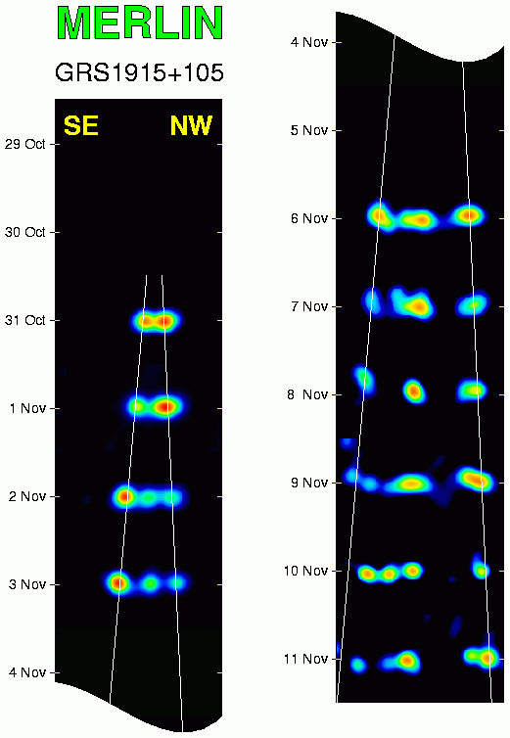
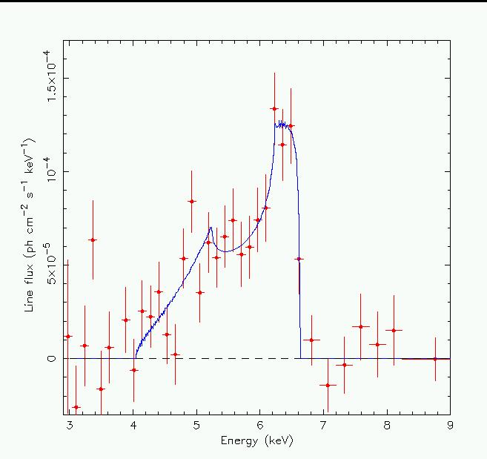
Jets & Motion in Accretion Disk
around Black Holes

Slide 15
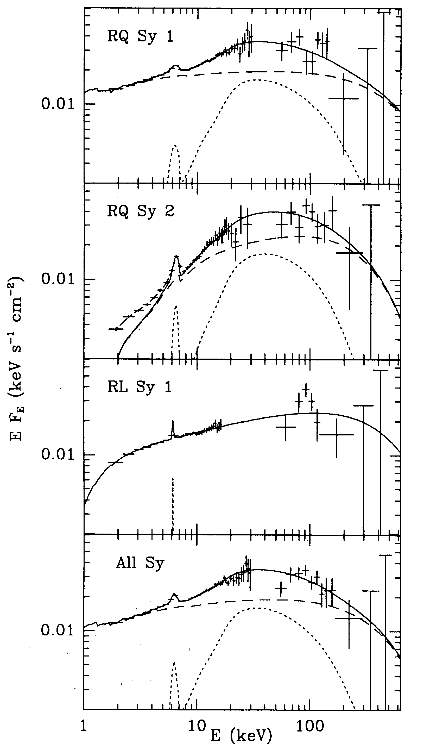
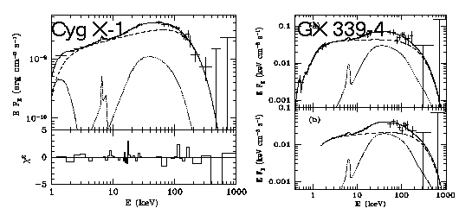
X-ray Reflection from BH Accretion Disk

Slide 16
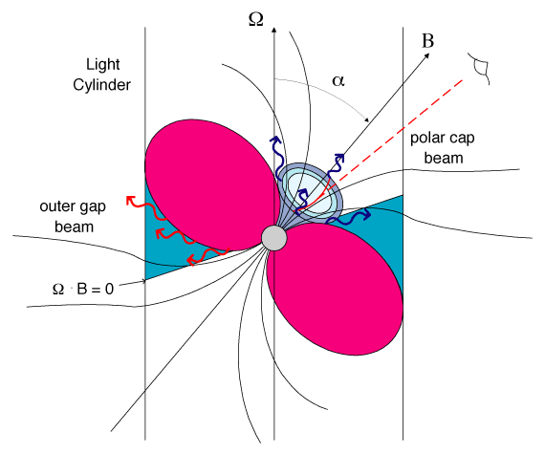
Rotation Powered Pulsars & Magnetars

Slide 17
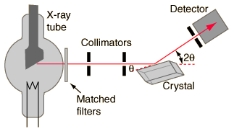
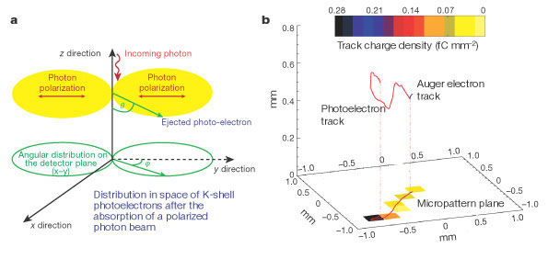
X-ray Polarisation Measurement Techniques
Bragg Reflection
Thompson Scattering
Photoelectron imaging

Slide 18
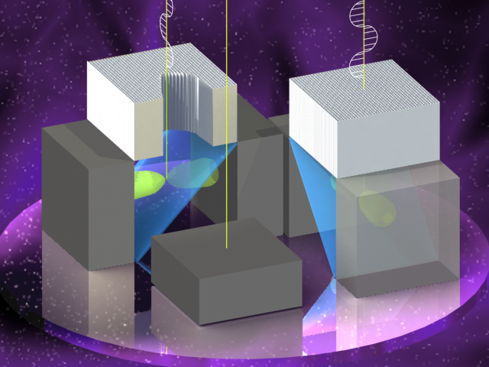
A Thomson X-ray Polarimeter
Photoelectron/Bragg: < 10 keV
Compton :> 30 KeV
Thomson: 5-30 keV
B. Paul (RRI)
S. Vadawale (PRL)
S. Seetha, P. Sreekumar (ISAC)
D. Bhattacharya (IUCAA)
R. Cowsik (St. Luis, U. Washington)
P. V. Rishin (RRI)

Slide 19
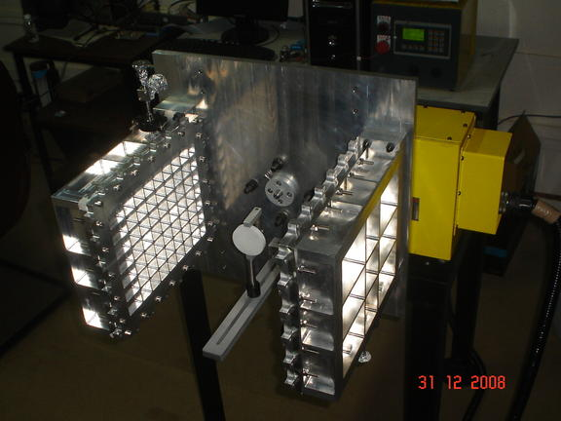
Test Setup

Slide 20
Polarised X-ray Source
Log (N)
Energy (keV)

Slide 21
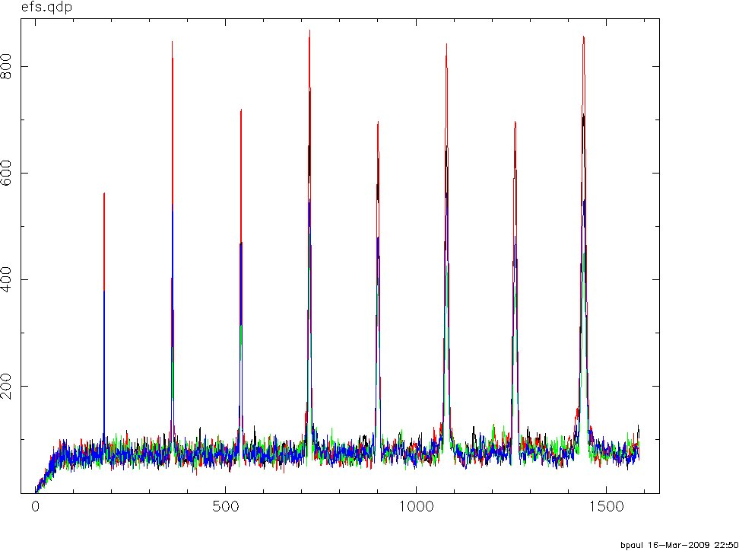
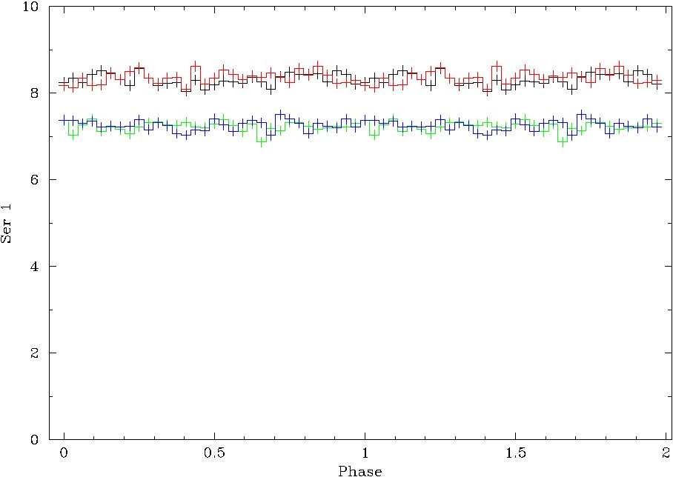
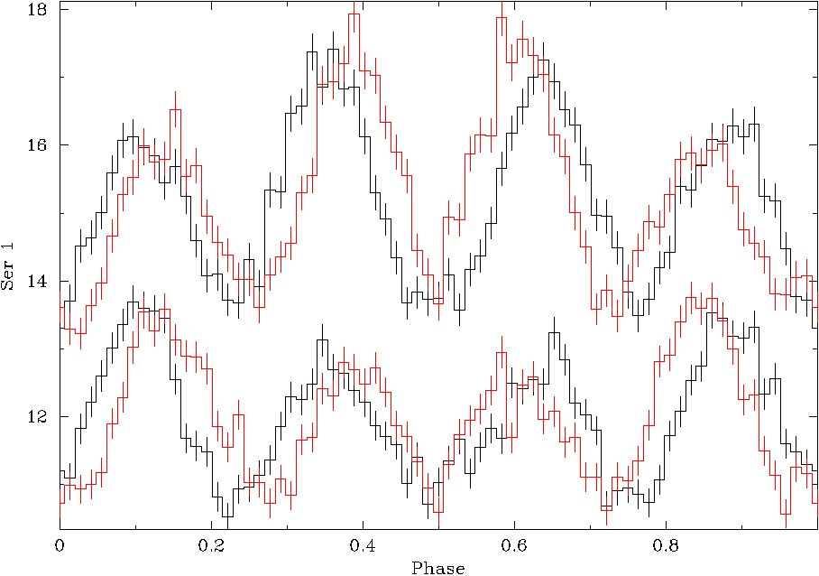
Test Results

Slide 22
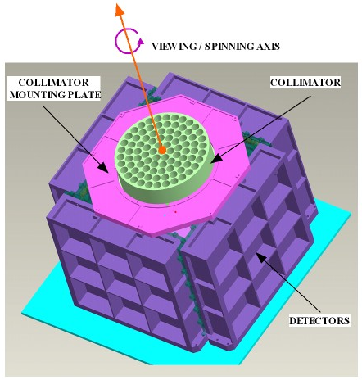

Slide 23
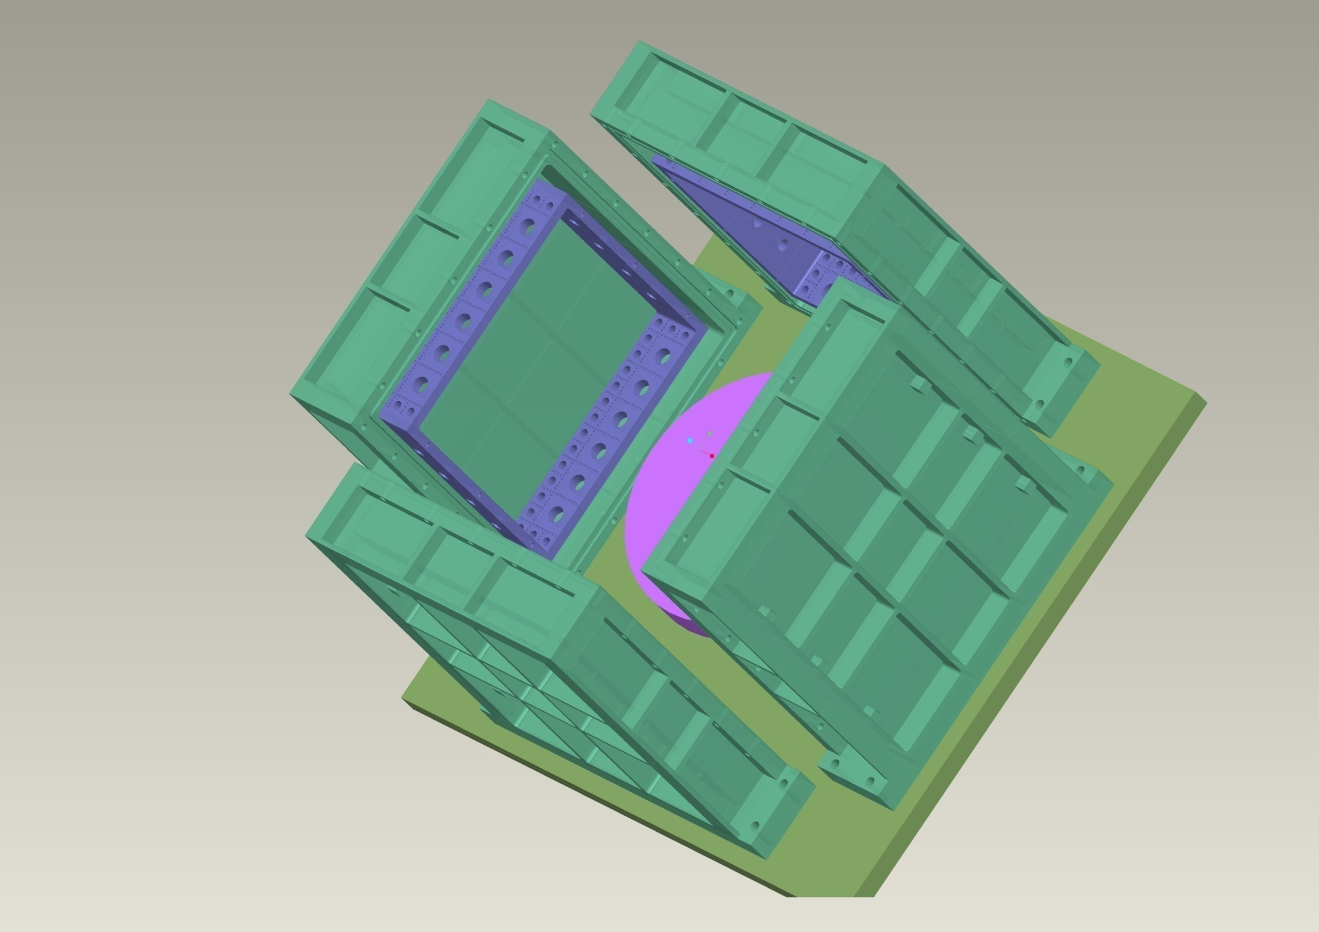
Design

Slide 24
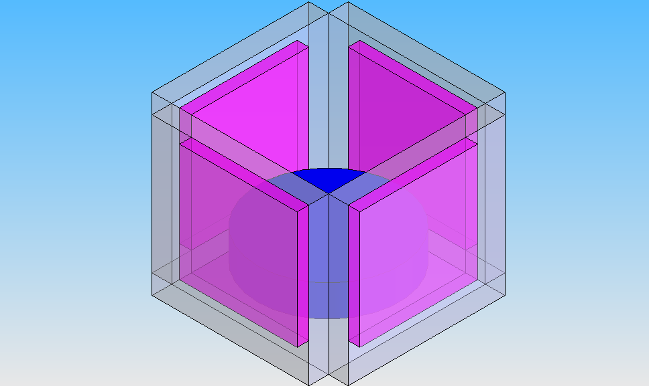
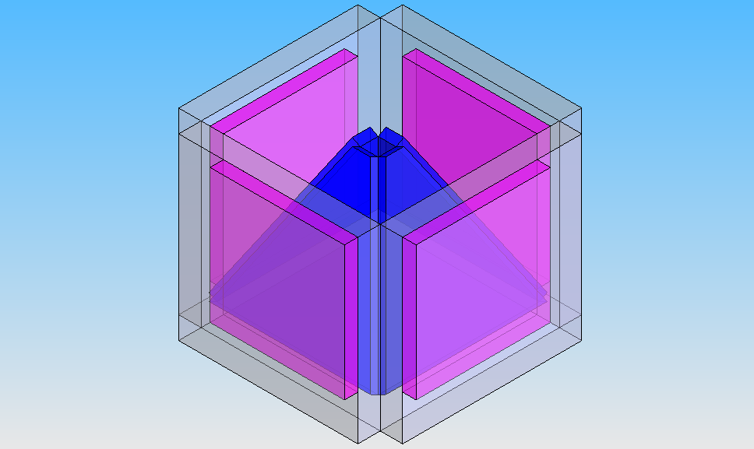
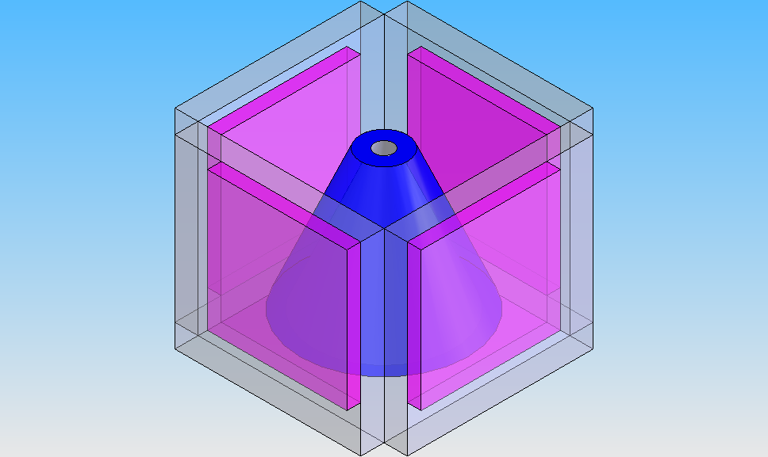
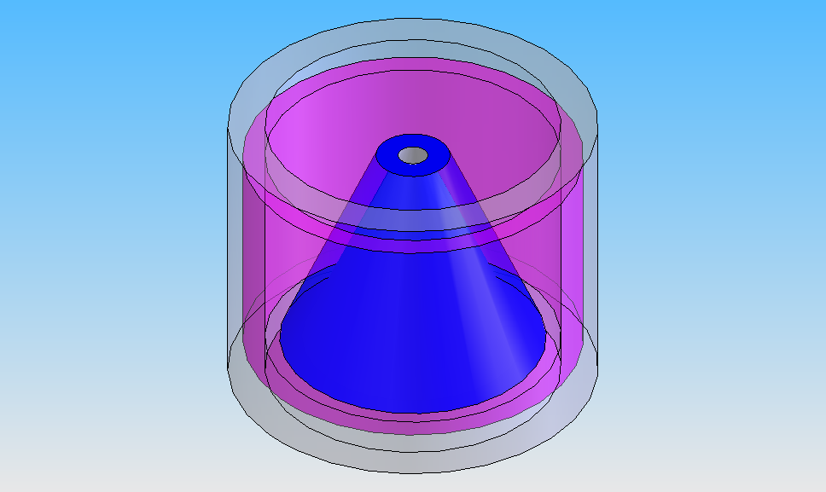
Design Simulations

Slide 25
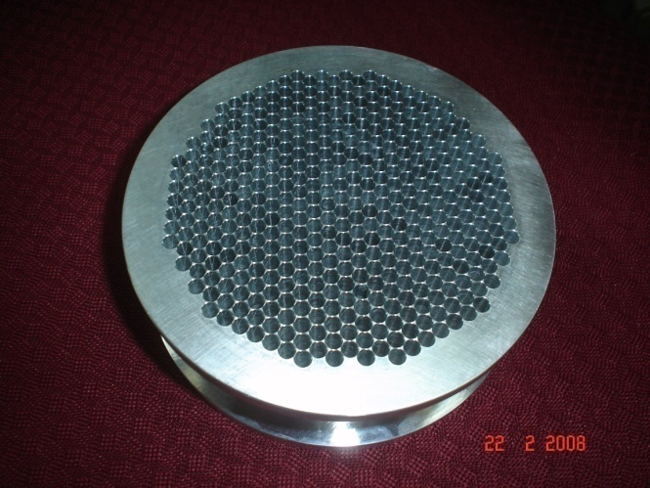
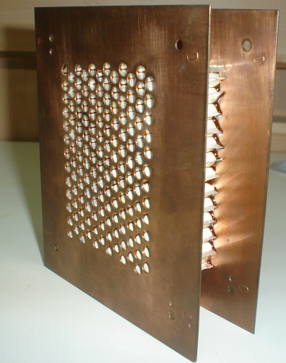
Collimators
Front
Back

Slide 26
Scientific Requirements & Experiment Configuration
Minimum Science goal:
MDP of 2-3% at 5 sigma level for 1 million sec exposure
of a 50 mCrab source.
Potential Sources :50
MDP (nσ) = (n / μ S) ×(2(S+B)/T) ^{1/2}

Slide 27
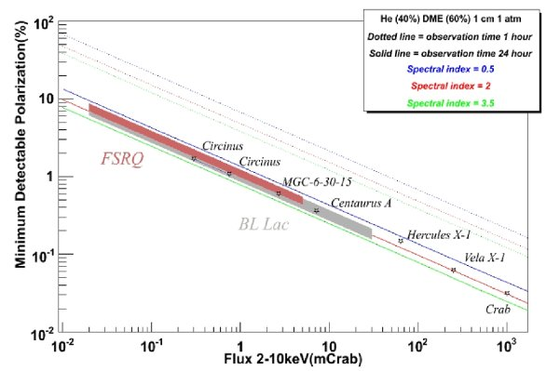
Sensitivity
MDP(nσ) =(n/μS) ×(2(S+B)/T) ^{1/2}
GEMS

Slide 28
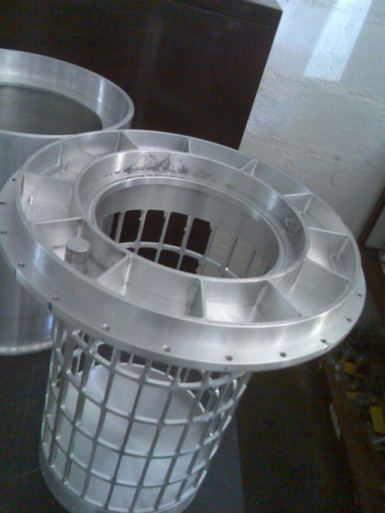
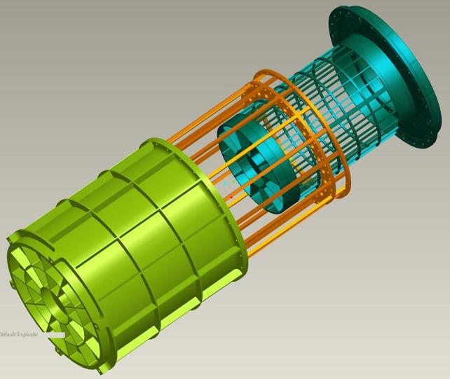
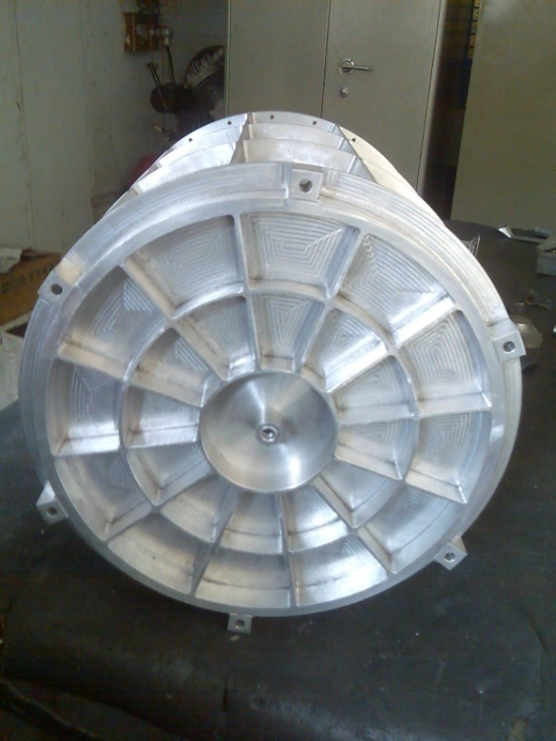
POLIX: Circular Detector

Slide 29
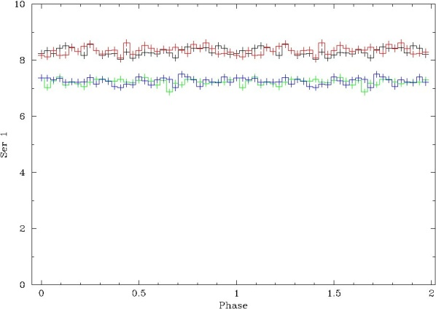
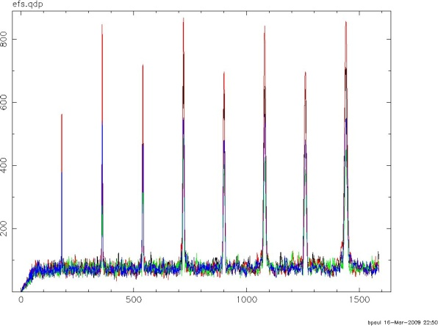
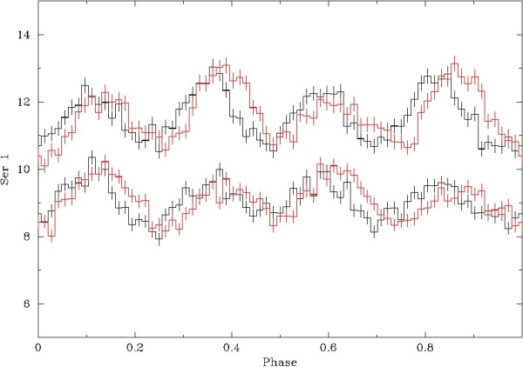
Development Status
A Thomson X-ray polarimeter has been designed, developed and successfully tested at RRI.
These have been made:
Detectors
Front end electronics
Processing electronics
Collimators with flat top response
Test and calibration setup
Rotational stage
Results
Power spectrum
Unpolarised source
Polarised source

Slide 30
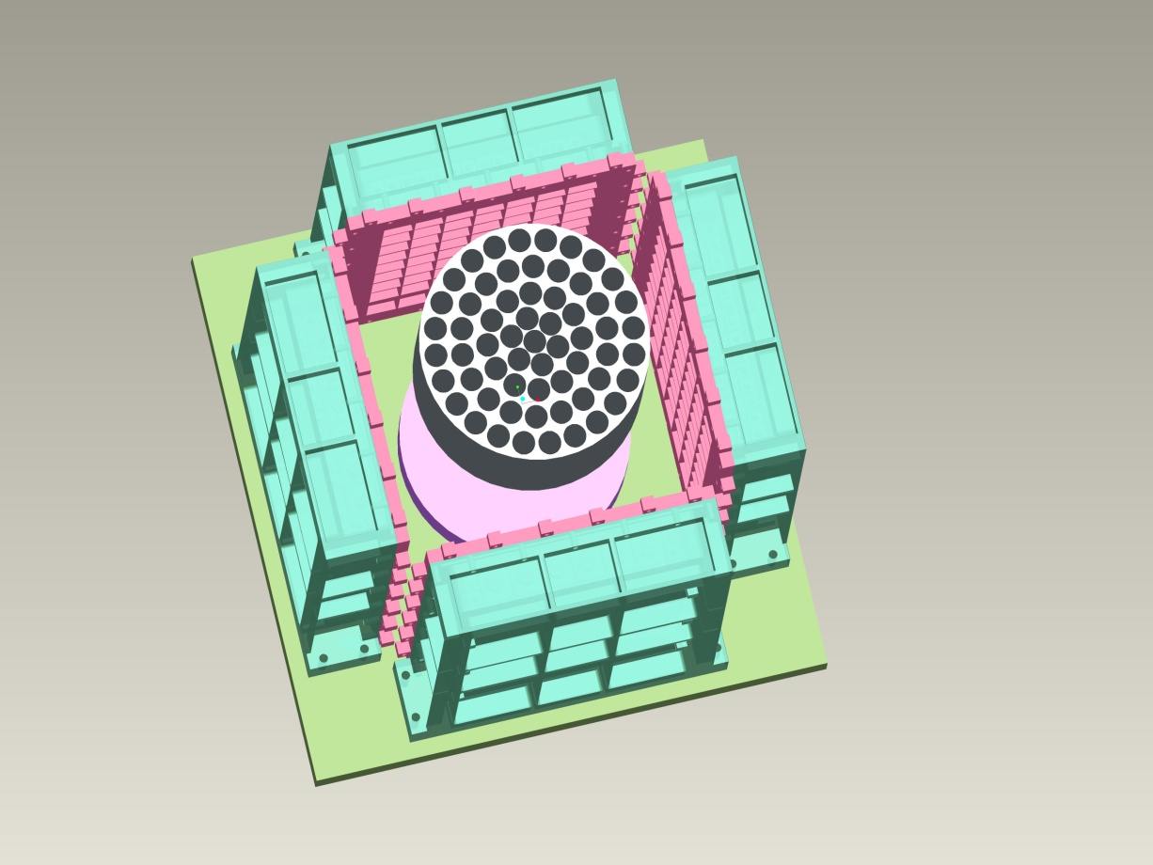
Thomson X-ray Polarimeter
Proposal submitted to ISRO
Key features of the polarimeter
Minimum detectable Polarisation of 2%
at 5 sigma level for a 50 mCrab source
No of sources: 50
Weight: 110 kg
Data rate: 300 Mb per orbit
Spacecraft requirements
Spinning platform/satellite, 0.5-5 rpm
Very long exposures required, one week to one month
Pointing accuracy required: 0.1 degree
Equatorial orbit, less than 10 degree
Altitude: 500—600 km
Collimator
Scatterer
Detectors

Slide 31
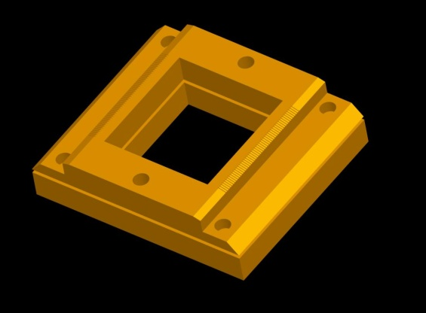
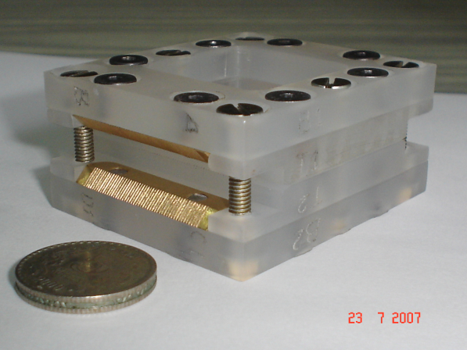



New Development/Technique
Photoelectron polarimeter with proportional counters
50mm
50.3mm
0.6mm
0.15mm
Initial two piece design
Anode wire
AN1
AN2
The new design

