Slide 1
Status Report on Search for Double Degenerates with ZTF
Kevin Burdge
California Institute of Technology

Slide 2
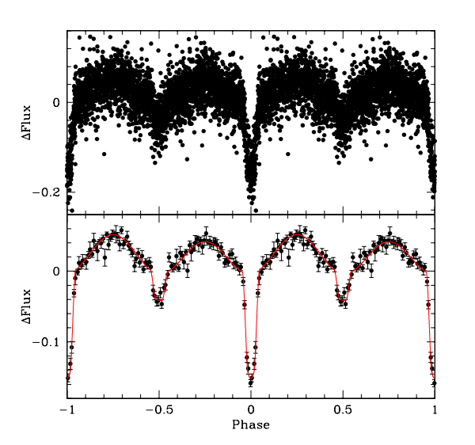
How do we find White Dwarf Binaries
Eclipses
Ellipsoidal modulation
Irradiation of companion
J0651, a 12.75 minute binary (Brown et al. 2011)

Slide 3
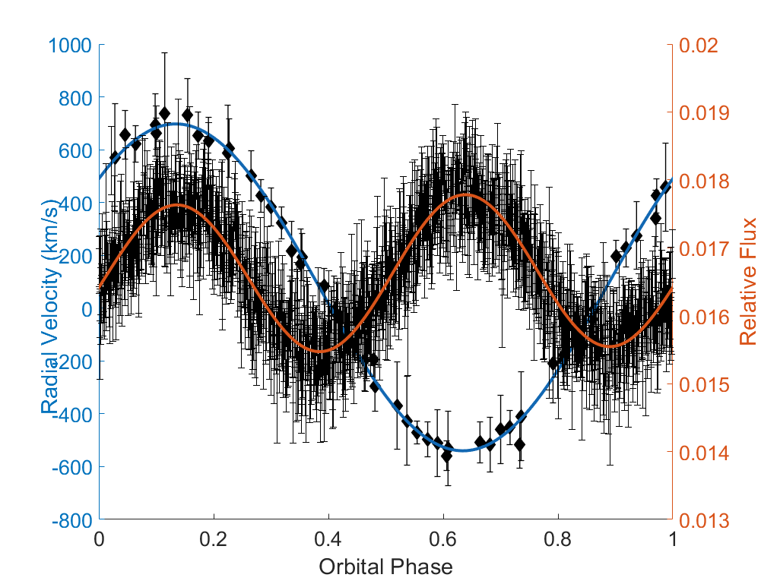
Before ZTF
Discovered one double degenerate in PTF
The system exhibits a 20 minute orbital period, ellipsoidal modulation, Doppler boosting, and significant orbital decay

Slide 4
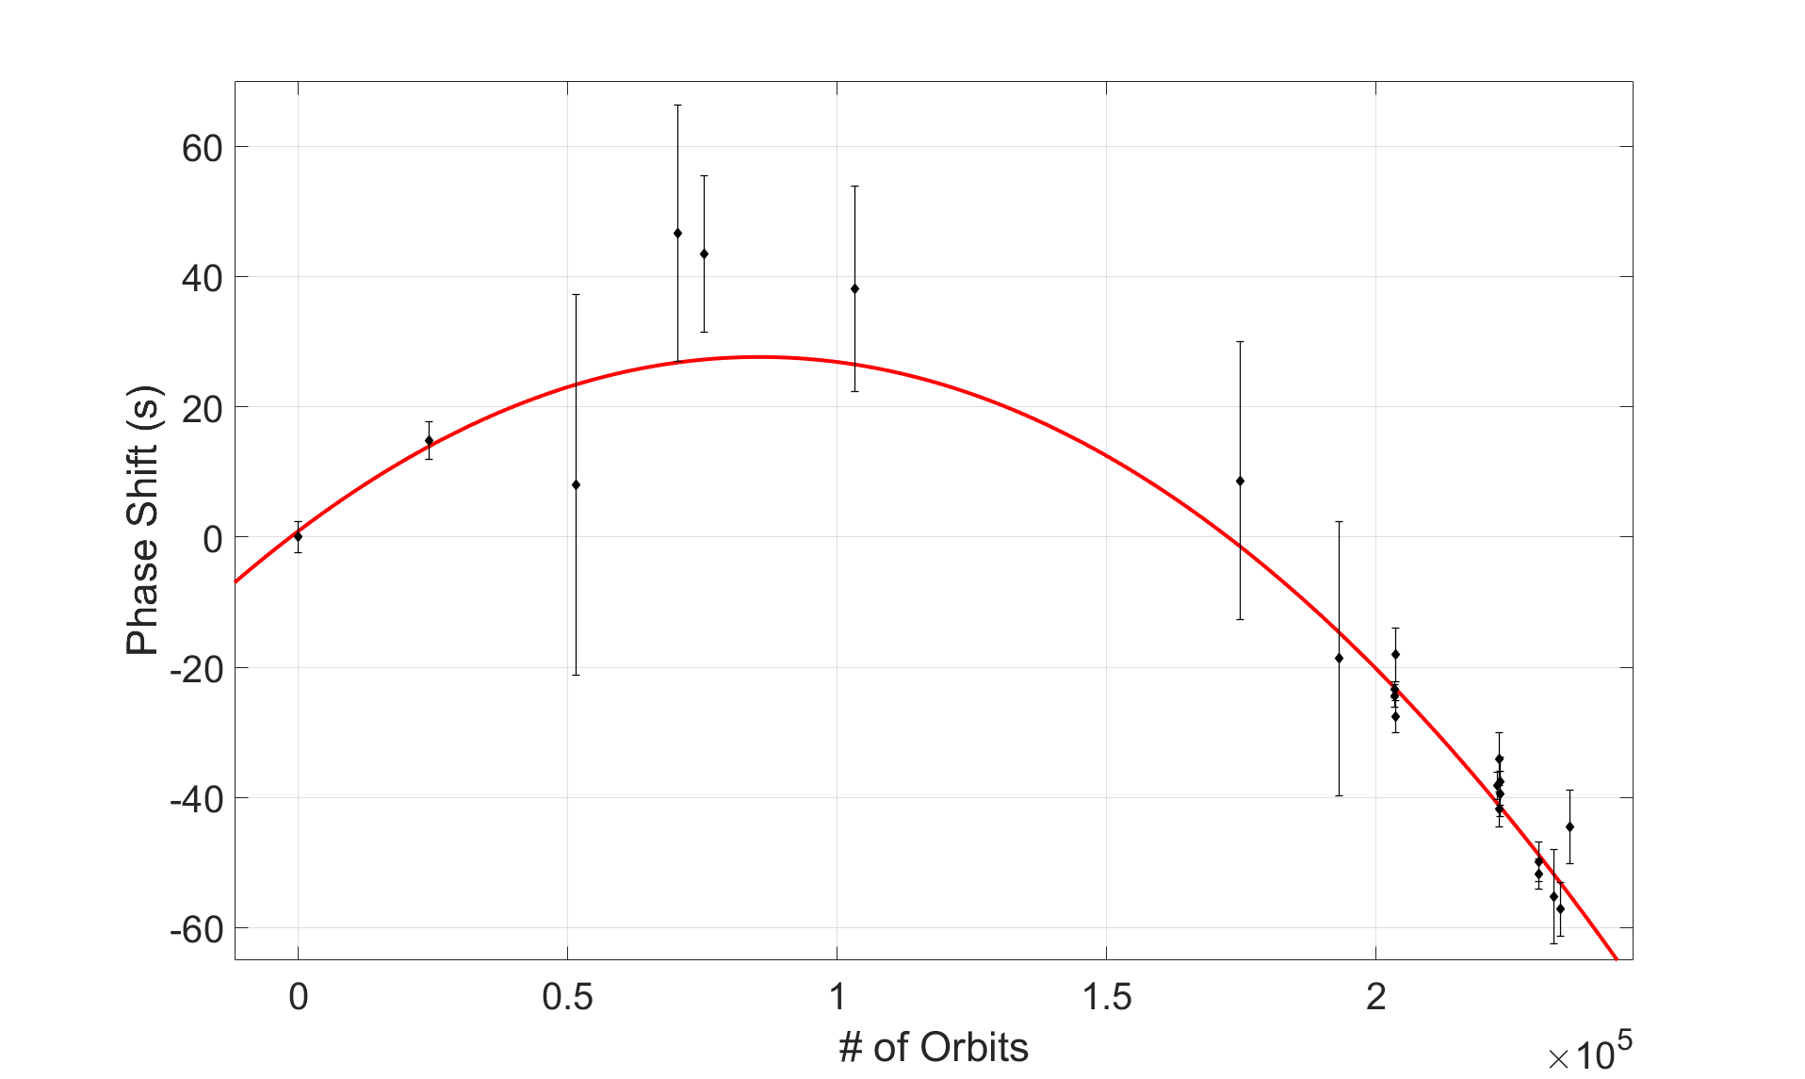
Orbital Decay
After waiting 1.5 years, we have measured, with significance, the orbital decay of this system.
The inferred chirp mass is rather large (~0.4 solar masses), indicating that this is likely a loud LISA source given its parallax measurement.

Slide 5
Technical Challenges and Solutions
Searching for short periods in long baseline data is computationally expensive
Graphics Processing Units (GPUs) can largely outperform CPUs in such searches
For the shortest orbital period systems, we must account for orbital period decay
Nvidia 1080 Ti GPU
(image from Nvidia.com)

Slide 6
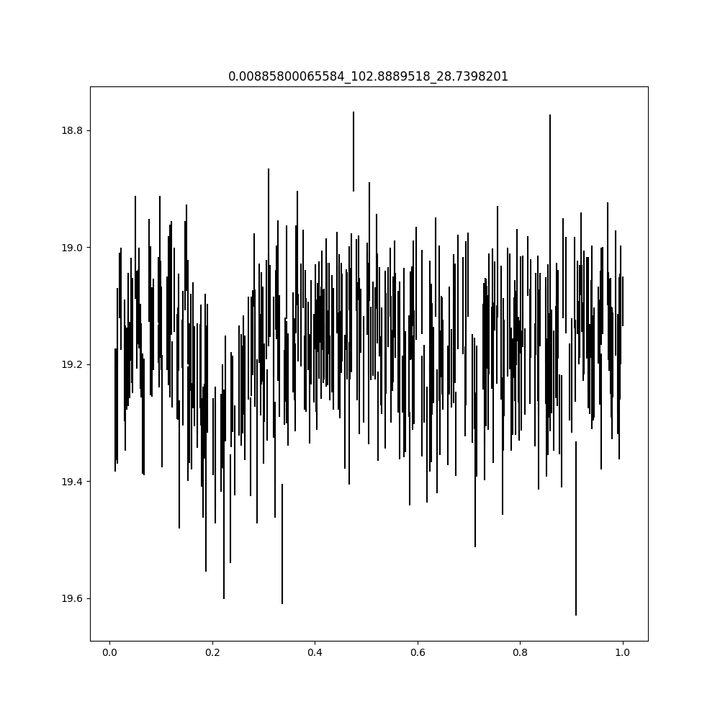
Our Test Run with ZTF
On the right, is a ZTF commissioning lightcurve of J0651, the 12.75 minute binary
The primary eclipse is clearly visible
J0651 in ZTF

Slide 7
ZTF Science Results
There are 6 published eclipsing detached DWDs
So far with ZTF, we have discovered 5 new eclipsing systems (with a possible 6th candidate)
In the remainder of this talk, we will highlight them

Slide 8
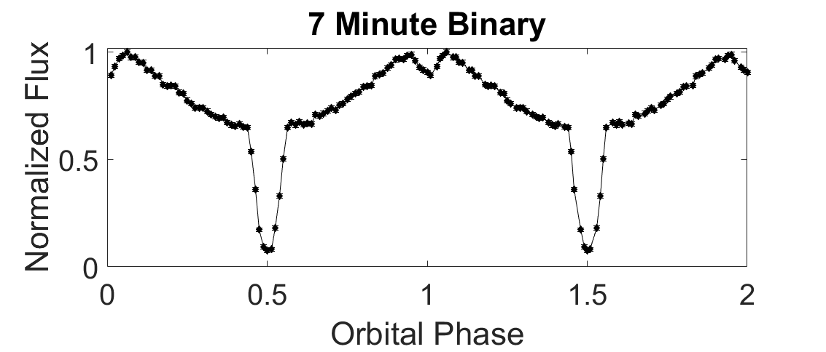
The 7 Minute Binary
Paper submitted
First candidate we found
Exhibits strong reflection effect and eclipses

Slide 9
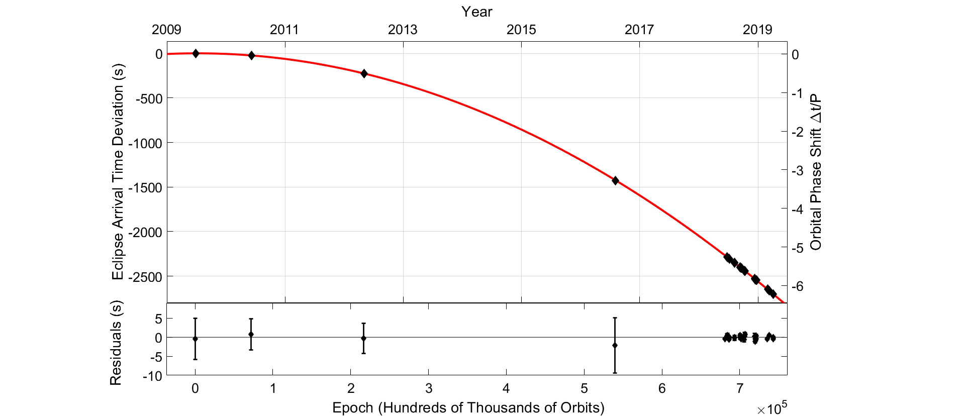
Orbital Decay Measurement on the 7-minute
Using archival PTF data, we managed to make a highly precise measurement of the orbital decay due to GR in this system

Slide 10
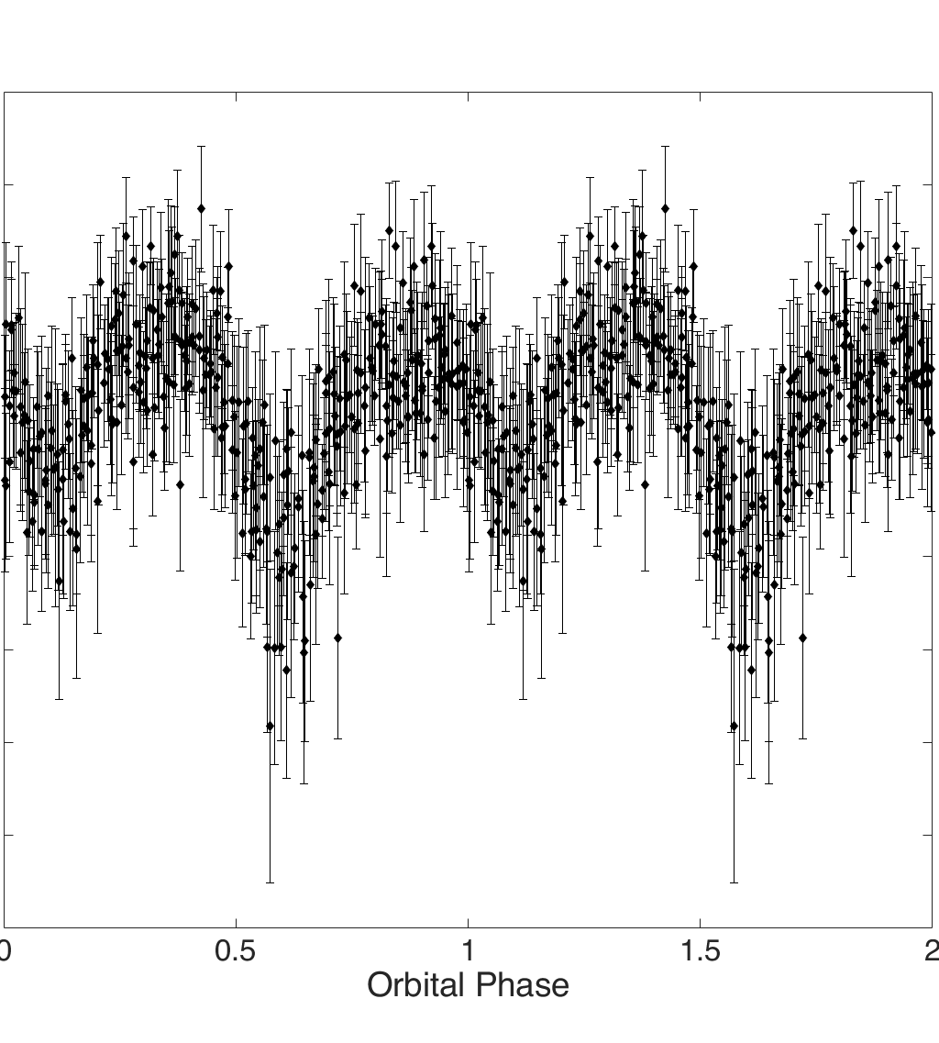
A new candidate at ~8 minutes
Appears likely to be a binary candidate based on position on HR diagram.
More follow up still needed. If real, would be highest SNR LISA source known (has a reasonably good parallax measurement)

Slide 11
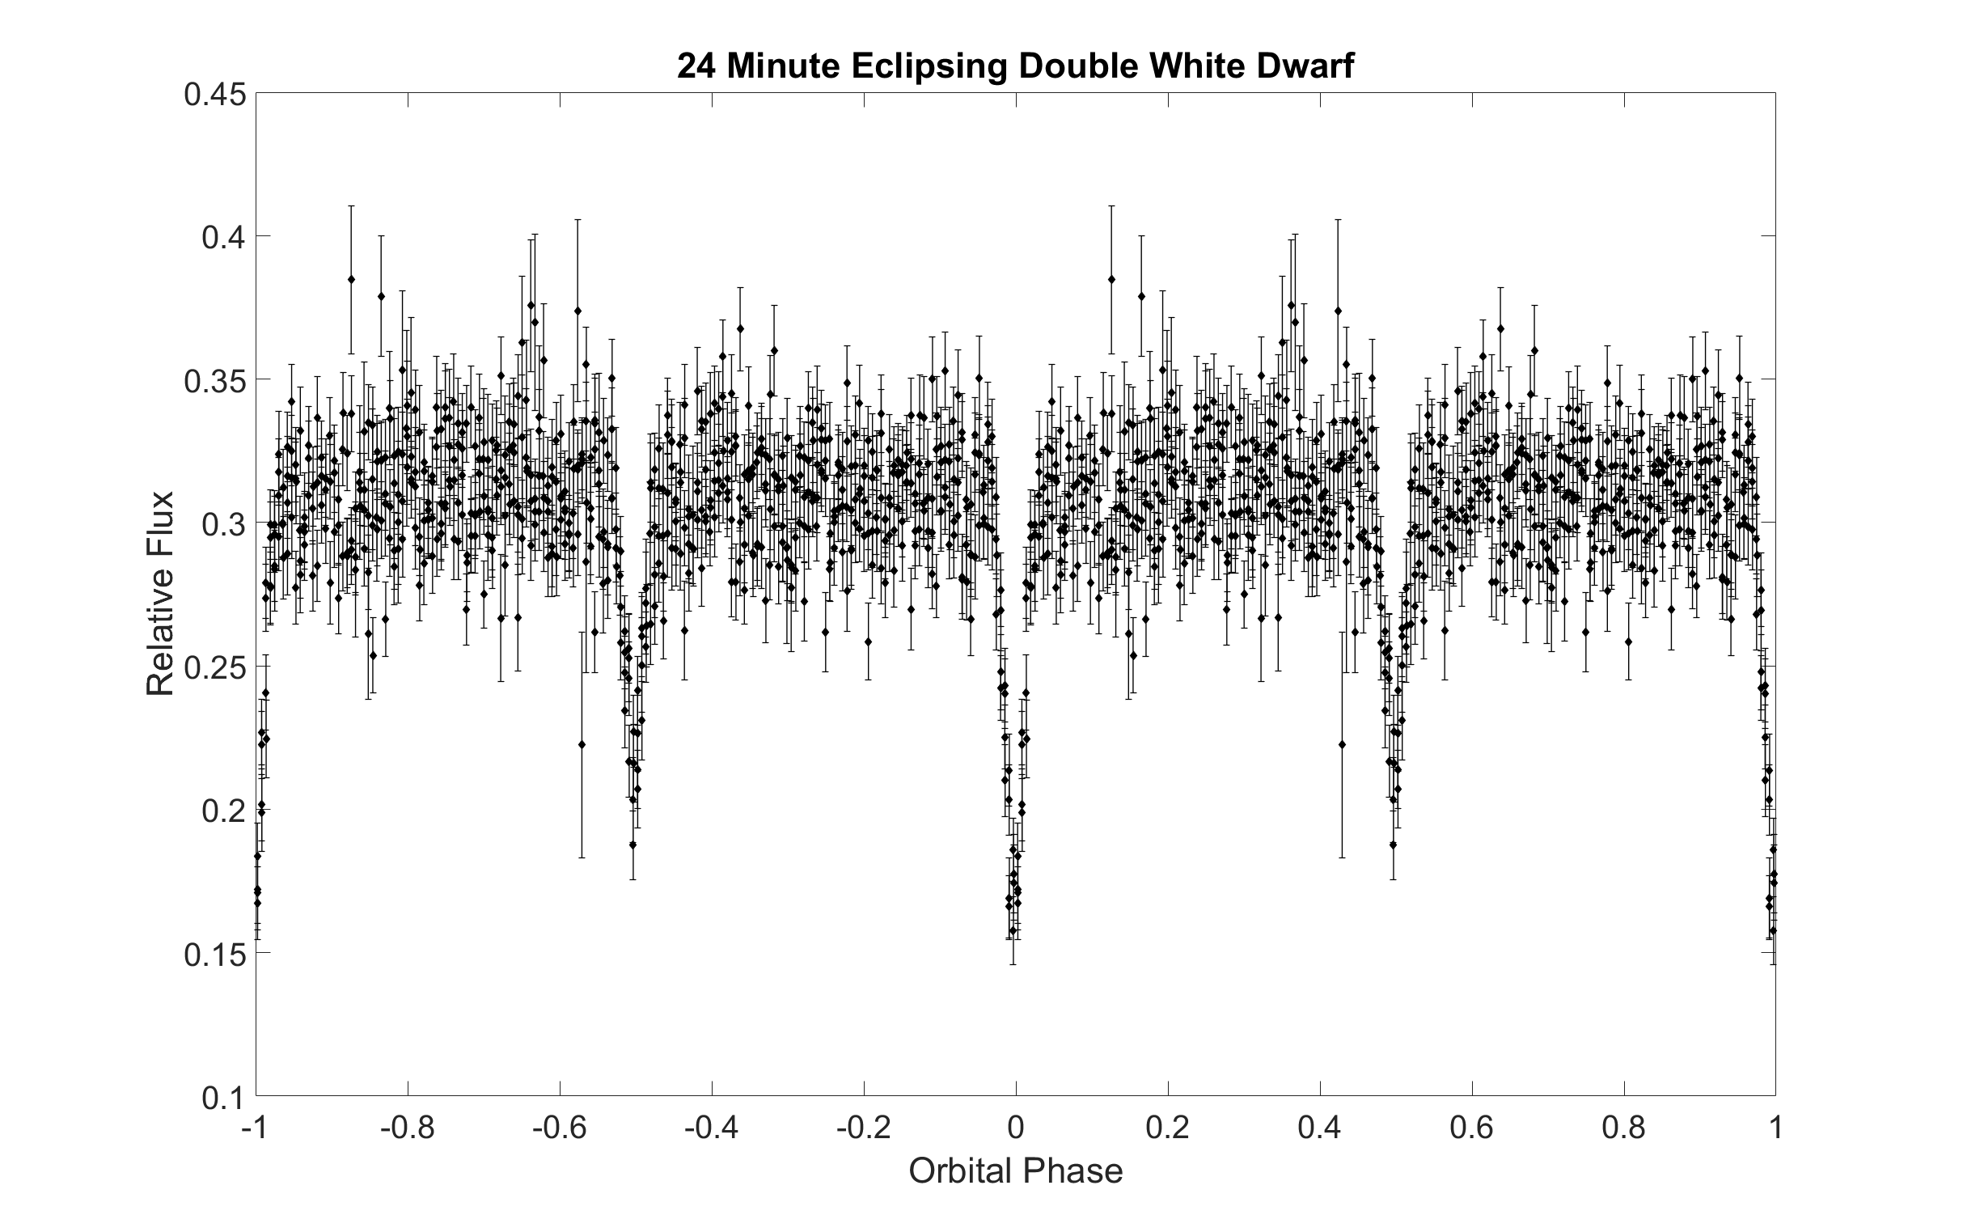
24 Minute Eclipsing System
Eclipses are comparable depth, indicating that the two components contribute comparable luminosity
Appears to be double lines from spectrum, but will be very challenging to fit due to two blended broad absorption lines
Estimated LISA signal quite marginal

Slide 12
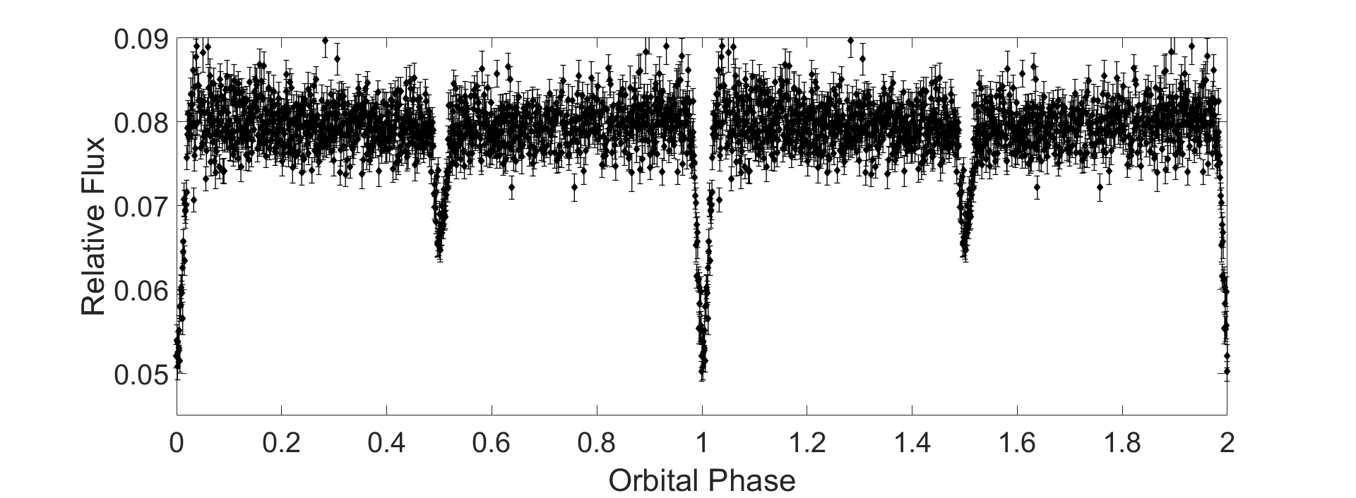
40 Minute Eclipsing System
Again, eclipses appear to be comparable in depth, suggesting comparable luminosity contribution
No spectrum yet.
Likely to have a marginal LISA signal

Slide 13
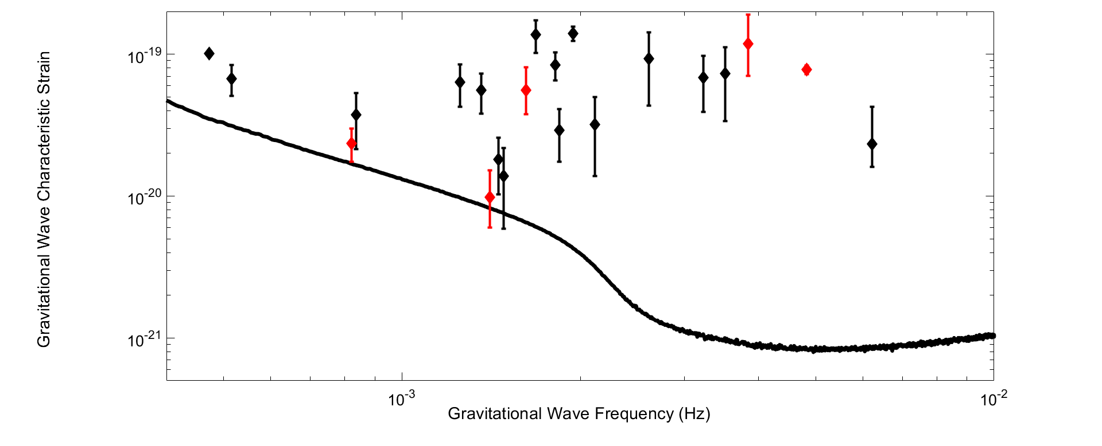
Where do these fall as LISA sources?

Slide 14
The future: SDSS V and Beyond
Spectroscopic follow up of these systems is challenging. The 24 minute for example, because of its double lined nature, does not appear to have significant Doppler shifts, but rather seems to change in log(g) and Teff as the Balmer lines “widen” and “narrow”. This could perhaps be used to target such systems.
Systems like the 20 minute binary, which are single lined, exhibit enormous radial velocity variations (620 km/s semi-amplitude in the case of this example). Even for low resolution surveys, this should be easy to resolve. However, exposures must be short.

