Slide 1
Light Curves and Data Products from the Transiting Exoplanet
Survey Satellite (TESS)
Ryan J. Oelkers
Vanderbilt University | Rice University
Carnegie Observatories 2019
Stellar/AGN Photometric Astronomy in the Era of SDSS-V

Slide 2
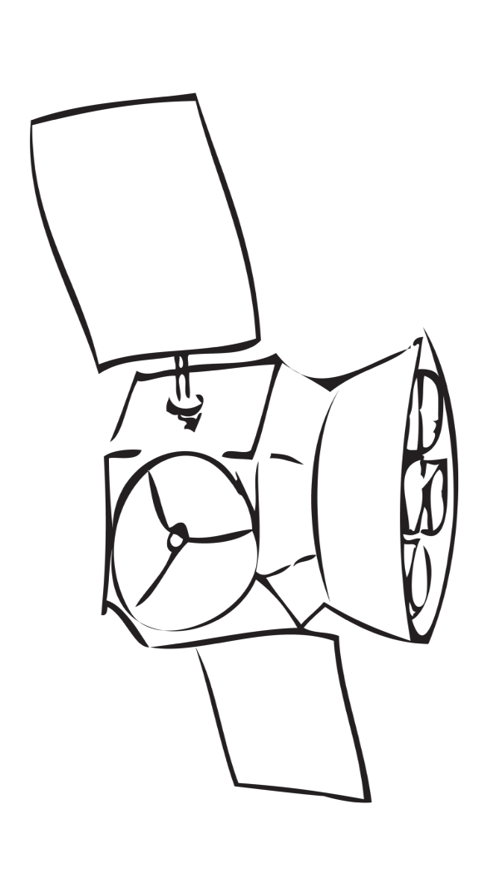
The Transiting Exoplanet
Survey Satellite (TESS)
TESS is an all-sky, wide-field survey of solar-type and cooler stars for Earth and Neptune-sized planets.
The survey expects to find ~2000 candidates
(300 Earth-sized objects) using the transit method.
There are 4 cameras, each with 4 CCDs, for a combined field-of-view of 24° x 96° per pointing.
100 mm effective pupil
16.7 megapixel cameras
600-1000 nm bandpass
Ricker et al. 2014, Sullivan et al. 2015

Slide 3
The Transiting Exoplanet
Survey Satellite (TESS)
200,000-400,000 stars will be observed every 2 minutes, and nearly 420 million stars will be observed every 30 minutes.
The stars observed every 30 mins will not have light curves provided by the mission, instead NASA will provide full-frame-images.
There is no proprietary period on the data, and most data products will be available ~4-6 months after downlink. First release was in December, as of early April, 7 Sectors have been released.
Ricker et al. 2014; Sullivan et al. 2015; Stassun et al. 2018

Slide 4
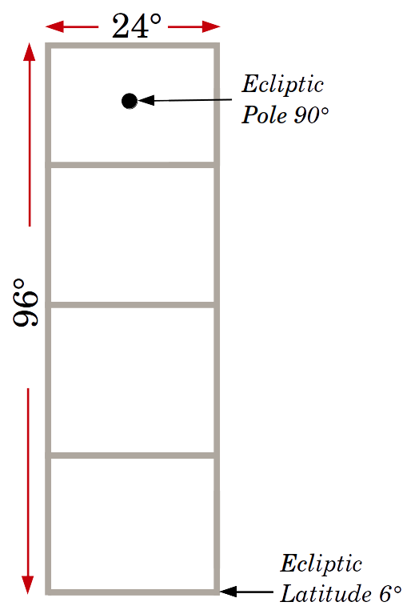
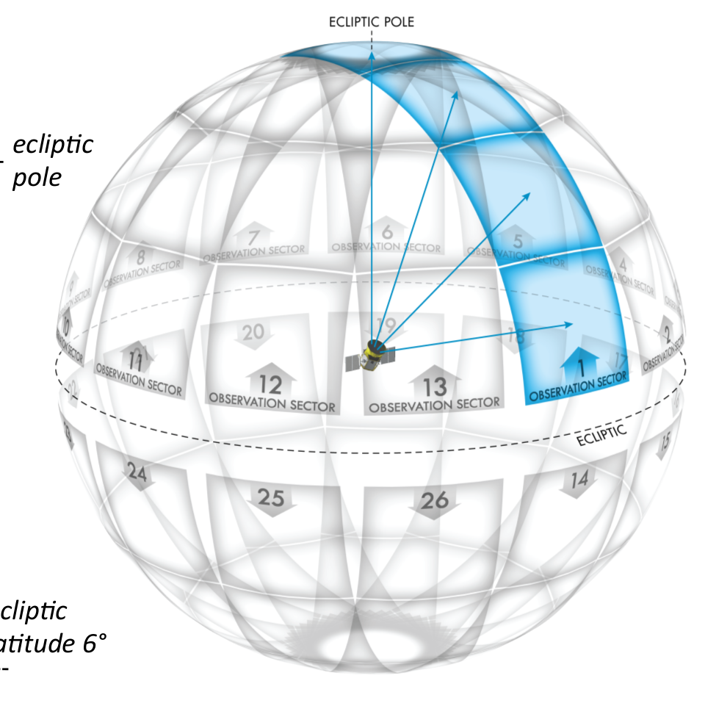
The TESS Observing Strategy
Southern Hemisphere
Continuous Viewing Zones
(Matches JWST CVZ)
Northern Hemisphere
Ricker et al. 2014, Sullivan et al. 2015

Slide 5
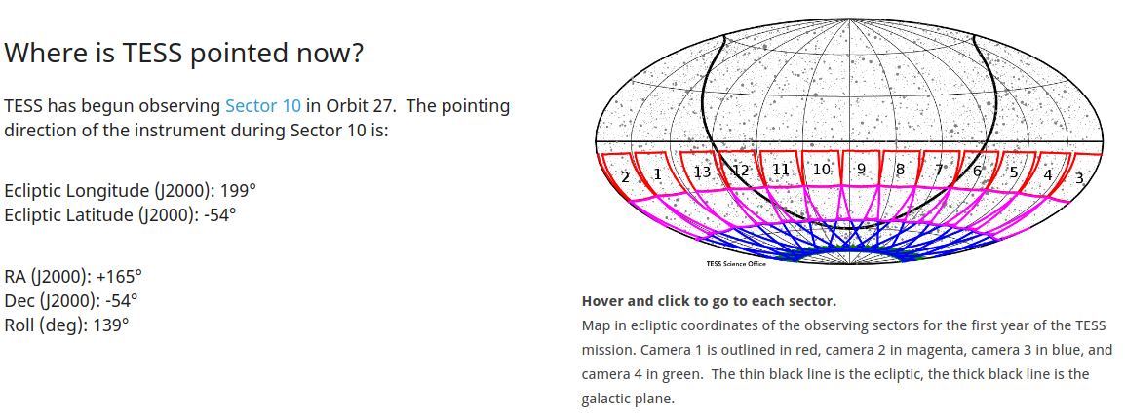
Current Observations
Northern Hemisphere
Southern Hemisphere
As of 4/13/2019, TESS has completed 9 sectors, with 7 sectors released to the public. The spacecraft is currently observing Sector 10. Northern observations start in July, 2019.
Courtesy of tess.mit.edu/pointing

Slide 6
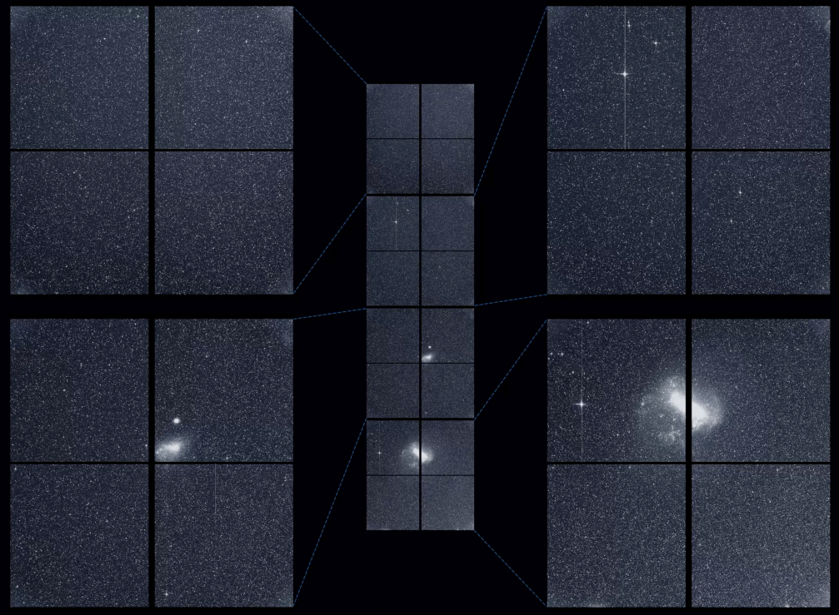
TESS Sector 1
Courtesy of NASA-TESS; MIT

Slide 7
‘Primary’ TESS Data Products
2-minute cadence light curves: ~15,000 stars per each sector (for a total near 400,000 stars) will receive 2 minute cadence, and have light curves produced by NASA.
30-minute cadence FFIs: All stars in the TESS FoV receive 30-minute cadence in the form of full-frame-images. These are not reduced to light curve form. Many groups are producing light curves for the community at large.
TESS Input Catalog: Stellar parameters, and a nearly full spectrum of magnitudes for more than 250 million stars -- 1.5 billion stars exist in the TIC with various measured quantities.

Slide 8
‘Primary’ TESS Data Products
2-minute cadence light curves: ~15,000 stars per each sector, for a total near 400,000 stars, receive 2 minute cadence, and have light curves produced by NASA.
30-minute cadence FFIs: All stars in the TESS FoV receive 30-minute cadence in the form of full-frame-images. These are not reduced to light curve form. Many groups are producing light curves on their own.
TESS Input Catalog: Physical stellar parameters, and nearly full spectrum magnitudes for more than 250 million stars -- 1.5 billion stars exist in the TIC with various measured quantities.
Many more types of data are available through MAST.

Slide 9
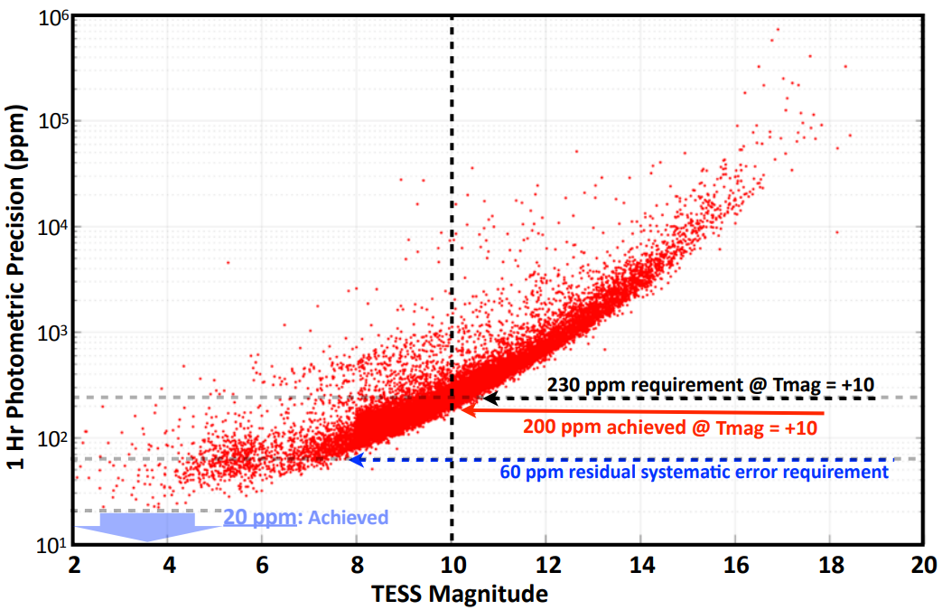
TESS’s Precision
Currently TESS can achieve 20 ppm for bright stars, well below the 60 ppm mission requirement. All data products mentioned in this proposal meet this precision.
Courtesy of George Ricker

Slide 10
A Variety of Official & Community-led Pipelines are Available to Access the Data
MAST: Primary location of most mission data products, and provides a variety of tools to access the data.
NASA: Official NASA-SPOC data to produce all NASA-TESS data products (Jenkins et al. 2016)
Eleanor: Open access PSF-fitting pipeline led by University of Chicago (Feinstein et al. 2019)
Filtergraph: Open access difference imaging pipeline led by Vanderbilt University (Oelkers & Stassun (2018 & 2019)
LightKurve: A package for Kepler & TESS time-series analysis (Barensten et al. 2019)
Quick-Look Pipeline (QLP): Aperture photometry pipeline led by MIT (Huang et al. 2018)
TASOC Pipeline: PSF photometry data reduction pipeline led by the TESS Asteroseismic Consortium

Slide 11
A Variety of Community-led Pipelines are
Available to Access the Data
MAST: Primary location of most mission data products, and provides a variety of tools to access the data.
Eleanor: Open access PSF-fitting pipeline led by University of Chicago
Filtergraph: Open access difference imaging pipeline led by Vanderbilt University
LightKurve: A package for Kepler & TESS time-series analysis.
NASA: Aperture based pipeline with 2-minute cadence
Quick-look Pipeline: Aperture photometry pipeline led by MIT
TASOC: PSF photometry data reduction pipeline led by the TESS Asteroseismic Consortium
There may be many more pipelines I have missed!

Slide 12
TESS Data on MAST
http://archive.stsci.edu/tess/all_products.html
Bulk Downloads
1- 2-minute cadence light curves
2- 30-minute fill frame images (both calibrated, and un-calibrated)
3- Target pixel files for 2-minute data
4- Data validation files (TCE summary and full reports)
5- Co-trending basis vectors
6- Simulated data (ETE-6)
7- The TESS Input Catalog
Data interaction tools
1- Search through data: MAST portal, exo.MAST, Astroquery.MAST
2- Make FFI cut-outs: TESScut
Slides adapted from a presentation by Scott Fleming

Slide 13
http://archive.stsci.edu/tess/
Slides adapted from a presentation by Scott Fleming

Slide 14
Official NASA-SPOC Data
Stars provided in the official releases:
1- The main data product from NASA-SPOC are light curves for
2-minute cadence targets.
2- Typically there are ~15,000 stars per sector which receive 2-minute
cadence. These stars were selected based on priority in the candidate
target list (CTL) of the TIC, the Asteroseismic Target List (ATL),
GI/GO targets, and other special target lists.
3- The pipeline is heavily based on the Kepler pipeline.
Data Products: Hosted on MAST (DATA available through Sector-7 as of 4/13/19)
1- 2-minute light curves
2- Data validation reports and TCE reports
3- 30-minute (un-)calibrated Full Frame Images
4- Co-basis detrending vectors
Jenkins et al. 2016 & 2018

Slide 15
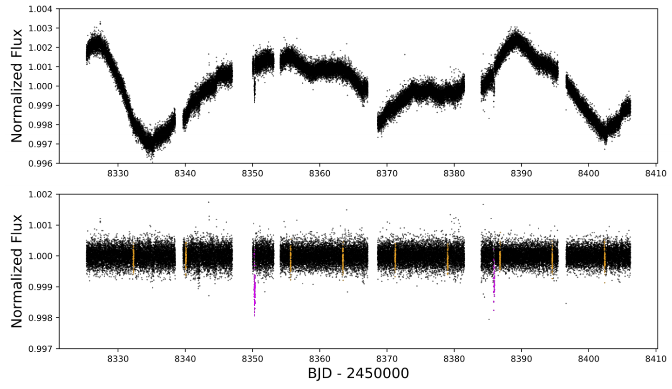
2-minute light curve of HD2685b
Jones et al. 2019

Slide 16
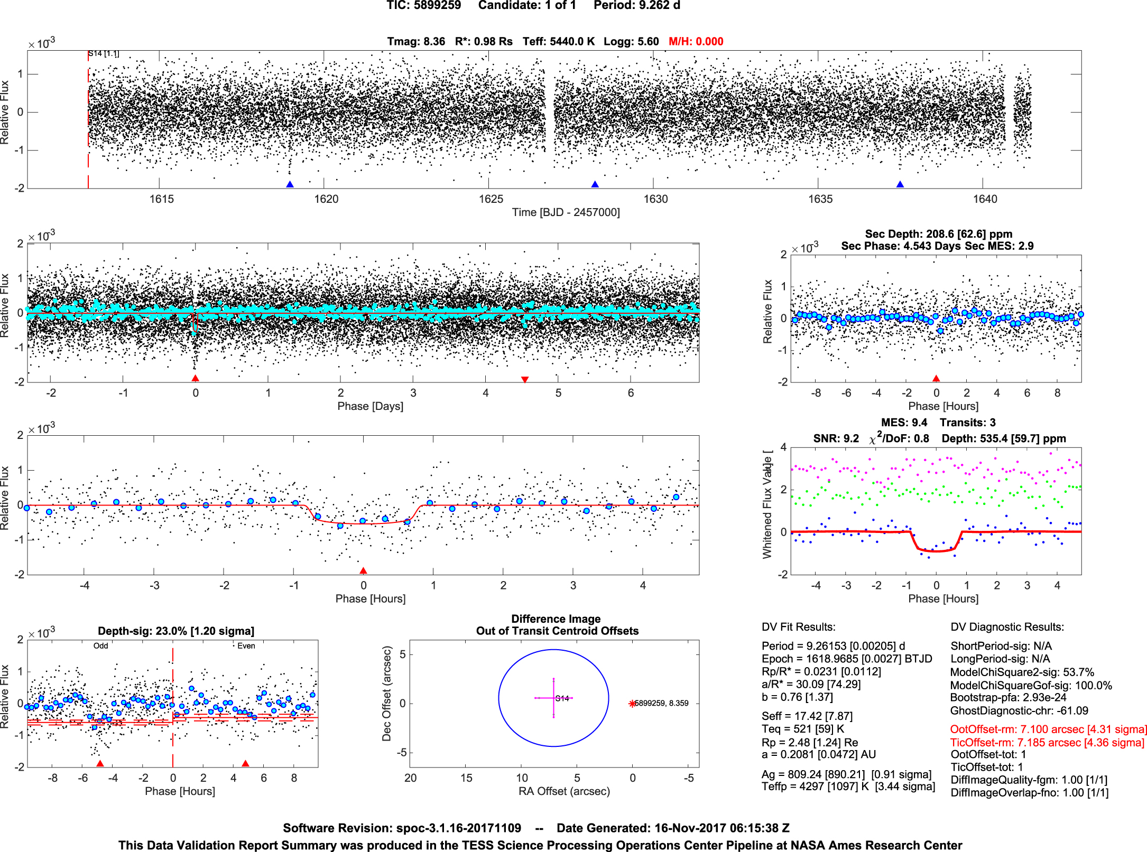
An example of a validation report
Jenkins et al. 2018

Slide 17
Community Generated
Light Curves and Ancillary Data Products

Slide 18
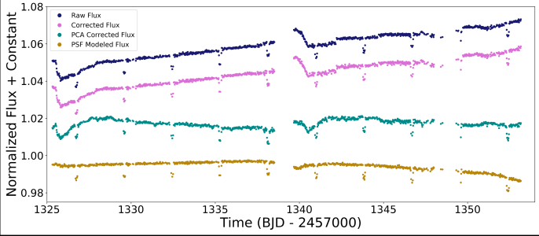
Courtesy of Adina Feinstein
ELEANOR Pipeline
(Feinstein, Montet, Bedell, Christiansen, Foreman-Mackey, Hedges, Luger, Saunders, Cardoso)
Creating light curves for all stars < 16 magnitude in the FFIs and searching them for exoplanets
Open-source software and light curves for Sector 1 are ready for use for all your time-series photometry needs.
We remove noticeable background noise
Principal Component Analysis of thousands of stars enables contending to remove shared Systematics.
PSF modeling is also available

Slide 19
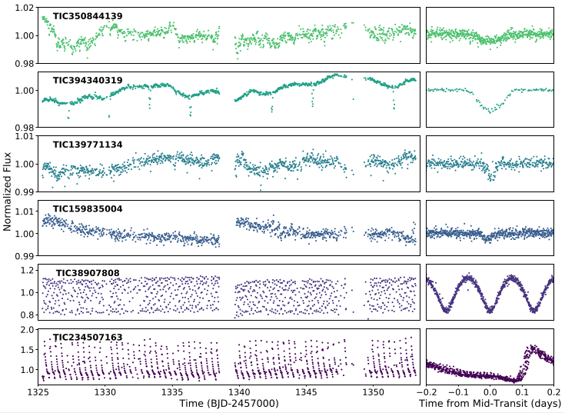
Courtesy of Adina Feinstein
ELEANOR Pipeline
We already have new exoplanet, eclipsing binary, and other candidates!
Light curves will be hosted on MAST soon
New exoplanet candidates are already being uploaded to ExoFOP-TESS!
Can’t wait until the light curves are uploaded? Make your own!
pip install eleanor
https://adina.feinste.in/eleanor

Slide 20
Filtergraph Pipeline (Oelkers & Stassun)
Pipeline Availability: https://github.com/ryanoelkers/DIA/
1- Difference imaging C-code
2- Wrappers and various routines for background subtraction, alignment,
master frame combination, de-trending and photometry.
Data Products: https://filtergraph/tess_ffi/ (DATA available through Sector-5)
1- TESS Input Catalog information (Stassun,Oelkers+2018)
2- Variability metrics and basic periodicity information
Box-Least-Squares output from VARTOOLS (Kovacs+2002; Hartman & Bakos 2016)
Lomb-Scargle output from VARTOOLS (Lomb 1976; Scargle 1982; Hartman & Bakos 2016)
Welch-Stetson J & L metrics and rms on 30m and 60m timescales (Stetson 1996; Oelkers+2018)
3- Light curves
Raw light curves for every star, cleaned light curves for a subset of low-contamination stars
4- Differenced images
Useful for discovering transients, and/or variable stars previously unknown.

Slide 21
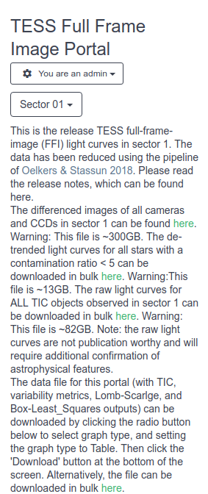
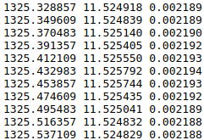
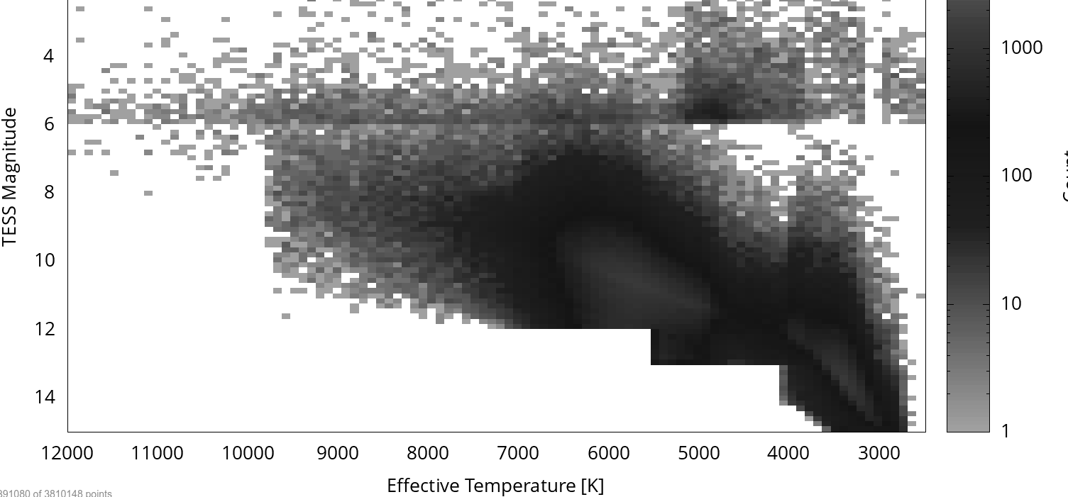
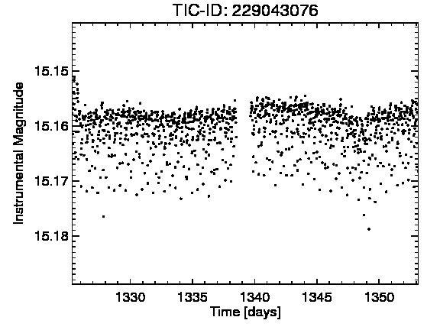
5. Grab data files
1. Change sectors
3. Plot stellar parameters
2. Bulk Download
6. Plot light curves
Filtergraph Pipeline
https://filtergraph.com/tess_ffi
4. Investigate variability metrics

Slide 22
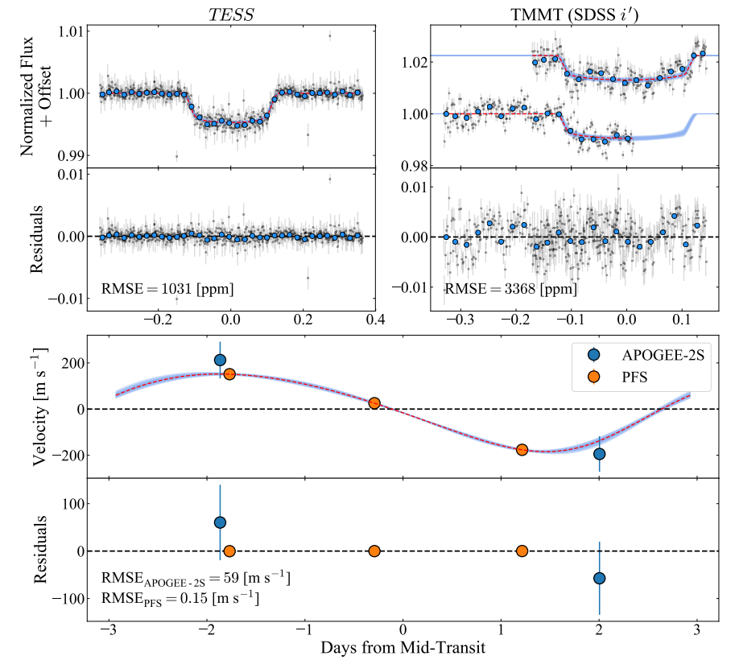
Filtergraph Pipeline
TOI-150b
Figure courtesy of Canas et al. 2019

Slide 23
LightKurve Package
(Cardoso, Barentsen, Cody, Hedges, Gully-Santiago, Barclay, Mighell, Bell, Zhang, Tzanidakis. Sagear, Turtelboom, Coughlin, Berta-Thompson, Sundaram, Hall, Saunders, Lerma, Evensberget, Gosnell, Williams, Elkins, Davies, Foreman-Mackey, Hey)
Availability: https://docs.lightkurve.org/index.html
Lightkurve provides a user-friendly, low-barrier-to-entry, method of
interacting with data from Kepler and TESS.
Written in PYTHON it can be installed, and used quickly.
Provides users opportunities to access Kepler and TESS data, plot light
curves, correct for systematics, identify trends, and find periodic signals.
Slide adapted from https://docs.lightkurve.org/

Slide 24
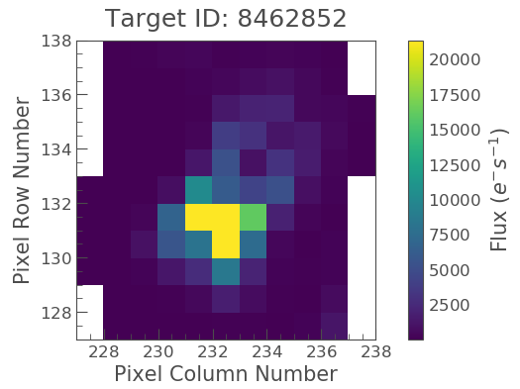
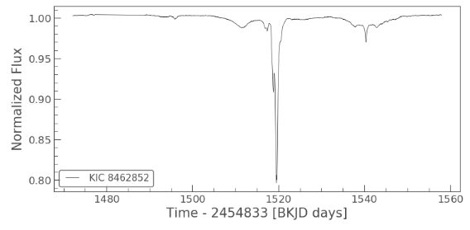
LightKurve Package
2.
5.
Slide adapted from https://docs.lightkurve.org/quickstart.html

Slide 25
TASOC Pipeline

Slide 26
TASOC Pipeline

Slide 27
MIT Quick-Look Pipeline (QLP)
(Huang, Pál, Vanderburg, Yu, Fausnaugh, Shporer, and the TESS team)
Calibrated
Images
Modified
Aperture
Photometry
Spline-fit Light Curve
Detrending
TESS Vetting
QLP
Reports
BLS Planet
Search
Huang et al. 2018; Slides adapted from a presentation by Lizhou Sha

Slide 28
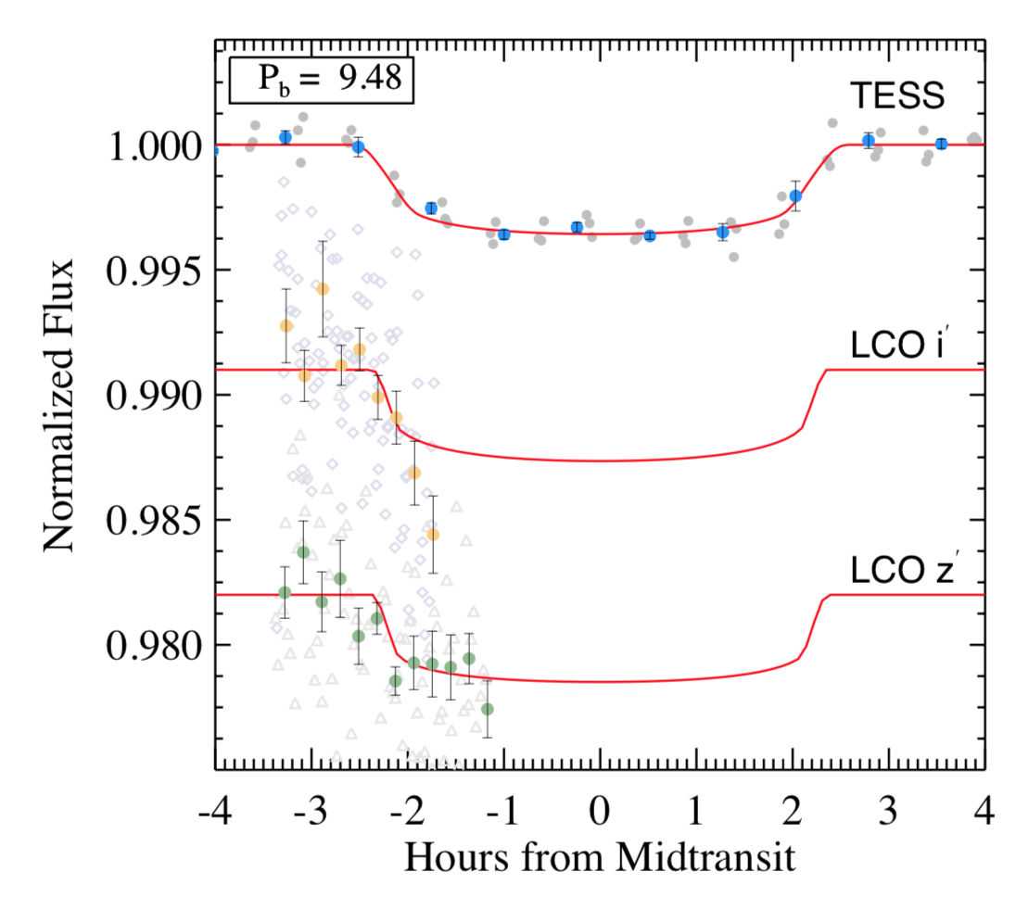
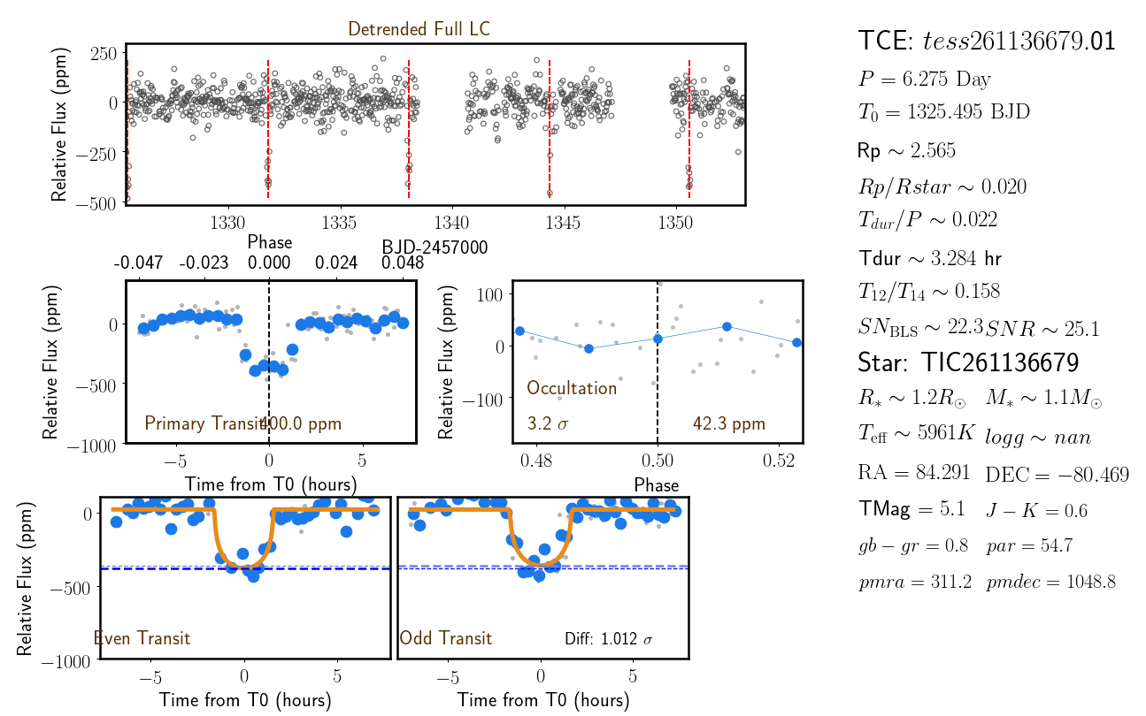
MIT Quick-Look Pipeline (QLP)
ⲡ Men c: Huang et al. 2018; TOI-271b: Rodriguez at el. 2019
π Men c
TOI-172b
Slides adapted from a presentation by Lizhou Sha

Slide 29
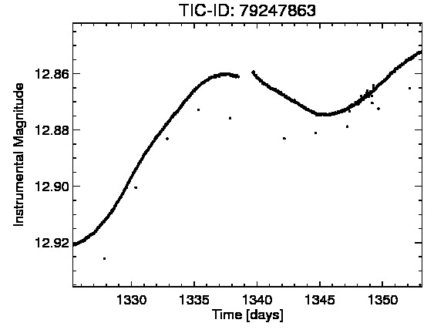
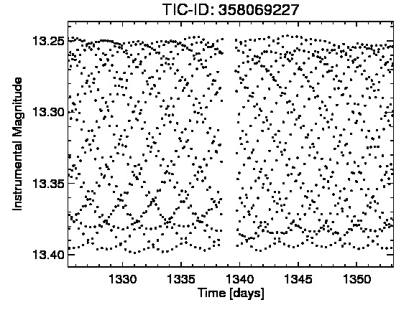
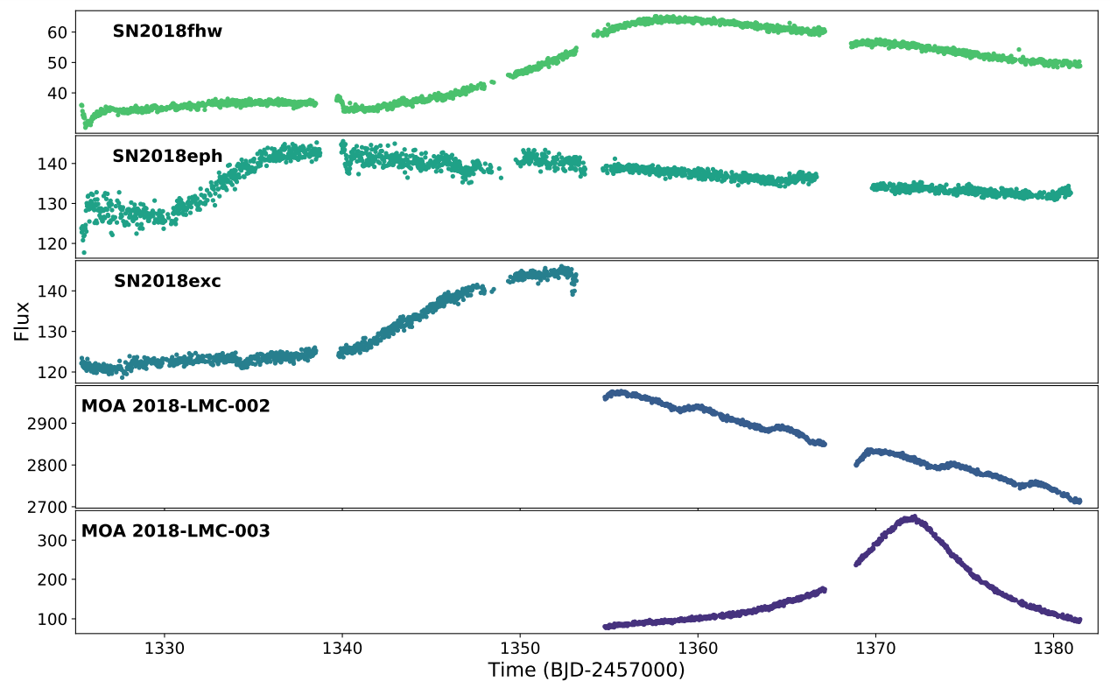
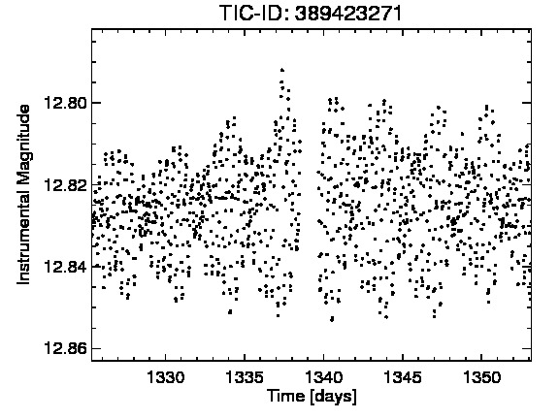
Examples of TESS stellar and extragalactic light curves showing variability
Feinstein et al. 2019
Oelkers & Stassun 2019

Slide 30
Summary
TESS is currently observing in Sector 10, with 7 sectors of data already released.
Most of the available data products can be found on MAST.
2-minute light curves
30-minute full frame images
TESS Input Catalog
Data validation reports
There are numerous community-led pipelines, already producing data light curves for 30-minute full frame images.
TESS has shown capabilities of detecting variability in stars and extra-galactic sources!

