Slide 1
Transient Science with TESS
Michael Fausnaugh
TESS Pipeline Scientist
MIT Kavli Institute
faus@mit.edu

Slide 2
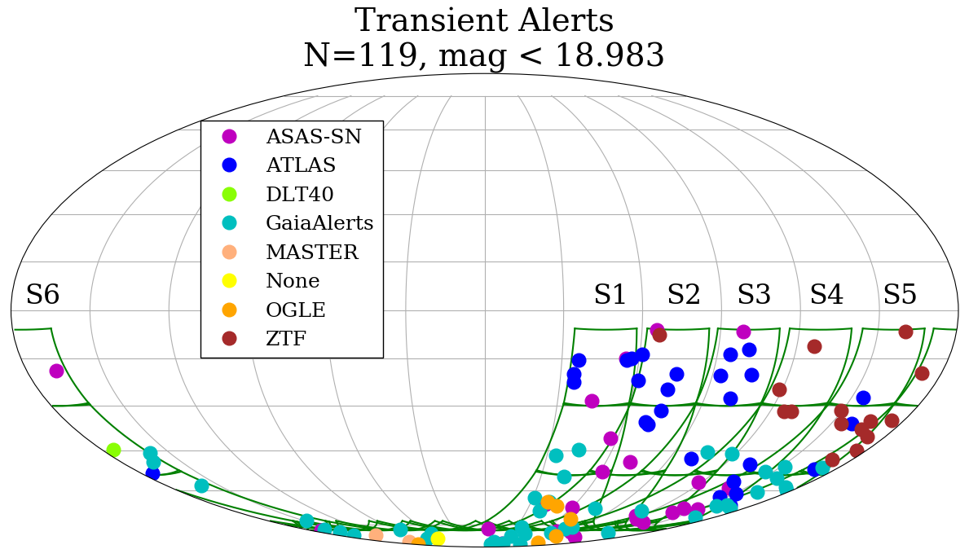
Notes:
TESS has a 5sigma limiting mag of ~19.1 in 30 minutes (I band). These are the objects uploaded to TNS that land in the TESS fields through about January 3rd, in ecliptic coordinates. Sectors 4/5/6 have a small amount of overlap with the northern hemisphere (hence the distribution of ZTF discoveries in these sectors).

Slide 3
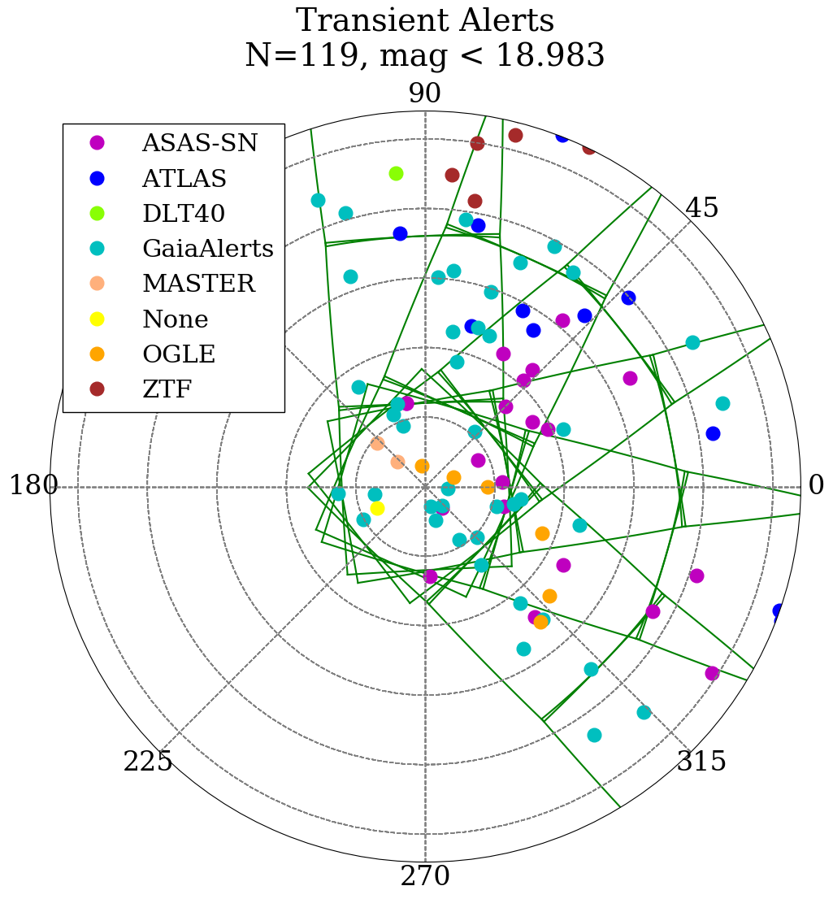
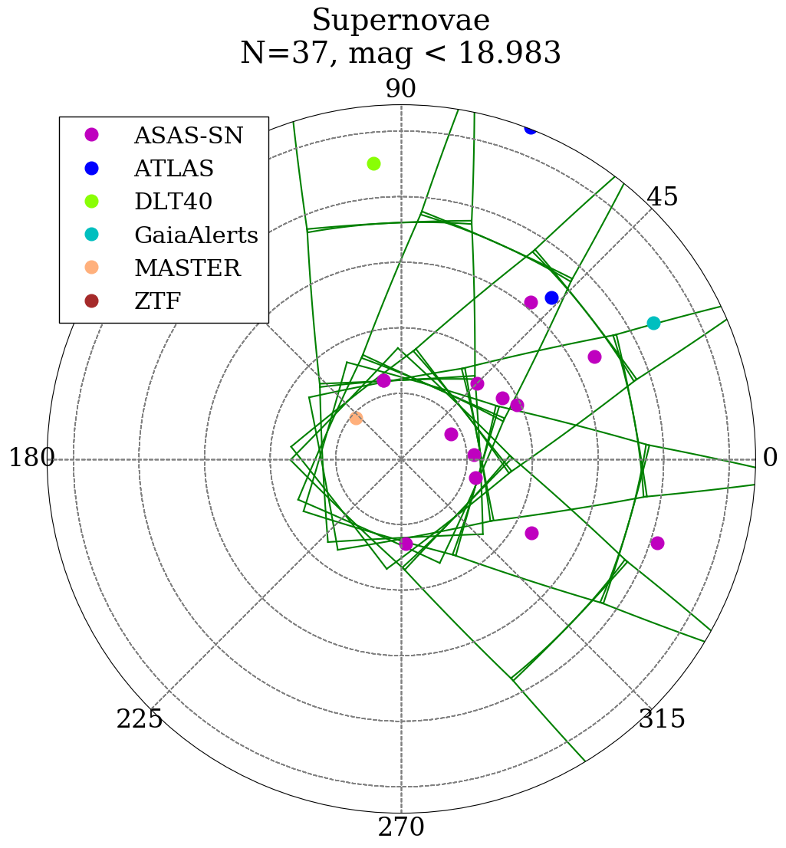
Notes:
Same data (as in previous slide) but in polar coordinates, emphasizing continuous coverage of the south ecliptic pole.

Slide 4
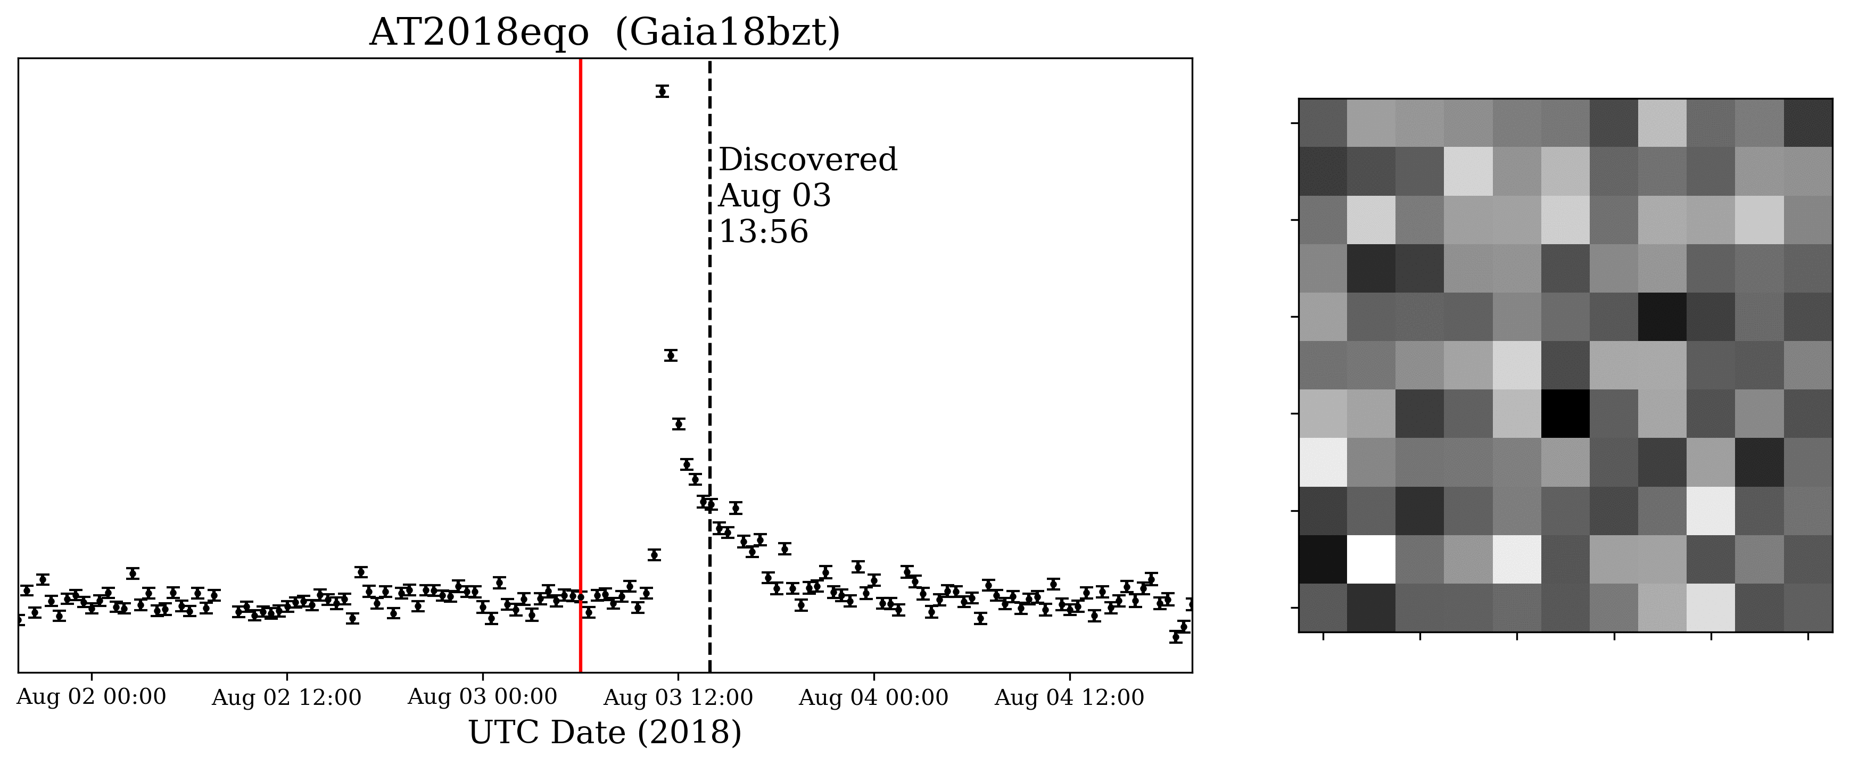
Preliminary
Notes:
One example of using TESS for transient science. There is a faint (Tmag ~18) M dwarf at the location of this transient, which we unambiguously see flare in the TESS data. The flare is at least 3 magnitudes. Note that the graphic is a .gif that should play an animation when you click on it.

Slide 5
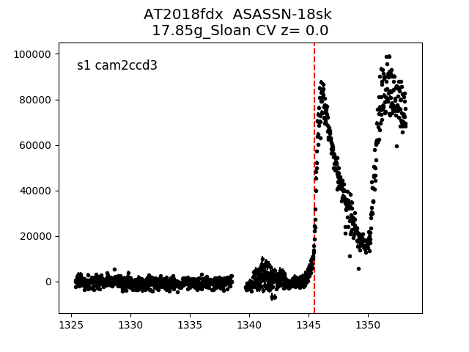
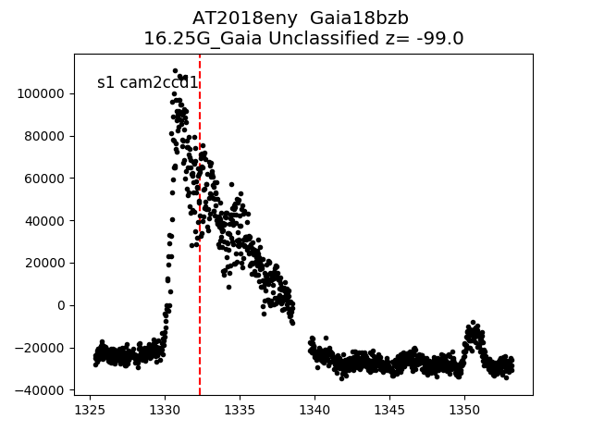
Ridden-Harper et al. 2018,
ATel #12292
Preliminary
Notes:
Examples of CV outbursts/ dwarf nova activity. 2018fdx has an ATel describing some analysis of the superhump at the end of the observation (that is real structure, and there is a few hour periodicity).

