Slide 1
An Explosion of Explosions
S. R. Kulkarni
Caltech Optical Observatories

Slide 2
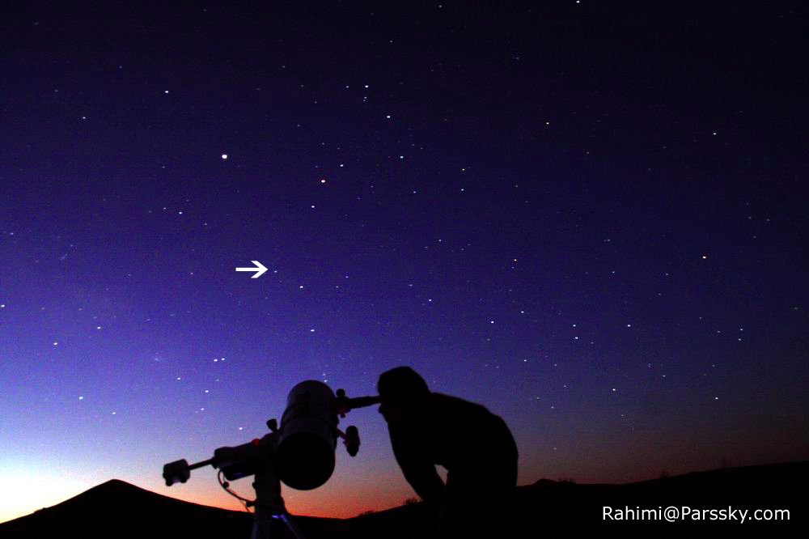
Bumps, Burps & Booms in the Skies
Source: APOD, NASA

Slide 3
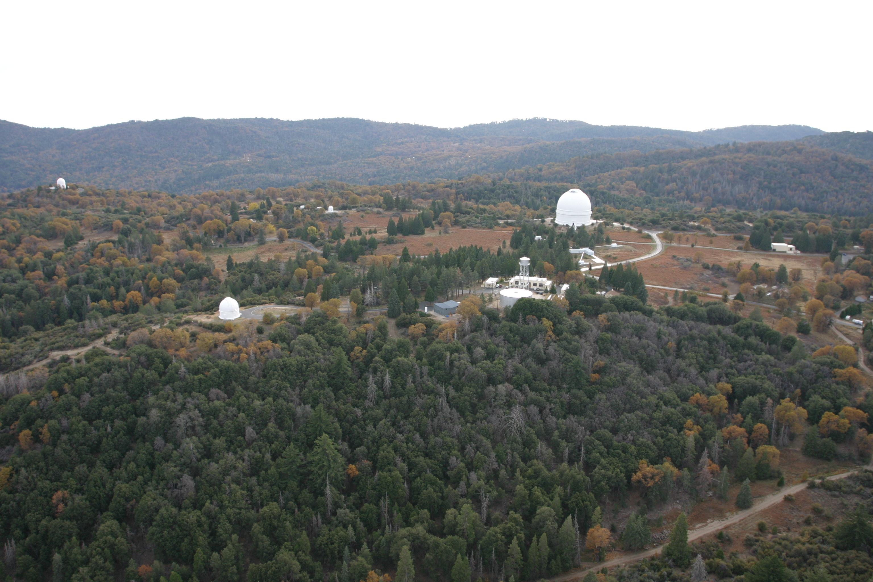
The Palomar Observatory

Slide 4
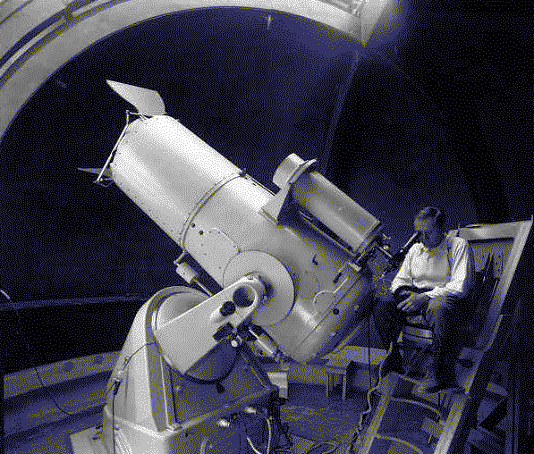
Fritz Zwicky (1889-1974)

Slide 5
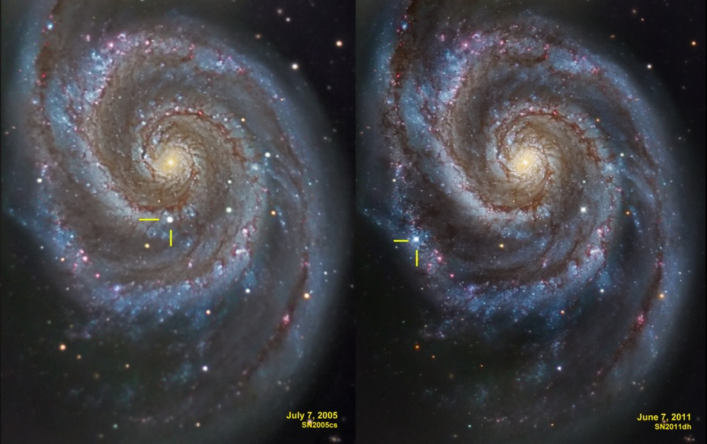
A Star Dies: A Supernova is born
Astronomy Picture of the Day (NASA)

Slide 6
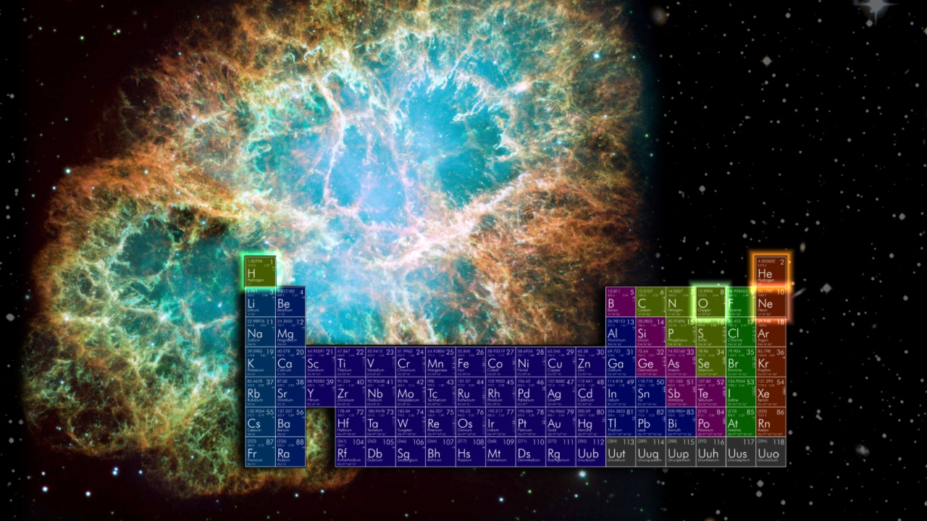
“Metals”=Stellar Ashes
Credit: NASA

Slide 7
II. Go and find new and weird stuff
(“Phase Space Exploration”)

Slide 8
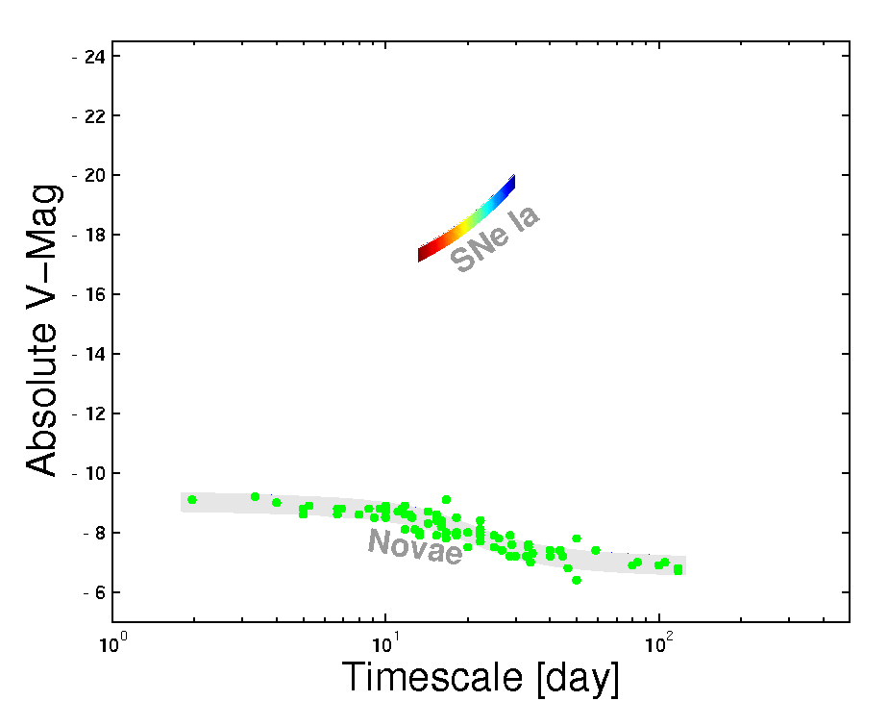
“Phase Space”
Notes:
It wasn’t hardly centuries ago that mankind thought the universe was unchanging. The discovery of transients has now led us to believe that the universe changes not only on month and weeks but also days, hours and minutes!
In Ay 1, or any introduction to cosmic explosions, two classes of optical transients are introduced - novae and supernovae. our understanding about them has grown in leaps and bounds in the past two decades. And for good reason. They are both easy to find and Novae are faint but plentiful, supernovae are rare but bright. Since the time of Hubble, this curious gap has been noted, and we have asked, are there are hitherto an undiscovered class of transients? Let us quantify this gap next.

Slide 9
Frontier areas of astronomy & physics

Slide 10
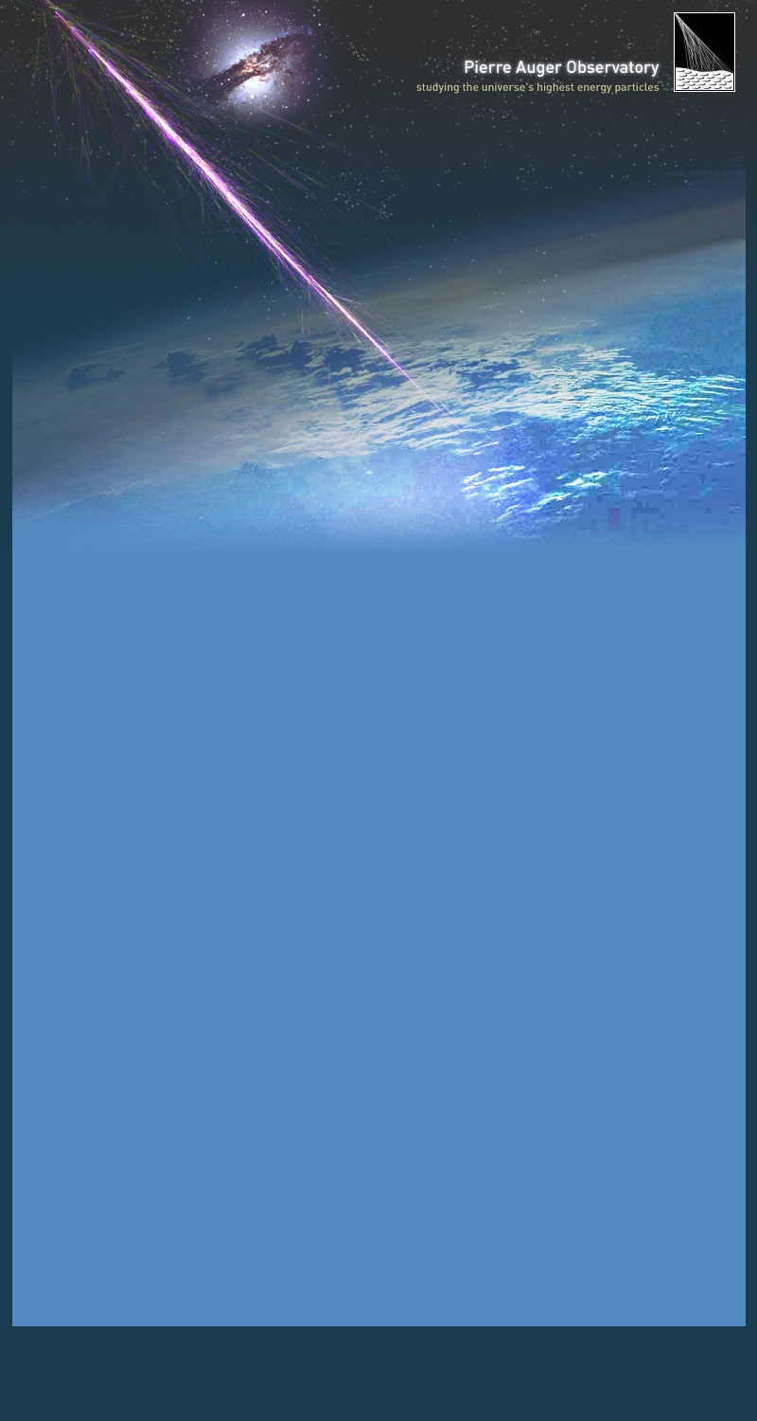
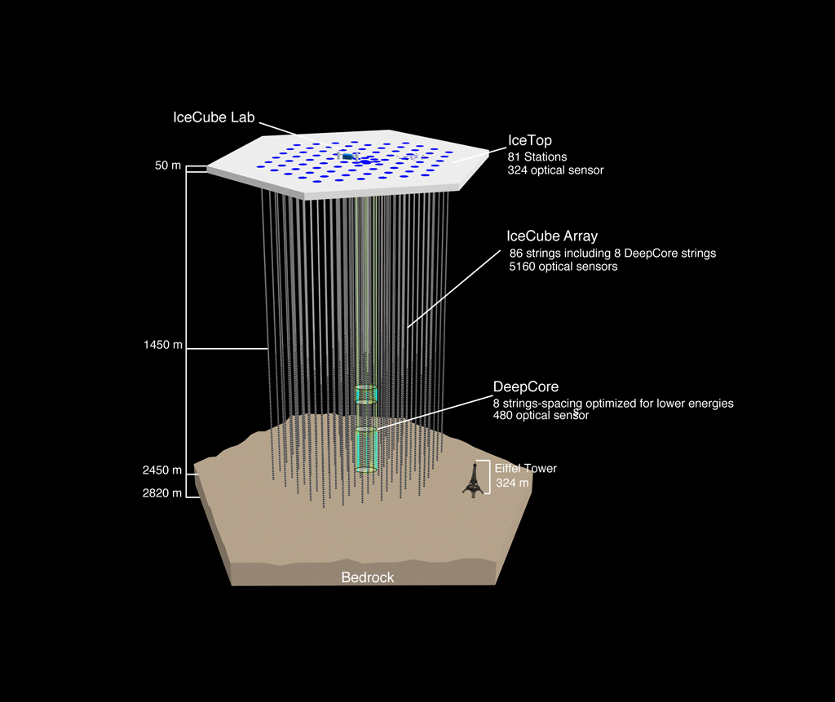
Frontier Area: Energetic Particles

Slide 11
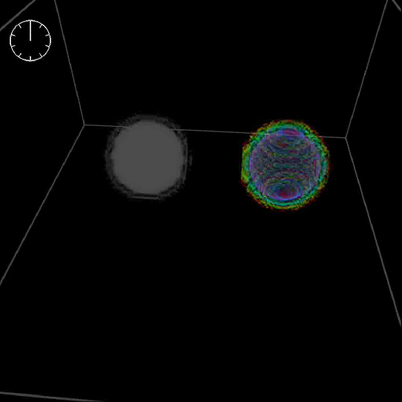
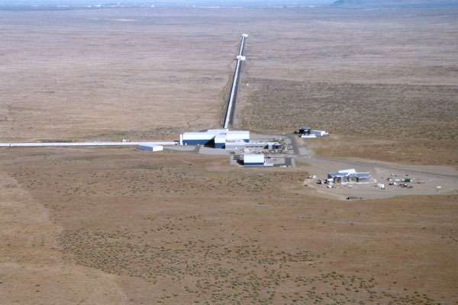
Frontier Area: Gravitational Waves

Slide 12
The Palomar Transient Factory
(Systematic Exploration of the Skies)

Slide 13
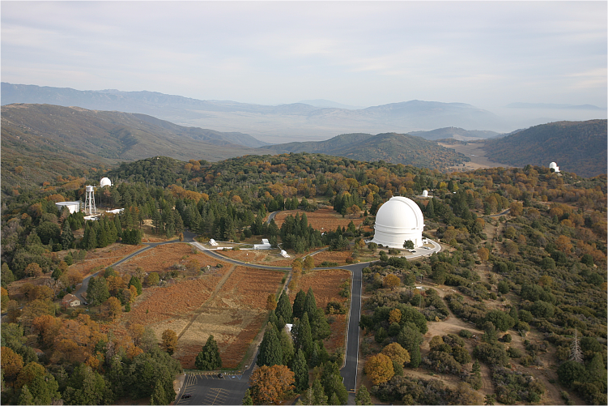
P60
Confirmation
P48
Discovery
200-inch

Slide 14
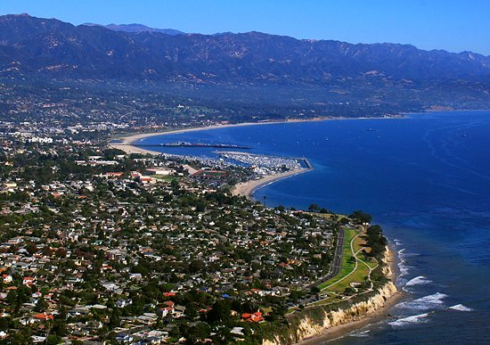
Credit: UCSB

Slide 15

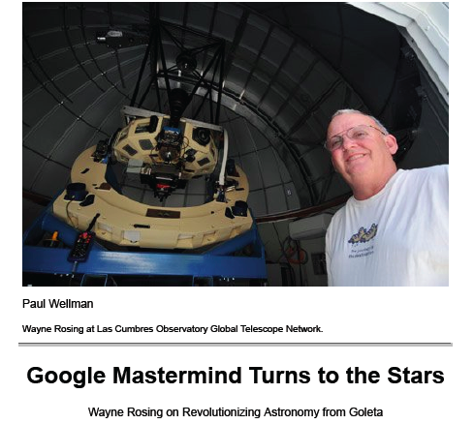

Slide 16
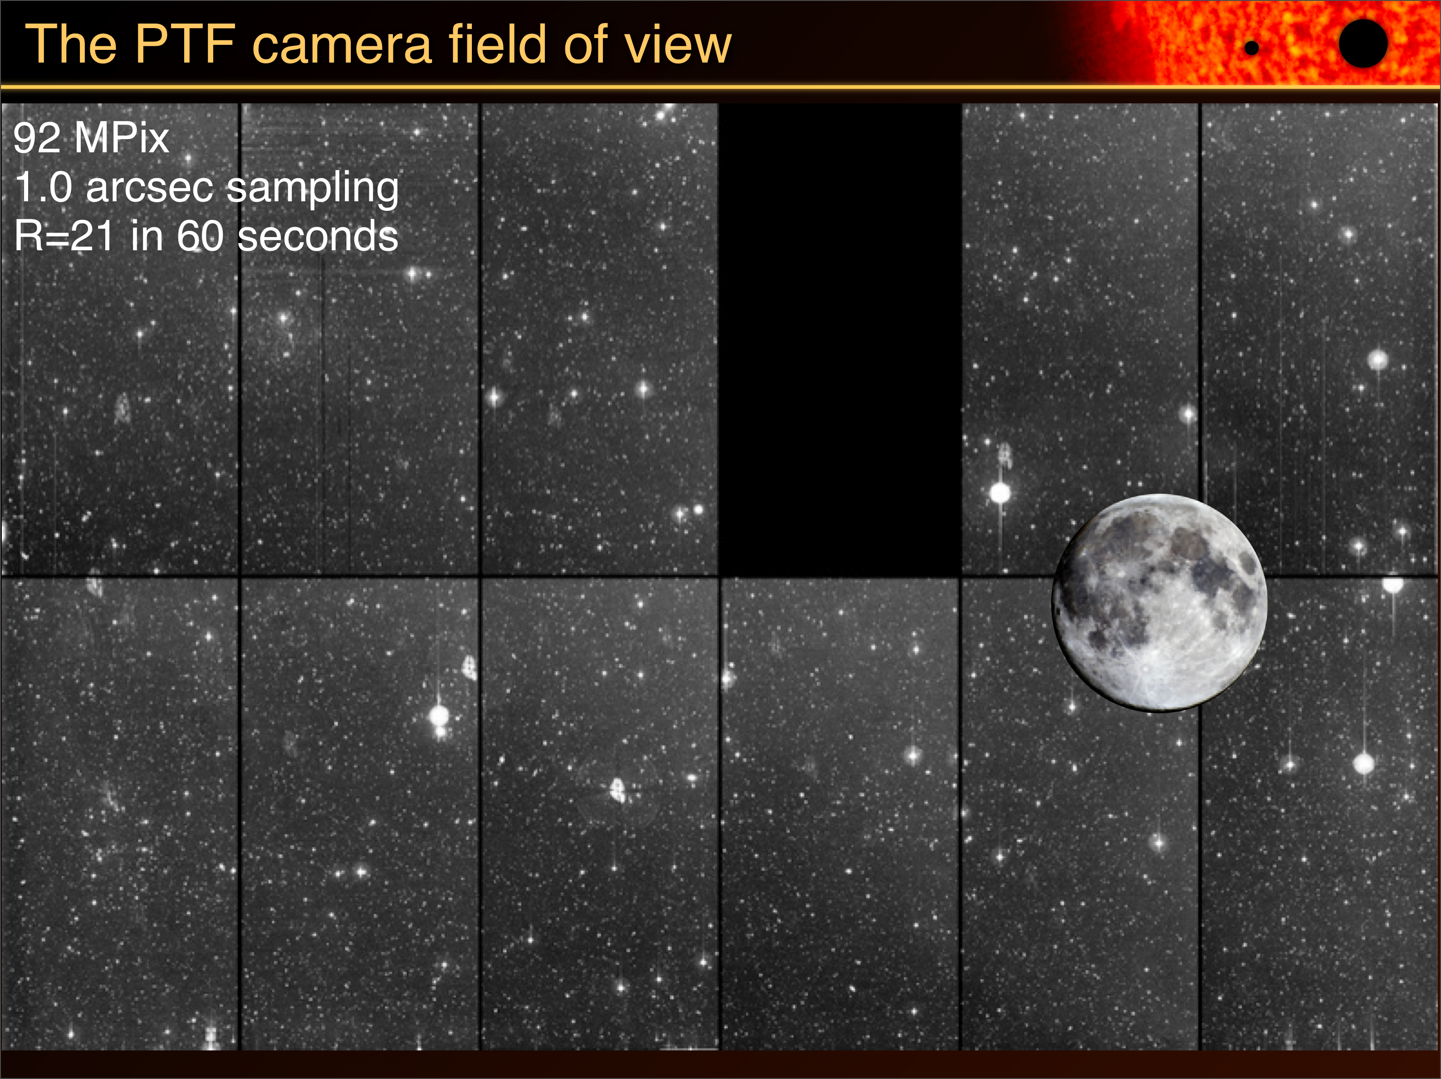
Hardware

Slide 17
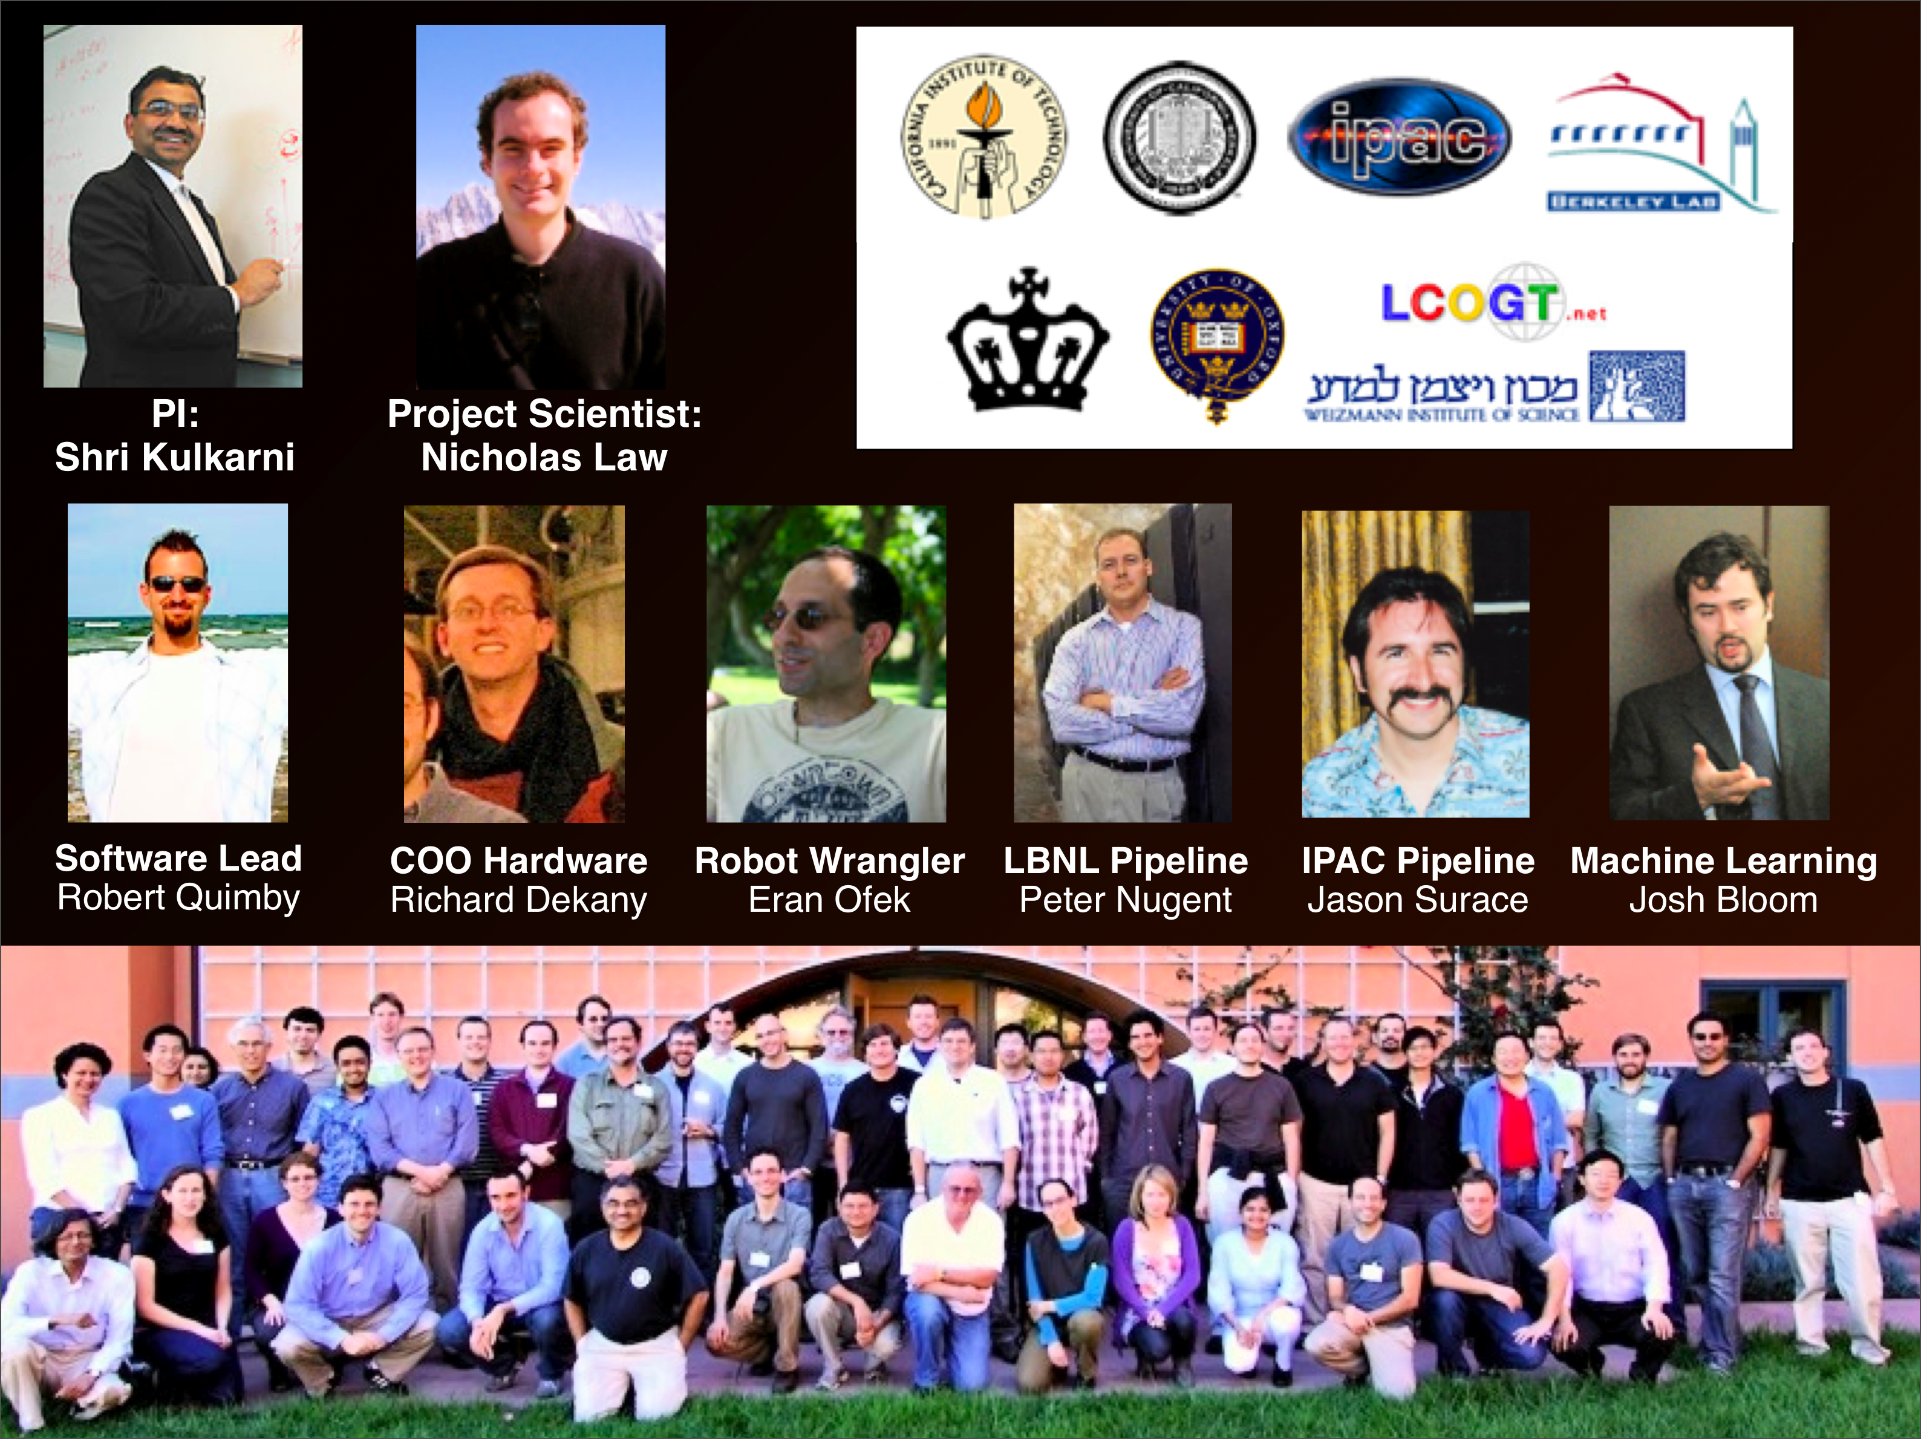
Gray-ware

Slide 18
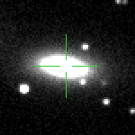
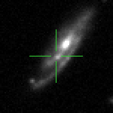
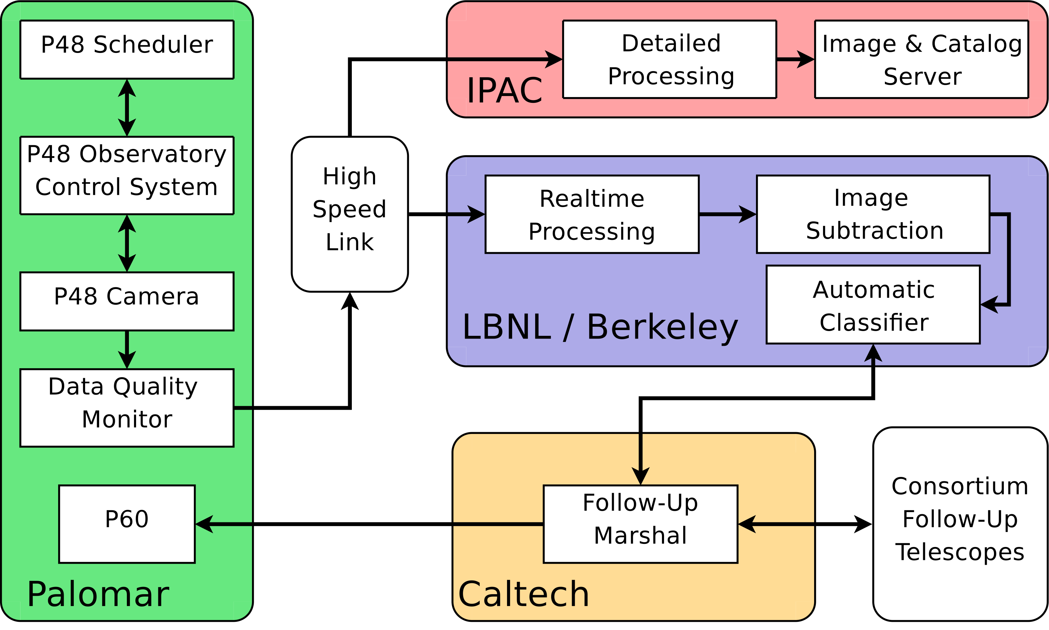
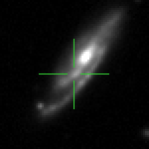
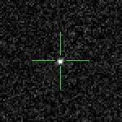
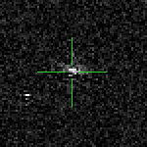
Software, software & more software
NEW
Rapid
REF
Time from exposure to candidates in the subtraction database: 20 - 40 minutes
SUB
Supernova, good!
Subtraction artifacts, bad!

Slide 19
IPAC images & catalogue pipeline
Lead by J. Surace
Data products:
Reduced images
~100TB per year
Catalogue
~10¹² sources per year (10 TB)

Slide 20
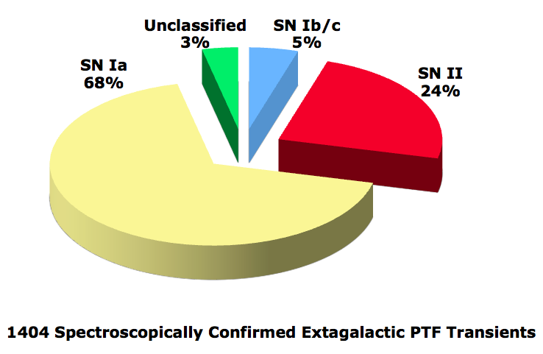
PTF haul (to date)

Slide 21
Kasliwal 2011 (PhDT)

Slide 22
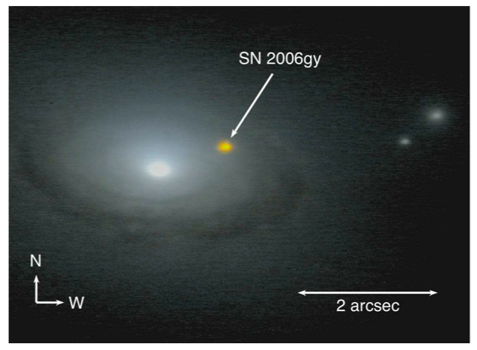
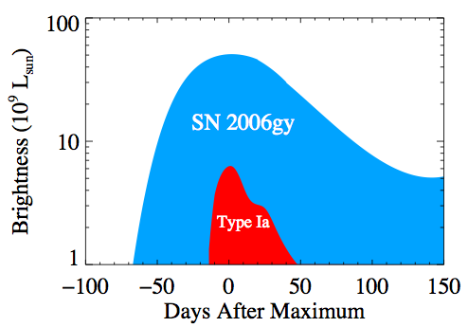
Super-Luminous Supernovae (Hydrogen)
R. Quimby

Slide 23
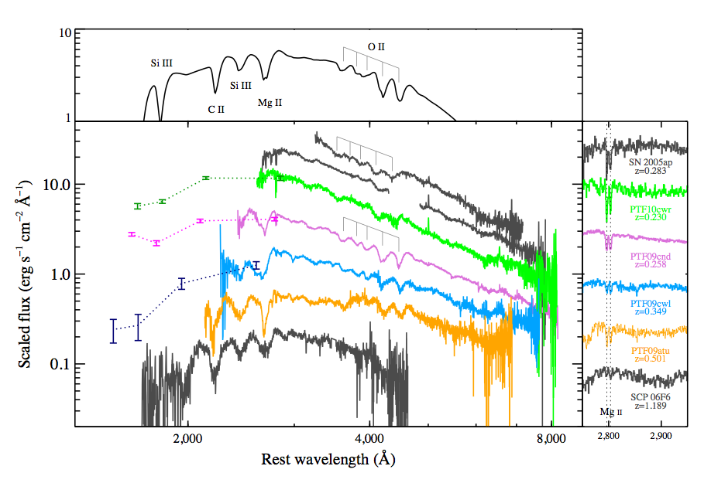
Superluminal Supernovae
(no Hydrogen)

Slide 24
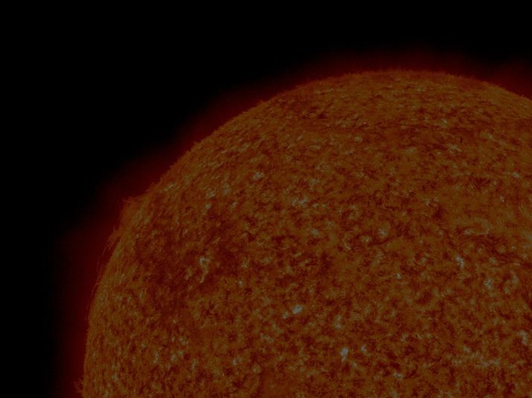
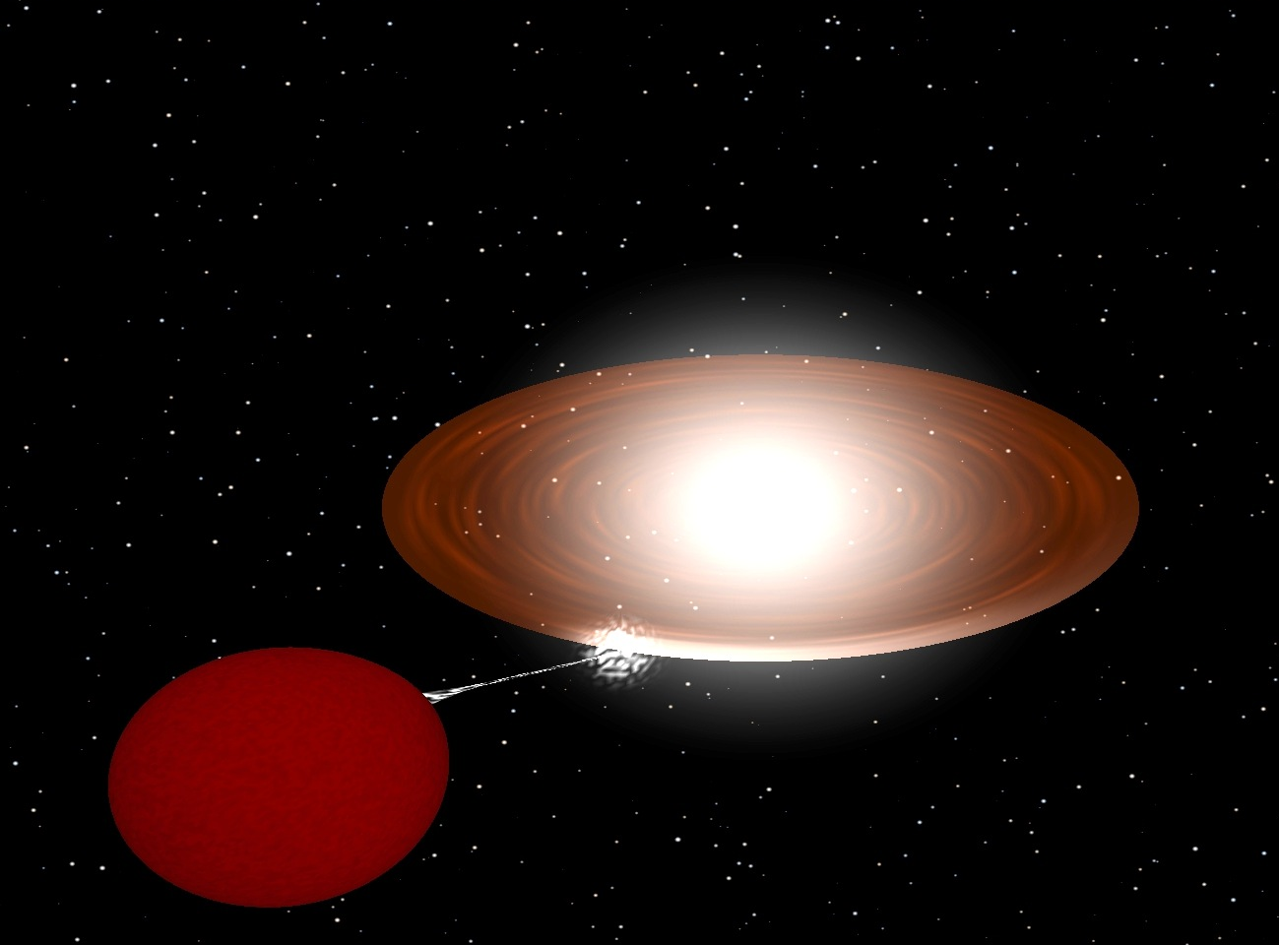
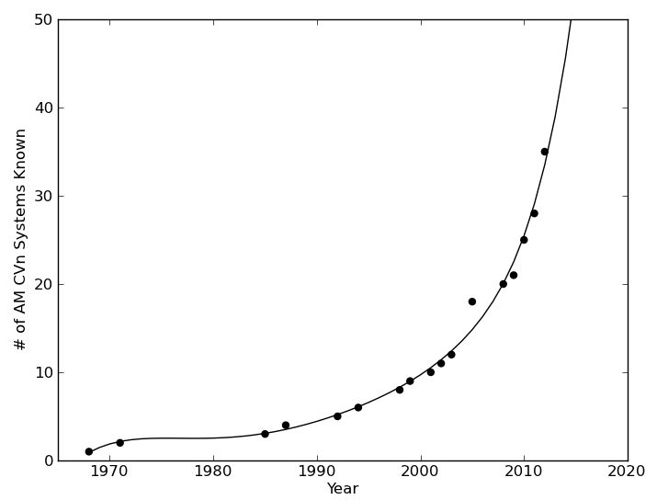
Double White Dwarfs (AM CVn)
AM CVn
PTF
SDSS
WD
WD

Slide 25
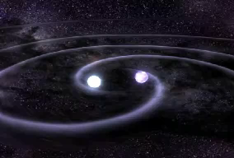
Gravity: The Final Frontier
Source: LISA Mission, NASA

Slide 26
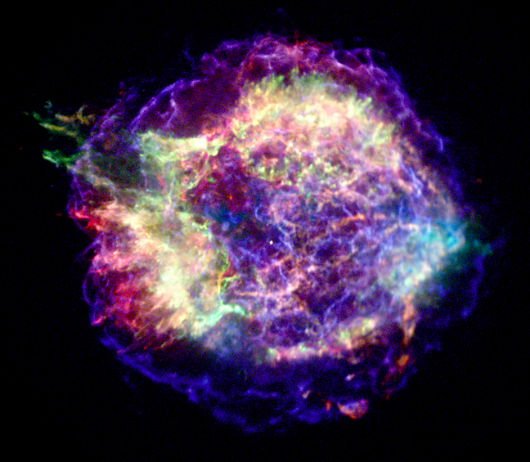
Weird Outcomes: Carbon Stars, Calcium Ashes, Thermonuclear Explosions
Got Calcium?

Slide 27
On to low latency
(Same night)

Slide 28
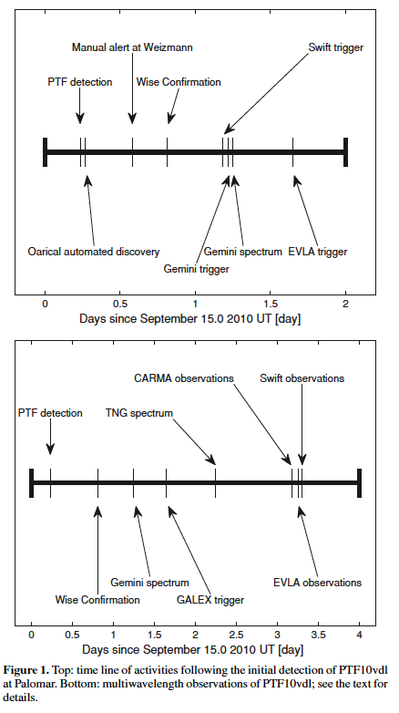
Rapid Response: PTF10vdl (dry run)
Led by A. Gal-Yam

Slide 29
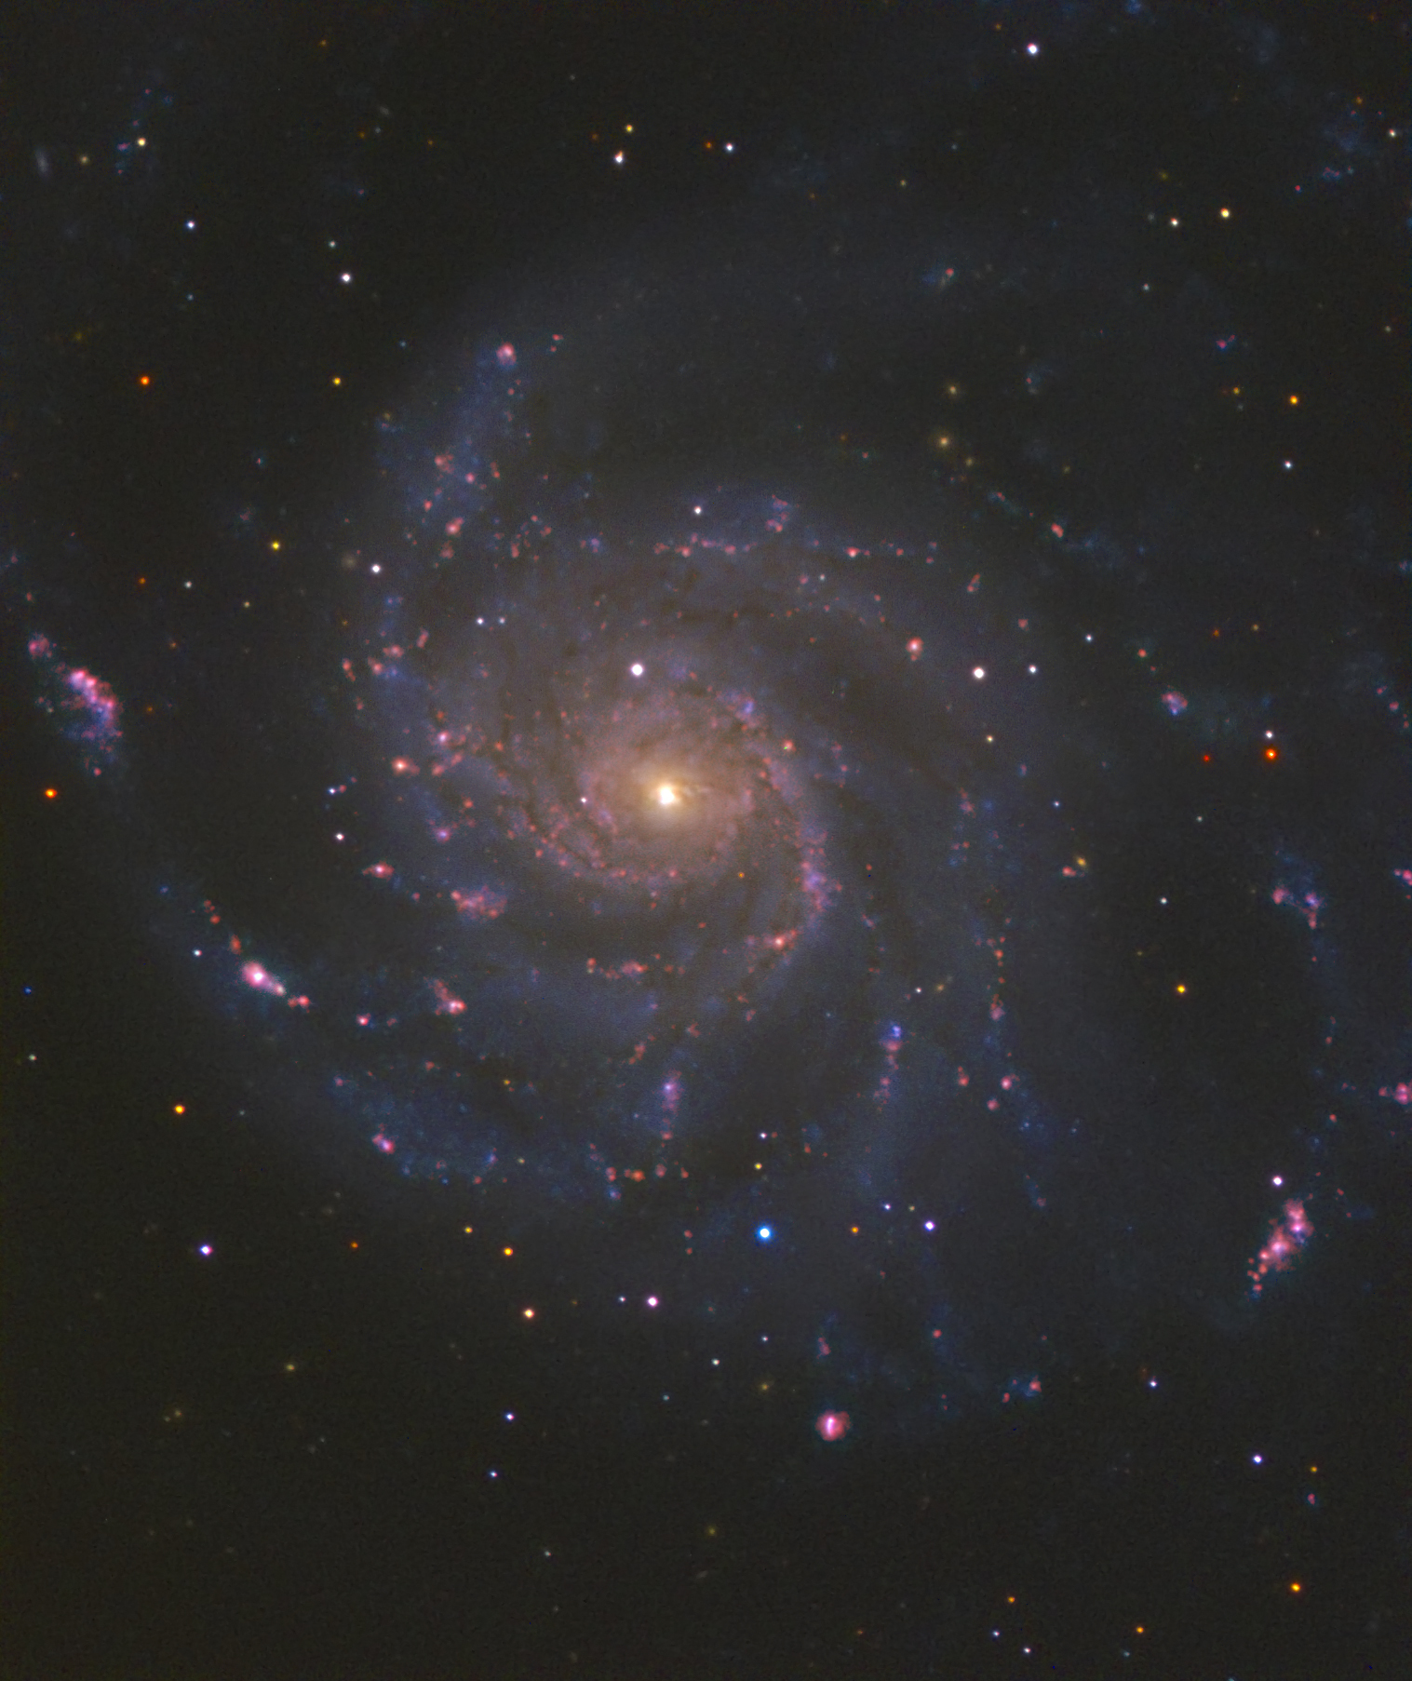
PTF11kly: A nearby Ia Explosion
(Rosetta Stone)
Nugent et al
Li et al.

Slide 30
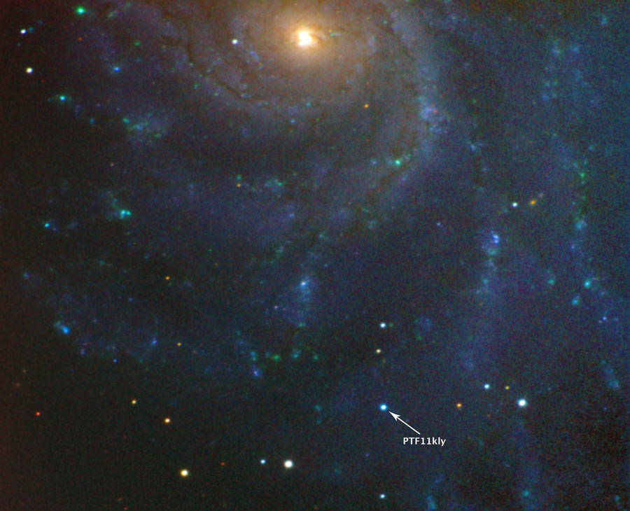
A Supernova
Source: PTF Collaboration

Slide 31
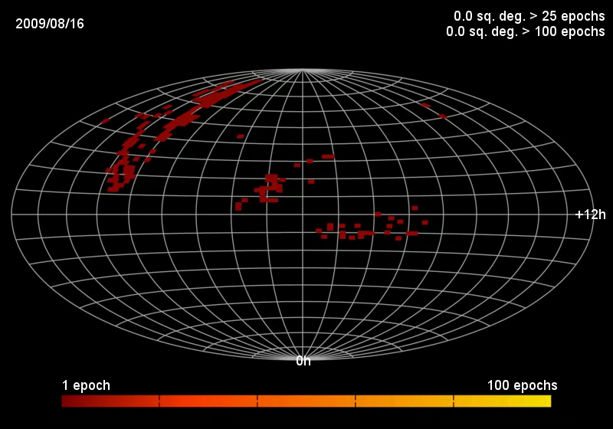

Slide 32
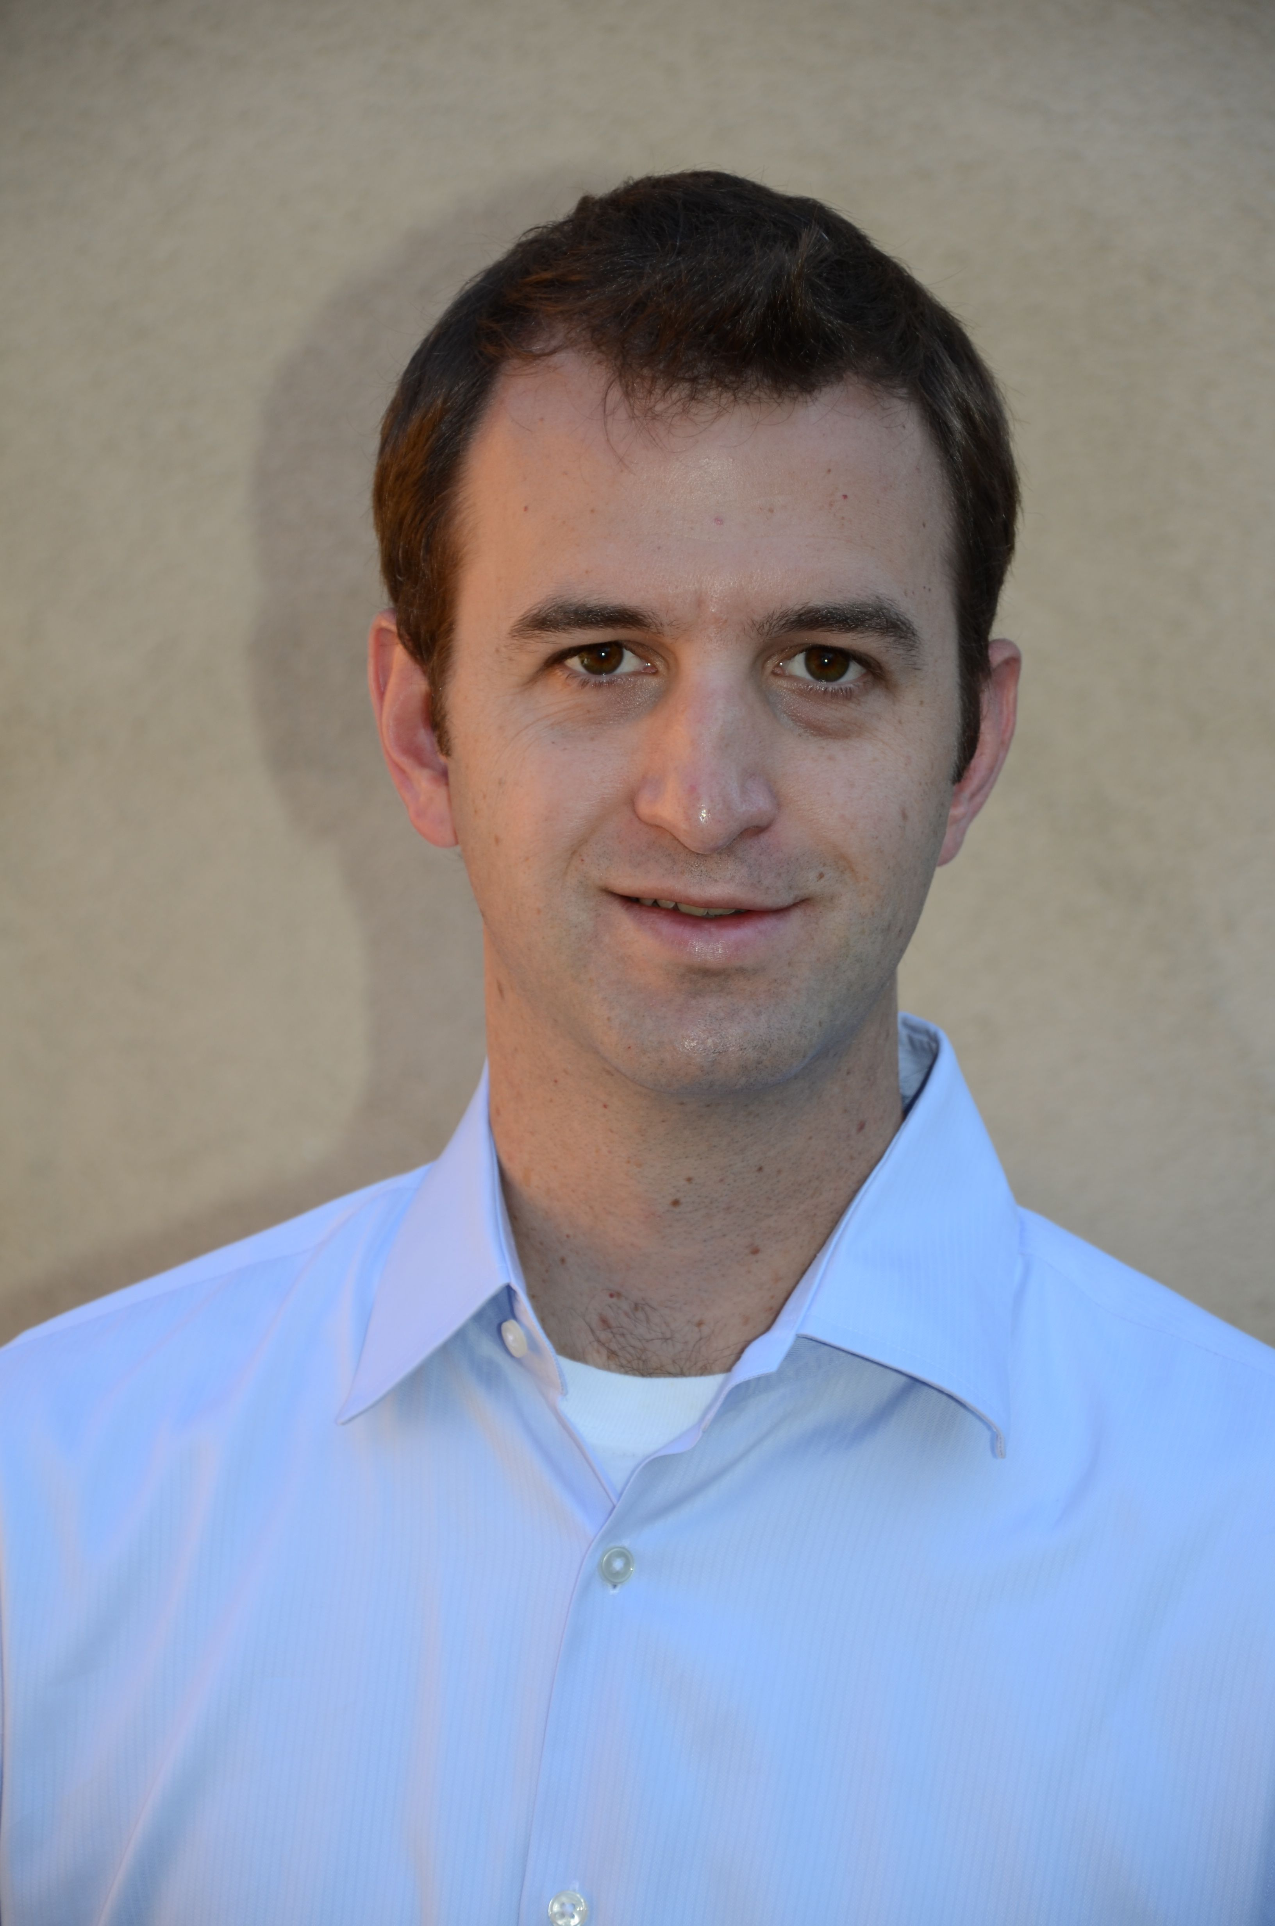
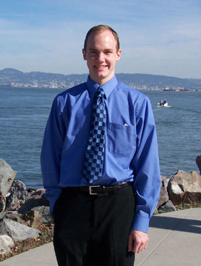
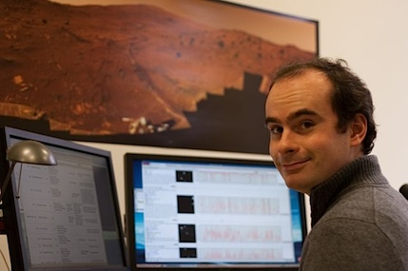
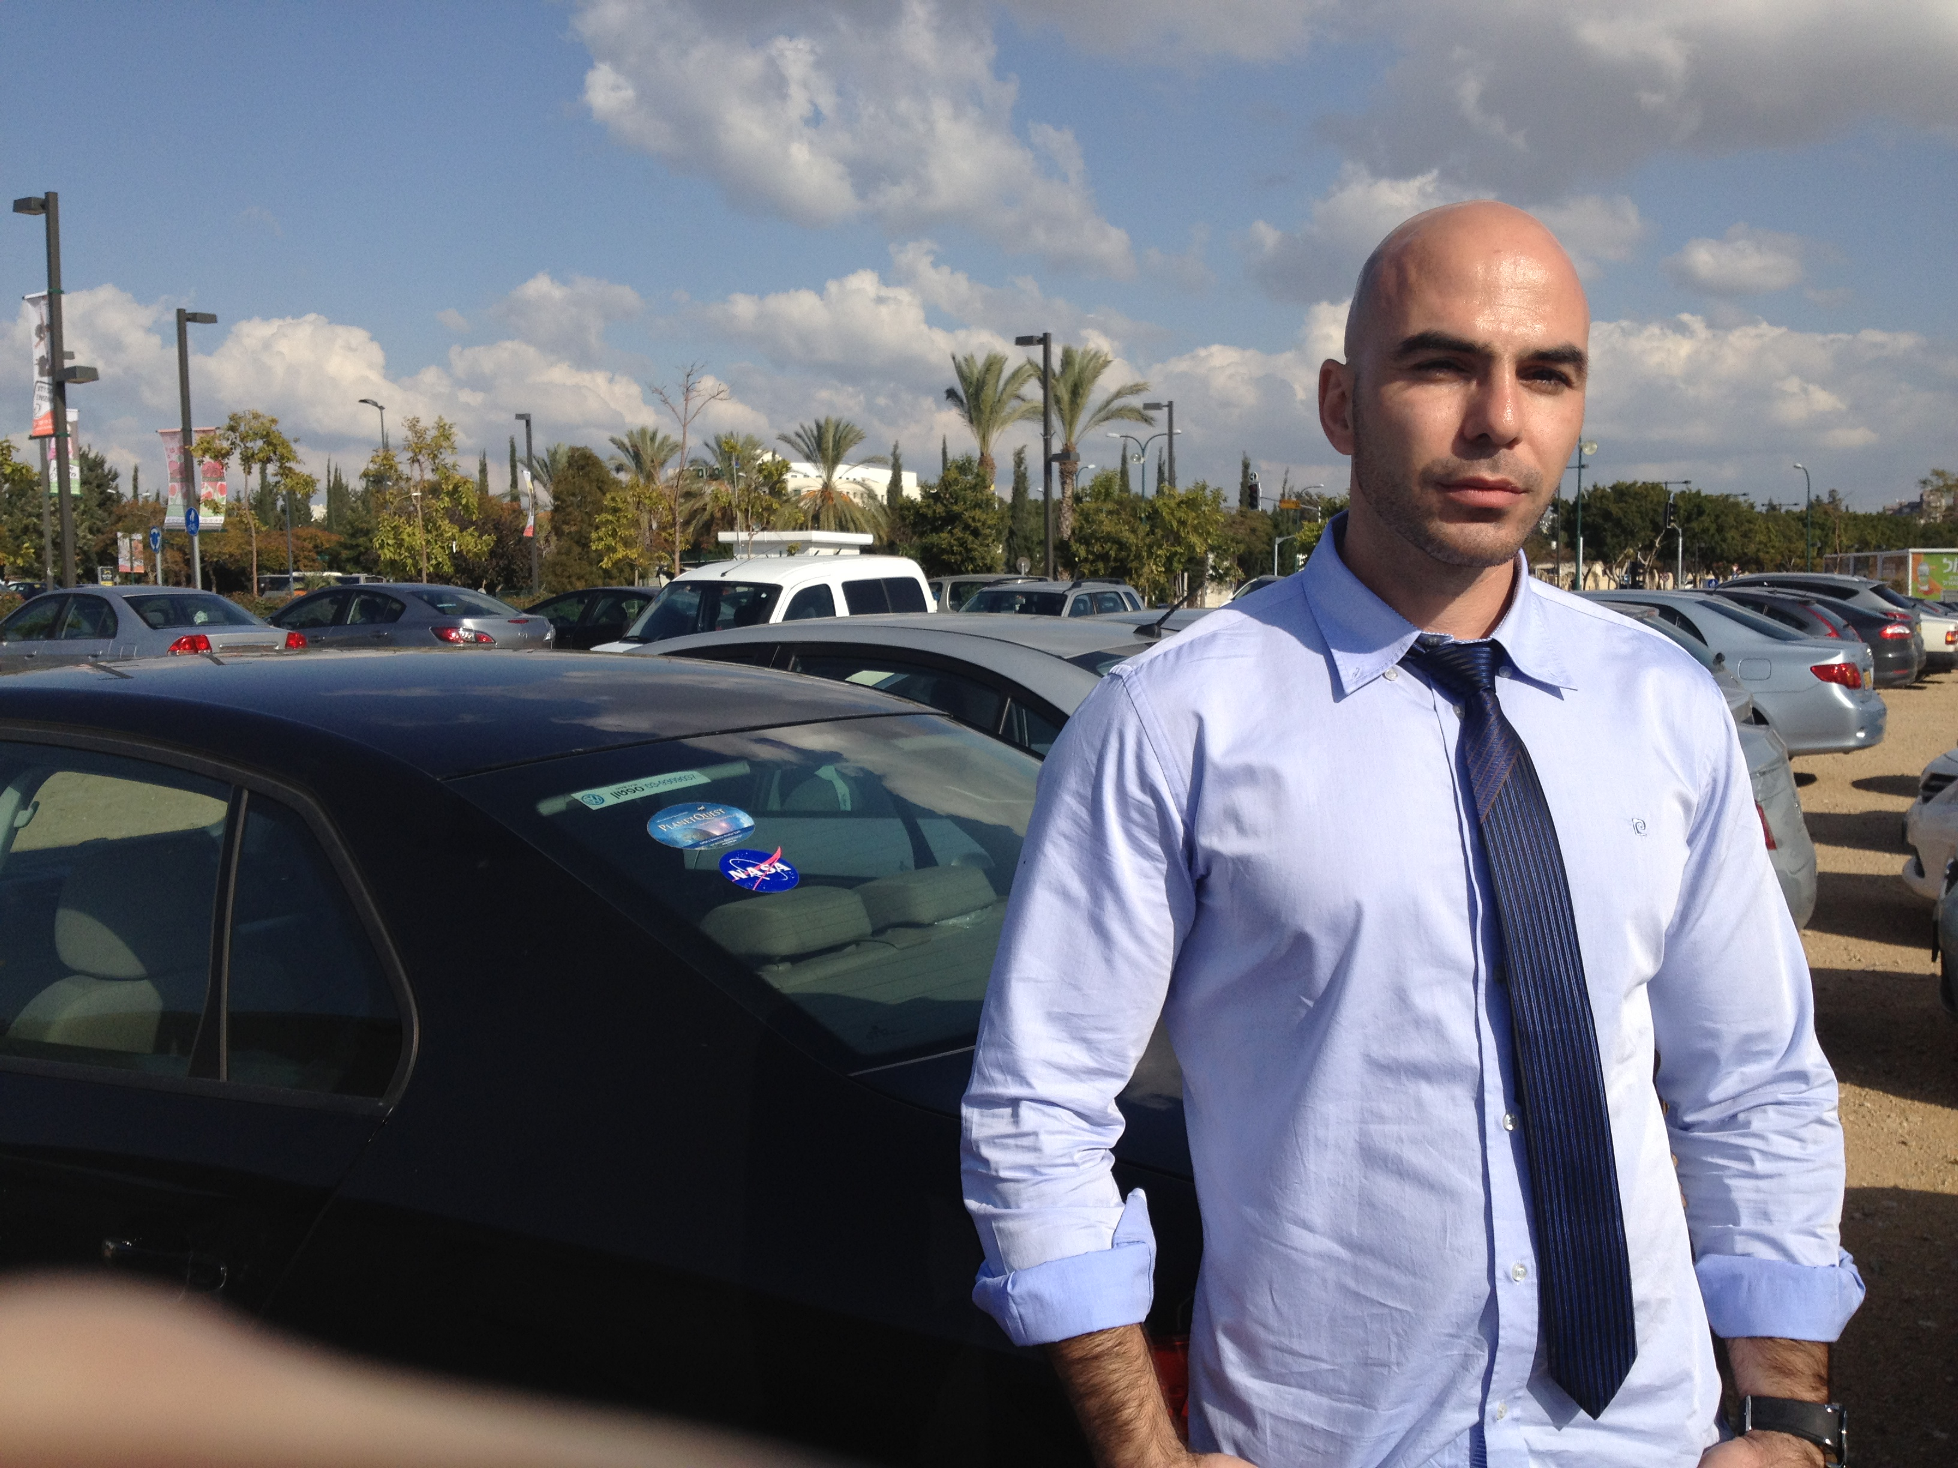

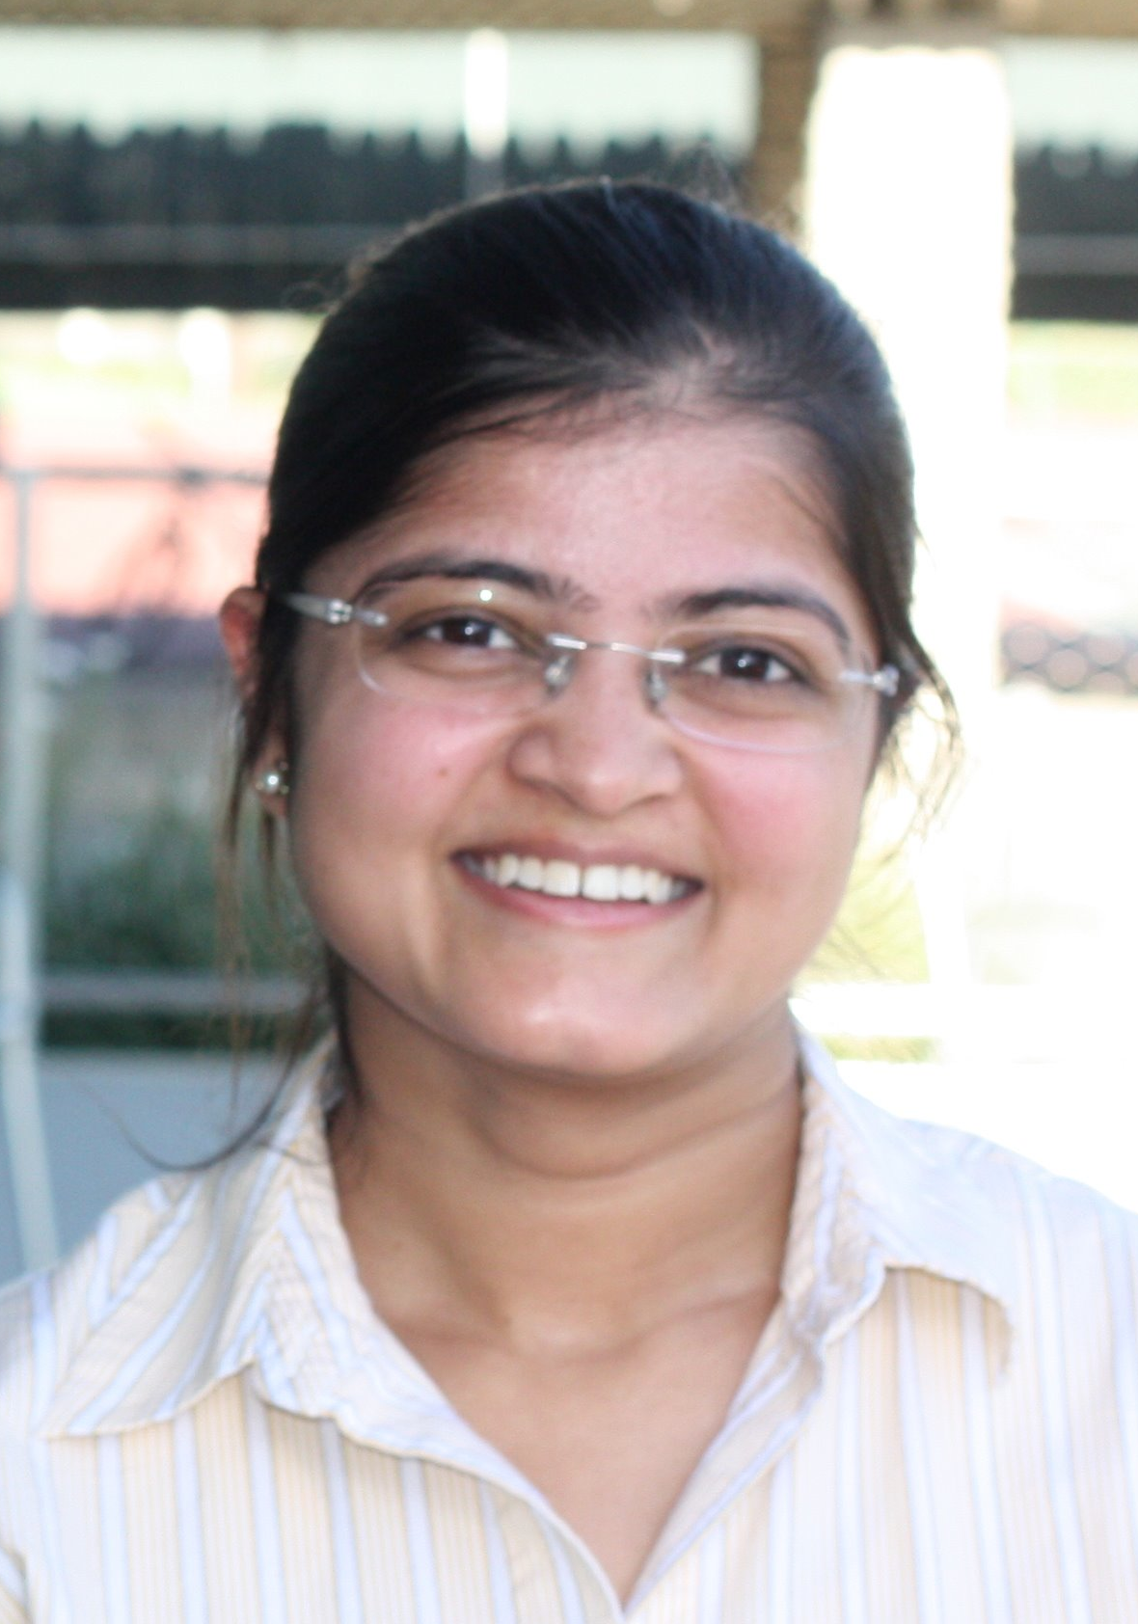
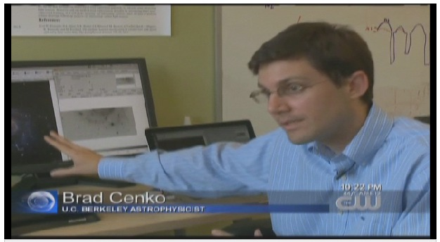
Talent matters as much as capital

Slide 33
What next?
S. R. Kulkarni

Slide 34
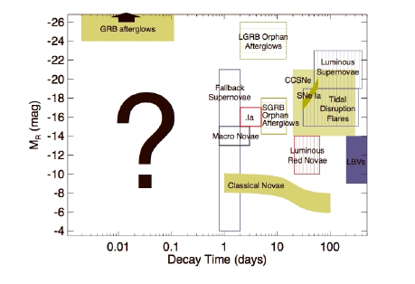
Short timescale is terra incognito

Slide 35
PTF: The Next Generation
40-square degree imager on P48
Target-of-Opportunity Telescope for rapid spectral classification
  Caltech & National Central University (Taiwan)
Robo-AO for photometry
  Caltech & IUCAA (India)
LIMSAT UV telescope in space
  Eight telescopes (12 cm), Total FOV of 1000 sq deg
  60 kg payload
  Israel, India, Canada, US

Slide 36
The Zwicky Transient Facility (ZTF)

Slide 37
There is plenty of room sideways
(A paradigm shift)

Slide 38
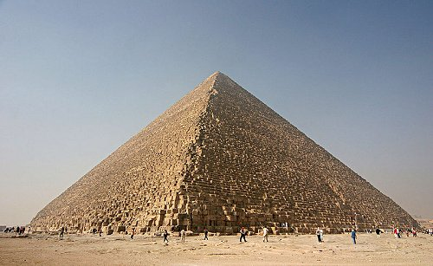
Ancient (Impressive)

Slide 39
Exponential Growth
Moore’s law (Exponential Growth):
  Semiconductor gains grow exponentially
SRK’s Law of Beyond Exponential Returns
  Faster than exponential progress is made when two or more technologies appear at the same time

Slide 40
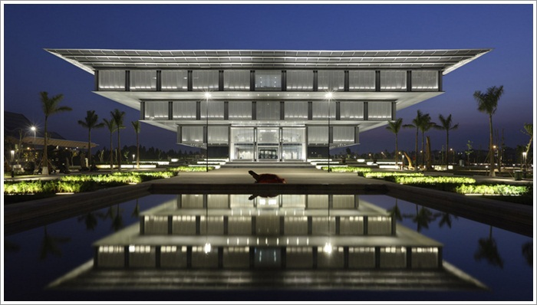
Inverted (Pretty)

Slide 41
P60
Confirmation
P48
Discovery
200-inch

Slide 42

What PTF Taught me: FOCUS

Slide 43
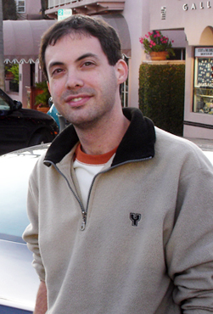

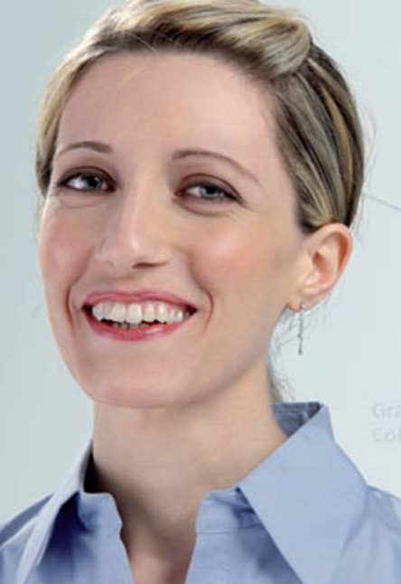

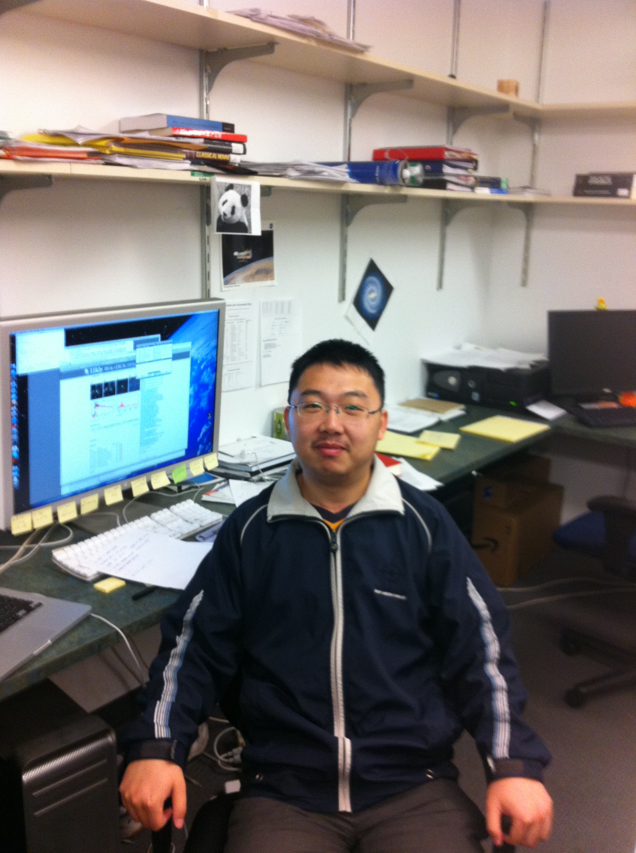
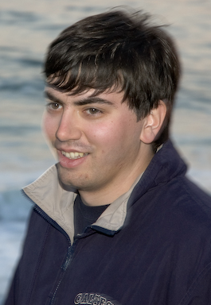
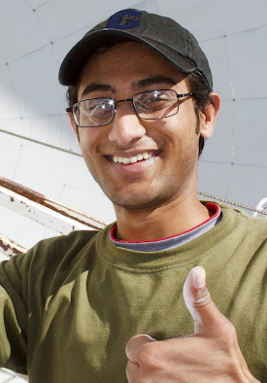
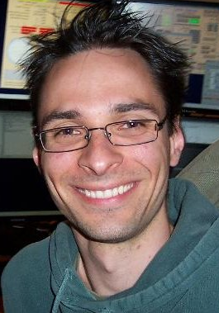
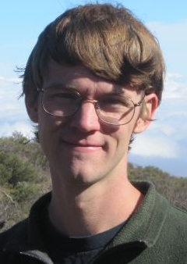

Why PTF succeeded?
Talent, Talent, Talent, Talent, Talent, ….
Iair Arcavi
Eric Bellm
Yi Cao
Alessandra Corsi
Assaf Horesh
David Levitan
Kunal Mooley
Branimir Sesar
Daniel Perley
Adam Waszczak

Slide 44
As we go to press

Slide 45



CatCat
Catalina Sky Survey
(Focus: Asteroids)

Slide 46

The Future: Inverted but Exciting

Slide 48


Slide 49

Notes:
It wasn’t hardly centuries ago that mankind thought the universe was unchanging. The discovery of transients has now led us to believe that the universe changes not only on month and weeks but also days, hours and minutes!
In Ay 1, or any introduction to cosmic explosions, two classes of optical transients are introduced - novae and supernovae. our understanding about them has grown in leaps and bounds in the past two decades. And for good reason. They are both easy to find and Novae are faint but plentiful, supernovae are rare but bright. Since the time of Hubble, this curious gap has been noted, and we have asked, are there are hitherto an undiscovered class of transients? Let us quantify this gap next.

Slide 50
Kasliwal 2011 (PhDT)

